Slide 1



Visual Arts Slide Deck
Grade 8

Slide 2

Visual Arts Slide Deck
Grade 8
This work is licensed under a Creative Commons Attribution-NonCommercial-ShareAlike 4.0 International License.
You are free:
to Share—to copy, distribute, and transmit the work to Remix—to adapt the work
Under the following conditions:
Attribution—You must attribute the work in the following manner:
This work is based on an original work of the Core Knowledge® Foundation (www.coreknowledge.org) and the additions from the Louisiana
Department of Education, made available through licensing under a Creative Commons Attribution-NonCommercial-ShareAlike4.0 International License. This does not in any way imply that the Core Knowledge Foundation or the Louisiana Department of Education endorses this work.
Noncommercial—You may not use this work for commercial purposes.
Share Alike—If you alter, transform, or build upon this work, you may distribute the resulting work only under the same or similar license to
this one.
With the understanding that:
For any reuse or distribution, you must make clear to others the license terms of this work. The best way to do this is with a link to this
web page:
https://creativecommons.org/licenses/by-nc-sa/4.0/
Copyright © 2025 Core Knowledge Foundation
www.coreknowledge.org
All Rights Reserved.
Core Knowledge©, Core Knowledge Curriculum Series™, Core Knowledge Visual Arts™, Core Knowledge Music™ are trademarks are trademarks of the Core Knowledge Foundation. Foundations of Freedom is a trademark of the Louisiana Department of Education.
Trademarks and trade names are shown in this book strictly for illustrative and educational purposes and are the property of their
respective owners. References herein should not be regarded as affecting the validity of said trademarks and trade names.
ISBN: 979-8-88970-650-2

Slide 3
Content
Visual Arts Slide Deck
Grade 8
I. Modern Representational Painting
1 | American Gothic, Grant Wood
2 | Nighthawks, Edward Hopper
3 | Christina’s World, Andrew Wyeth
4 | Detroit Industry, Diego Rivera
5 | Campbell’s Soup Can, Andy Warhol
IV. Contemporary Art
14 | Dos Cabezas II, Jean-Michel Basquiat
15 | Chambermaid, Banksy
V. Post-Modern Architecture
16 | Center Pompidou, Richard Rogers & Renzo Piano
17 | Neue Staatsgalerie, Stuttgart, James Stirling
18 | Guggenheim Biblao, Frank Gehry
19 | Burj Kalifa, Dubai, SOM
II. 20th Century Photography
6 | The Steerage, Alfred Steiglitz
7 | Migrant Mother, California, Dorothea Lange
8 | Washington, D.C. Government Charwoman, Gordon Parks
III. 20th Century Sculpture
9 | The Thinker, Auguste Rodin
10 | Bird in Space, Constantin Brancusi
11 | Bull’s Head, Pablo Picasso
12 | Black Wall, Louise Nevelson
13 | Vietnam Veterans Memorial, Maya Lin

Slide 4

1 | American Gothic (1930) | Grant Wood (1891 - 1942), American Oil on beaverboard 78 cm × 65.3 cm Art Institute of Chicago, Chicago
Visual Arts Slide Deck
Modern Representational Painting
Grade 8

Slide 5
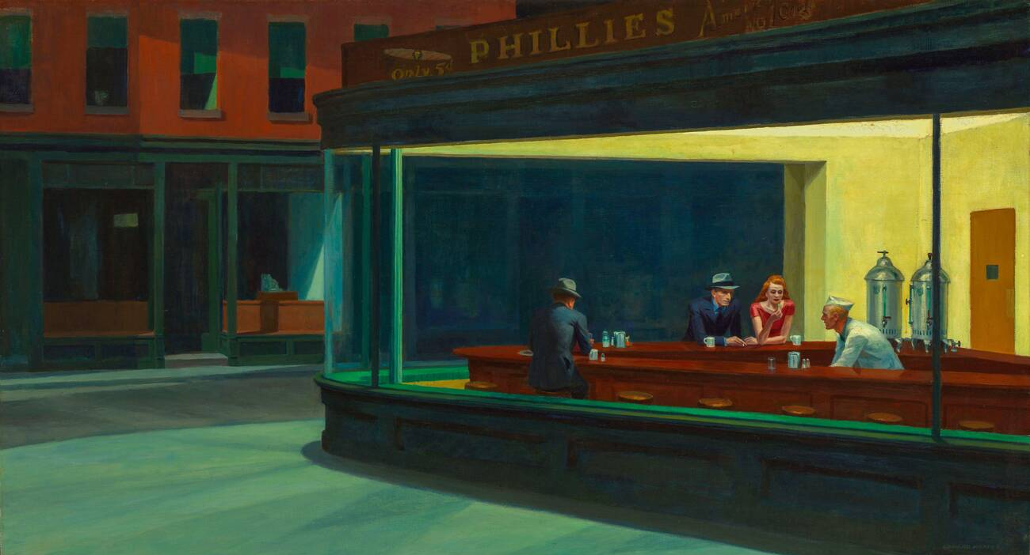
2 | Nighthawks (1942) | Edward Hopper (1882 - 1967), American Oil on canvas 84.1 cm x 152.4 cm Art Institute of Chicago
Visual Arts Slide Deck
Modern Representational Painting
Grade 8

Slide 6
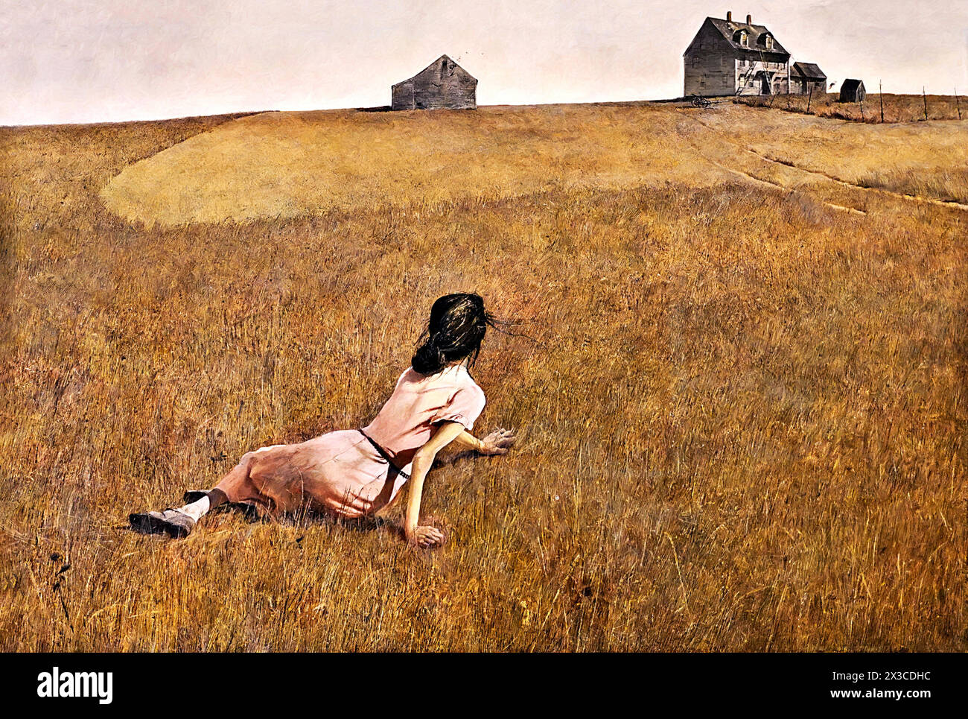
3 | Christina’s World (1948) | Andrew Wyeth (1917 - 2009), American Egg tempera on gessoed panel 81.9 cm × 121.3 cm Museum of Modern Art, New York
Visual Arts Slide Deck
Modern Representational Painting
Grade 8

Slide 7
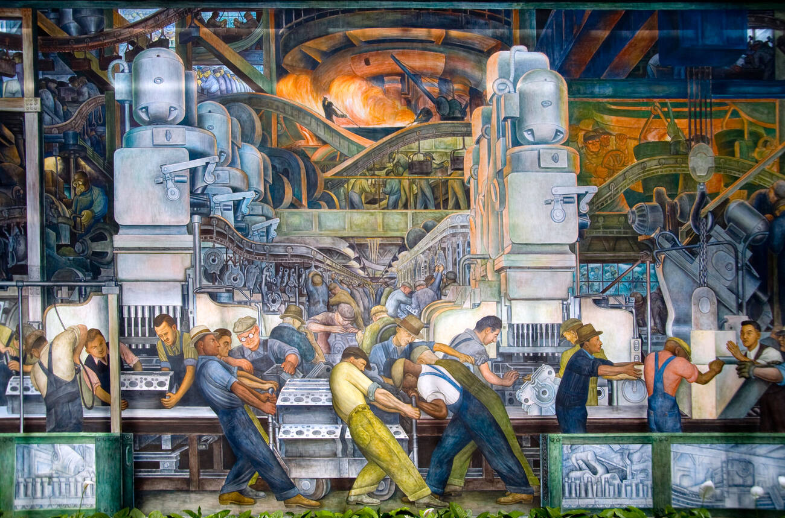
4 | Detroit Industry (1933) | Diego Rivera (1886 - 1957), Mexican fresco Detroit Institute of Arts, Detroit, United States
Visual Arts Slide Deck
Modern Representational Painting
Grade 8

Slide 8
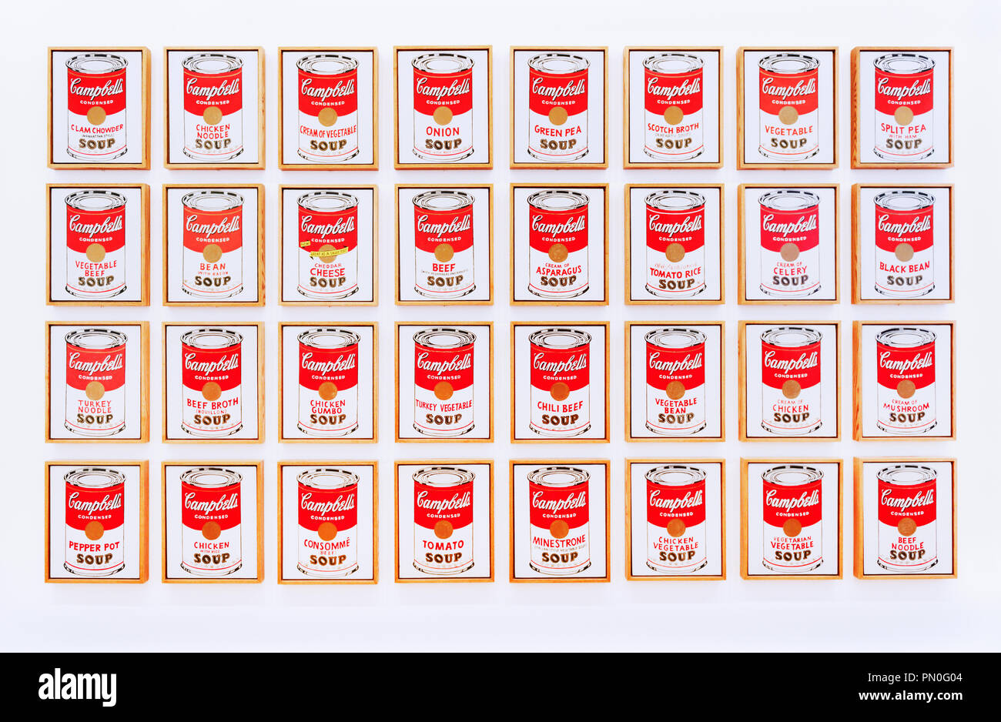
5 | Campbell’s Soup Cans (1962) | Andy Warhol (1928 - 1987), American Synthetic polymer paint on canvas 51 cm × 41 cm Museum of Modern Art, New York
Visual Arts Slide Deck
Modern Representational Painting
Grade 8

Slide 9
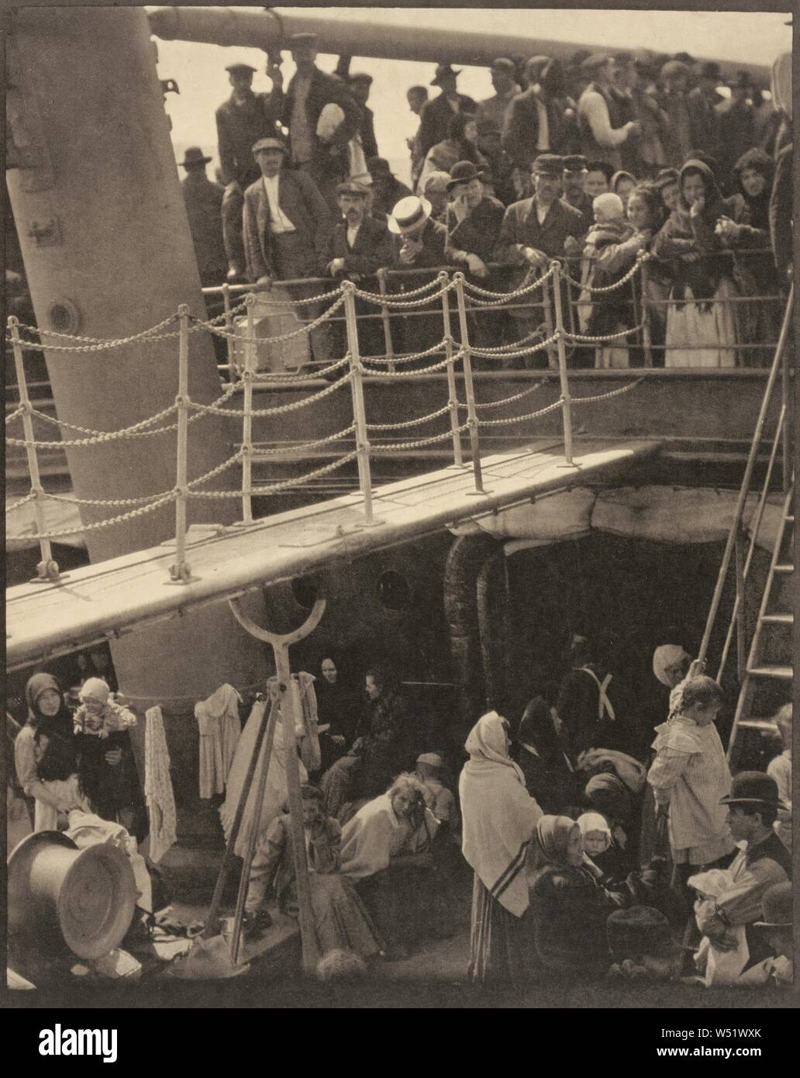
6 | The Steerage (1907) | Alfred Steiglitz (1864 - 1946), American Photography 6.19 in x 7.75 in Minneapolis Institute of Art
Visual Arts Slide Deck
20th Century Photography
Grade 8

Slide 10

7 | Human Erosion in California (Migrant Mother) (1936) | Dorothea Lange (1895 - 1965), American Gelatin silver print photograph 28.3 cm × 21.8 cm Museum of Modern Art, New York
Visual Arts Slide Deck
20th Century Photography
Grade 8

Slide 11
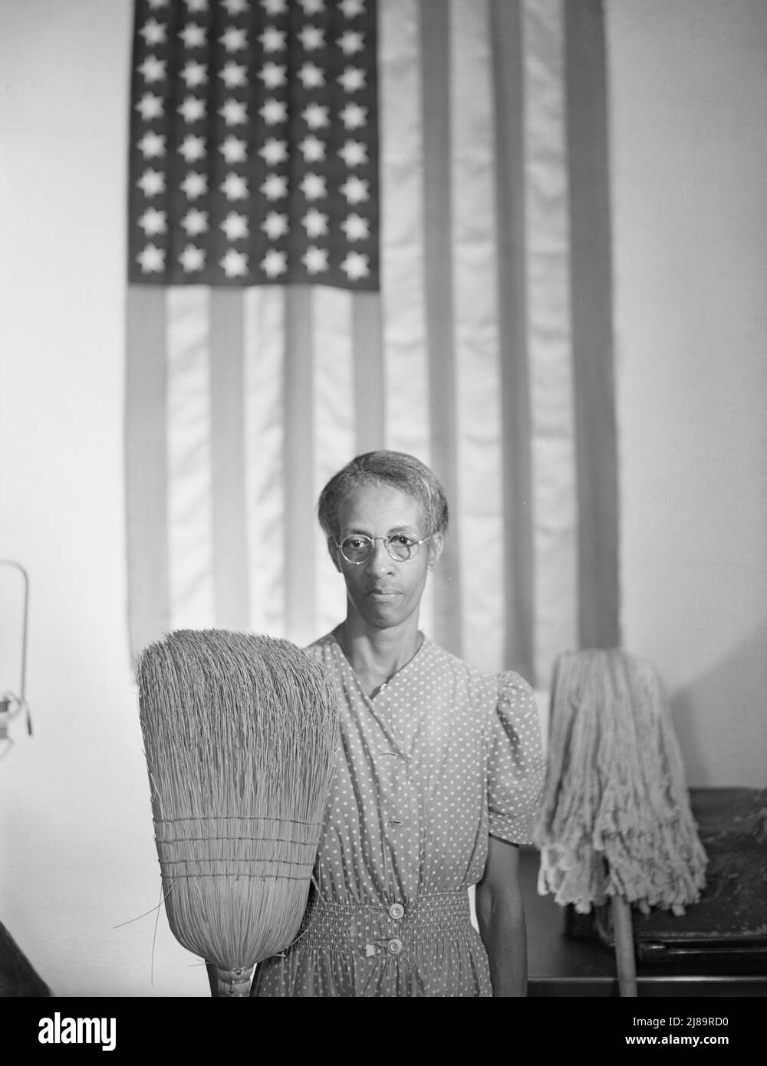
8 | Washington, D.C. Government Charwoman (1942) | Gordon Parks (1912 - 2006), American gelatin silver print 110.7 cm x 81 cm Corcoran Collection, National Gallery of Art, Washington D.C., USA
Visual Arts Slide Deck
20th Century Photography
Grade 8

Slide 12
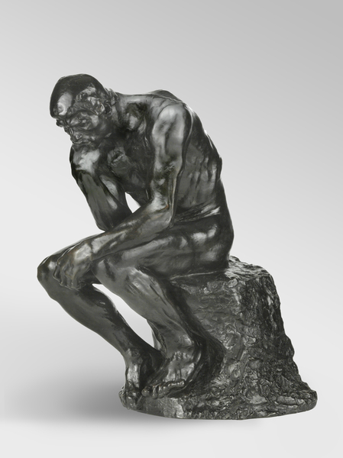
4 | The Thinker (1880 – 81) | Auguste Rodin (1840 – 1917), French Bronze 68.9 cm x 40 cm x 50.2 cm Philadelphia Museum of Art, Pennsylvania, PA, USA
Visual Arts Slide Deck
20th Century Sculpture
Grade 8

Slide 13
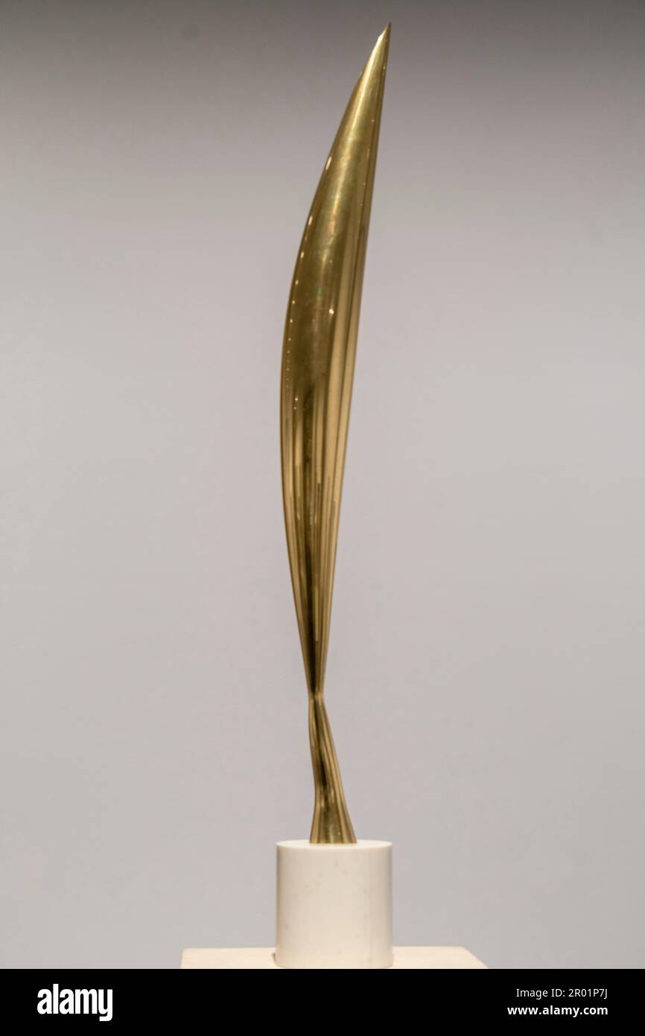
10 | Bird in Space (1923-1940) | Constantin Brancusi (1876 - 1957), Romanian Marble, bronze Philadelphia Museum of Art
Visual Arts Slide Deck
20th Century Sculpture
Grade 8

Slide 14
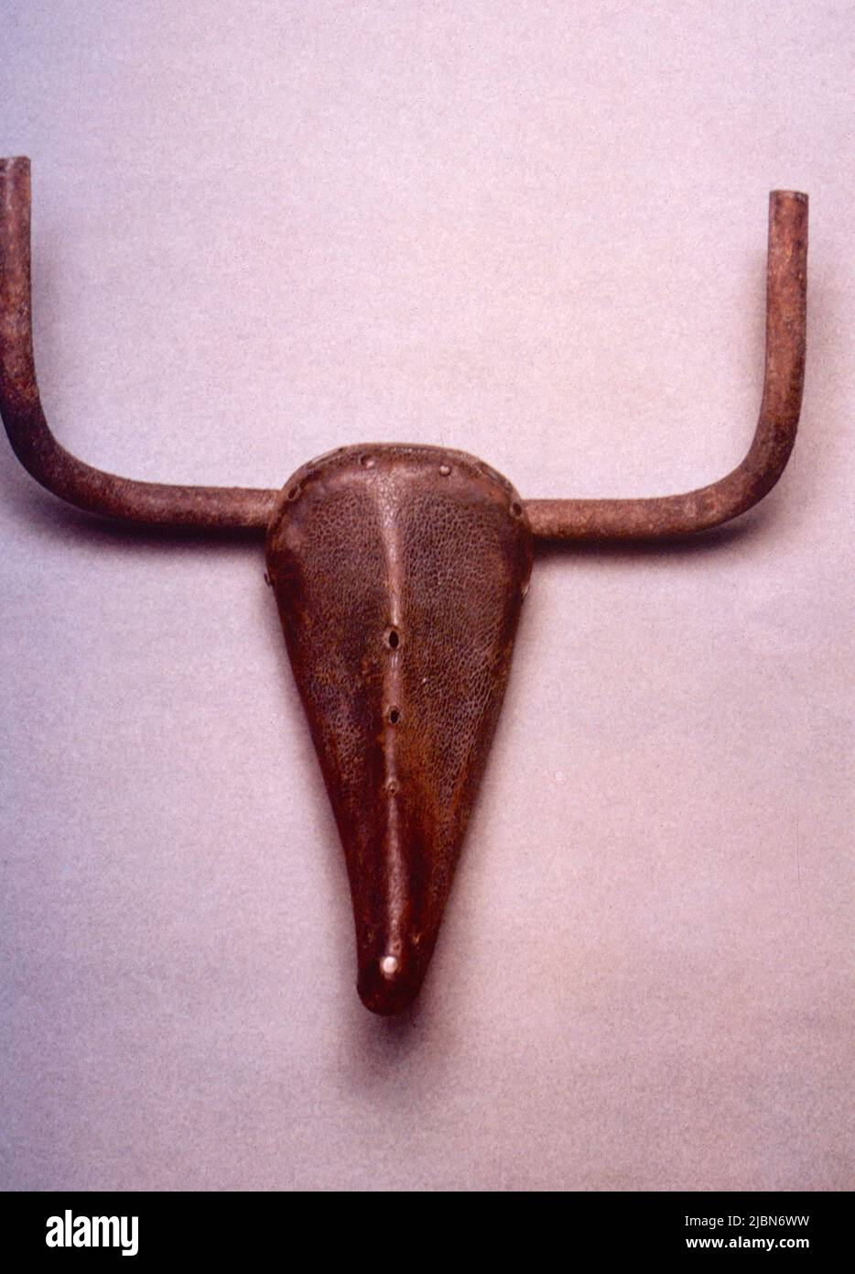
11 | Bull’s Head (1942) | Pablo Picasso (1881 - 1973), Spanish bicycle seat and handlebars 33.5 cm x 43.5 cm x 19 cm Musée Picasso, Paris
Visual Arts Slide Deck
20th Century Sculpture
Grade 8

Slide 15
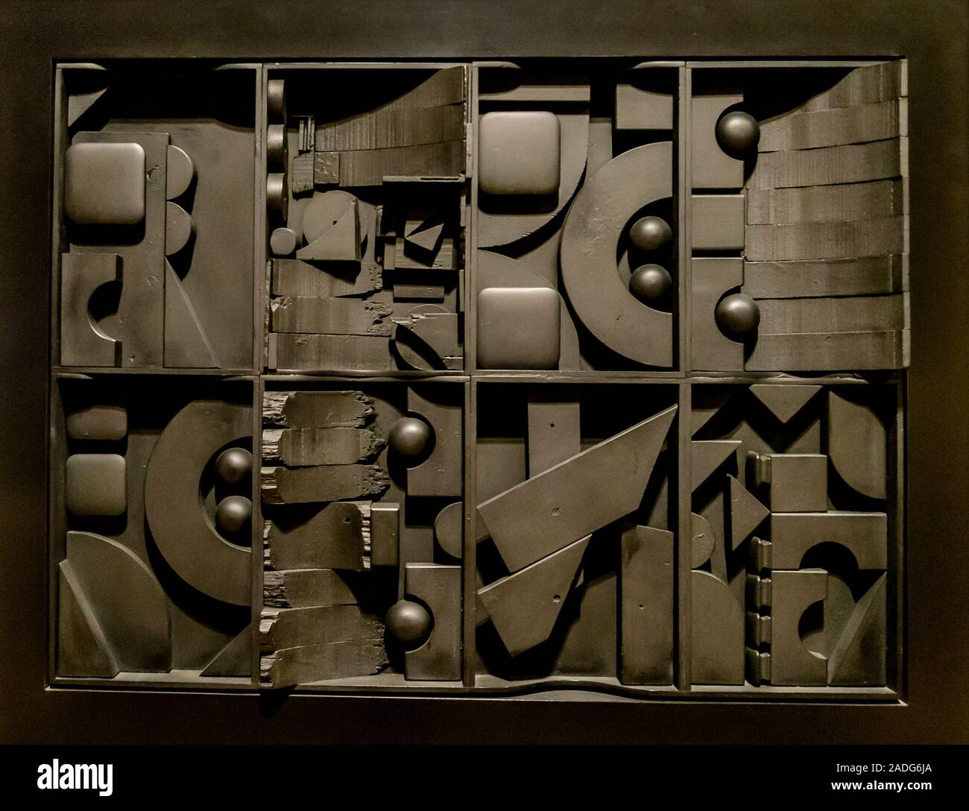
12 | Black Light 1 (1970) | Louise Nevelson (1899 - 1988), American Wood, paint, and Formica 36 1/2 x 47 x 5 1/2 in Chazen Museum of Art, Madison, Wisconsin, USA
Visual Arts Slide Deck
20th Century Sculpture
Grade 8

Slide 16

13 | Vietnam Veterans Memorial (1982) | Maya Lin (1959), American 2 acres Washington, D.C., U.S.
Visual Arts Slide Deck
20th Century Sculpture
Grade 8

Slide 17
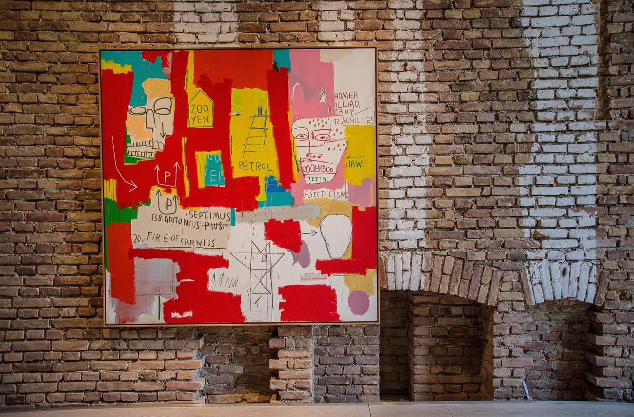
14 | Dos Cabezas II (1983) | Jean-Michel Basquiat (1960 - 1988), American Acrylic and oilstick on canvas 213.4 cm x 213.4 cm Museum Brandhorst, Munich
Visual Arts Slide Deck
Contemporary Art
Grade 8

Slide 18
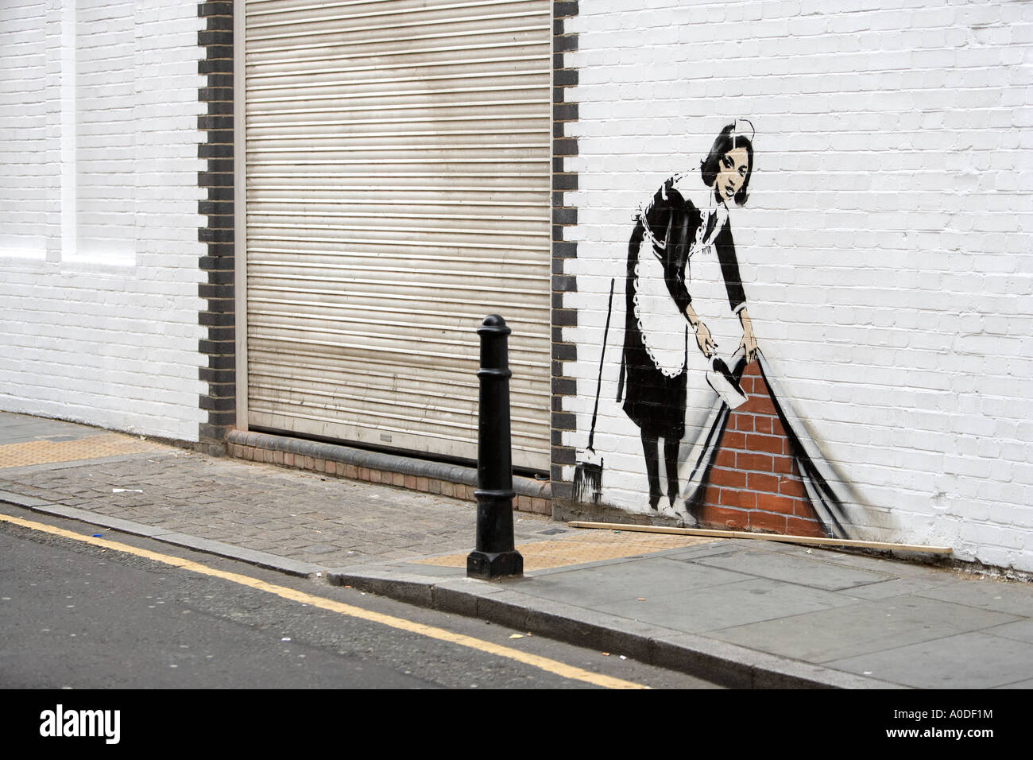
15 | Chambermaid (2006) | Banksy, English Spray Paint Chalk Farm Road, London, England
Visual Arts Slide Deck
Contemporary Art
Grade 8

Slide 19
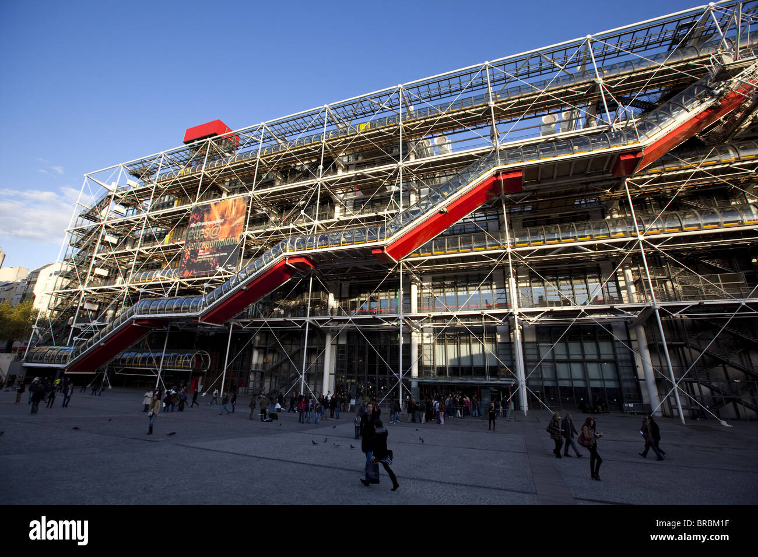
16 | Center Pompidou (1971–1977) | Richard Rogers, (1933 – 2021), British & Renzo Piano, (1937), Italian Paris, France
Visual Arts Slide Deck
Post-Modern Architecture
Grade 8

Slide 20
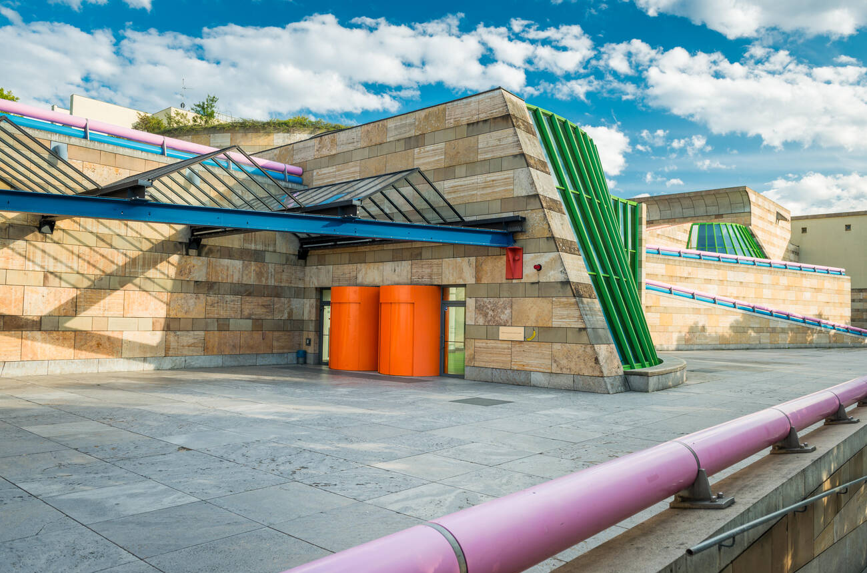
17 | Neue Staatsgalerie (1984) | James Stirling (1926 – 1992), British Stuttgart, Germany
Visual Arts Slide Deck
Post-Modern Architecture
Grade 8

Slide 21
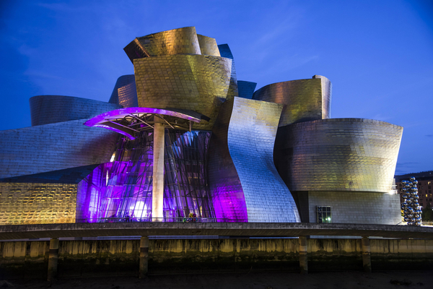
18 | Guggenheim Bilbao (1997) | Frank Gehry (1929), Canadian-American Abando, Bilbao, Spain
Visual Arts Slide Deck
Post-Modern Architecture
Grade 8

Slide 22
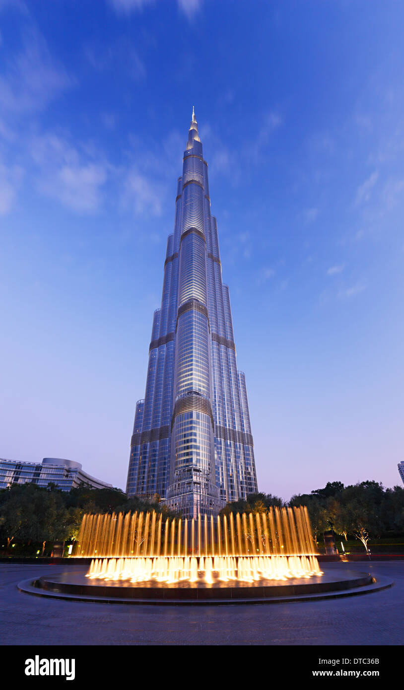
19 | Burj Khalifa | SOM (Louis Skidmore (1897 – 1962), Nathaniel A. Owings (1903 – 1984), John O. Merrill (1896 - 1975)) Dubai, United Arab Emirates
Visual Arts Slide Deck
Post-Modern Architecture
Grade 8

Slide 23
Visual Arts Slide Deck
Grade 8
Credits
Image 1 | classicpaintings / Alamy Stock Photo
Image 2 | FineArt / Alamy Stock Photo
Image 3 | ROBERT / Alamy Stock Vector
Image 4 | Rubens Alarcon / Alamy Stock Photo
Image 5 | Martin Shields / Alamy Stock Photo
Image 6 | Penta Springs Limited / Alamy Stock Photo
Image 7 | Penta Springs Limited / Alamy Stock Photo
Image 8 | Heritage Image Partnership Ltd / Alamy Stock Photo
Image 9 | The Thinker, modeled 1880-81, cast by Alexis Rudier (1874-1952), 1924 (bronze) / Rodin, Auguste (1840-1917) / French /
Philadelphia Museum of Art, Pennsylvania, PA, USA / Philadelphia Museum of Art / Bridgeman Images
Image 10 | Album / Alamy Stock Photo
Image 11 | colaimages / Alamy Stock Photo
Image 12 | Bosiljka Zutich / Alamy Stock Photo
Image 13 | Ivan Sebborn / Alamy Stock Photo
Image 14 | Manfred Glueck / Alamy Stock Photo
Image 15 | Darrin Jenkins / Alamy Stock Photo
Image 16 | robertharding / Alamy Stock Photo
Image 17 | Timo Christ / Alamy Stock Photo
Image 18 | Guggenheim Museum / Bilbao (photo) / Gehry, Frank (b.1929) / American / G. Lenz / Picture Alliance / ImageBROKER /
Bridgeman Images
Image 19 | Nino Marcutti / Alamy Stock Photo

