Slide 1



Visual Arts Slide Deck
Grade 7

Slide 2

Visual Arts Slide Deck
Grade 7
This work is licensed under a Creative Commons Attribution-NonCommercial-ShareAlike 4.0 International License.
You are free:
to Share—to copy, distribute, and transmit the work to Remix—to adapt the work
Under the following conditions:
Attribution—You must attribute the work in the following manner:
This work is based on an original work of the Core Knowledge® Foundation (www.coreknowledge.org) and the additions from the Louisiana Department of Education, made available through licensing under a Creative Commons Attribution-NonCommercial-ShareAlike4.0 International License. This does not in any way imply that the Core Knowledge Foundation or the Louisiana Department of Education endorses this work.
Noncommercial—You may not use this work for commercial purposes.
Share Alike—If you alter, transform, or build upon this work, you may distribute the resulting work only under the same or similar license to this one.
With the understanding that:
For any reuse or distribution, you must make clear to others the license terms of this work. The best way to do this is with a link to this web page:
https://creativecommons.org/licenses/by-nc-sa/4.0/
Copyright © 2025 Core Knowledge Foundation
www.coreknowledge.org
All Rights Reserved.
Core Knowledge©, Core Knowledge Curriculum Series™, Core Knowledge Visual Arts™, Core Knowledge Music™ are trademarks are trademarks of the Core Knowledge Foundation. Foundations of Freedom is a trademark of the Louisiana Department of Education.
Trademarks and trade names are shown in this book strictly for illustrative and educational purposes and are the property of their respective owners. References herein should not be regarded as affecting the validity of said trademarks and trade names.
ISBN: 979-8-88970-649-6

Slide 3
Content
Visual Arts Slide Deck
Grade 7
I. Fauvism/Expressionism: 1905-1920
1 | The Scream, Edvard Munch
2 | The Red Room, Henri Matisse
II. Cubism: 1907-1914
3 | Le Verre, Georges Braque
4 | Guernica, Pablo Picasso
III. Surrealism: 1924-1966
5 | The Persistence of Memory, Salvador Dali
6 | Creation of the Birds, Remedios Varo
7 | Self Portrait, Leonora Carrington
8 | Forest and Dove, Max Ernst
IV. Abstract Expressionism: 1940s – 1950s
10 | “Little Image” series, Lee Krasner
9 | Painting, Jackson Pollock
11 | No. 9, Mark Rothko
12 | John F. Kennedy, Elaine de Kooning
IV. Abstraction – Other: 20th century
14 | Points Vassily Kadinsky
13 | Broadway Boogie Woogie, Piet Mondrian
15 | Senecio, Paul Klee
16 | Les Festishes, Lois Mailou Jones
V. Organic Architecture (turn of 20th cent)
17 | Tassel House, Victor Horta
18 | Guaranty Building (Buffalo), Louis Sullivan
19 | Darwin Martin House, Frank Lloyd Wright
20 | Casa Battlo (Barcelona), Antoni Gaudi

Slide 4
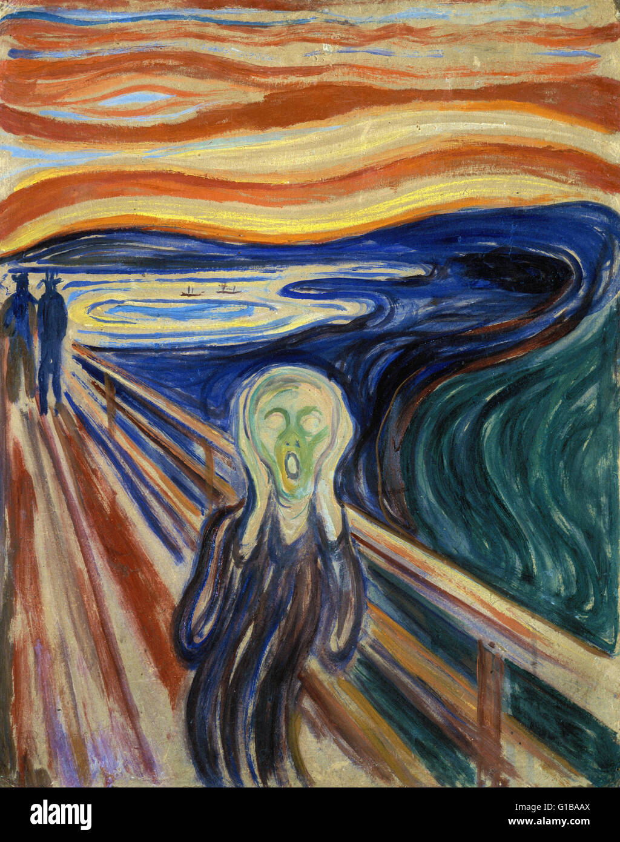
1 | The Scream (1893) | Edvard Munch (1863 - 1944), Norwegian Oil, tempera, pastel and crayon on cardboard 91 cm × 73.5 cm National Museum and Munch Museum, Oslo, Norway
Visual Arts Slide Deck
Fauvism/Expressionism 1905-1920
Grade 7

Slide 5
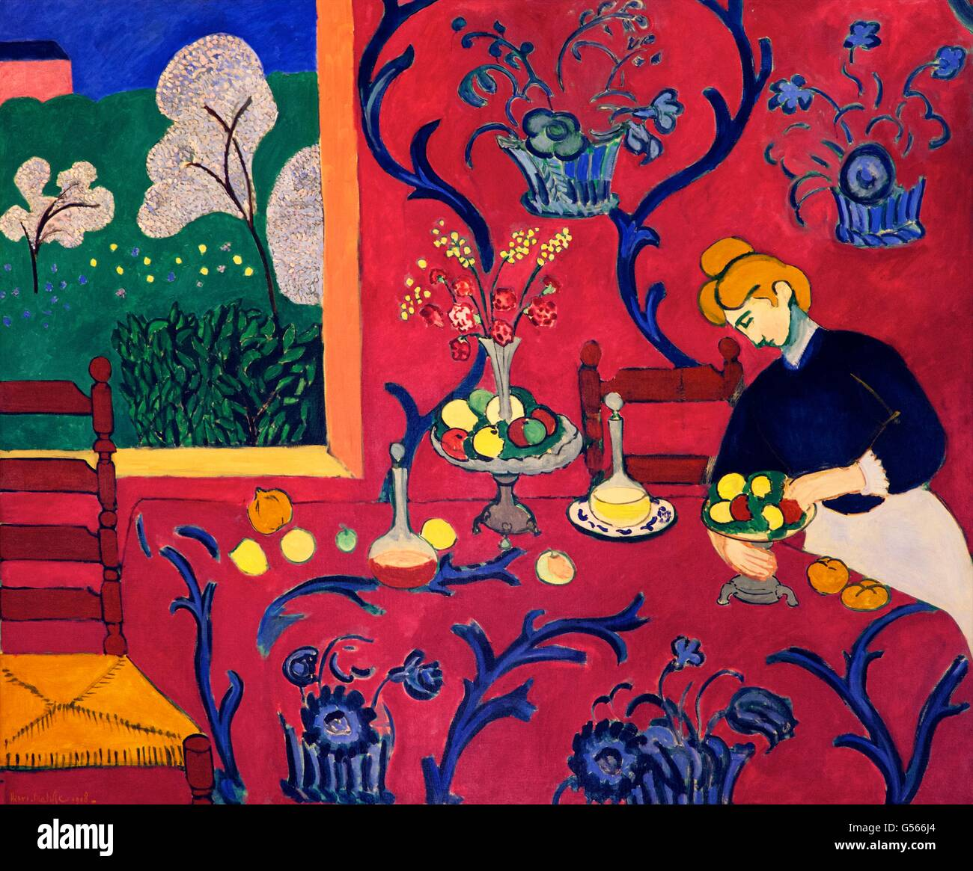
2 | The Red Room (The Dessert: Harmony in Red) (1908) | Henri Matisse (1869-1954), French Oil on canvas 180 cm × 220 cm Hermitage Museum, St. Petersburg
Visual Arts Slide Deck
Fauvism/Expressionism 1905-1920
Grade 7

Slide 6
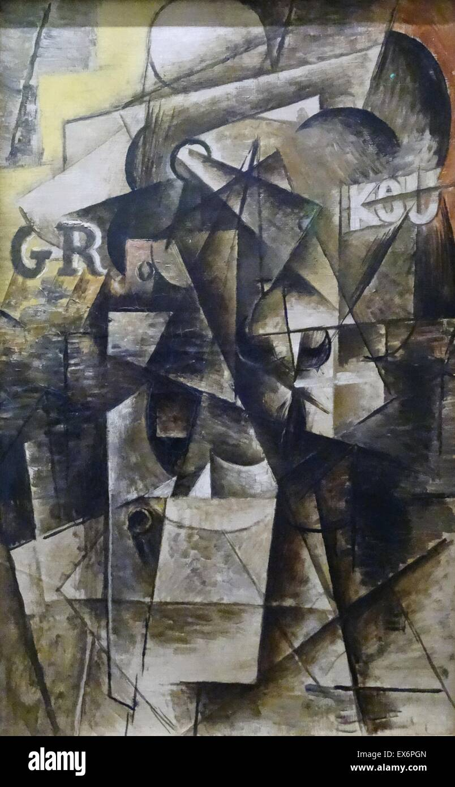
3 | Le Verre (1911) | Georges Braque (1882-1963), French Oil on Canvas 100 cm x 73 cm The painting is part of a private collection
Visual Arts Slide Deck
Cubism 1907-1914
Grade 7

Slide 7
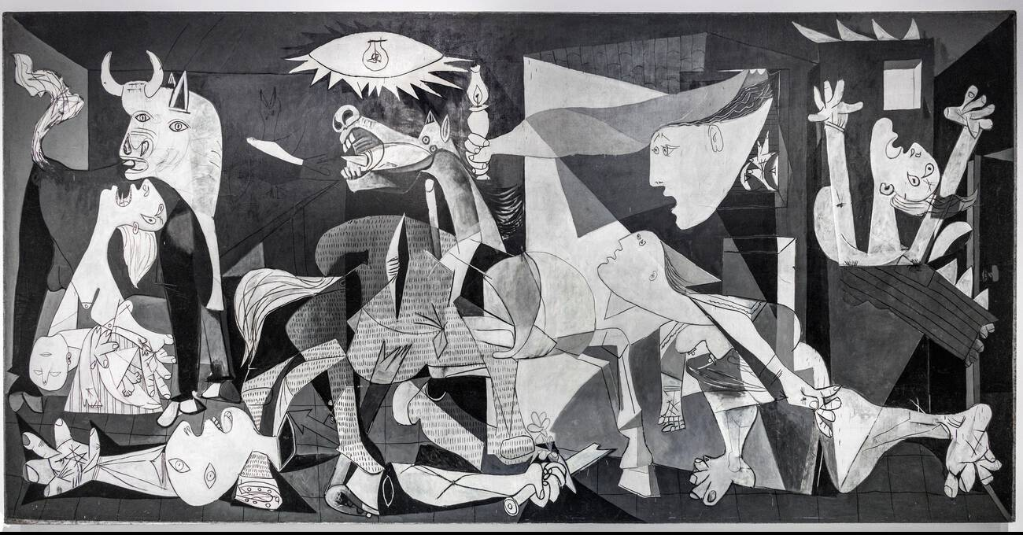
4 | Guernica (1937) | Pablo Picasso (1881-1973), Spanish Oil on canvas 349.3 cm × 776.5 cm Museo Reina Sofía, Madrid
Visual Arts Slide Deck
Cubism 1907-1914
Grade 7

Slide 8
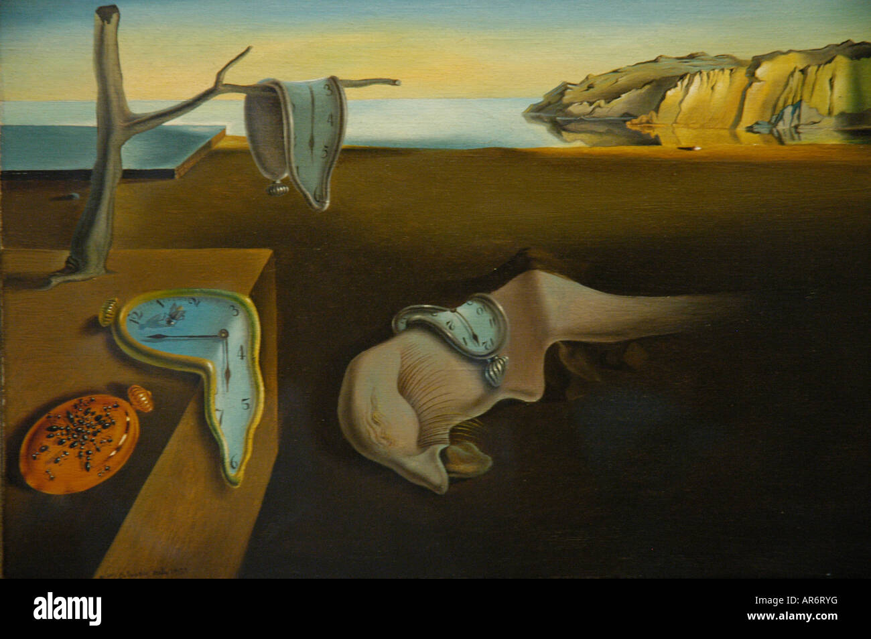
5 | The Persistence of Memory (1931) | Salvador Dali (1904 - 1989), Spanish Oil on canvas 24 cm × 33 cm Museum of Modern Art, New York City
Visual Arts Slide Deck
Surrealism 1924-1966
Grade 7

Slide 9
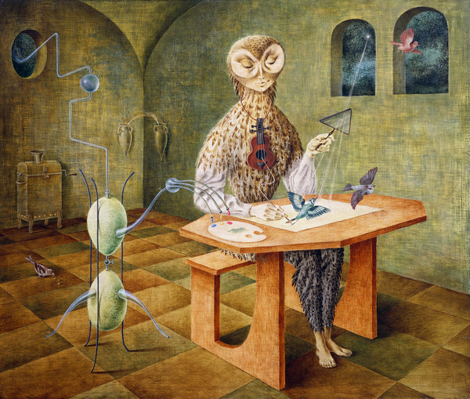
6 | Creation of the Birds (1957) | Remedios Varo (1908-1963), Spanish Oil, Masonite 54 cm x 64 cm Museo de Arte Moderno, Mexico City, Mexico
Visual Arts Slide Deck
Surrealism 1924-1966
Grade 7

Slide 10
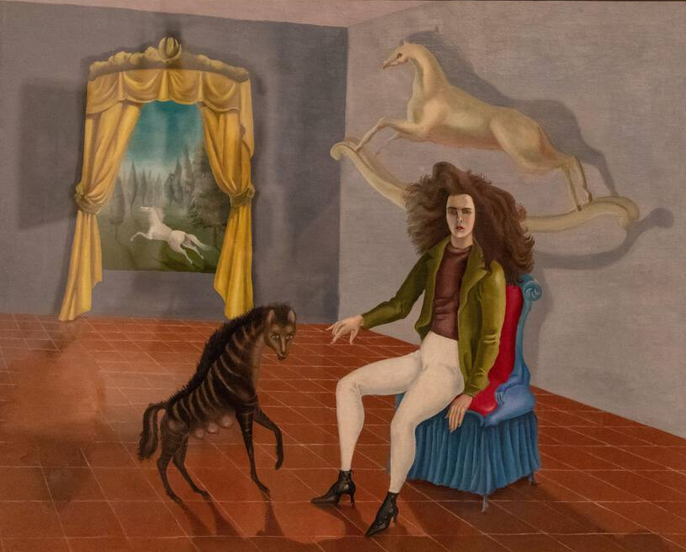
7 | Self Portrait (1937-1938) | Leonora Carrington (1917–2011), Mexican Oil on canvas 65 cm x 81.2 cm Metropolitan Museum of Art, New York
Visual Arts Slide Deck
Surrealism 1924-1966
Grade 7

Slide 11
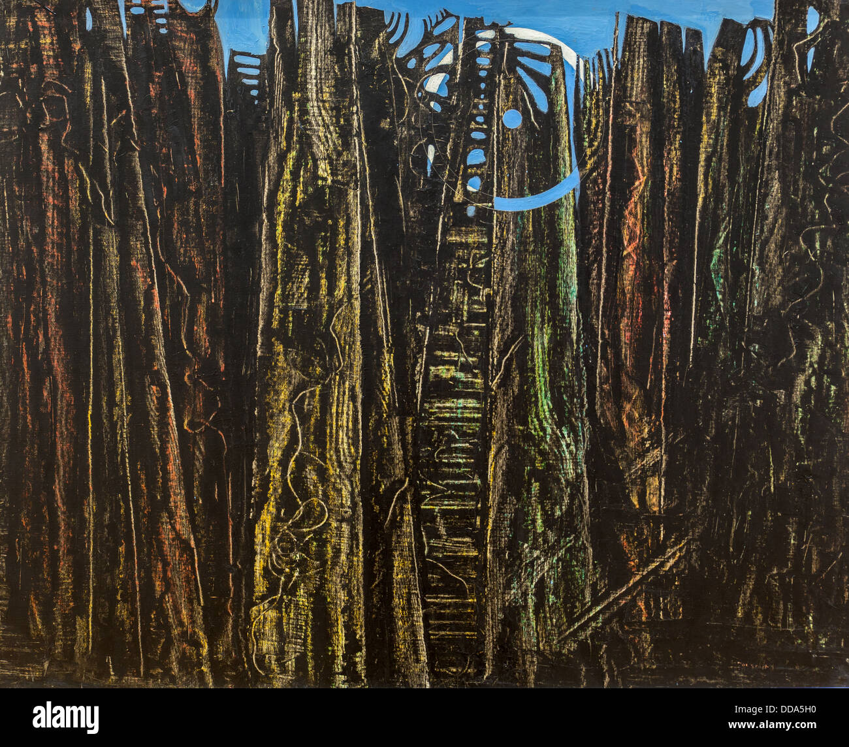
8 | The Forest (1928) | Max Ernst (1891 - 1976), German Oil on canvas 114 cm x 146 cm Staatliche Kunsthalle Karlsruhe, Karlsruhe, Germany
Visual Arts Slide Deck
Surrealism 1924-1966
Grade 7

Slide 12
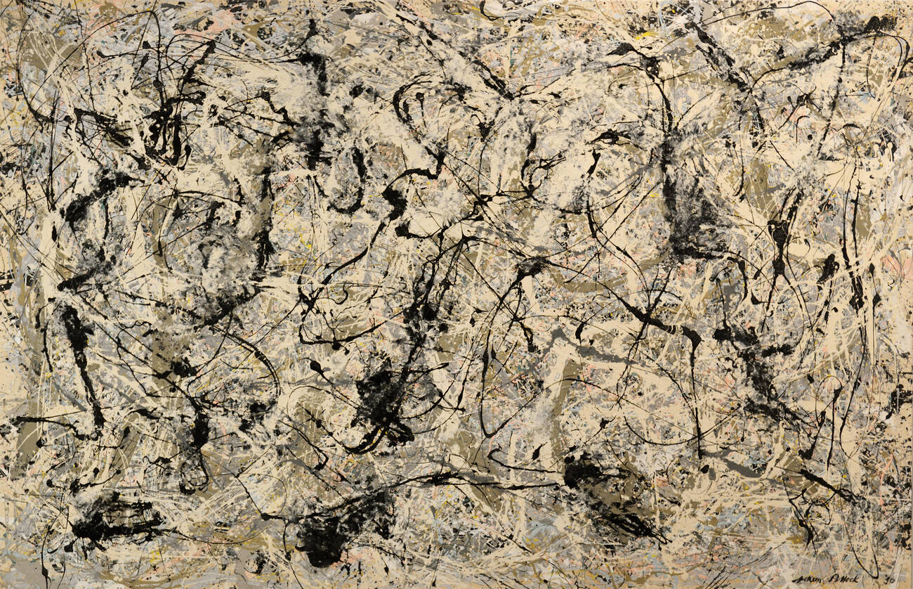
9 | Painting (Number 28,1950) | Jackson Pollock (1912 - 1956), American Oil on canvas 121.92 cm x 243.84 cm Guggenheim Museum in New York City
Visual Arts Slide Deck
Abstract Expressionism 1940s – 1950s
Grade 7

Slide 13
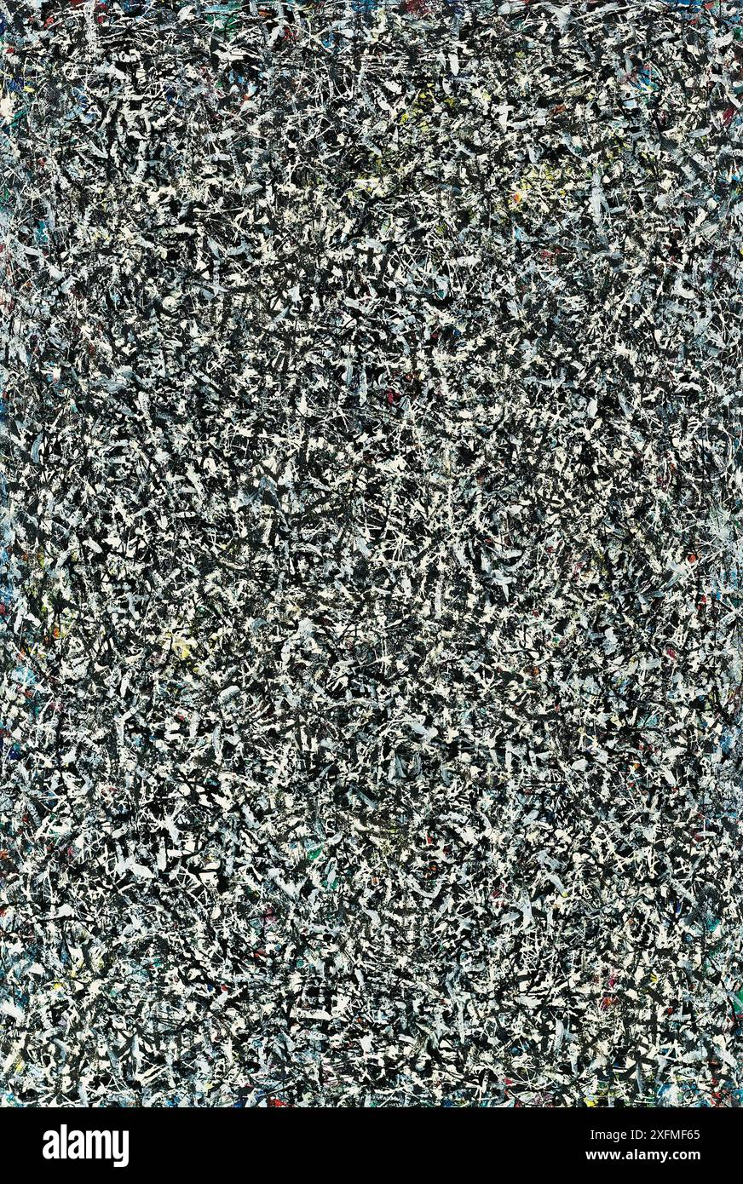
10 | “Little Image” series, Untitled (1949) | Lee Krasner (1908-1984), American oil and enamel on canvas 55.8 cm x 43.2 cm Private Collection
Visual Arts Slide Deck
Abstract Expressionism 1940s – 1950s
Grade 7

Slide 14
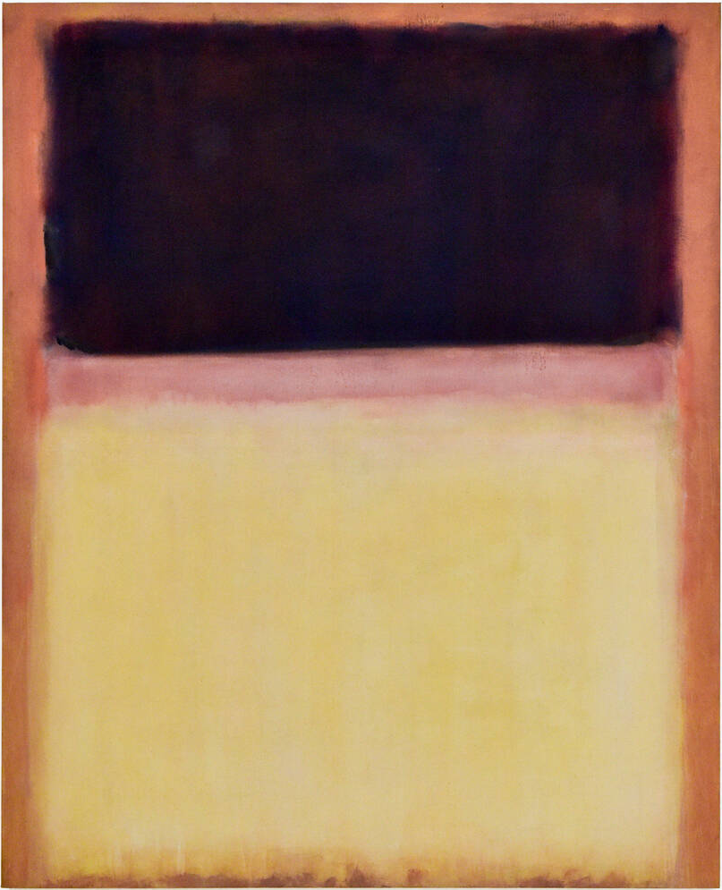
11 | No.9 (Dark over Light Earth) (1954) | Mark Rothko (1903 - 1970), American Oil on canvas 211.46 cm x 172.72 cm x 4.45 cm MOCA Gallery, Los Angeles, California
Visual Arts Slide Deck
Abstract Expressionism 1940s – 1950s
Grade 7

Slide 15
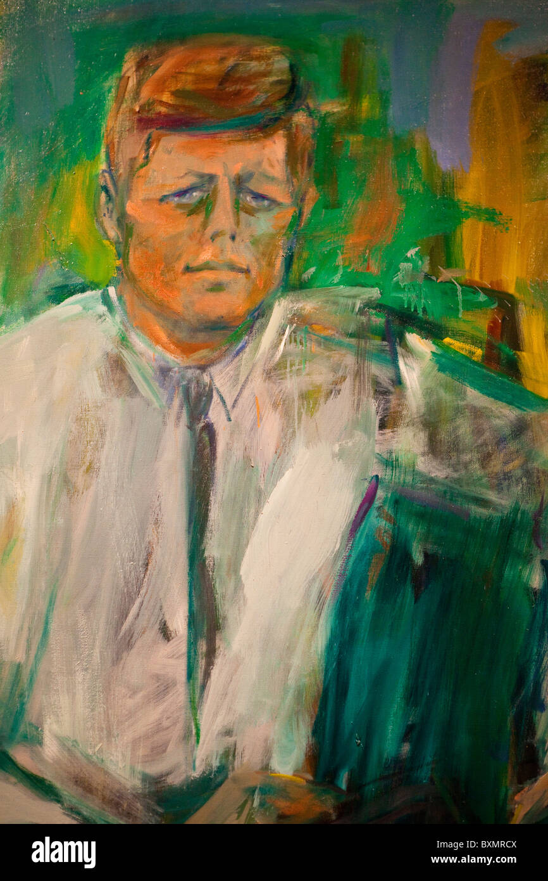
12 | John F. Kennedy (1962) | Elaine de Kooning (1918 – 1989), American Oil on canvas 115.6 cm x 262.9 cm x 6.4 cm National Portrait Gallery, Smithsonian institution
Visual Arts Slide Deck
Abstract Expressionism 1940s – 1950s
Grade 7

Slide 16
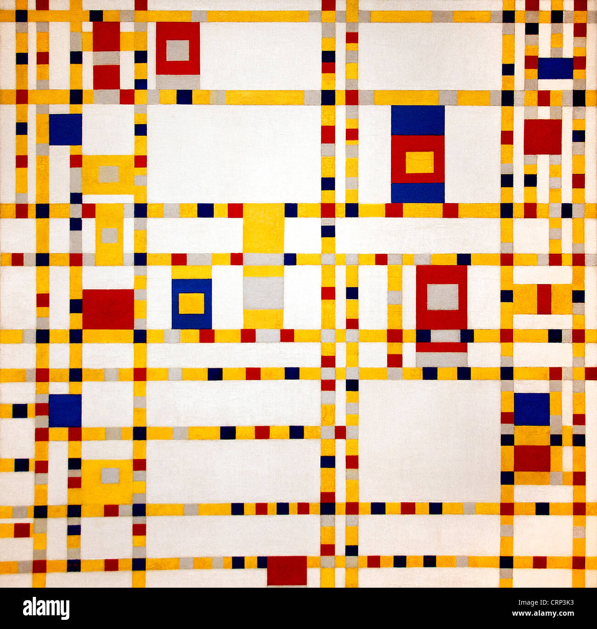
13 | Broadway Boogie Woogie (1942) | Piet Mondrian (1872 – 1944), Dutch Oil on canvas 127 cm × 127 cm Museum of Modern Art, New York
Visual Arts Slide Deck
Abstraction – Other 20th century
Grade 7

Slide 17
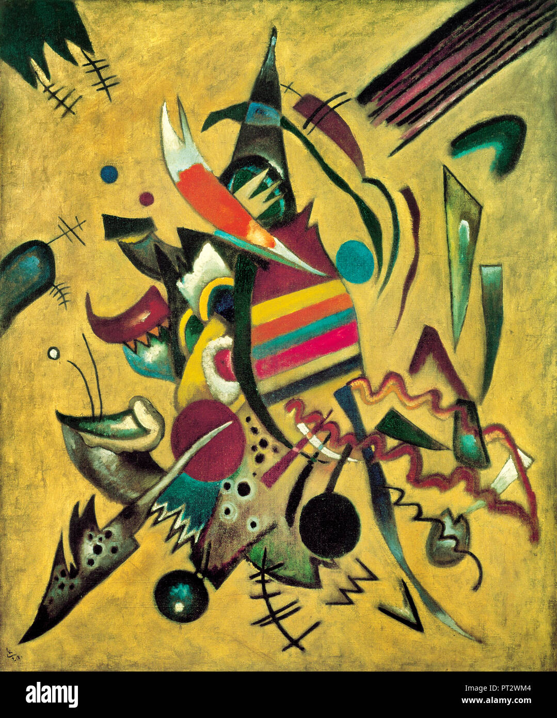
14 | Points (1920) | Wassily Kandinsky (1866 – 1944), Russian Oil on canvas 110.3 cm x91.8 cm Ohara Museum of Art
Visual Arts Slide Deck
Abstraction – Other 20th century
Grade 7

Slide 18
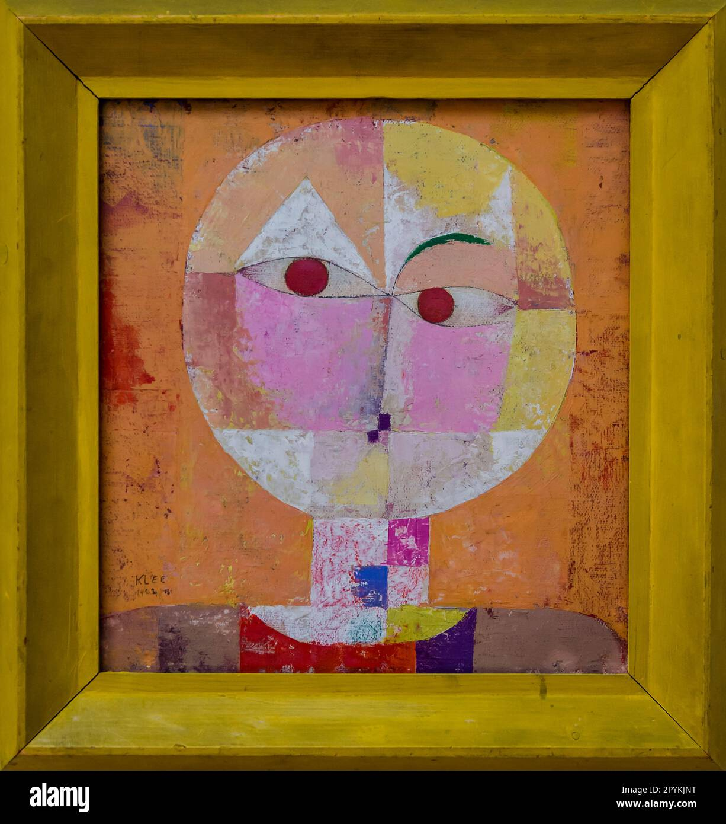
15 | Senecio (1922) | Paul Klee (1879 – 1940), German-Swiss Oil on canvas 40.5 cm × 38 cm Kunstmuseum Basel, Basel
Visual Arts Slide Deck
Abstraction – Other 20th century
Grade 7

Slide 19
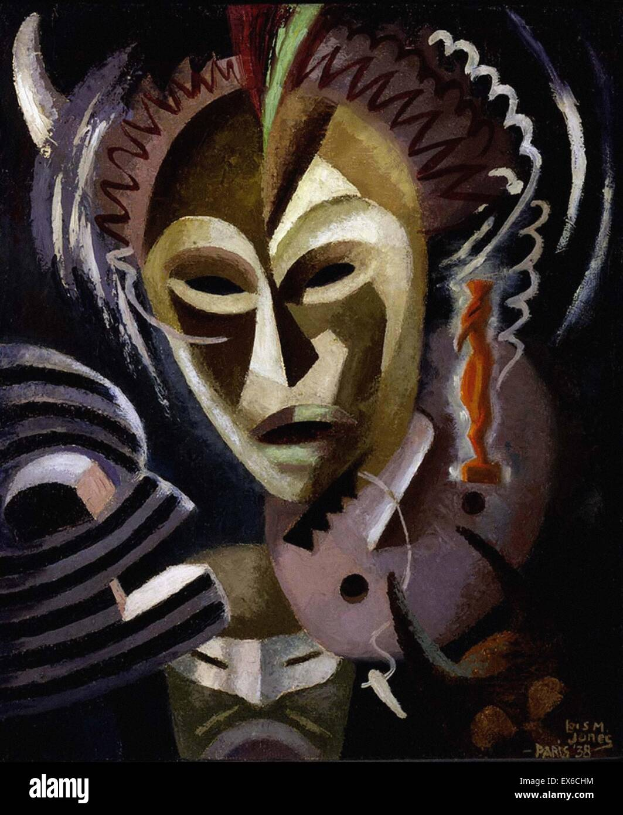
16 | Les Festishes (1938) | Lois Mailou Jones (1905 – 1998), African-American Oil on linen 64.7 cm × 54 cm Smithsonian American Art Museum, Washington, D.C.
Visual Arts Slide Deck
Abstraction – Other 20th century
Grade 7

Slide 20
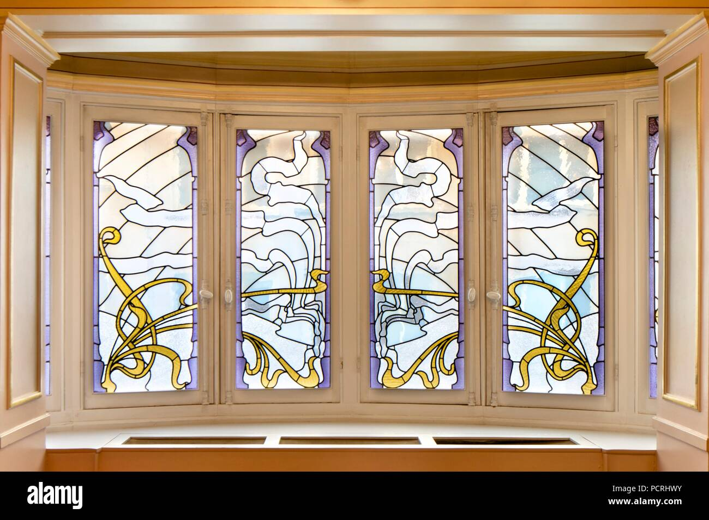
17 | Tassel House | Victor Horta (1861 – 1947), Belgian Brussels, Belgium
Visual Arts Slide Deck
Organic Architecture (turn of 20th cent)
Grade 7

Slide 21
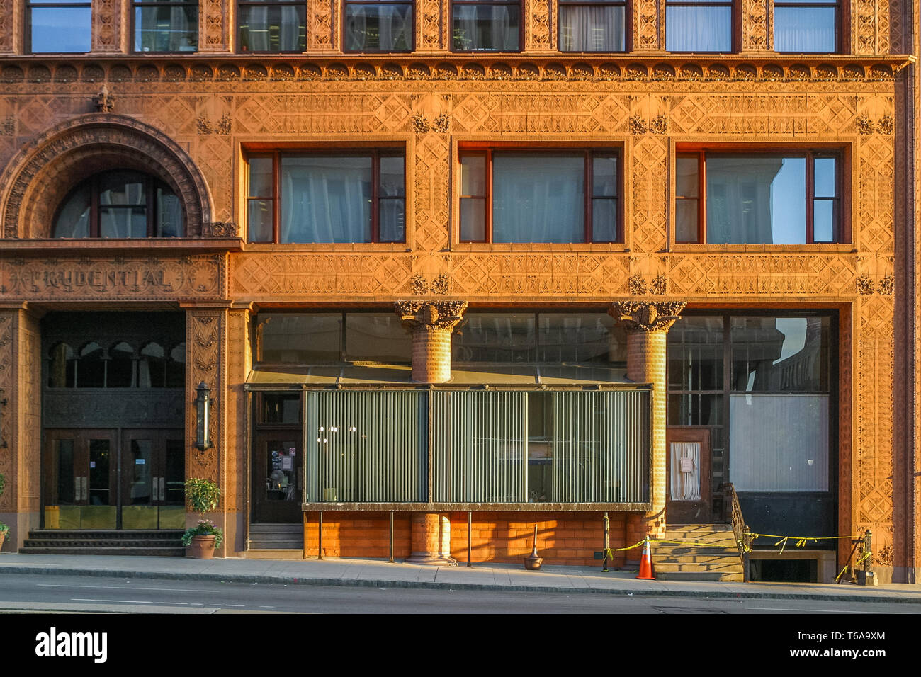
18 | Guaranty Building (1896) | Louis Sullivan (1856 – 1924), American Buffalo, New York
Visual Arts Slide Deck
Organic Architecture (turn of 20th cent)
Grade 7

Slide 22
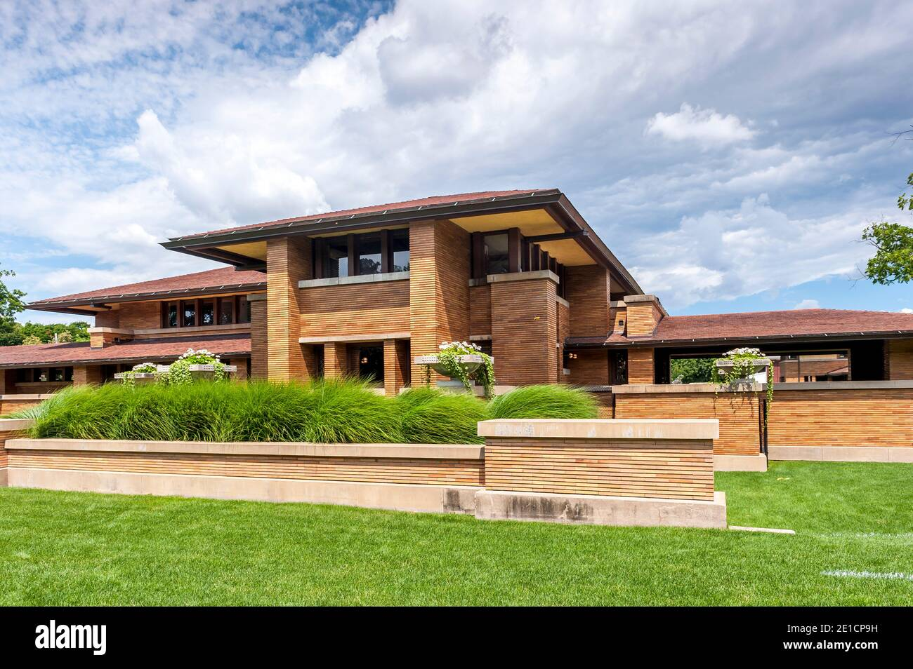
19 | Darwin Martin House (1904) | Frank Lloyd Wright (1867 – 1959), American Buffalo, New York
Visual Arts Slide Deck
Organic Architecture (turn of 20th cent)
Grade 7

Slide 23
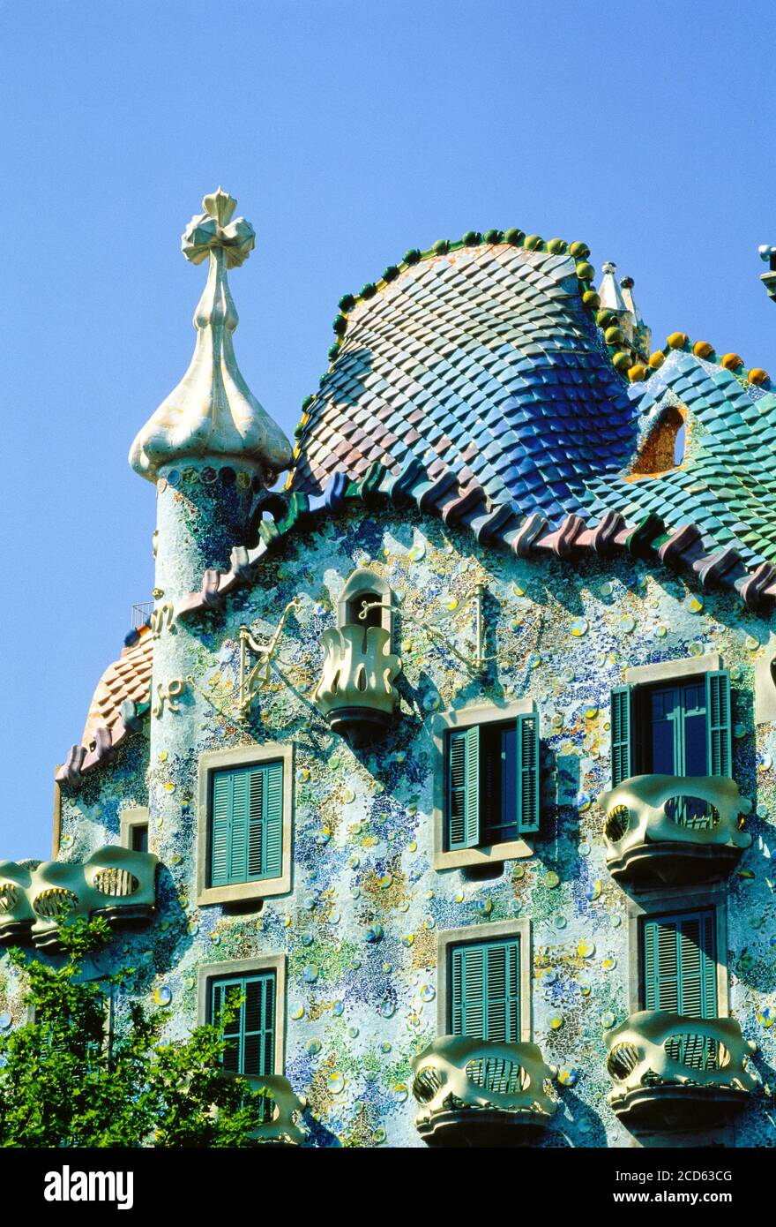
20 | Casa Battlo | Antoni Gaudi (1852 – 1926), Catalan Barcelona, Catalonia, Spain
Visual Arts Slide Deck
Organic Architecture (turn of 20th cent)
Grade 7

Slide 24
Visual Arts Slide Deck
Grade 7
Credits
Image 1 | Archivart / Alamy Stock Photo
Image 2 | incamerastock / Alamy Stock Photo
Image 3 | World History Archive / Alamy Stock Photo
Image 4 | colaimages / Alamy Stock Photo
Image 5 | M.Flynn / Alamy Stock Photo
Image 6 | Creation of the bird, 1957, by Remedios Varo (1908-1963). Mexico, 20th century./Varo, Remedios (1908-63) / Spanish/Museo de Arte Moderno, Mexico City, Mexico/© NPL - DeA Picture Library / Bridgeman Images
Image 7 | Wirestock, Inc. / Alamy Stock Photo
Image 8 | ACTIVE MUSEUM / ACTIVE ART / Alamy Stock Photo
Image 9 | Martin Shields / Alamy Stock Photo
Image 10 | Album / Alamy Stock Photo
Image 11 | Ken Howard / Alamy Stock Photo
Image 12 | dbtravel / Alamy Stock Photo
Image 13 | Peter Horree / Alamy Stock Photo
Image 14 | PAINTING / Alamy Stock Photo
Image 15 | Bjanka Kadic / Alamy Stock Photo
Image 16 | classicpaintings / Alamy Stock Photo
Image 17 | Heritage Image Partnership Ltd / Alamy Stock Photo
Image 18 | Serhii Chrucky / Alamy Stock Photo
Image 19 | Cavan Images / Alamy Stock Photo
Image 20 | Panoramic Images / Alamy Stock Photo

