Slide 1



Visual Arts Slide Deck
Grade 6

Slide 2

Visual Arts Slide Deck
Grade 6
This work is licensed under a Creative Commons Attribution-NonCommercial-ShareAlike 4.0 International License.
You are free:
to Share—to copy, distribute, and transmit the work to Remix—to adapt the work
Under the following conditions:
Attribution—You must attribute the work in the following manner:
This work is based on an original work of the Core Knowledge® Foundation (www.coreknowledge.org) and the additions from the Louisiana
Department of Education, made available through licensing under a Creative Commons Attribution-NonCommercial-ShareAlike4.0 International License. This does not in any way imply that the Core Knowledge Foundation or the Louisiana Department of Education endorses this work.
Noncommercial—You may not use this work for commercial purposes.
Share Alike—If you alter, transform, or build upon this work, you may distribute the resulting work only under the same or similar license to
this one.
With the understanding that:
For any reuse or distribution, you must make clear to others the license terms of this work. The best way to do this is with a link to this
web page:
https://creativecommons.org/licenses/by-nc-sa/4.0/
Copyright © 2025 Core Knowledge Foundation
www.coreknowledge.org
All Rights Reserved.
Core Knowledge©, Core Knowledge Curriculum Series™, Core Knowledge Visual Arts™, Core Knowledge Music™ are trademarks are trademarks of the Core Knowledge Foundation. Foundations of Freedom is a trademark of the Louisiana Department of Education.
Trademarks and trade names are shown in this book strictly for illustrative and educational purposes and are the property of their
respective owners. References herein should not be regarded as affecting the validity of said trademarks and trade names.
ISBN: 979-8-88970-648-9

Slide 3
Content
Visual Arts Slide Deck
Grade 6
I. Classical Art
The Art of Ancient Greece & Rome
1 | The Parthenon
2 | The School of Athens
3 | The Pantheon
II. Gothic Art & Architecture
4 | Palace of Westminster, Charles Barry & AWN Pugin
5 | Notre Dame Cathedral
III. Rococo
6 | The Swing, Jean Honore Fragonard
7 | Self-Portrait with Two Pupils, Adelaide Labille-Guiard
IV. Neoclassical Art & Architecture
8 | Marie-Antoinette de Lorraine-Habsbourg,
Queen of France & Her Children,
Elisabeth Louise Vigee-LeBrun
9 | Oath of the Horatii, Jacques Louis David
V. Romantic
10 | The Bullfight, Francisco Goya
VI. Realism
11 | The Gleaners, Jean Millet
12 | The Stone Breakers, Gustave Courbet
13 | The Banjo Lesson, Henry O. Tanner
14 | The Gross Clinic, Thomas Eakins
VII. Impressionism
15 | Luncheon of the Boating Party, Pierre Auguste Renoir
16 | The Boating Party, Mary Cassat
17 | Bridge Over a Pool of Lilies, Claude Monet
18 | Dancing Class, Edgar Degas
VIII. Post-Impressionism
19 | Hail Mary (la Orana Maria), Paul Gauguin
20 | The Starry Night, Vincent Van Gogh
21 | Sunday Afternoon on the Island of the Grande Jatte,
George Seurat
IX. Architecture in the Age of the Industrial Revolution
22 | Statue of Liberty
23 | The Brooklyn Bridge
24 | The Eiffel Tower

Slide 4
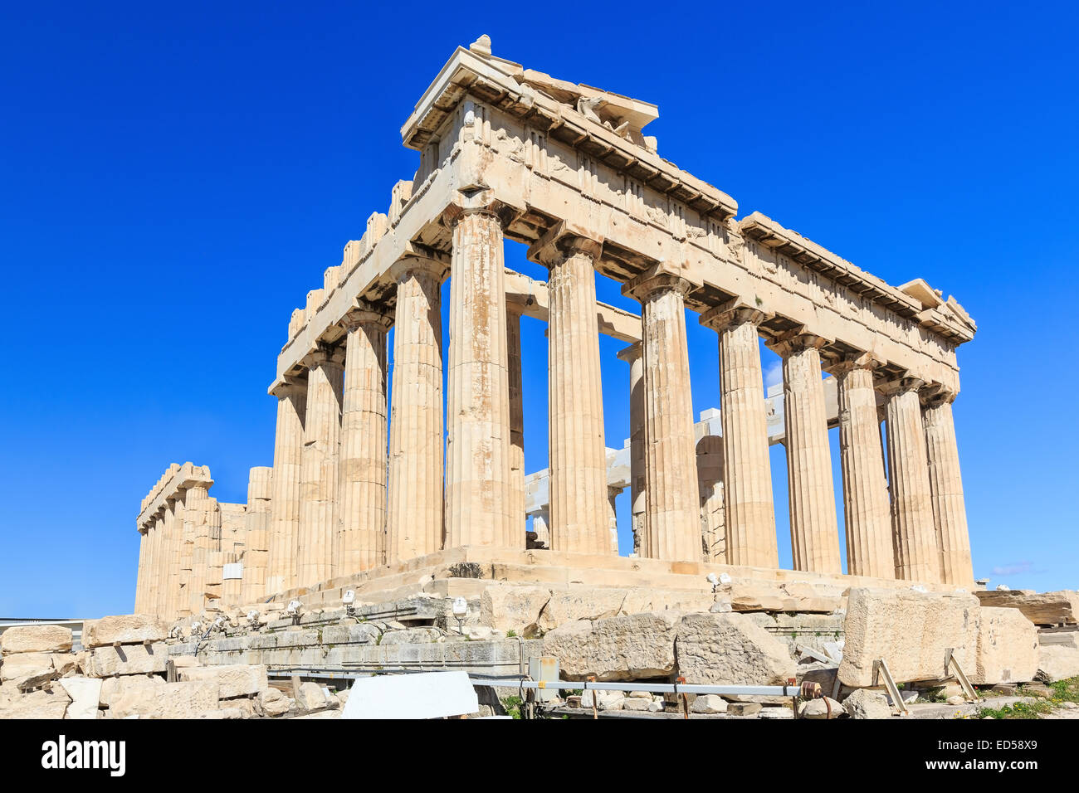
1 | The Parthenon | 69.5 m x 30.9 m Athens, Greece
Visual Arts Slide Deck
Classical Art
The Art of Ancient Greece and Rome
Grade 6

Slide 5
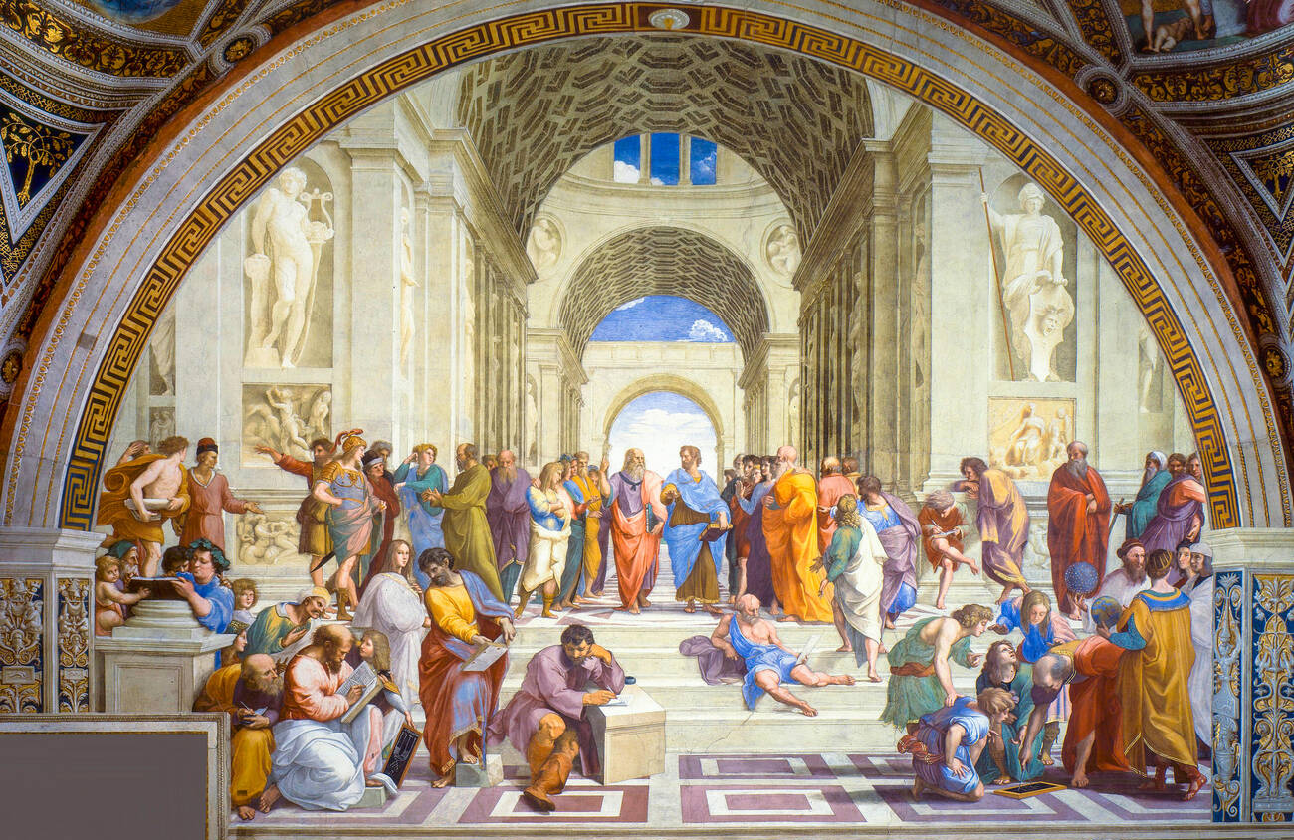
2 | The School of Athens (1511) | Raphael (1483 - 1520), Italian Fresco 500 cm × 770 cm Apostolic Palace, Vatican Museums, Vatican City
Visual Arts Slide Deck
Classical Art
The Art of Ancient Greece and Rome
Grade 6

Slide 6
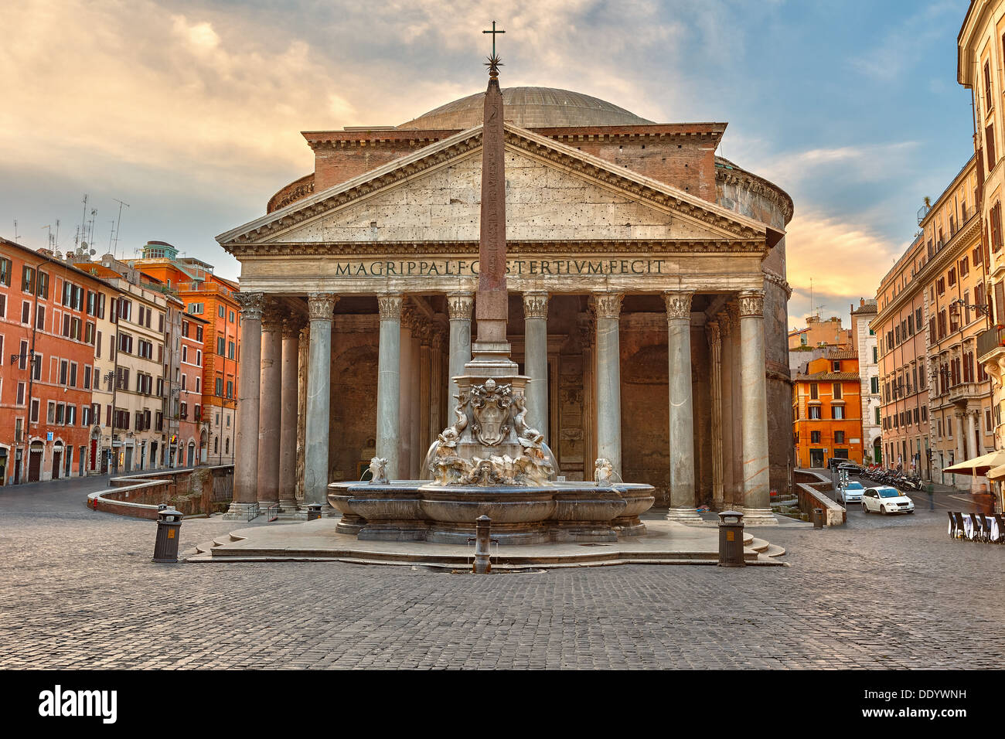
3 | The Pantheon | Piazza Della Rotonda, Rome, Italy, Europe
Visual Arts Slide Deck
Classical Art
The Art of Ancient Greece and Rome
Grade 6

Slide 7
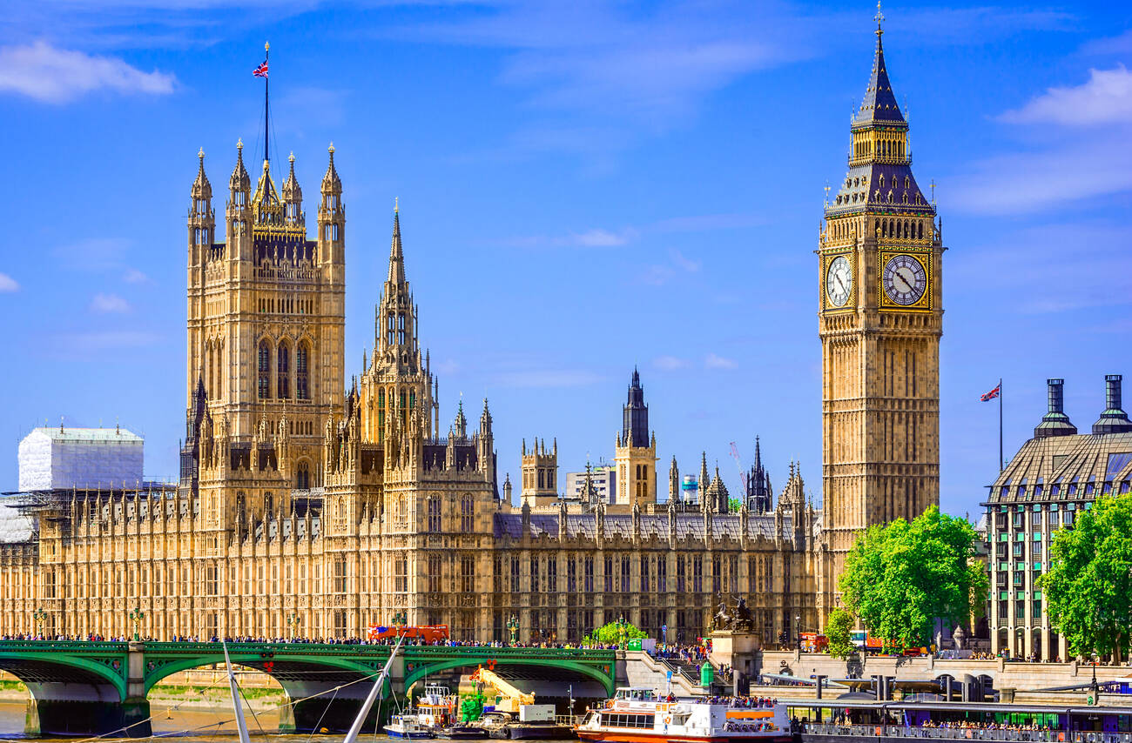
4 | Palace of Westminster | Charles Barry & AWN Pugin, London, The United Kingdom of Great Britain
Visual Arts Slide Deck
Gothic Art and Architecture
Grade 6

Slide 8
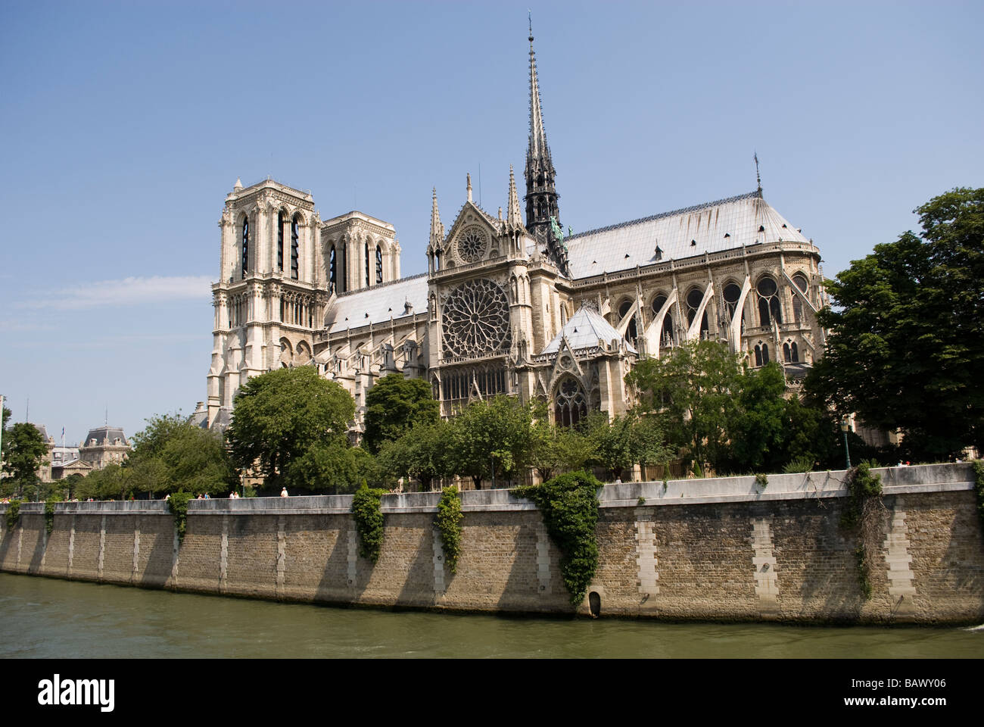
5 | Notre Dame | Paris, France
Visual Arts Slide Deck
Gothic Art and Architecture
Grade 6

Slide 9
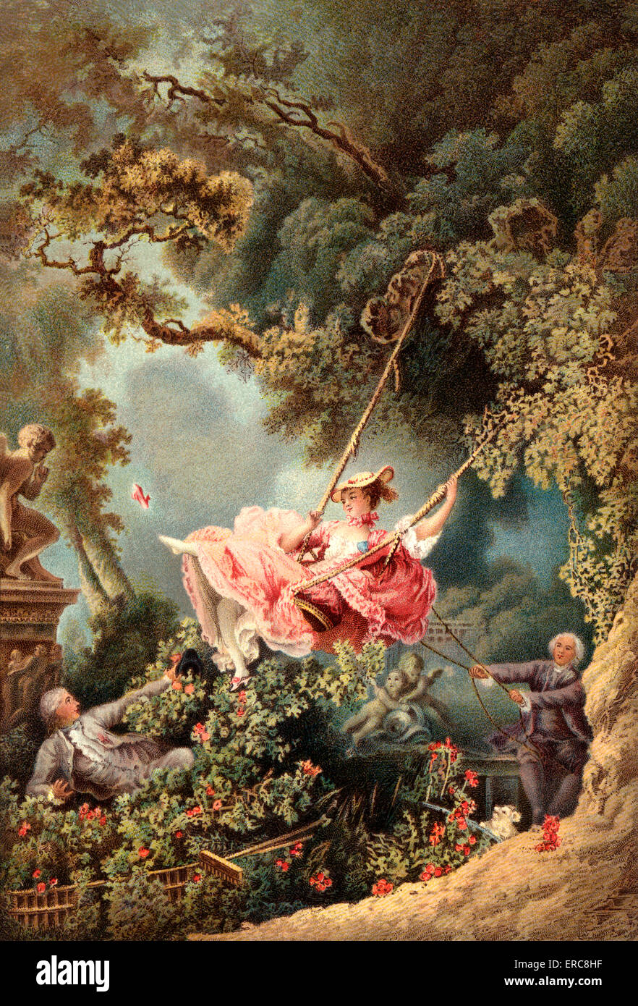
6 | The Swing (1768) | Jean-Honoré Fragonard (1731 - 1806), French Oil on canvas 81 cm × 64.2 cm The Wallace Collection, London, United Kingdom
Visual Arts Slide Deck
Rococo
Grade 6

Slide 10
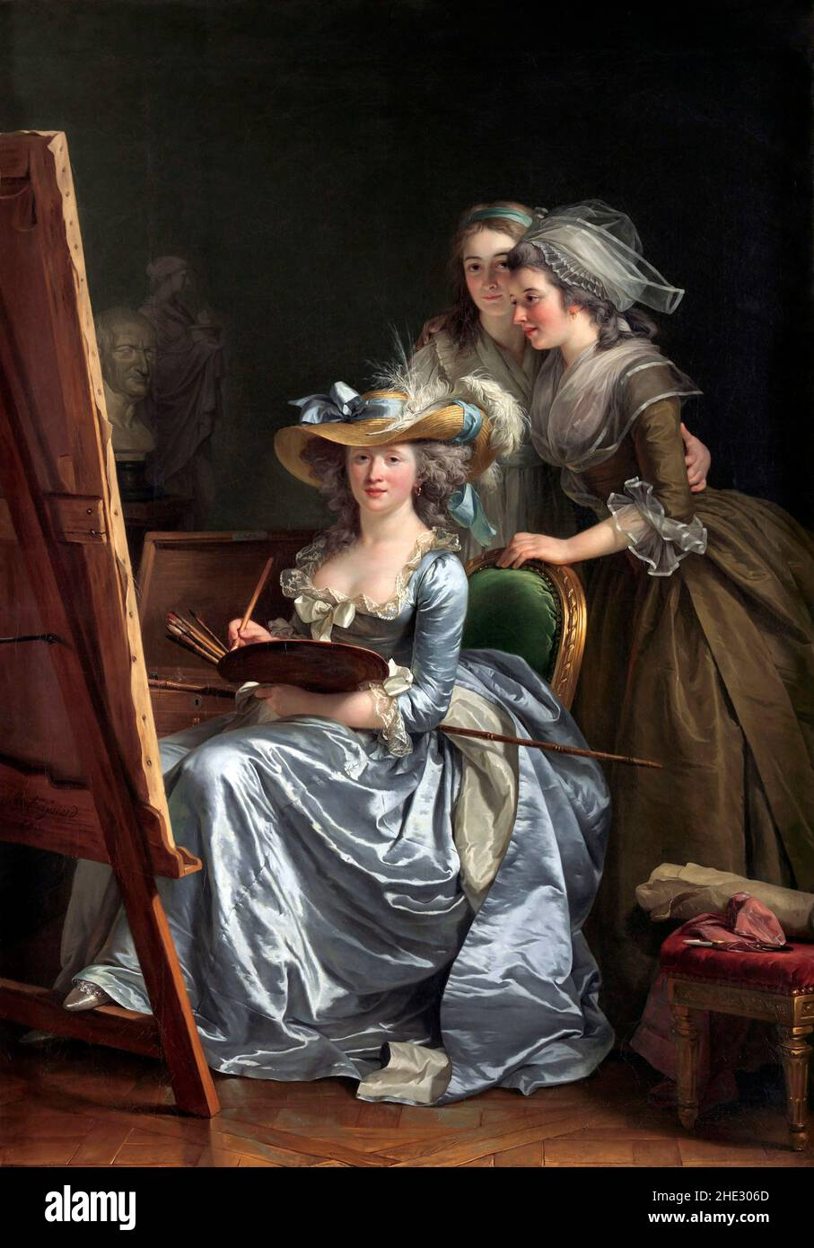
7 | Self-Portrait with Two Pupils (1785) | Adélaïde Labille-Guiard (1749 - 1803), French Oil on canvas 210.8cm x 151.1cm Metropolitan Museum of Art, New York
Visual Arts Slide Deck
Rococo
Grade 6

Slide 11
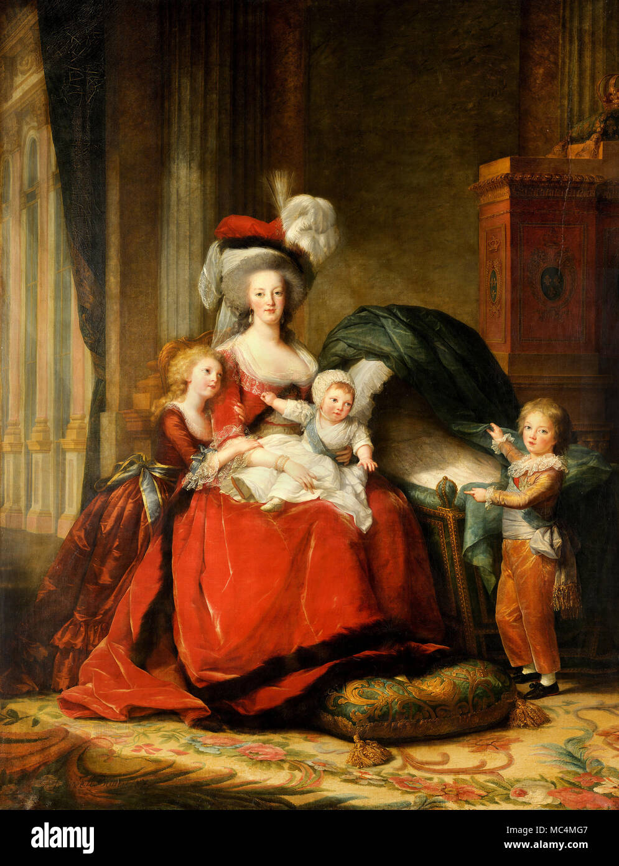
8 | Marie-Antoinette de Lorraine-Habsbourg, Queen of France & Her Children (1787) | Élisabeth Vigée Le Brun (1755 - 1842), French Oil on canvas 275 cm × 216.5 cm Palace of Versailles, Versailles
Visual Arts Slide Deck
Neoclassical Art and Architecture
Grade 6

Slide 12
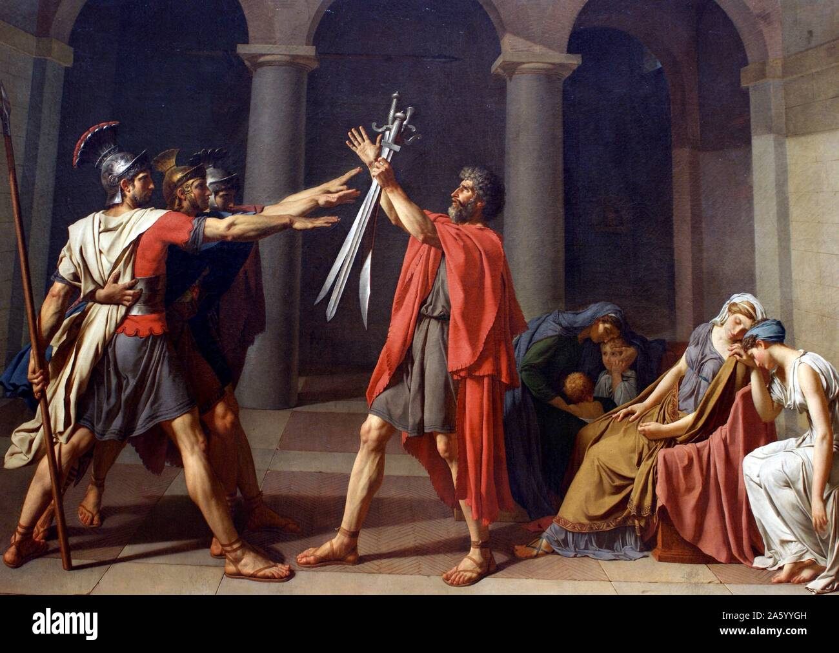
9 | Oath of the Horatii (1784) | Jacques Louis David (1748 - 1825), French Oil on canvas 329.8 cm × 424.8 cm Louvre, Paris
Visual Arts Slide Deck
Neoclassical Art and Architecture
Grade 6

Slide 13
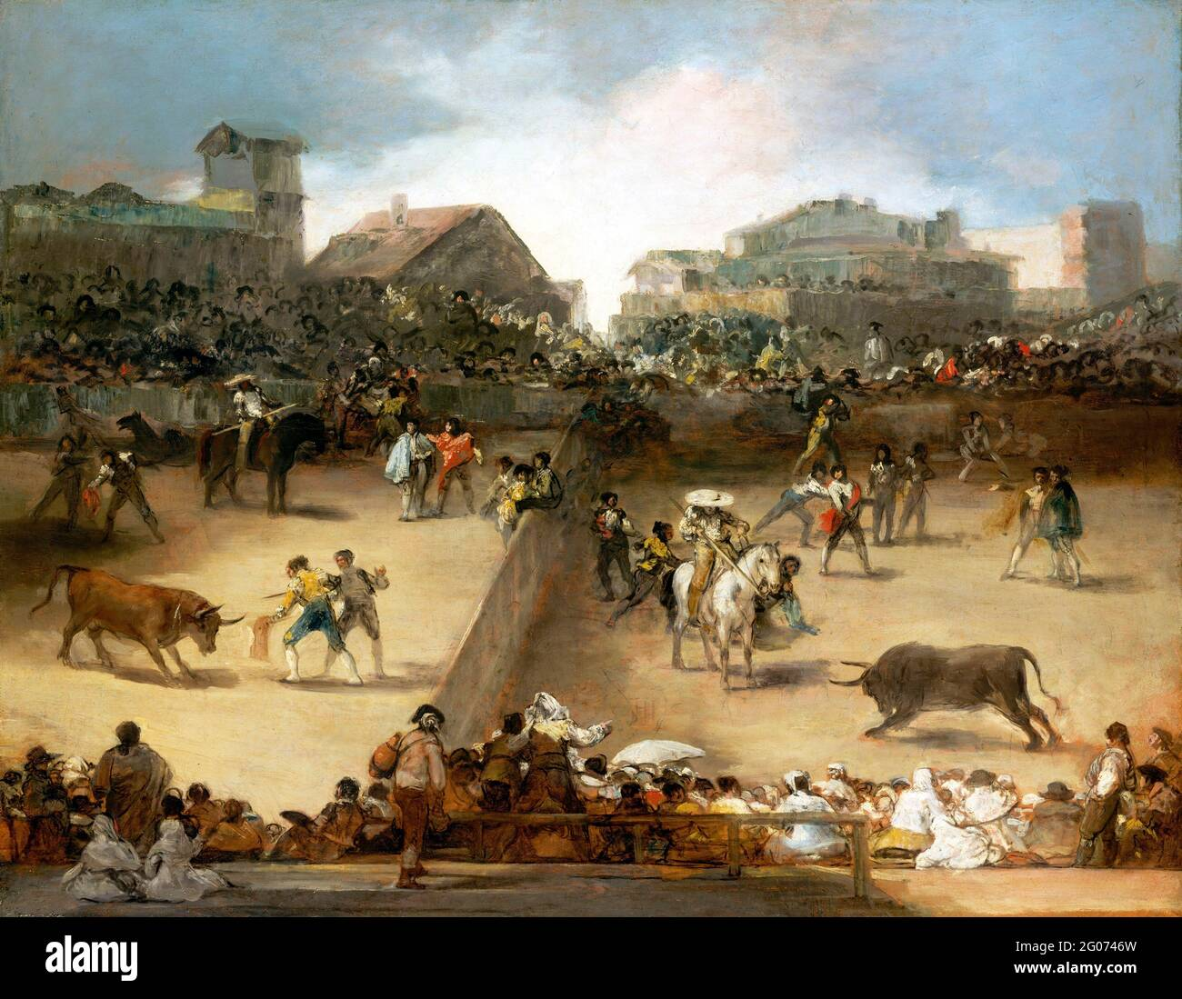
10 | The Bullfight (1824) | Francisco Goya (1746 - 1828), Spanish Oil on canvas 49.5 cm x 61 cm Getty Center
Visual Arts Slide Deck
Romantic
Grade 6

Slide 14
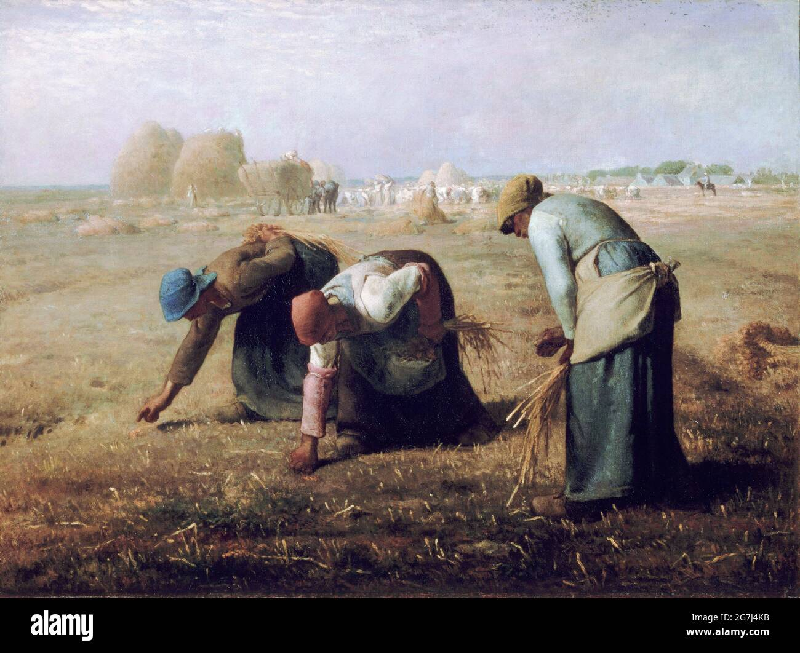
11 | The Gleaners (1857) | Jean Francois Millet (1814 - 1875), French Oil on canvas 83.8 cm × 111.8 cm Musée d'Orsay, Paris
Visual Arts Slide Deck
Realism
Grade 6

Slide 15
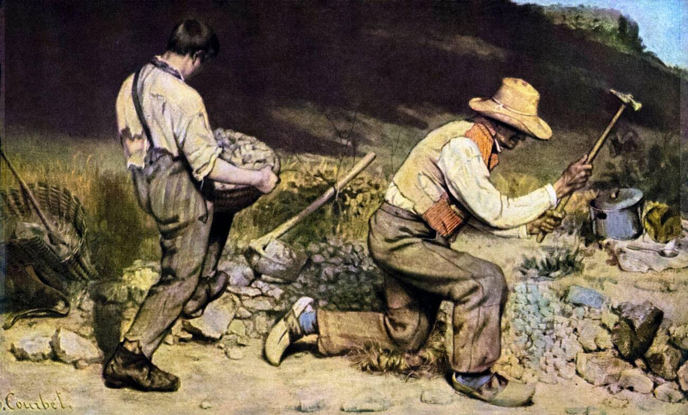
12 | The Stone Breakers (1849) | Gustave Courbet (1452 - 1519), French Oil on canvas 150 cm x 260 cm Gemäldegalerie Alte Meister, Dresden (until 1945), Destroyed in bombing
Visual Arts Slide Deck
Realism
Grade 6

Slide 16
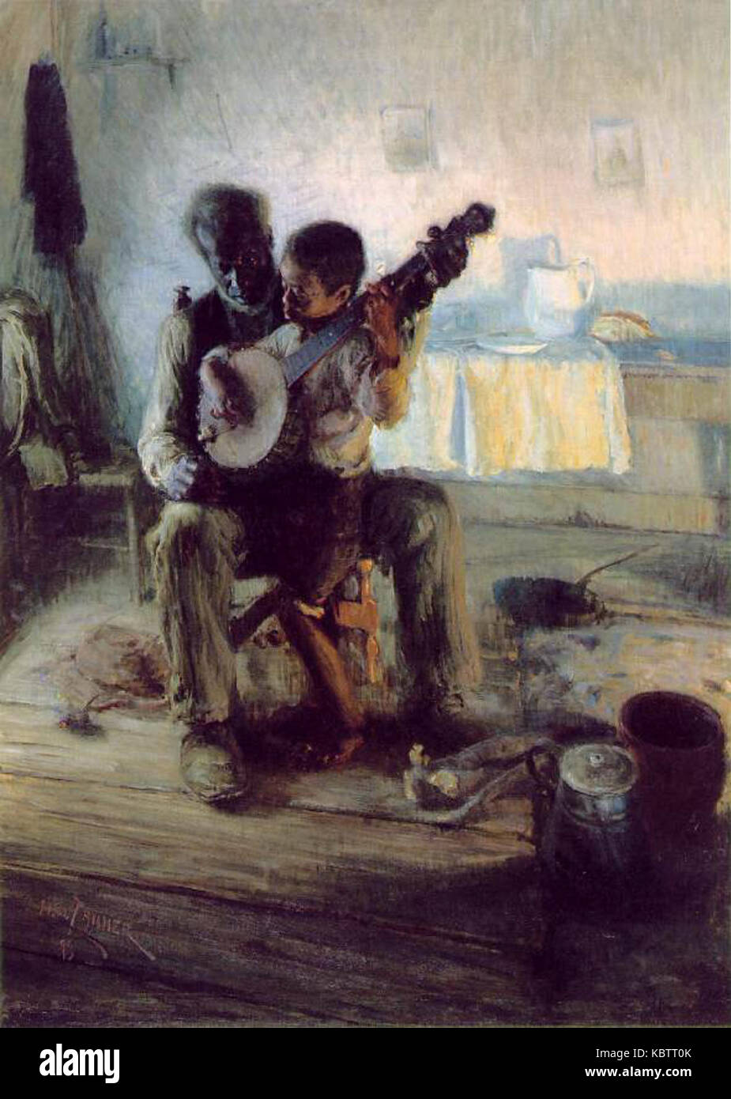
13 | The Banjo Lesson (1893) | Henry O. Tanner (1859 - 1937), African-American Oil on canvas 124.46 cm x 90.17 cm Hampton University Museum
Visual Arts Slide Deck
Realism
Grade 6

Slide 17
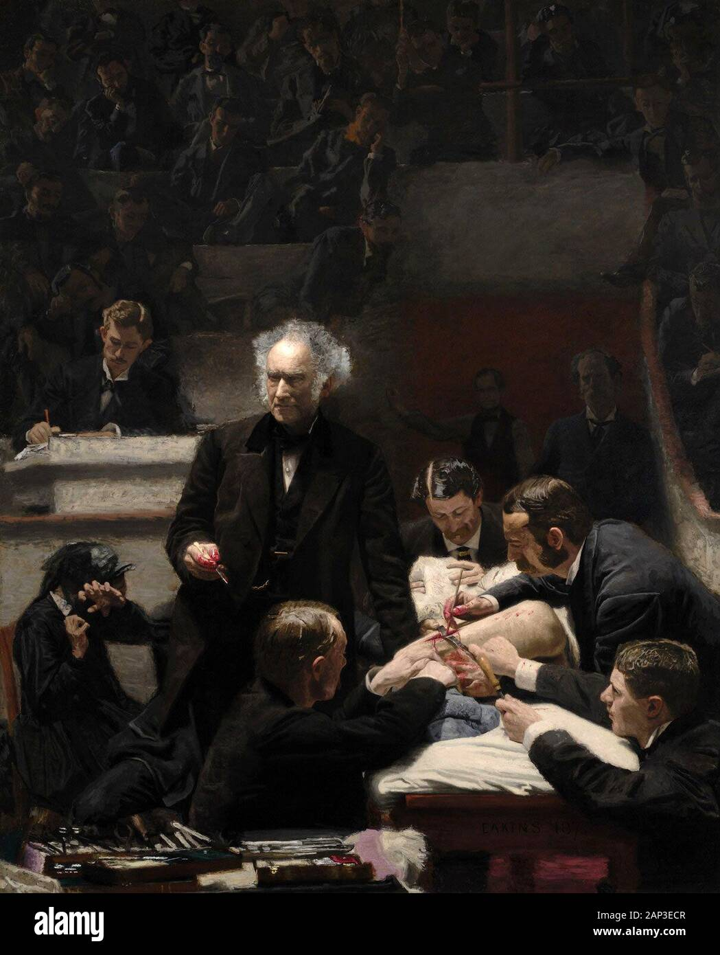
14 | The Gross Clinic (1875) | Thomas Eakins (1844 - 1916), American Oil on canvas 240 cm × 200 cm Philadelphia Museum of Art and the Pennsylvania Academy of Fine Arts
Visual Arts Slide Deck
Realism
Grade 6

Slide 18
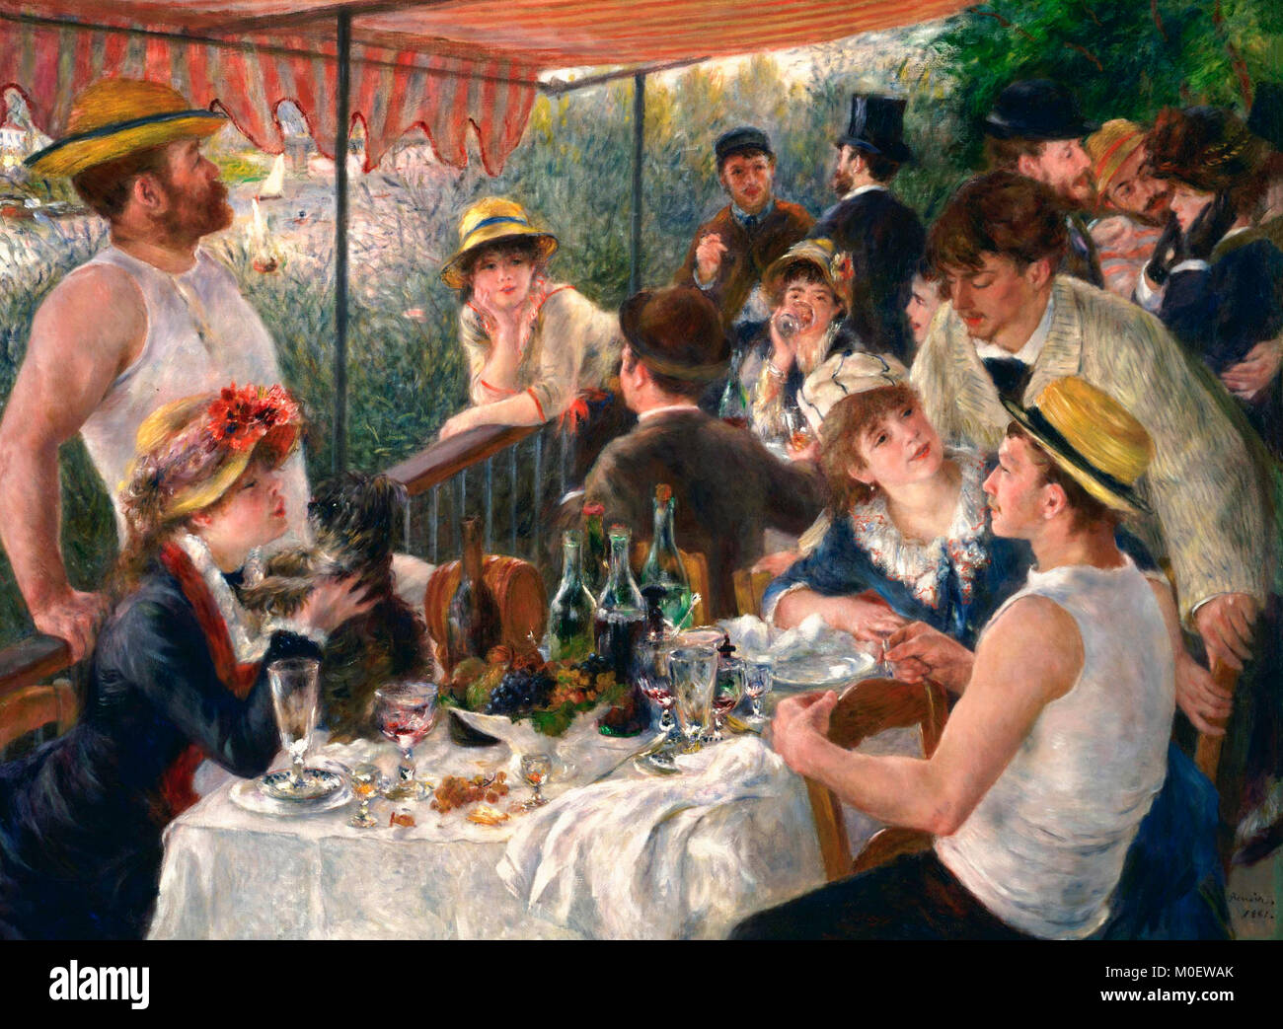
15 | Luncheon of the Boating Party (1881) | Pierre Auguste Renoir (1452 - 1519), French Oil on canvas 129.9 cm × 172.7 cm The Phillips Collection, Washington, DC
Visual Arts Slide Deck
Impressionism
Grade 6

Slide 19
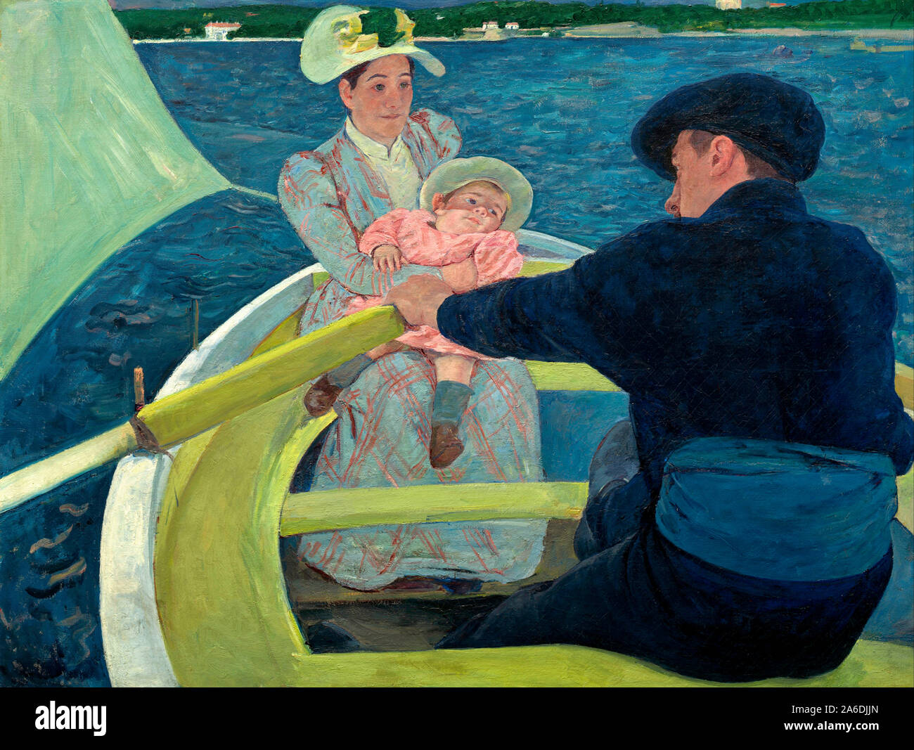
16 | The Boating Party (1893) | Mary Cassat (1844 - 1926), American Oil on canvas 90 cm × 117.3 cm National Gallery of Art, Washington, DC
Visual Arts Slide Deck
Impressionism
Grade 6

Slide 20
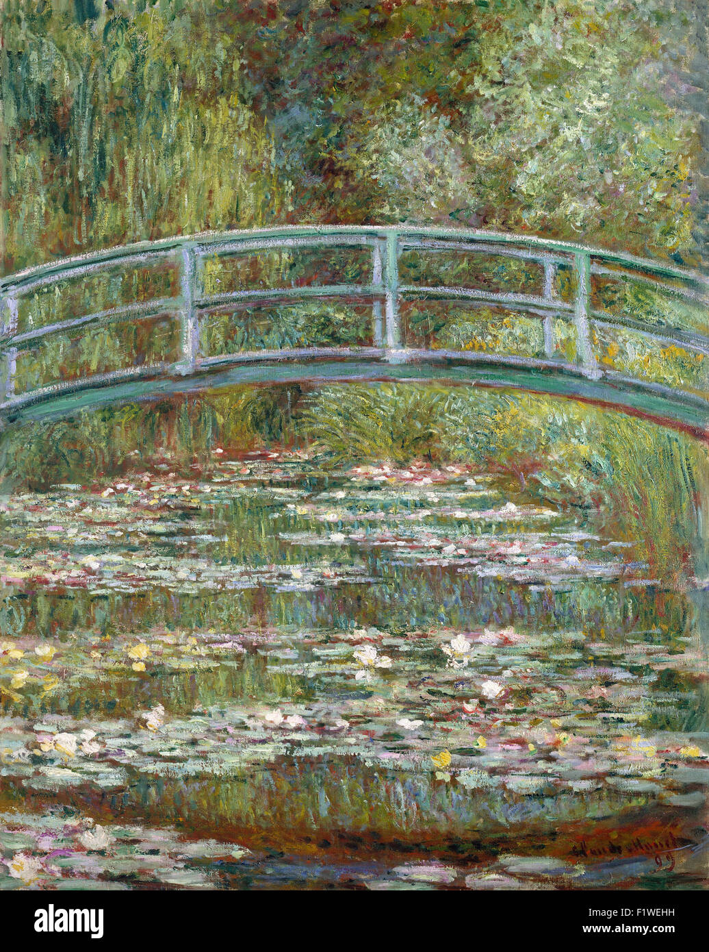
17 | Bridge Over a Pool of Lilies | Claude Monet (1840–1926), French Oil on canvas 91.4 cm x 73.7 cm National Gallery, London, UK
Visual Arts Slide Deck
Impressionism
Grade 6

Slide 21
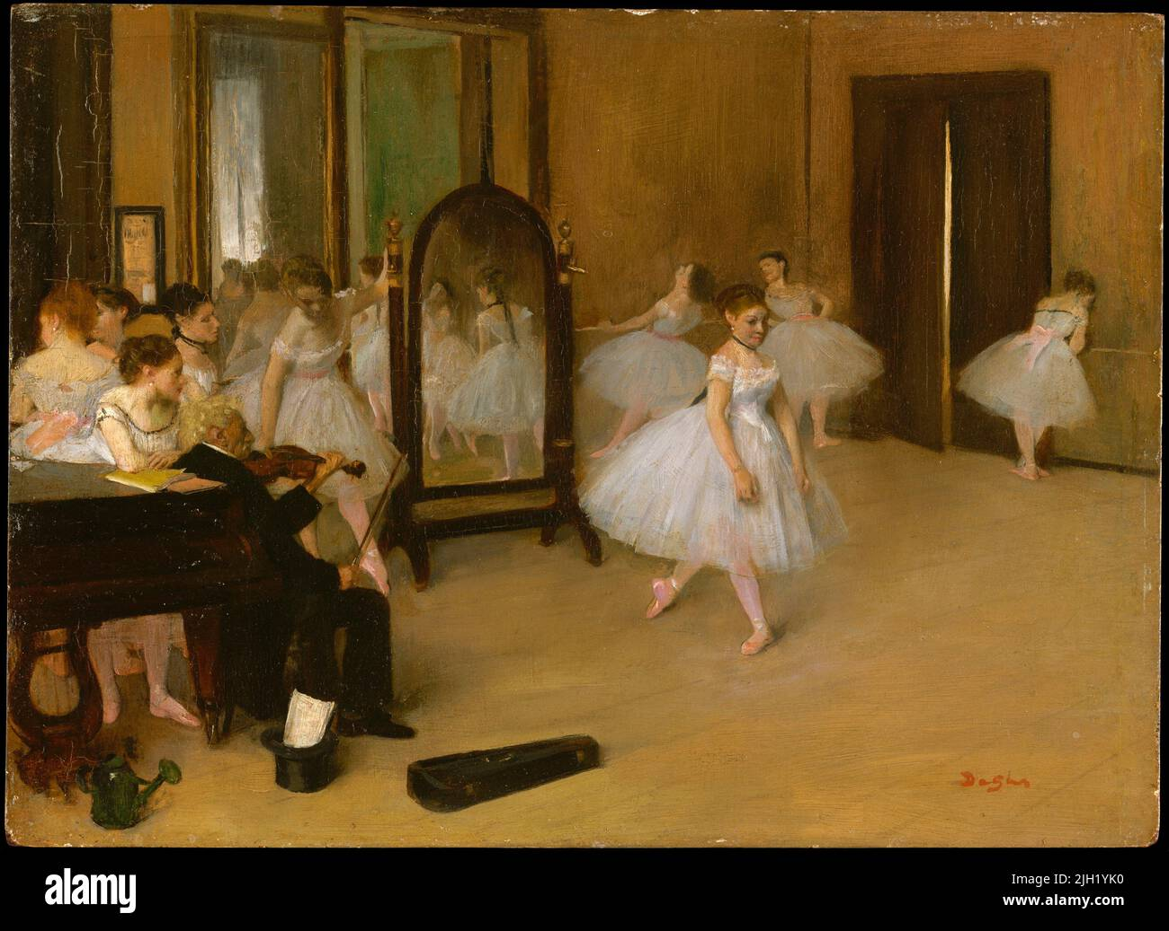
18 | The Dancing Class (1870) | Edgar Degas (1834 - 1917), French Oil on wood 19.7 cm × 27 cm Metropolitan Museum of Art, New York
Visual Arts Slide Deck
Impressionism
Grade 6

Slide 22
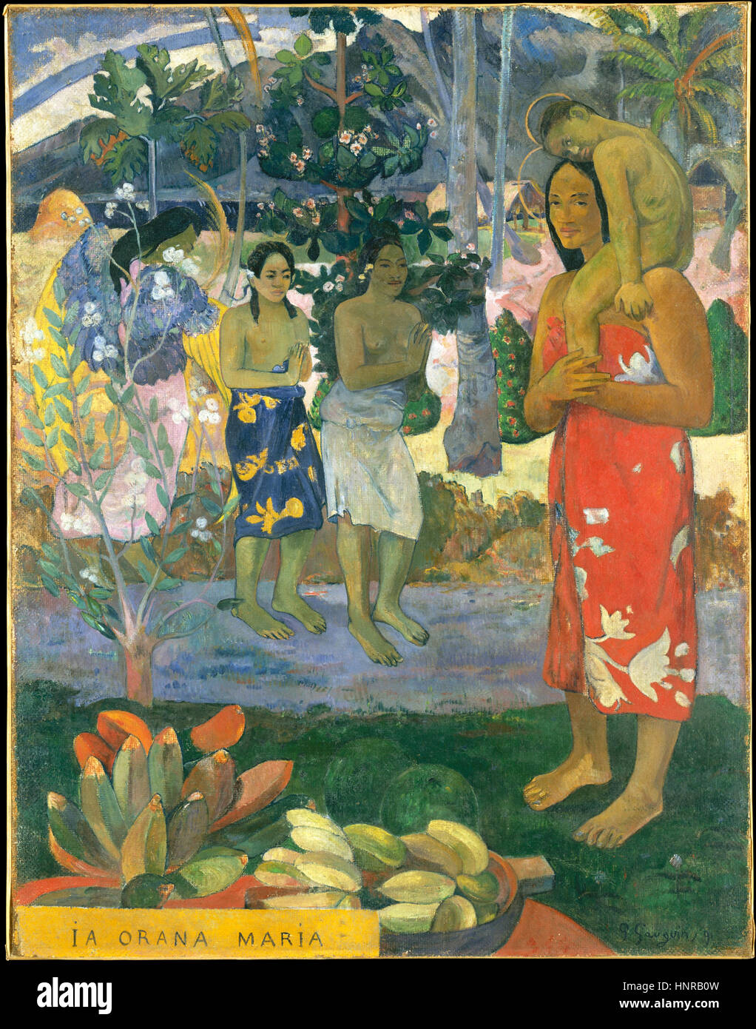
19 | Hail Mary (la Orana Maria) (1891) | Paul Gauguin (1452 - 1519), French Oil on canvas 114 cm × 88 cm Metropolitan Museum of Art, New York
Visual Arts Slide Deck
Post-Impressionism
Grade 6

Slide 23
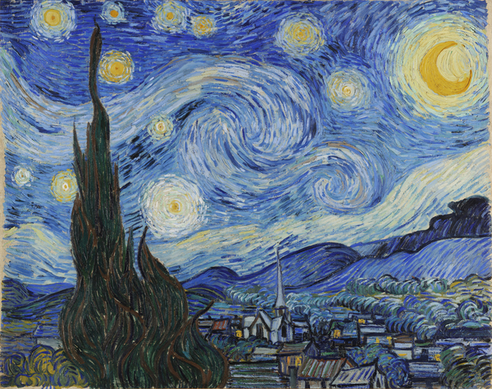
20 | The Starry Night (1889) | Vincent Van Gogh (1853 - 1890), Dutch Oil on canvas 73.7 cm x 92.1 cm Museum of Modern Art (MoMA), New York, USA
Visual Arts Slide Deck
Post-Impressionism
Grade 6

Slide 24
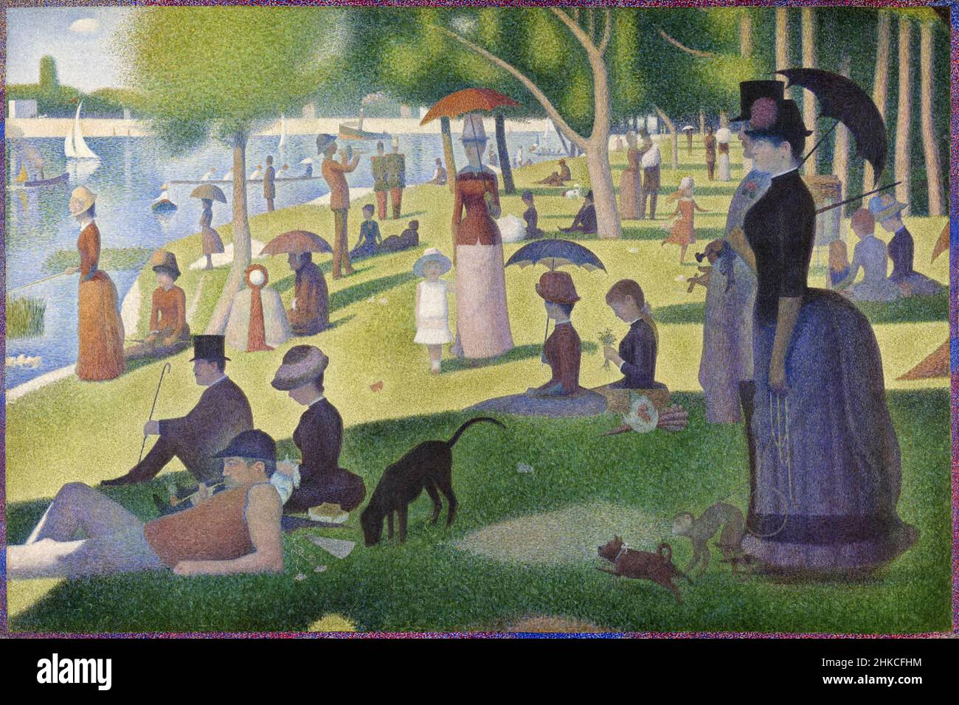
21 | Sunday Afternoon on the Island of the Grande Jatte (1884–1886) | George Seurat (1859 - 1891), French Oil on canvas 207.6 cm × 308 cm Art Institute of Chicago, Chicago
Visual Arts Slide Deck
Post-Impressionism
Grade 6

Slide 25
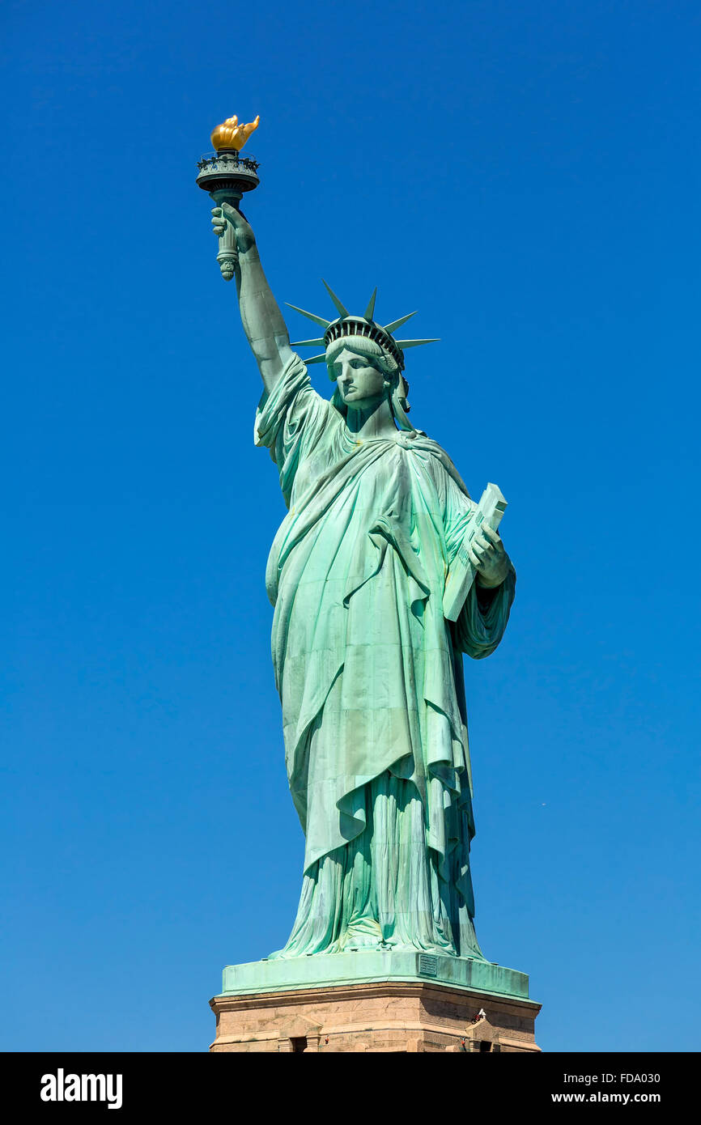
22 | The Statue of Liberty | New York City
Visual Arts Slide Deck
Architecture in the Age of the Industrial Revolution
Grade 6

Slide 26
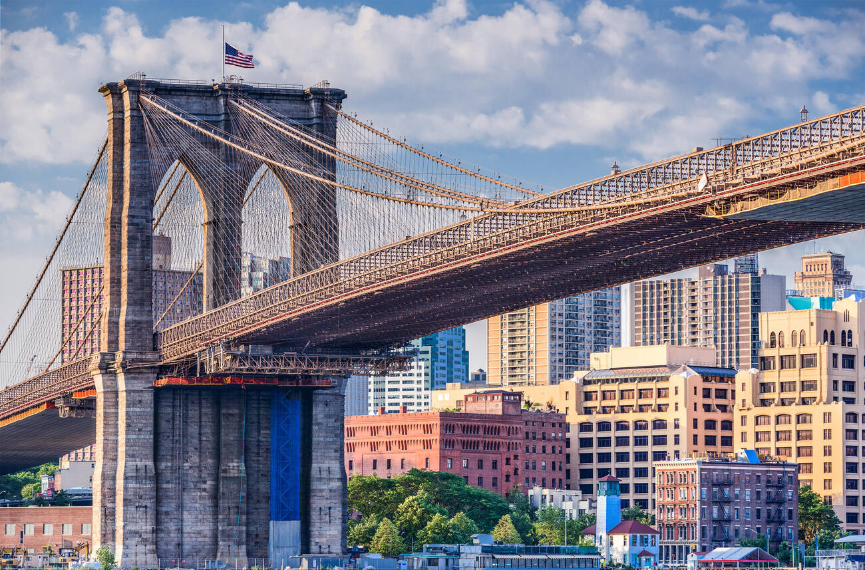
23 | The Brooklyn Bridge | New York City
Visual Arts Slide Deck
Architecture in the Age of the Industrial Revolution
Grade 6

Slide 27
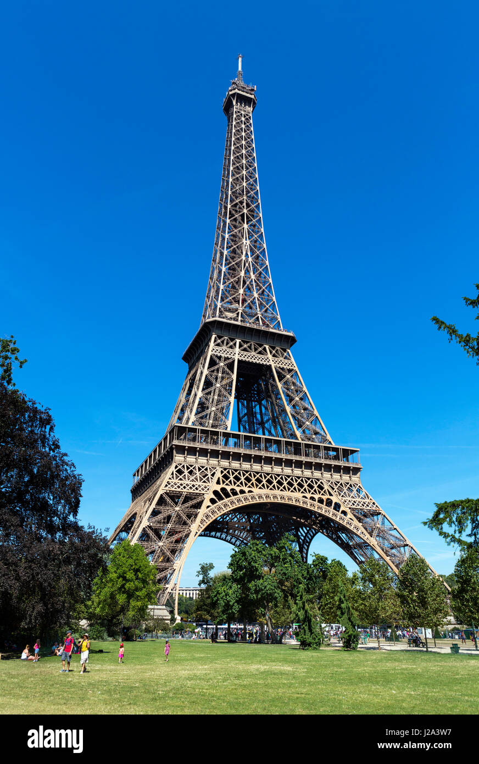
24 | The Eiffel Tower (1887) | Paris, France
Visual Arts Slide Deck
Architecture in the Age of the Industrial Revolution
Grade 6

Slide 28
Visual Art Cards
Grade 6
Credits
Image 1 | Sorin Colac / Alamy Stock Photo
Image 2 | incamerastock / Alamy Stock Photo
Image 3 | Sergey Borisov / Alamy Stock Photo
Image 4 | Ionut David / Alamy Stock Photo
Image 5 | John Baran / Alamy Stock Photo
Image 6 | ClassicStock / Alamy Stock Photo
Image 7 | IanDagnall Computing / Alamy Stock Photo
Image 8 | PAINTING / Alamy Stock Photo
Image 9 | GL Archive / Alamy Stock Photo
Image 10 | IanDagnall Computing / Alamy Stock Photo
Image 11 | PAINTING / Alamy Stock Photo
Image 12 | incamerastock / Alamy Stock Photo
Image 13 | Historic Collection / Alamy Stock Photo
Image 14 | Niday Picture Library / Alamy Stock Photo
Image 15 | Niday Picture Library / Alamy Stock Photo
Image 16 | Niday Picture Library / Alamy Stock Photo
Image 17 | classicpaintings / Alamy Stock Photo
Image 18 | SJArt / Alamy Stock Photo
Image 19 | mambo / Alamy Stock Photo
Image 20 | The Starry Night, June 1889 (oil on canvas) / Gogh, Vincent van (1853-90) / Dutch / Museum of Modern Art (MoMA),
New York, USA / Bridgeman Images
Image 21 | Universal Art Archive / Alamy Stock Photo
Image 22 | JOHN KELLERMAN / Alamy Stock Photo
Image 23 | Sean Pavone / Alamy Stock Photo
Image 24 | Ian Dagnall / Alamy Stock Photo

