Slide 1



Visual Arts Slide Deck
Grade 3

Slide 2

Visual Arts Slide Deck
Grade 3
This work is licensed under a Creative Commons Attribution-NonCommercial-ShareAlike 4.0 International License.
You are free:
to Share—to copy, distribute, and transmit the work to Remix—to adapt the work
Under the following conditions:
Attribution—You must attribute the work in the following manner:
This work is based on an original work of the Core Knowledge® Foundation (www.coreknowledge.org) and the additions from the Louisiana Department of Education, made available through licensing under a Creative Commons Attribution-NonCommercial-ShareAlike4.0 International License. This does not in any way imply that the Core Knowledge Foundation or the Louisiana Department of Education endorses this work.
Noncommercial—You may not use this work for commercial purposes.
Share Alike—If you alter, transform, or build upon this work, you may distribute the resulting work only under the same or similar license to this one.
With the understanding that:
For any reuse or distribution, you must make clear to others the license terms of this work. The best way to do this is with a link to this web page:
https://creativecommons.org/licenses/by-nc-sa/4.0/
Copyright © 2025 Core Knowledge Foundation
www.coreknowledge.org
All Rights Reserved.
Core Knowledge©, Core Knowledge Curriculum Series™, Core Knowledge Visual Arts™, Core Knowledge Music™ are trademarks are trademarks of the Core Knowledge Foundation. Foundations of Freedom is a trademark of the Louisiana Department of Education.
Trademarks and trade names are shown in this book strictly for illustrative and educational purposes and are the property of their respective owners. References herein should not be regarded as affecting the validity of said trademarks and trade names.
ISBN: 979-8-88970-645-8

Slide 3
Content
Visual Arts Slide Deck
Grade 3
I. Elements of Art
Light and Space
1 | Ruby Green Singing, James Chapin
2 | The Milkmaid, Jan Vermeer
3 | El Jaleo (1882), John Singer Sargent
4 | Florida Mexicana (1936), Alfred Ramo Martinez
5 | The Gleaners, Jean Francois Millet
6 | Peasant Wedding, Pieter Bruegel
Design and the Elements of Art
7 | The Peaceable Kingdom, Edward Hicks
8 | The Child's Bath, Mary Cassatt
9 | The Scream, Edvard Munch
10 | Icarus, Henri Matisse
11 | The Block, Romare Bearden
II. Art and Architecture: Roman and Byzantine Empires
12 | Le Pont du Gard
13 | The Pantheon
14 | Emperor Justinian and Members of His Court
15 | Hagia Sophia
III. Architecture of the Earliest Peoples
16 | Neolithic Long House
17 | Plains American Tipi (4000 BCE)
IV. Native American Art
18 | Hopi Kachina doll
19 | Navajo (Dine) blankets and rugs, sand paintings
20 | Valise, Nellie Two Bear Gates

Slide 4
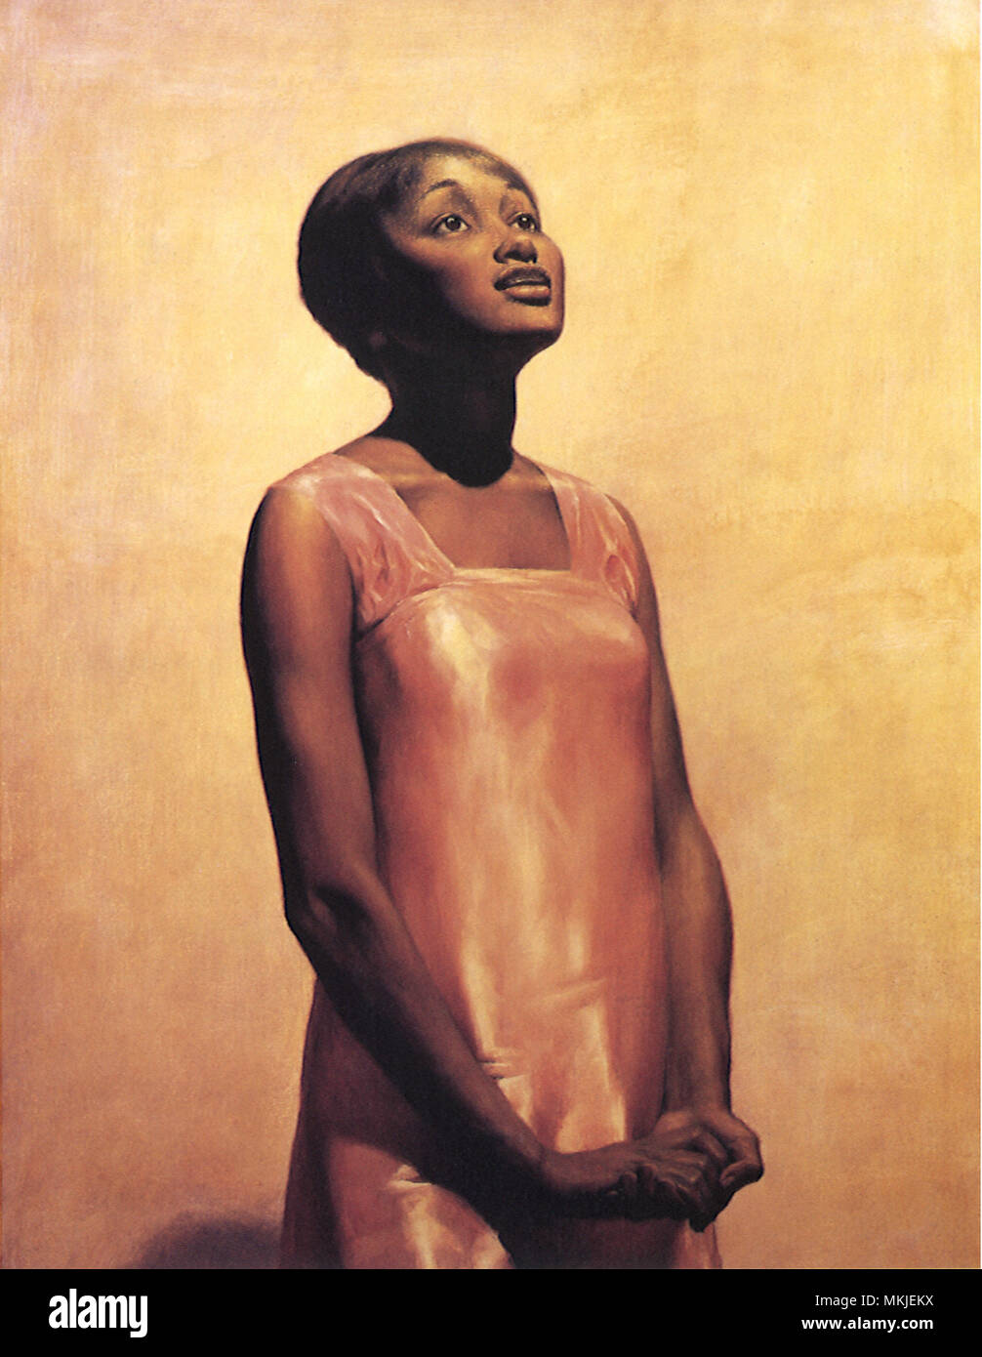
1 | Ruby Green Singing (1928) | James Chapin (1887 - 1975), American Oil on canvas 96.5 cm x76.2 cm Norton Museum of Art
Visual Arts Slide Deck
Elements of Art
Light and Space
Grade 3

Slide 5
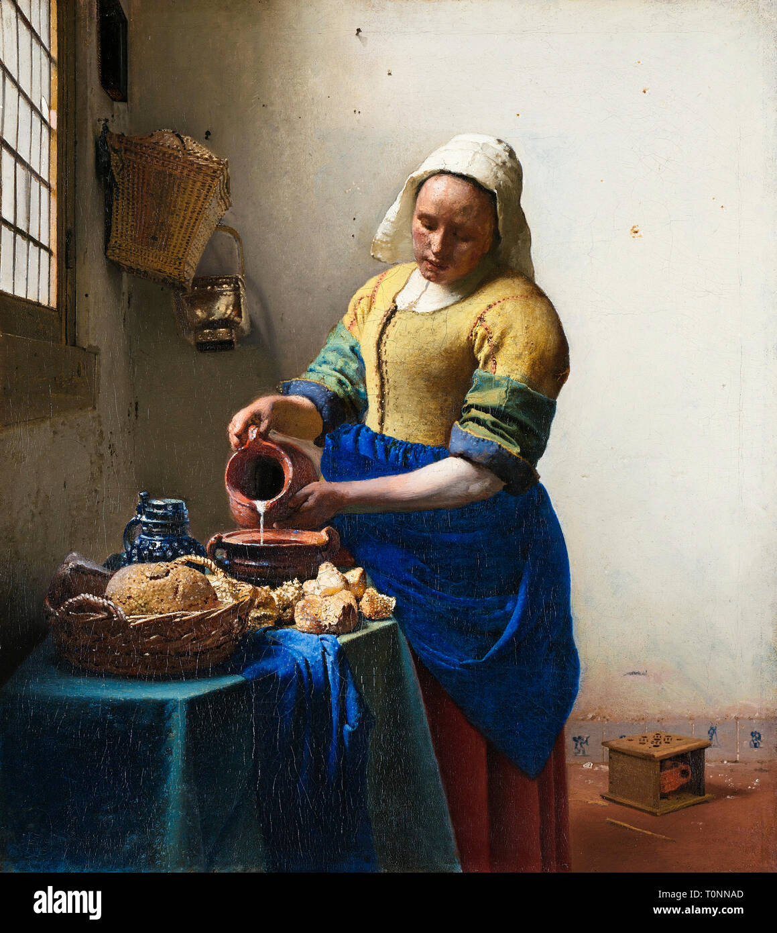
2 | The Milkmaid (1660) | Jan Vermeer (1632 - 1675), Dutch Oil on canvas 45.5 cm x 41 cm Rijksmuseum, Amsterdam
Visual Arts Slide Deck
Elements of Art
Light and Space
Grade 3

Slide 6
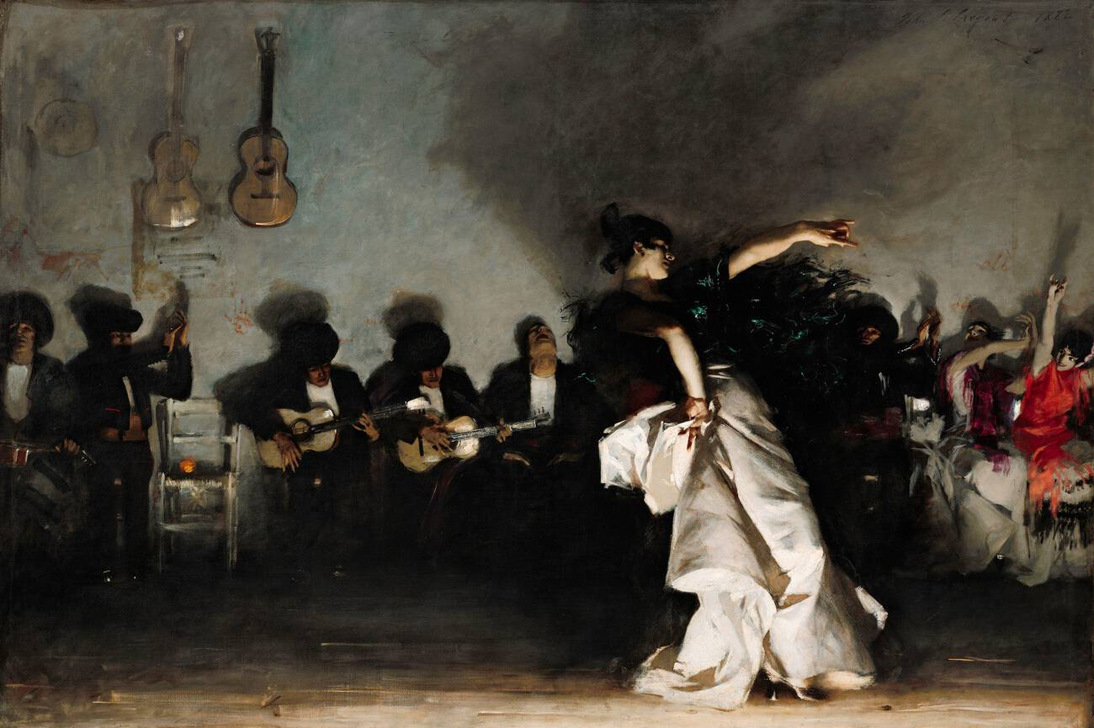
3 | El Jaleo (1882) | John Singer Sargent (1856 - 1925), American Oil on canvas 237 cm x 352 cm Isabella Stewart Gardner Museum, Boston
Visual Arts Slide Deck
Elements of Art
Light and Space
Grade 3

Slide 7
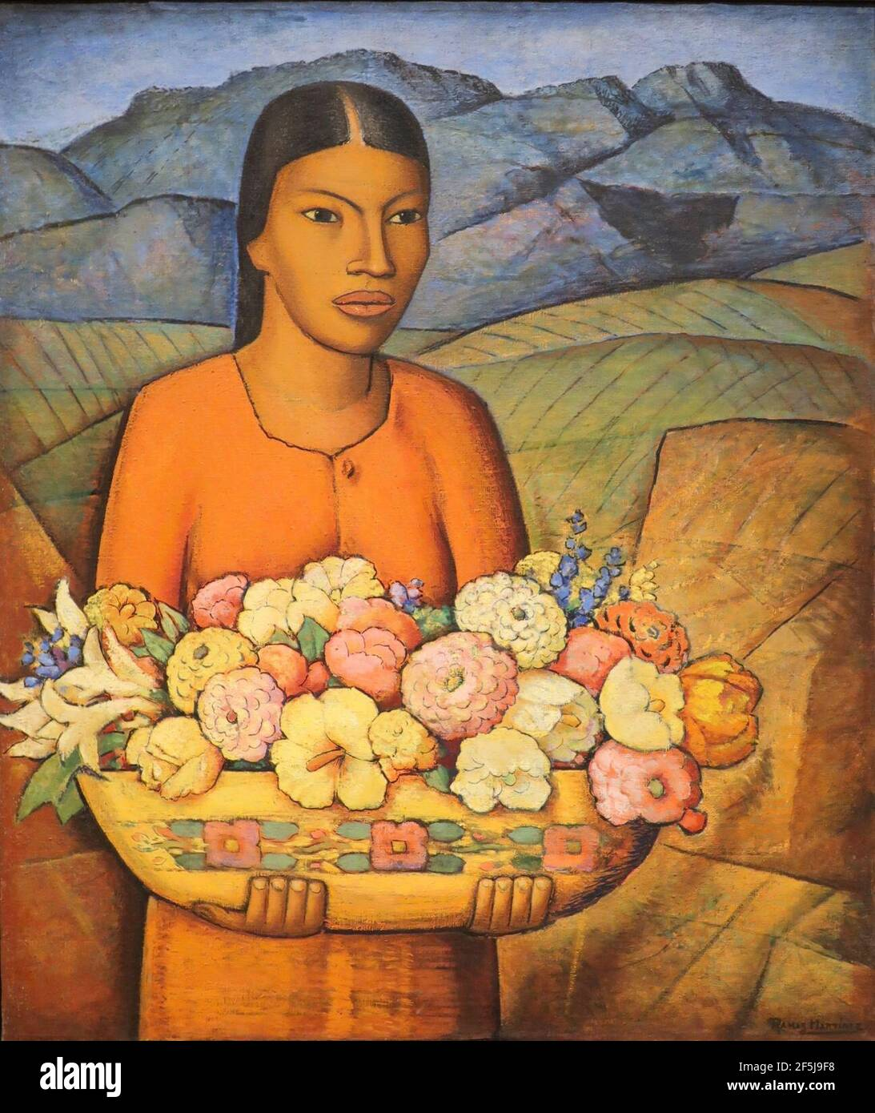
4 | Florida Mexicana (1936) | Alfred Ramos Martinez (1871 - 1946), Mexican Oil on canvas 91.4 cm x 76.2 cm Crystal Bridges Museum of American Art, Bentonville, Arkansas
Visual Arts Slide Deck
Elements of Art
Light and Space
Grade 3

Slide 8
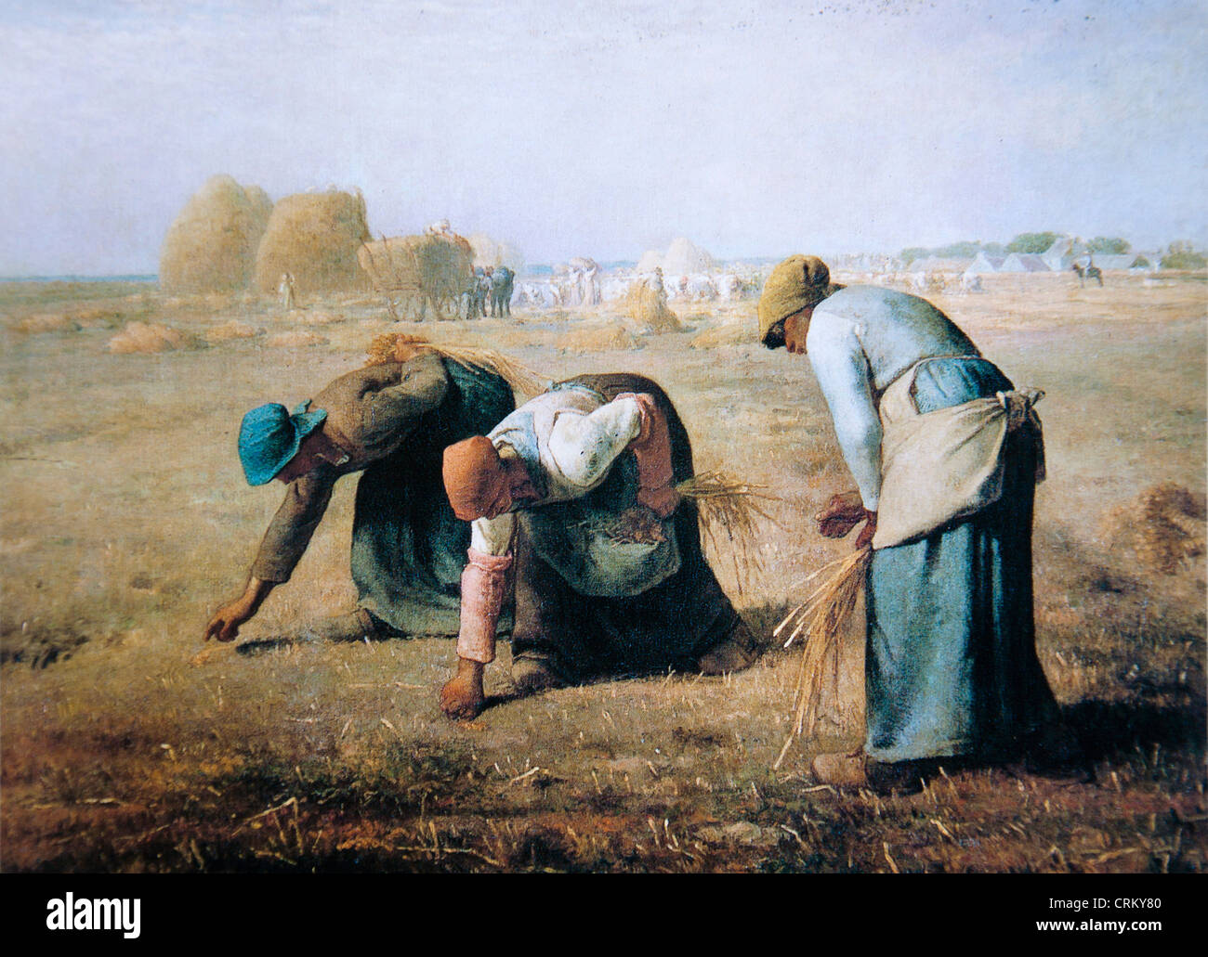
5 | The Gleaners (1857) | Jean Francois Millet (1814 - 1875), French Oil on canvas 83.8 cm × 111.8 cm Musée d'Orsay, Paris
Visual Arts Slide Deck
Elements of Art
Light and Space
Grade 3

Slide 9
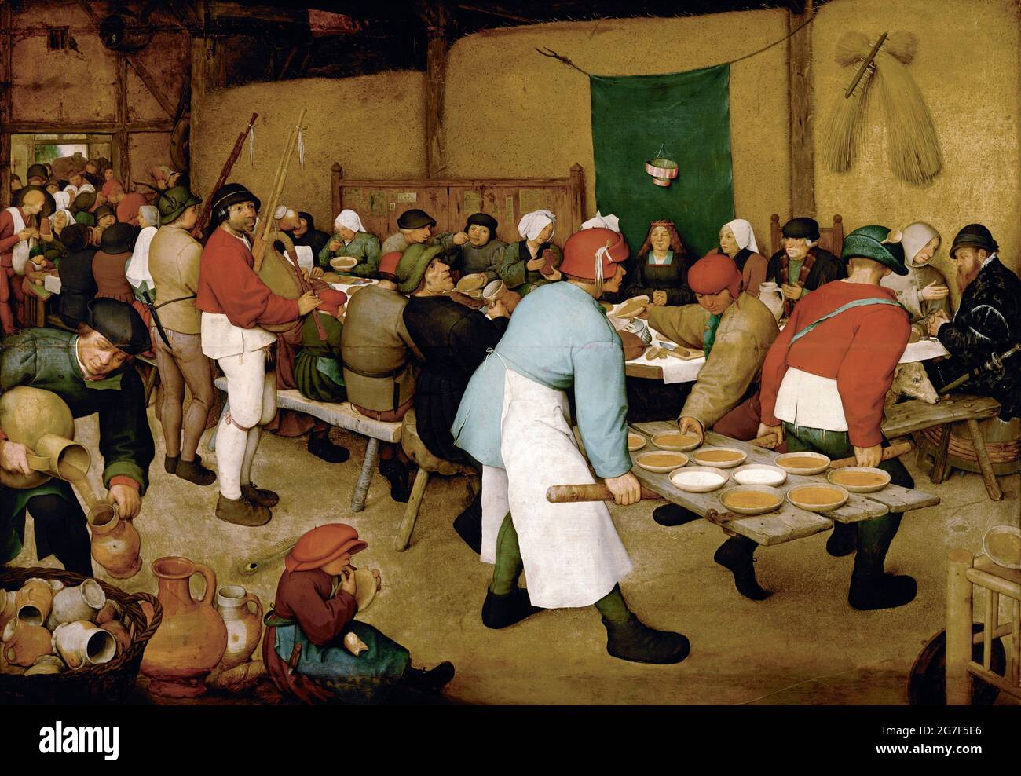
6 | Peasant Wedding (1567) | Pieter Bruegel (1525 - 1569), Dutch Oil on panel 114 cm × 164 cm Vienna, Kunsthistorisches Museum
Visual Arts Slide Deck
Elements of Art
Light and Space
Grade 3

Slide 10
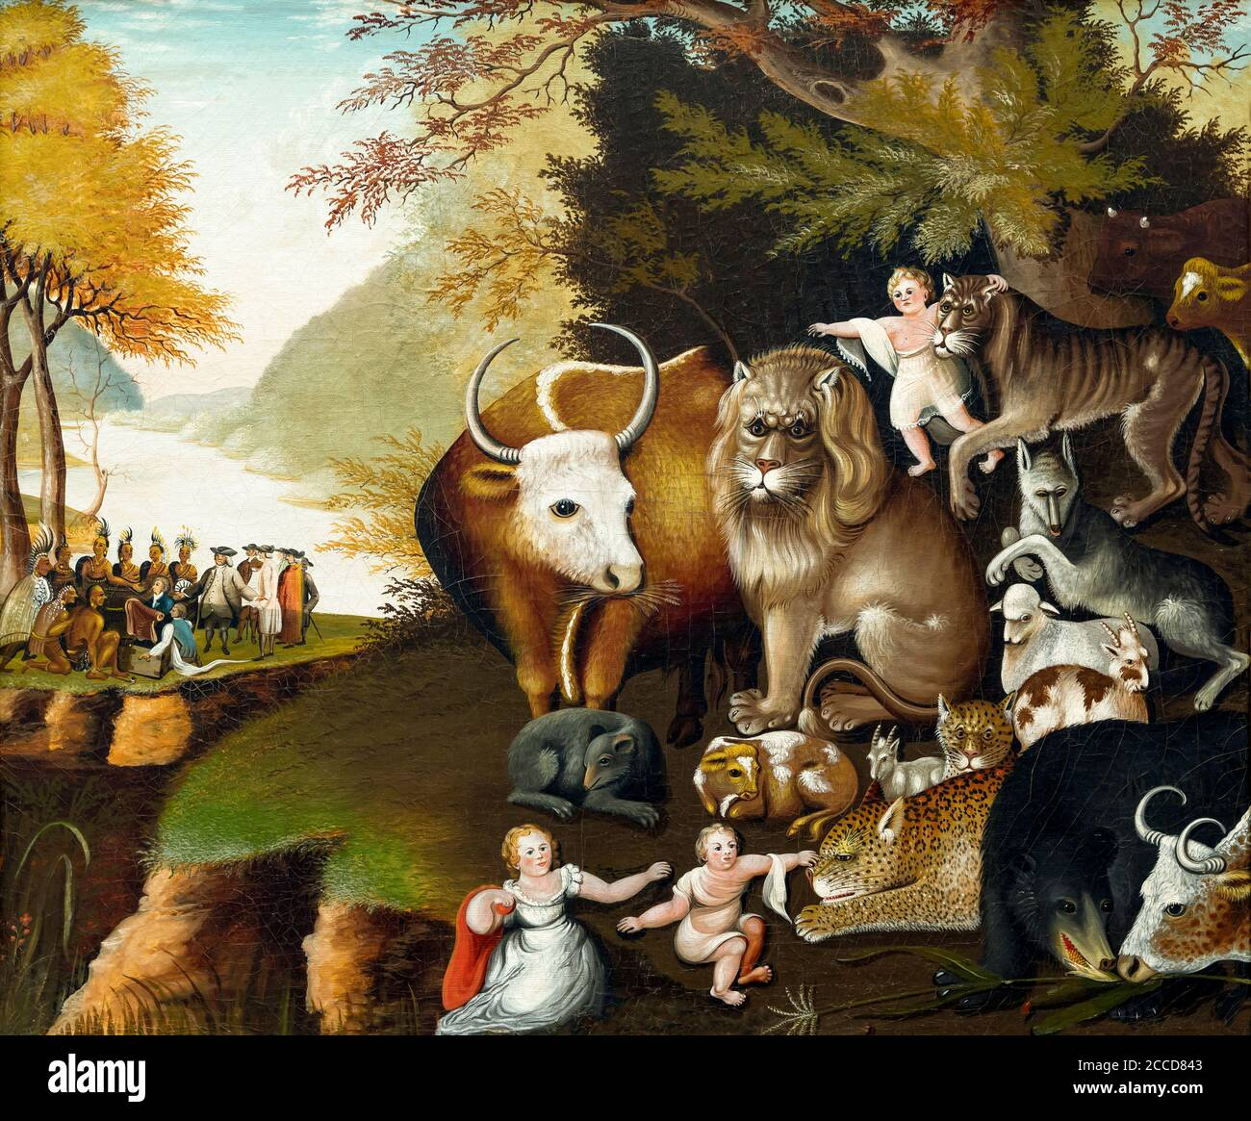
7 | The Peaceable Kingdom (1834) | Edward Hicks (1780 - 1849), American Oil on canvas 74.5 cm x 90.1 cm National Gallery of Art, Washington DC, USA
Visual Arts Slide Deck
Elements of Art
Design and the Elements of Art
Grade 3

Slide 11
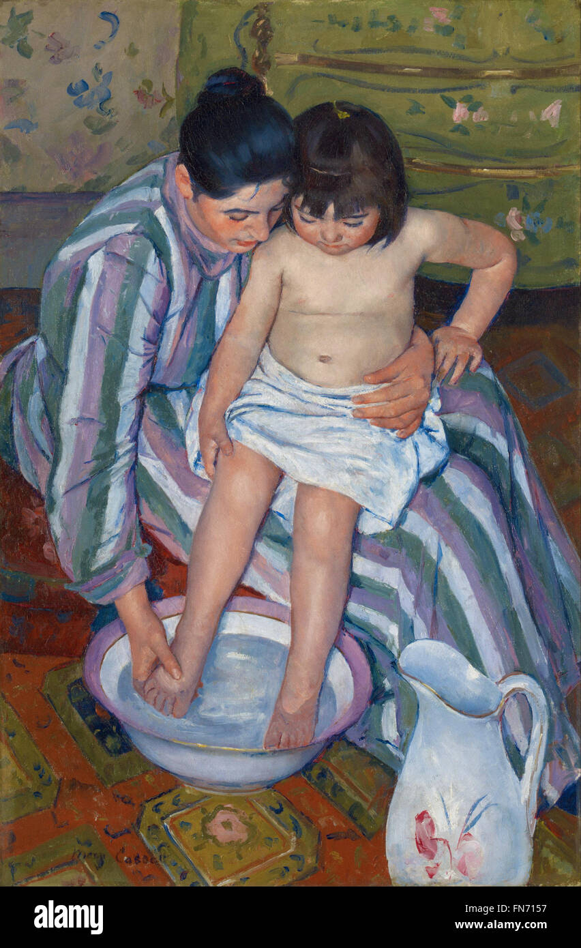
8 | The Child's Bath (1893) | Mary Cassatt (1844 - 1926), American Oil on canvas 100.3 cm x 66.1 cm Art Institute of Chicago, Chicago
Visual Arts Slide Deck
Elements of Art
Design and the Elements of Art
Grade 3

Slide 12
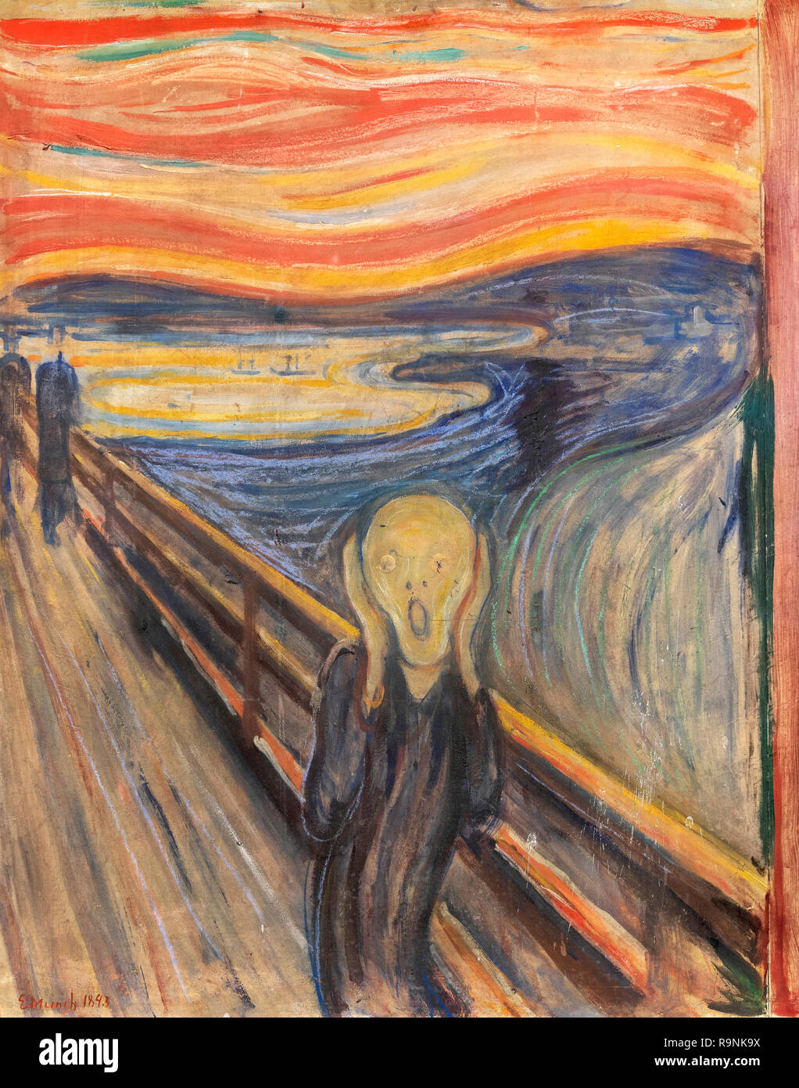
9 | The Scream (1893) | Edvard Munch (1863-1944), Norwegian Oil, tempera, pastel and crayon on cardboard 91 cm x 73.5 cm National Museum and Munch Museum, Oslo, Norway
Visual Arts Slide Deck
Elements of Art
Design and the Elements of Art
Grade 3

Slide 13
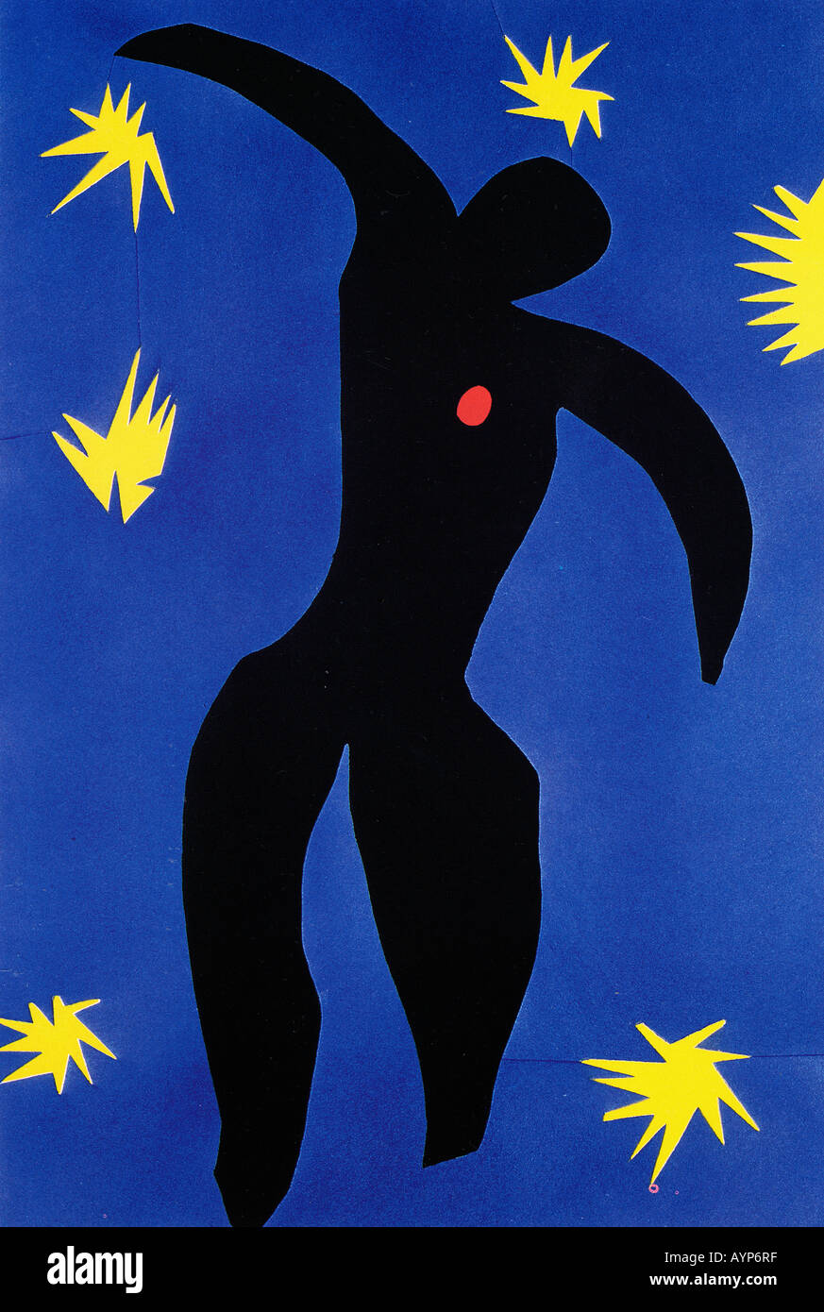
10 | Icarus (1947) | Henri Matisse (1869 - 1954), French Print, Lithograph 42.2 cm x 65.7 cm Museum of Modern Art (MoMA), New York City, U.S.
Visual Arts Slide Deck
Elements of Art
Design and the Elements of Art
Grade 3

Slide 14
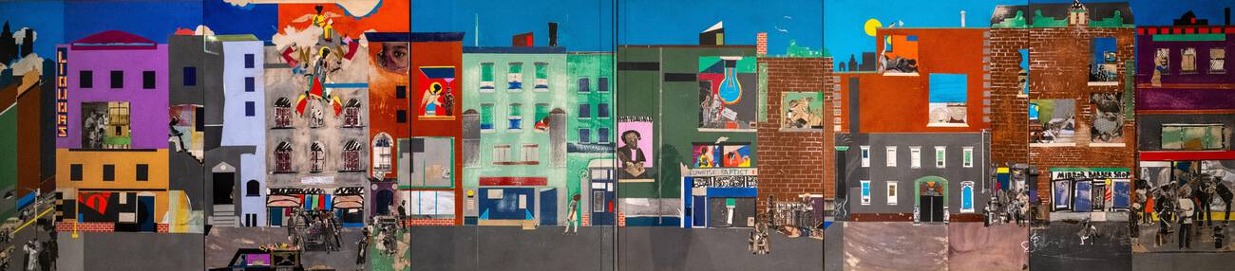
11 | The Block (1971) | Romare Bearden (1911–1988), American Collage of cut and torn printed, colored, painted and metallic papers with graphite, porous-point pen, watercolor, opaque watercolor, and ink on Masonit 121.9 cm x 548.6 cm
Visual Arts Slide Deck
Elements of Art
Design and the Elements of Art
Grade 3

Slide 15
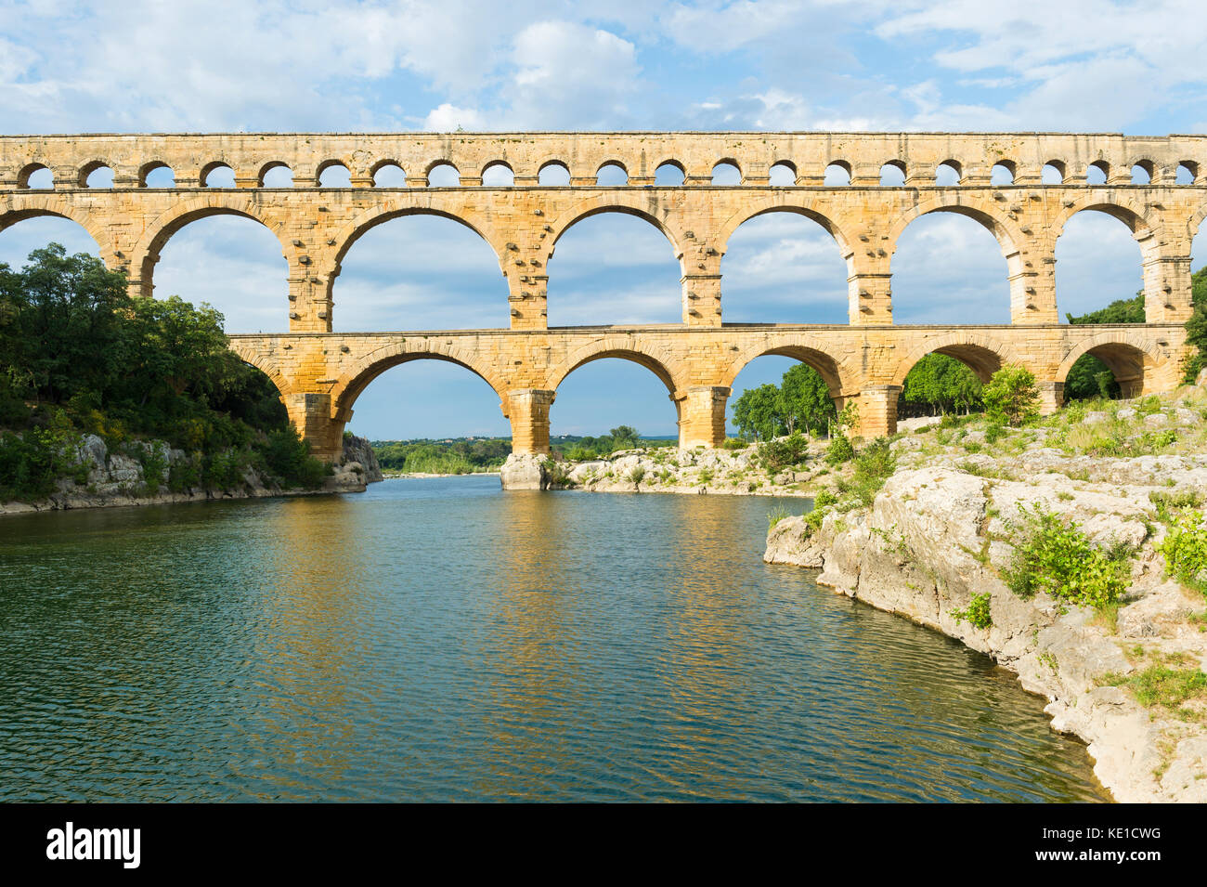
12 | Le Pont du Gard | Languedoc Roussillon region, France, Unesco World Heritage Site
Visual Arts Slide Deck
Art and Architecture
Roman and Byzantine Empires
Grade 3

Slide 16
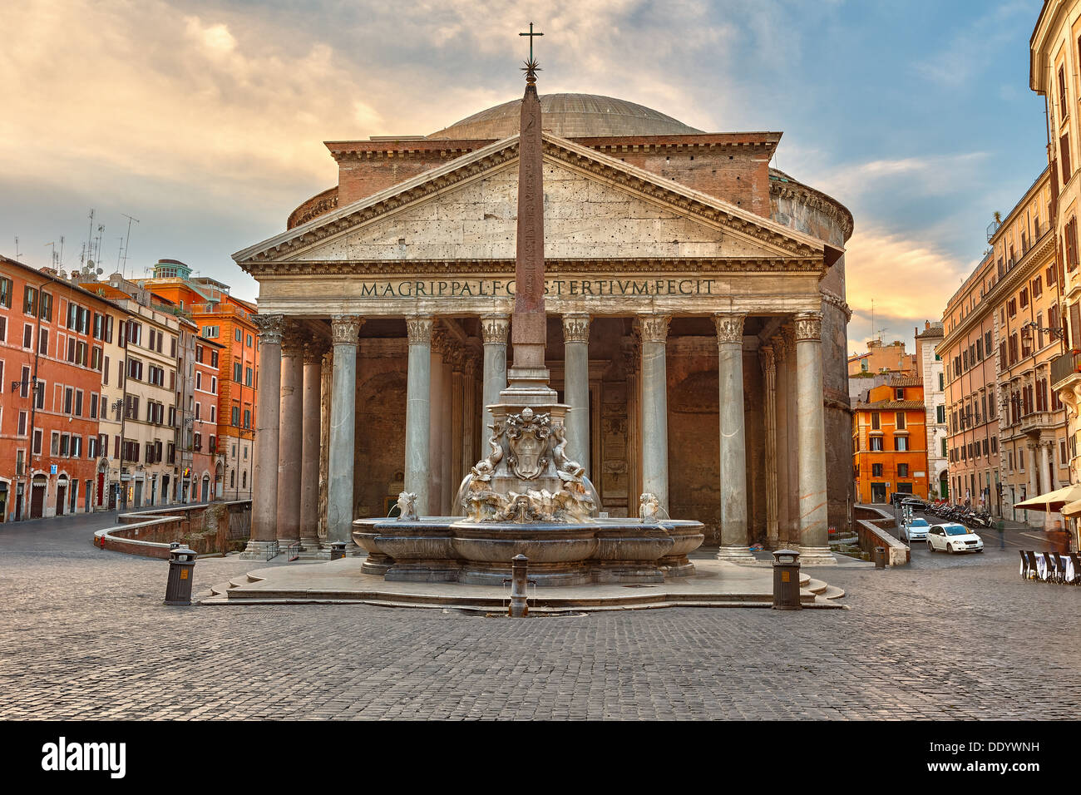
13 | The Pantheon | Rome, Italy
Visual Arts Slide Deck
Art and Architecture
Roman and Byzantine Empires
Grade 3

Slide 17
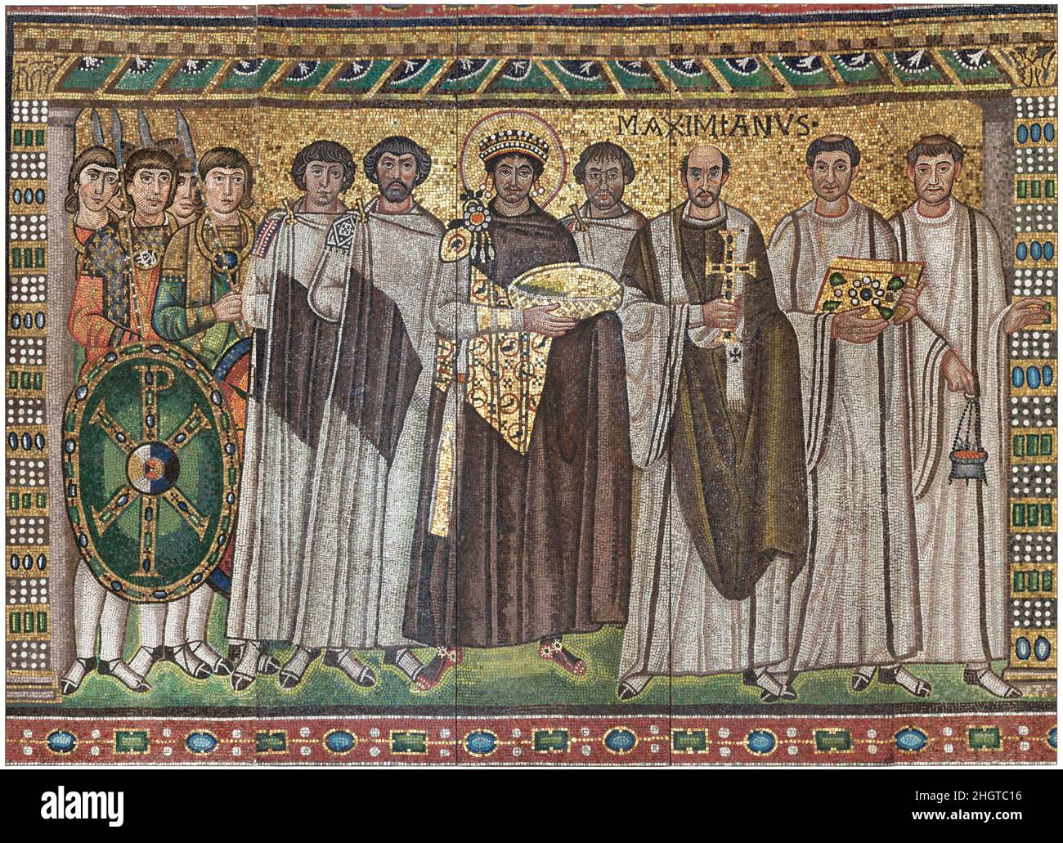
14 | Emperor Justinian and Members of His Court | Emperor Justinian and Members of His Court early 20th century (original dated 6th century) Byzantine. Emperor Justinian and Members of His Court. Byzantine. early 20th century (original dated 6th century). Glass and stone Tesserae. Reproductions-Mosaics
Visual Arts Slide Deck
Art and Architecture
Roman and Byzantine Empires
Grade 3

Slide 18
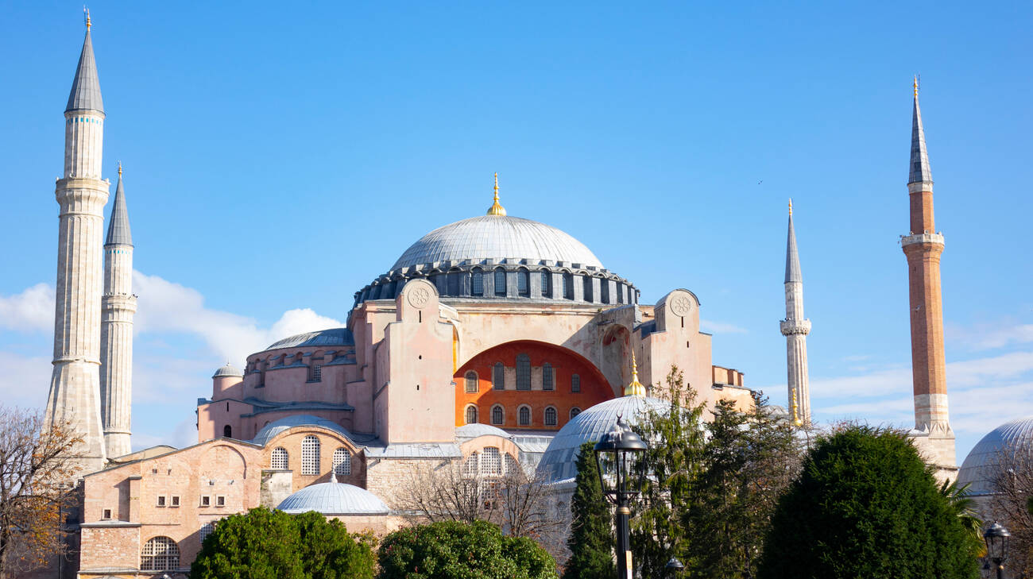
15 | Hagia Sophia | Hagia Sophia domes and minarets in the old town of Istanbul, Turkey
Visual Arts Slide Deck
Art and Architecture
Roman and Byzantine Empires
Grade 3

Slide 19
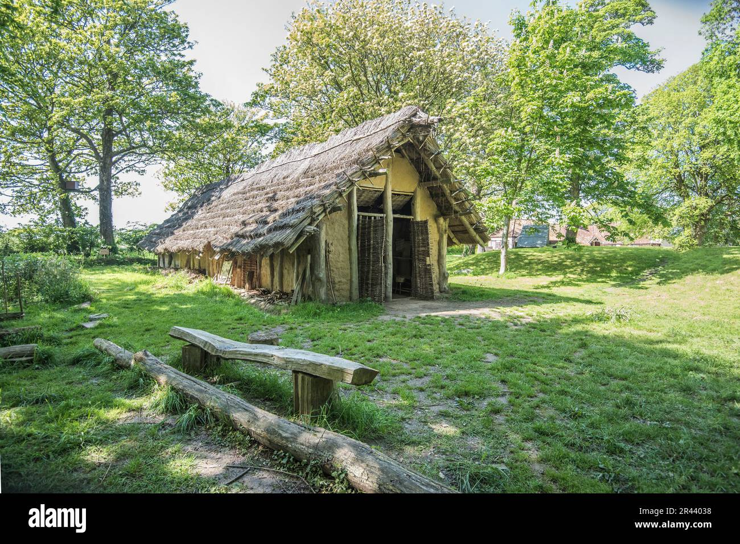
16 | Neolithic Long House | 20-metre long replica of a Neolithic Longhouse at La Hougue Bie, Jersey
Visual Arts Slide Deck
Architecture of the Earliest Peoples
Grade 3

Slide 20
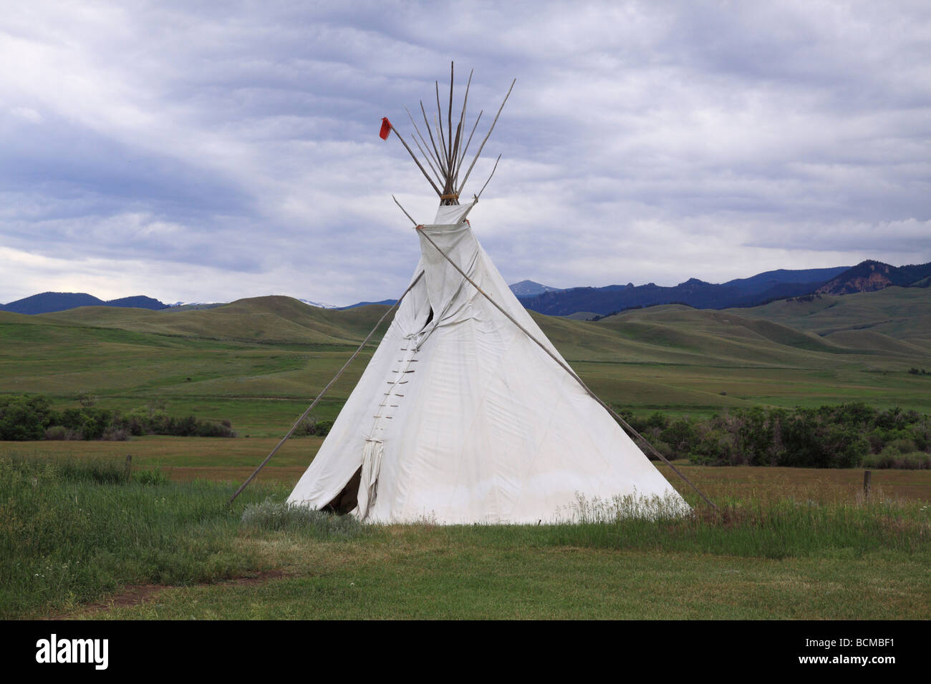
17 | Plains American Tipi | Plains Indian Tepee in the foothills
Visual Arts Slide Deck
Architecture of the Earliest Peoples
Grade 3

Slide 21
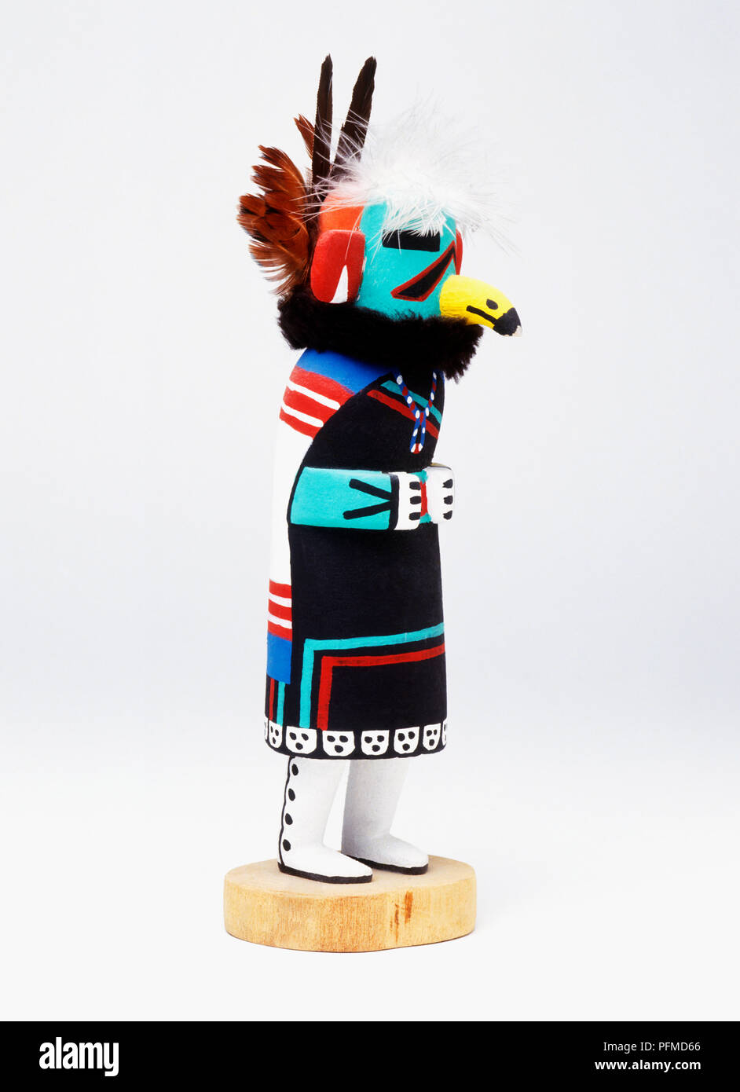
18 | Hopi Kachina doll | A colourfully painted Hopi doll or Kachina
Visual Arts Slide Deck
Native American Art
Grade 3

Slide 22
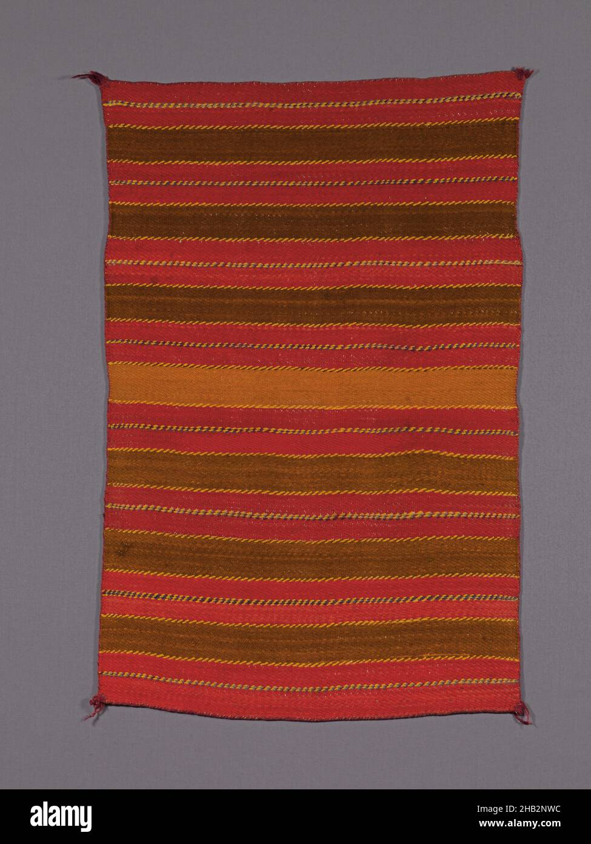
19 | Navajo (Dine) Saddle blanket | 1890, Wool and dye, Southwest, United States, North and Central America, Coverings & hangings, textiles, 48 × 33 in.
Visual Arts Slide Deck
Native American Art
Grade 3

Slide 23
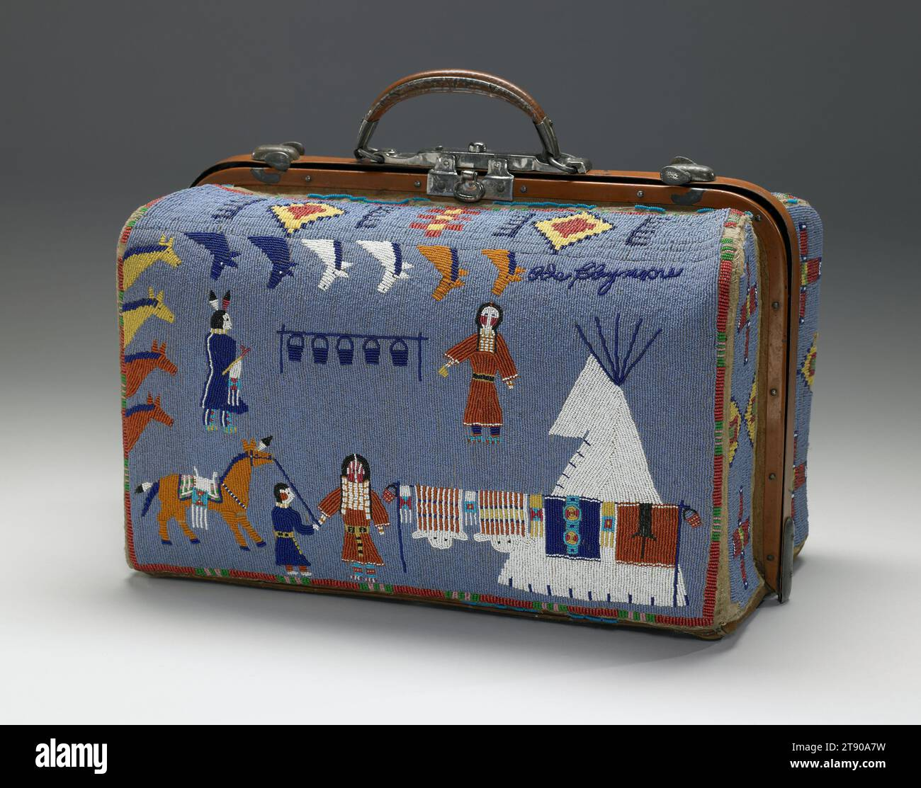
20 | Valise | Nellie Two Bear Gates (1854 – 1935), Native American Iháƞktȟuƞwaƞna Dakhóta, Standing Rock Reservation 31.75 cm x 44.93 cm x 26.04 cm
Visual Arts Slide Deck
Native American Art
Grade 3

Slide 24
Visual Art Cards
Grade 3
Credits
Image 1 | Pictures Now / Alamy Stock Photo
Image 2 | incamerastock / Alamy Stock Photo
Image 3 | GL Archive / Alamy Stock Photo
Image 4 | Eraza Collection / Alamy Stock Photo
Image 5 | PAINTING / Alamy Stock Photo
Image 6 | GL Archive / Alamy Stock Photo
Image 7 | Peaceable Kingdom, c.1834 (oil on canvas) / Hicks, Edward (1780-1849) / American / National Gallery of Art, Washington DC, USA / Bridgeman Images
Image 8 | Archivart / Alamy Stock Photo
Image 9 | Archivart / Alamy Stock Photo
Image 10 | Dennis Hallinan / Alamy Stock Photo
Image 11 | Gina Rodgers / Alamy Stock Photo
Image 12 | Michel & Gabrielle Therin-Weise / Alamy Stock Photo
Image 13 | Sergey Borisov / Alamy Stock Photo
Image 14 | MET/BOT / Alamy Stock Photo
Image 15 | batuhan toker / Alamy Stock Photo
Image 16 | Malcolm Walker / Alamy Stock Photo
Image 17 | KRCrowley / Alamy Stock Photo
Image 18 | Dorling Kindersley ltd / Alamy Stock Photo
Image 19 | Penta Springs Limited / Alamy Stock Photo
Image 20 | Penta Springs Limited / Alamy Stock Photo

