Slide 1



Music Slide Deck
Grade 7

Slide 2

Music Slide Deck
Grade 7
This work is licensed under a Creative Commons Attribution-NonCommercial-ShareAlike 4.0 International License.
You are free:
to Share—to copy, distribute, and transmit the work to Remix—to adapt the work
Under the following conditions:
Attribution—You must attribute the work in the following manner:
This work is based on an original work of the Core Knowledge® Foundation (www.coreknowledge.org) and the additions from the Louisiana Department of Education, made available through licensing under a Creative Commons Attribution-NonCommercial-ShareAlike4.0 International License. This does not in any way imply that the Core Knowledge Foundation or the Louisiana Department of Education endorses this work.
Noncommercial—You may not use this work for commercial purposes.
Share Alike—If you alter, transform, or build upon this work, you may distribute the resulting work only under the same or similar license to this one.
With the understanding that:
For any reuse or distribution, you must make clear to others the license terms of this work. The best way to do this is with a link to this web page:
https://creativecommons.org/licenses/by-nc-sa/4.0/
Copyright © 2025 Core Knowledge Foundation
www.coreknowledge.org
All Rights Reserved.
Core Knowledge©, Core Knowledge Curriculum Series™, Core Knowledge Arts™, Core Knowledge Music™ are trademarks are trademarks of the Core Knowledge Foundation. Foundations of Freedom is a trademark of the Louisiana Department of Education.
Trademarks and trade names are shown in this book strictly for illustrative and educational purposes and are the property of their respective owners. References herein should not be regarded as affecting the validity of said trademarks and trade names.
ISBN: 979-8-88970-662-5

Slide 3

Content
Music Slide Deck
Grade 7
I. Elements of Music
1 | Orchestra Seating Positions
2 | Rhythm Tree Note Durations
3 | Rhythm Tree Rest Durations
4 | Reading Tied and Dotted Notes
5 | Types of Chords
6 | Dynamic Markings
7 | Repeating Measures
II. Romantic Period Music
III. Music of Norway, Russia, and Mexico
IV. Blues
V. Jazz

Slide 4
1 | Orchestra Seating Positions
Music Slide Deck
Elements of Music
Grade 7

Slide 5
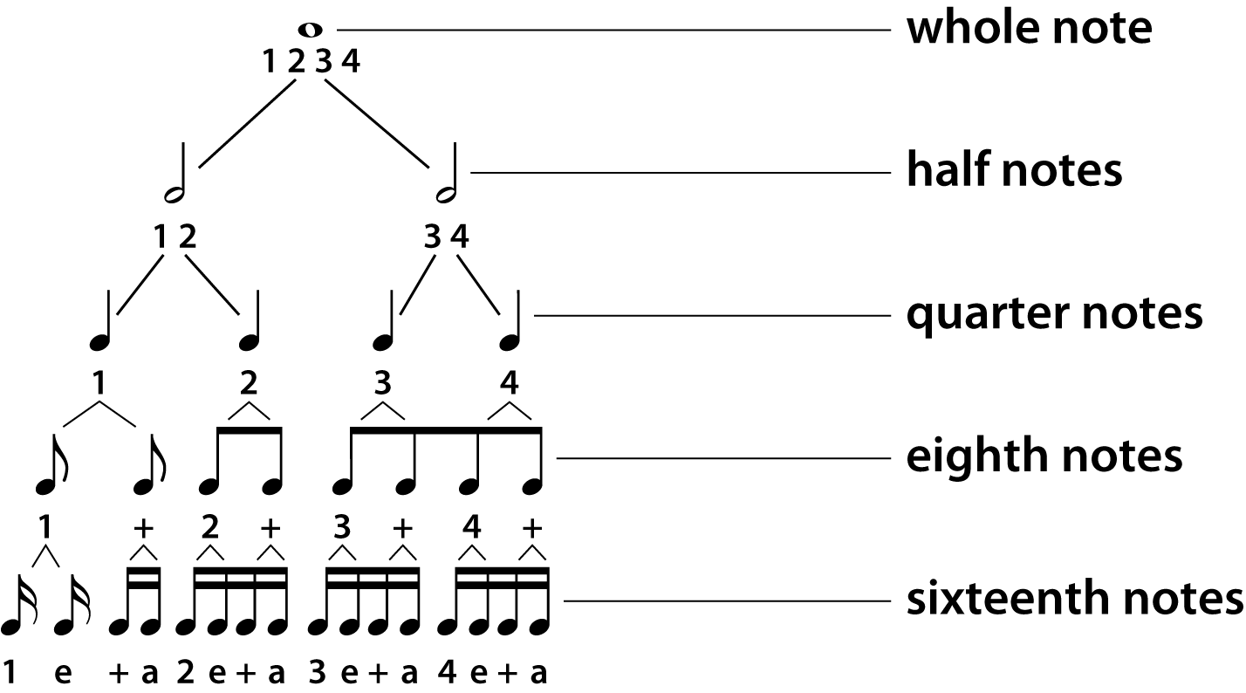
2 | Rhythm Tree Note Durations
Music Slide Deck
Elements of Music
Grade 7

Slide 6
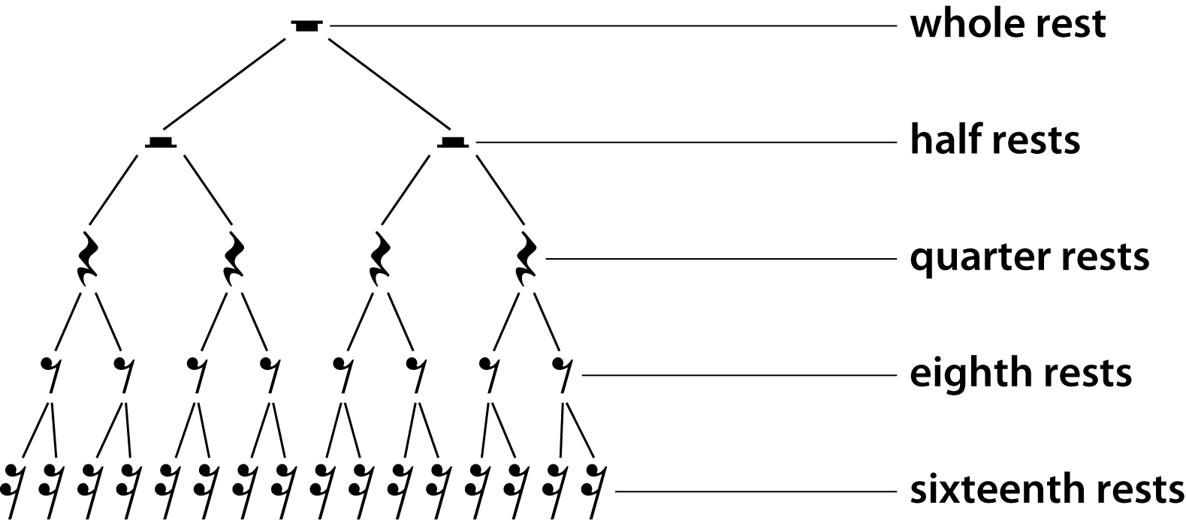
3 | Rhythm Tree Rest Durations
Music Slide Deck
Elements of Music
Grade 7

Slide 7
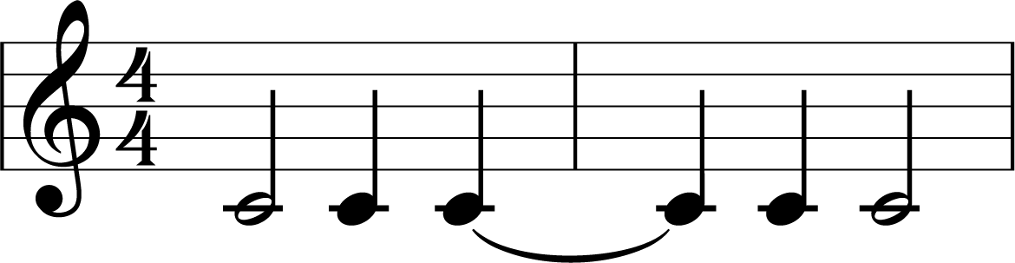
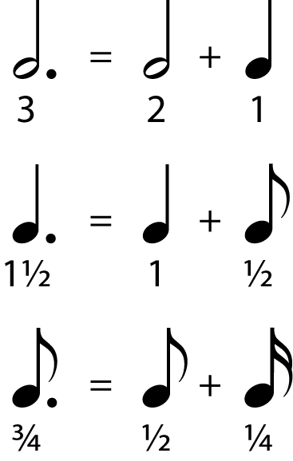
4 | Reading Tied and Dotted Notes
Tied notes connect the values of notes of the same pitch, using a curved line, or tie.
Dotted notes add half the value of a note to the note that is dotted.
Music Slide Deck
Elements of Music
Grade 7

Slide 8
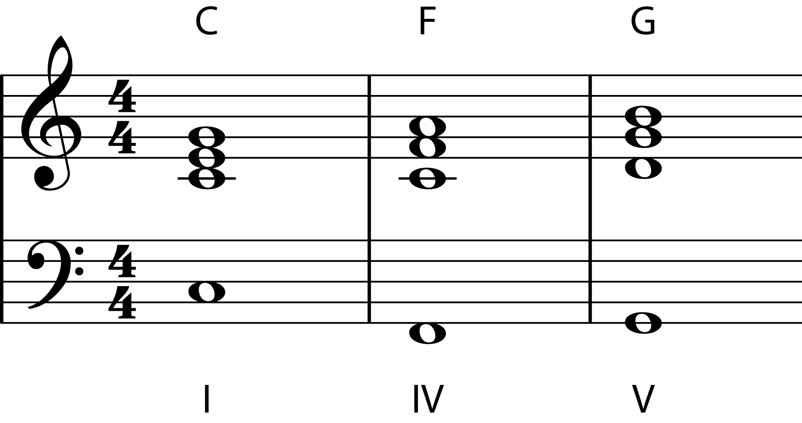
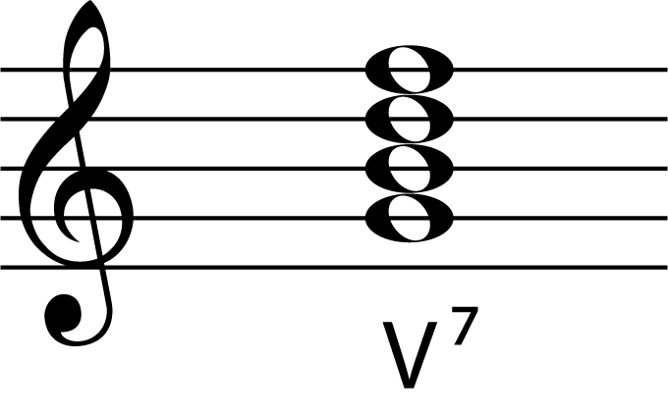
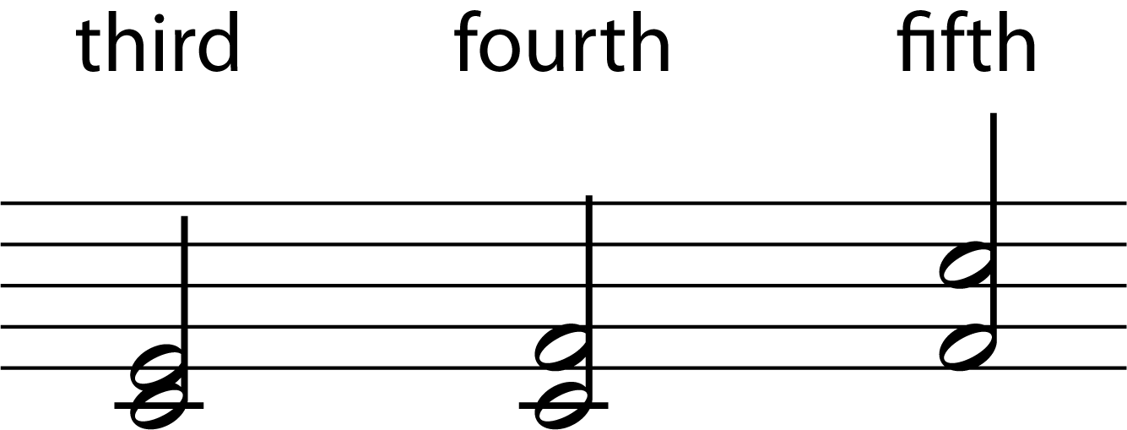
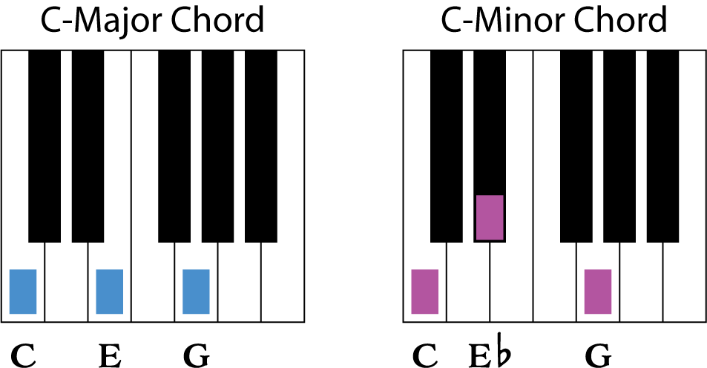
5 | Types of Chords
A chord is a group of notes played simultaneously. A I (tonic) chord, IV (subdominant) chord, and V (dominant) chord are shown below. A V7 chord has an added seventh note.
Intervals are named by the number of scale degrees they span, with third, fourth, and fifth being the most common.
Major chords generally sound bright and happy, while minor chords generally sound darker and sadder.
Music Slide Deck
Elements of Music
Grade 7

Slide 9
6 | Dynamic Markings
Composers use various dynamics markings to indicate how sheet music should be played. ​
• forte = loud​
• piano = soft​
• mezzo = medium
pp | p | mp | mf | f | ff
Very soft | Soft | Medium soft | Medium-loud | Loud | Very loud
Pianissimo | Piano | Mezzo piano | Mezzo forte | Forte | Fortissimo
crescendo (cresc.) gradual increase in volume
decrescendo (decresc.) gradual decrease in volume
Music Slide Deck
Elements of Music
Grade 7

Slide 10
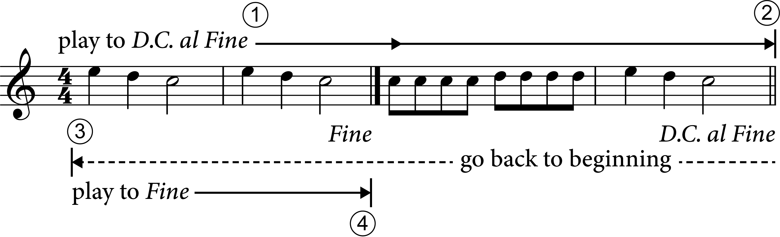
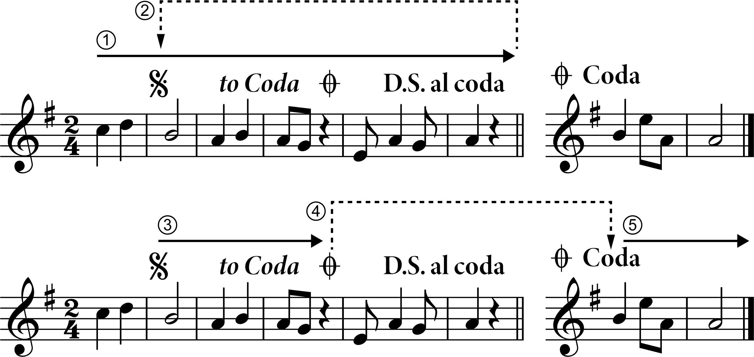
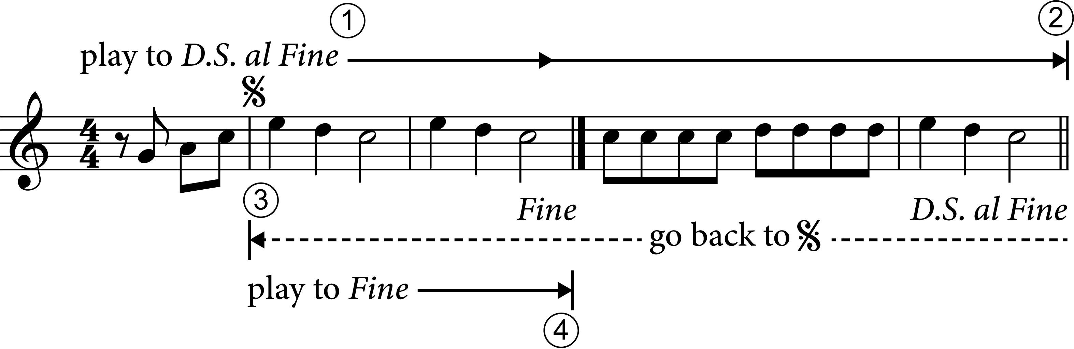
7 | Repeating Measures
D.C. al fine (da capo al fine)
D.S. al coda (dal segno al coda
D.S. al fine (dal segno al fine)
Music Slide Deck
Elements of Music
Grade 7

Slide 11
Music Cards
Credits
Grade 7
ElenaBs / Alamy Stock Photo: 4

