Slide 1



Music Slide Deck
Grade 6

Slide 2

Music Slide Deck
Grade 6
This work is licensed under a Creative Commons Attribution-NonCommercial-ShareAlike 4.0 International License.
You are free:
to Share—to copy, distribute, and transmit the work to Remix—to adapt the work
Under the following conditions:
Attribution—You must attribute the work in the following manner:
This work is based on an original work of the Core Knowledge® Foundation (www.coreknowledge.org) and the additions from the Louisiana
Department of Education, made available through licensing under a Creative Commons Attribution-NonCommercial-ShareAlike4.0 International License. This does not in any way imply that the Core Knowledge Foundation or the Louisiana Department of Education endorses this work.
Noncommercial—You may not use this work for commercial purposes.
Share Alike—If you alter, transform, or build upon this work, you may distribute the resulting work only under the same or similar license to this one.
With the understanding that:
For any reuse or distribution, you must make clear to others the license terms of this work. The best way to do this is with a link to this web page:
https://creativecommons.org/licenses/by-nc-sa/4.0/
Copyright © 2025 Core Knowledge Foundation
www.coreknowledge.org
All Rights Reserved.
Core Knowledge©, Core Knowledge Curriculum Series™, Core Knowledge Arts™, Core Knowledge Music™ are trademarks are trademarks of the Core Knowledge Foundation. Foundations of Freedom is a trademark of the Louisiana Department of Education.
Trademarks and trade names are shown in this book strictly for illustrative and educational purposes and are the property of their respective owners. References herein should not be regarded as affecting the validity of said trademarks and trade names.
ISBN: 979-8-88970-661-8

Slide 3

Content
Music Slide Deck
Grade 6
I. Elements of Music
1 | Reading Rhythms
2 | Notation Review
3 | Dynamic Markings
4 | Major and Minor Triads
5 | Repeat Signs and Markings
II. Expression Through Song
6 | Empowering Music
7 | The Power of Music to Heal
III. Baroque Music
IV. Classical Music
V. Romantic Composers

Slide 4
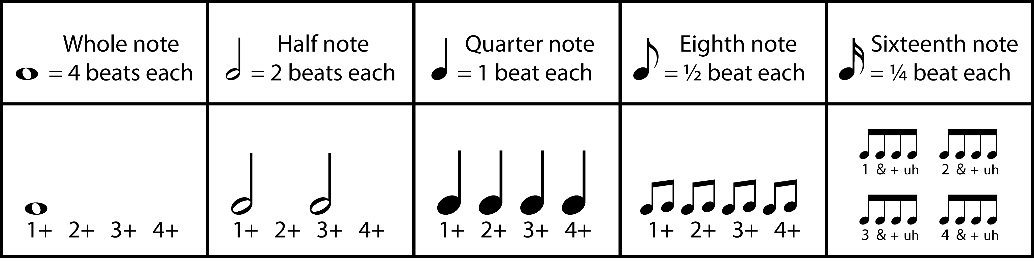
1 | Reading Rhythms
Music Slide Deck
Elements of Music
Grade 6

Slide 5
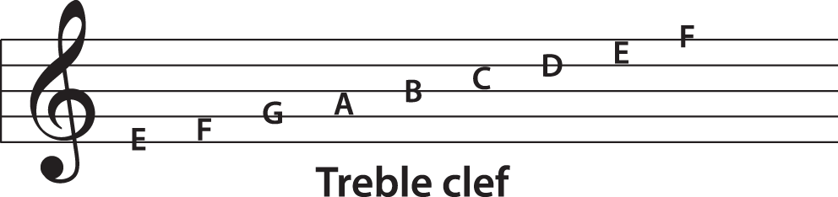
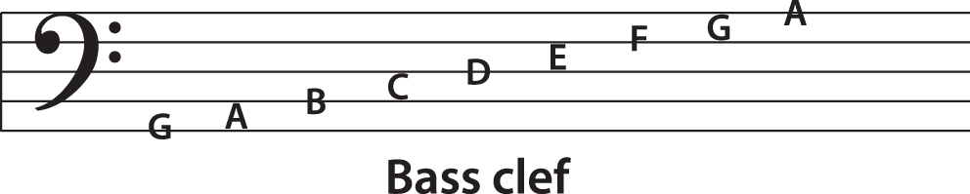
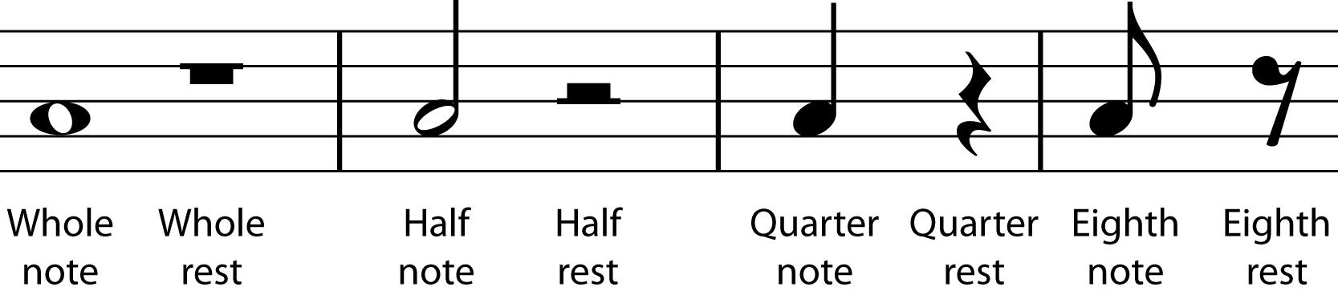
2 | Notation Review
Musical Notation Clefs, such as the treble clef and the bass clef, indicate the range of notes appearing on a staff.
Rests show when silences should occur when music is being played. Rests and notes have matching values.
Tied Notes connect the values of two neighboring notes of the same pitch using a curved line. | Dotted Notes use dots to add a half value to the note being dotted.
Music Slide Deck
Elements of Music
Grade 6

Slide 6
3 | Dynamic Markings
Composers use various dynamics markings to indicate how sheet music should be played. ​
• forte = loud​
• piano = soft​
• mezzo = medium
pp​ | p​ | mp​ | mf​ | f​ | ff​
Very soft​ | Soft​ | Medium soft​ | Medium loud​ | Loud​ | Very loud​
Pianissimo​ | Piano​ | Mezzo piano​ | Mezzo forte​ | Forte​ | Fortissimo​
crescendo
gradual increase in volume
decrescendo
gradual decrease in volume
Music Slide Deck
Elements of Music
Grade 6

Slide 7
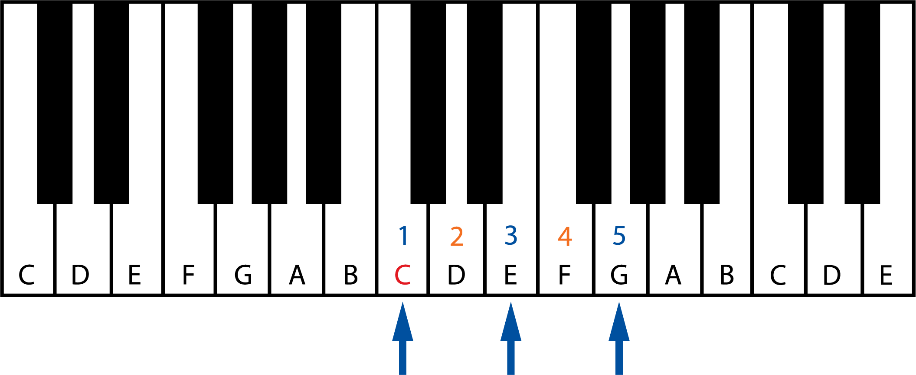
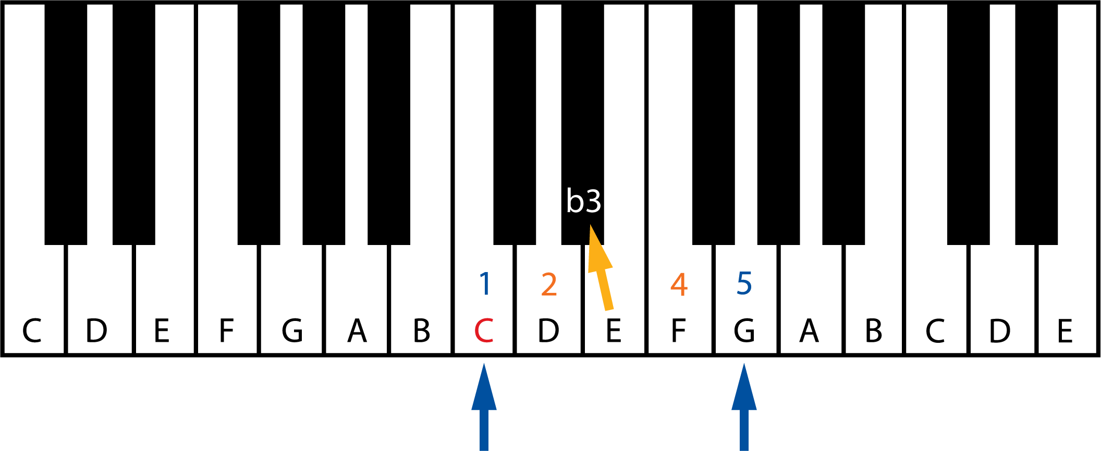
4 | Major and Minor Triads
Major Triad
Minor Triad
Music Slide Deck
Elements of Music
Grade 6

Slide 8
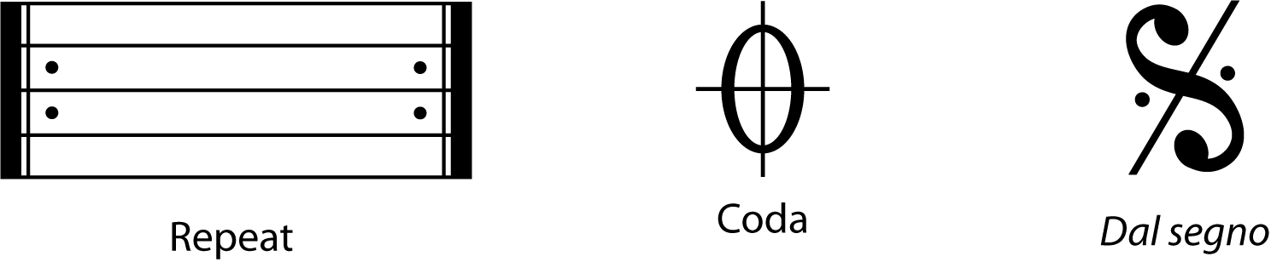
5 | Repeat Signs and Markings
Musical term | Meaning
repeat | Play section again
coda | The end of a section
Dal segno [D.S.] | Go to the sign
Da capo [D.C.] | Go back to the beginning
al fine | Play to the end
al coda | Play to the coda
Music Slide Deck
Elements of Music
Grade 6

Slide 9
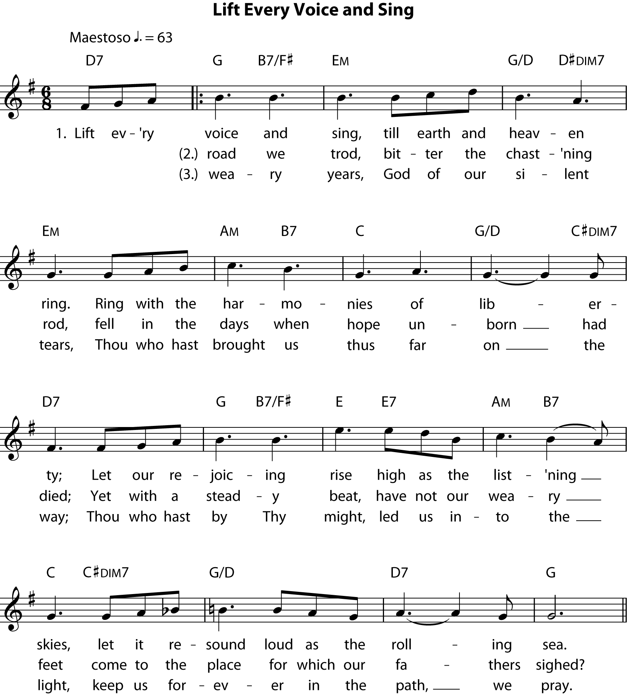
6 | Empowering Music
Music Slide Deck
Expression Through Song
Grade 6

Slide 10
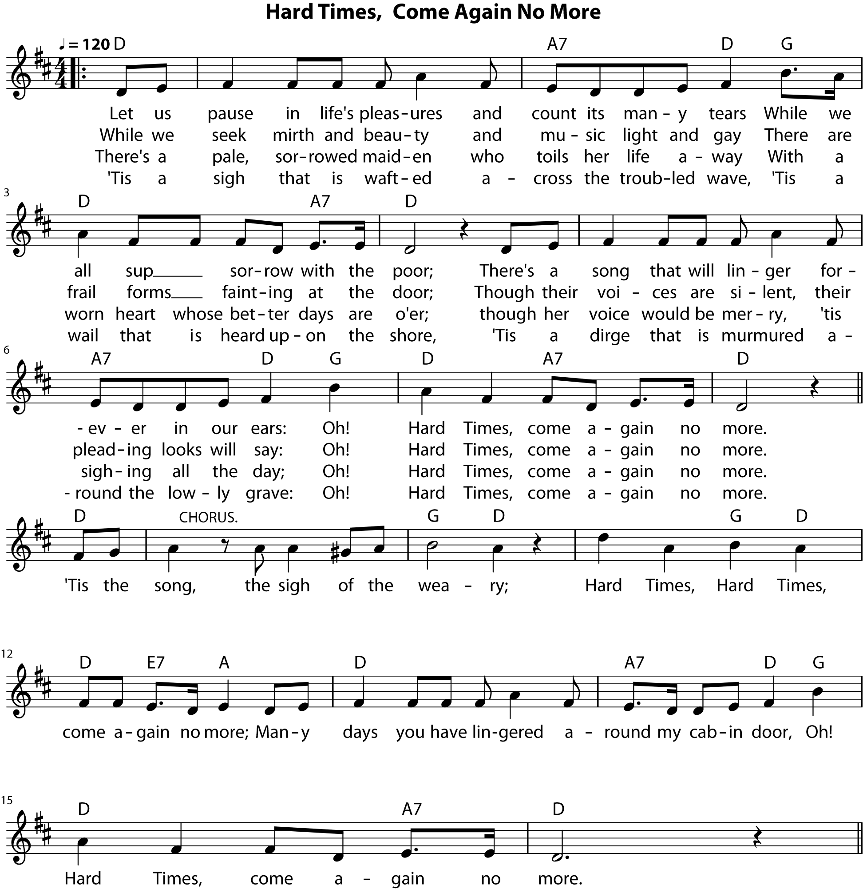
7 | The Power of Music to Heal
Music Slide Deck
Expression Through Song
Grade 6

