Slide 1



Visual Arts Slide Deck
Grade 2

Slide 2

Visual Arts Cards
Grade 2
This work is licensed under a Creative Commons Attribution-NonCommercial-ShareAlike 4.0 International License.
You are free:
to Share—to copy, distribute, and transmit the work to Remix—to adapt the work
Under the following conditions:
Attribution—You must attribute the work in the following manner:
This work is based on an original work of the Core Knowledge® Foundation (www.coreknowledge.org) and the additions from the Louisiana Department of Education, made available through licensing under a Creative Commons Attribution-NonCommercial-ShareAlike4.0 International License. This does not in any way imply that the Core Knowledge Foundation or the Louisiana Department of Education endorses this work.
Noncommercial—You may not use this work for commercial purposes.
Share Alike—If you alter, transform, or build upon this work, you may distribute the resulting work only under the same or similar license to this one.
With the understanding that:
For any reuse or distribution, you must make clear to others the license terms of this work. The best way to do this is with a link to this web page:
https://creativecommons.org/licenses/by-nc-sa/4.0/
Copyright © 2025 Core Knowledge Foundation
www.coreknowledge.org
All Rights Reserved.
Core Knowledge©, Core Knowledge Curriculum Series™, Core Knowledge Visual Arts™, Core Knowledge Music™ are trademarks are trademarks of the Core Knowledge Foundation. Foundations of Freedom is a trademark of the Louisiana Department of Education.
Trademarks and trade names are shown in this book strictly for illustrative and educational purposes and are the property of their respective owners. References herein should not be regarded as affecting the validity of said trademarks and trade names.
ISBN: 979-8-88970-644-1

Slide 3
Content
Visual Arts Cards
Grade 2
I. Elements of Art
1 | Mother and Child, Pablo Picasso
2 | The Great Wave off Kanagawa, Katsusika Hokusai
II. Sculpture
3 | Flying Horse of Gansu, (Ancient China)
4 | The Thinker, Auguste Rodin
III. Landscape
5 | View from Mount Holyoke, Northampton, MA after a Thunderstorm, Thomas Cole
6 | View of Toldeo, El Greco
7 | Virgin Forest at Sunset, Henri Rousseau
8 | The Starry Night, Van Gogh
9 | Baptism, Clementine Hunter
IV. Abstract Art
10 | Young Hare, Albrecht Durer
11 | Cat and Bird, Paul Klee
12 | Bull's Head, Pablo Picasso
13 | Bird in Space, Constantin Brancusi
14 | Passenger Pigeon, John James Audubon
15 | I and the Village, Marc Chagall
V. Architecture
16 | The Parthenon
17 | Great Stupa
18 | Lakshmana Temple
19 | Katsura Palace

Slide 4
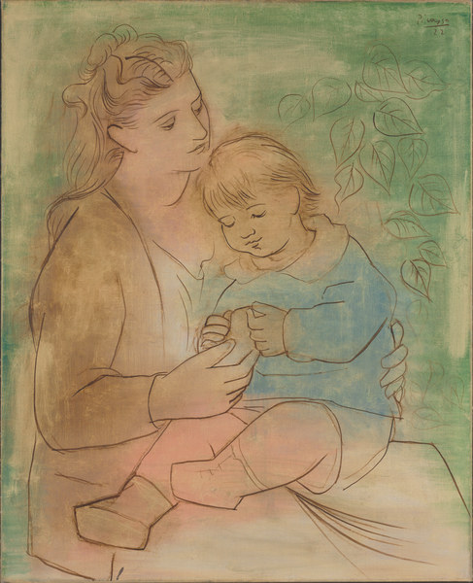
1 | Mother and Child (1922) | Pablo Picasso (1881 - 1973), Spanish Oil on canvas 100.3 cm x81.4 cm Baltimore Museum of Art, Maryland, USA
Visual Arts Slide Deck
Elements of Art
Grade 2

Slide 5
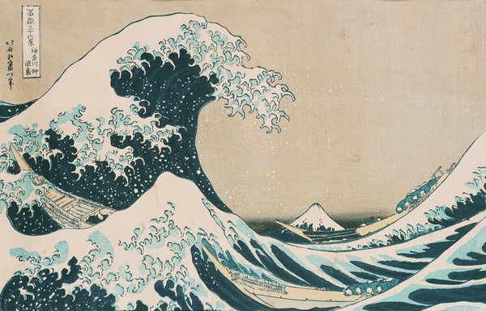
2 | The Great Wave off Kanagawa (1830-31) | Katsusika Hokusai (1760 - 1849), Japanese woodblock print 26 cm x 28 cm Private Collection
Visual Arts Slide Deck
Elements of Art
Grade 2

Slide 6
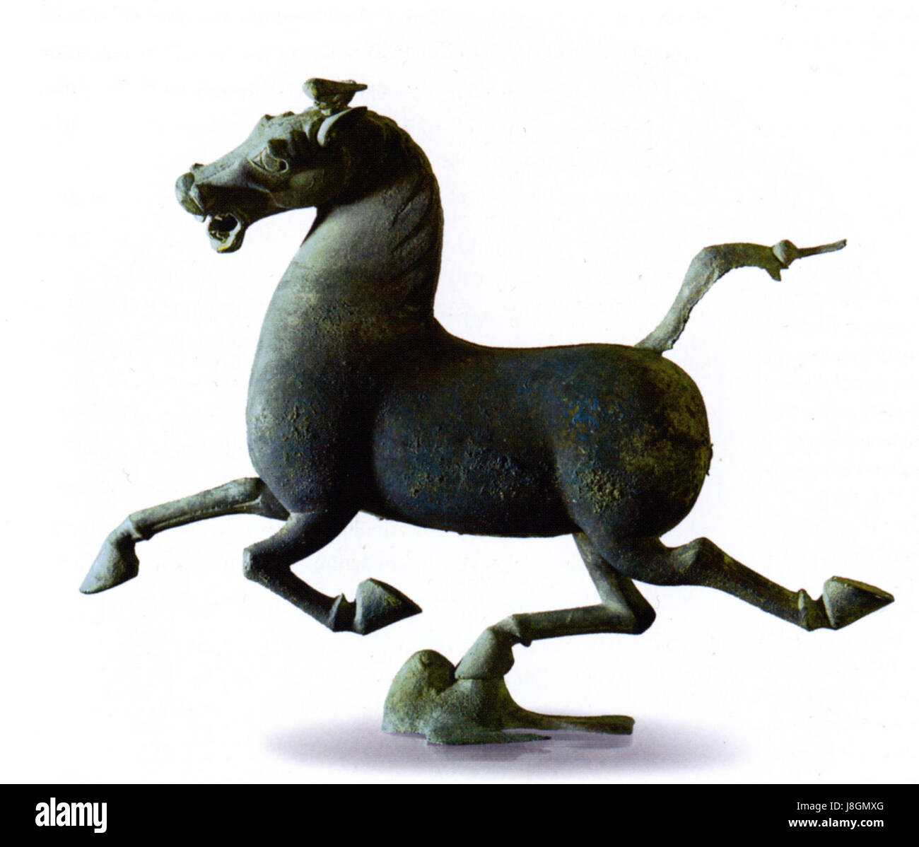
3 | Flying Horse of Gansu | Discovered in 1969 near the city of Wuwei, in the province of Gansu 34.5 cm in height, 45 cm in length, and 13.1 cm in width Gansu Provincial Museum, Lanzhou
Visual Arts Slide Deck
Sculpture
Grade 2

Slide 7
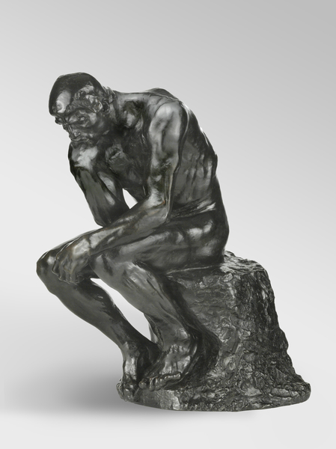
4 | The Thinker (1880 – 81) | Auguste Rodin (1840 – 1917), French Bronze 68.9 cm x 40 cm x 50.2 cm Philadelphia Museum of Art, Pennsylvania, PA, USA
Visual Arts Slide Deck
Sculpture
Grade 2

Slide 8
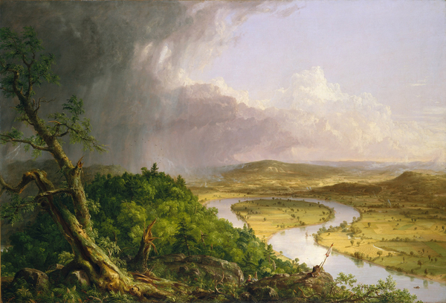
5 | View from Mount Holyoke, Northampton, MA after a Thunderstorm (1937) | Thomas Cole (1801 - 1848), American Oil on canvas 130.8 cm x 193 cm Metropolitan Museum of Art, New York, USA
Visual Arts Slide Deck
Landscapes
Grade 2

Slide 9
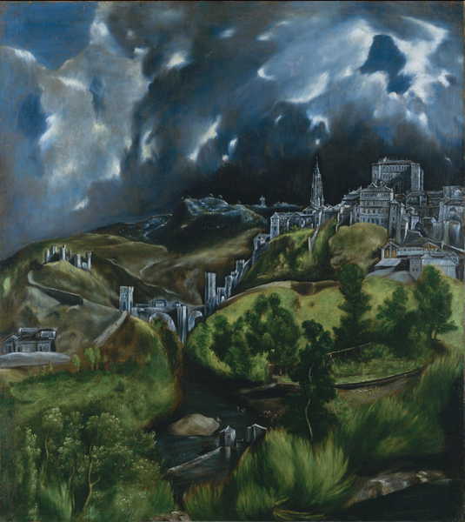
6 | View of Toledo (1597 – 99) | El Greco (1541 - 1614), Greek Oil on canvas 121.2 cm x 108.5 cm Metropolitan Museum of Art, New York, USA
Visual Arts Slide Deck
Landscapes
Grade 2

Slide 10
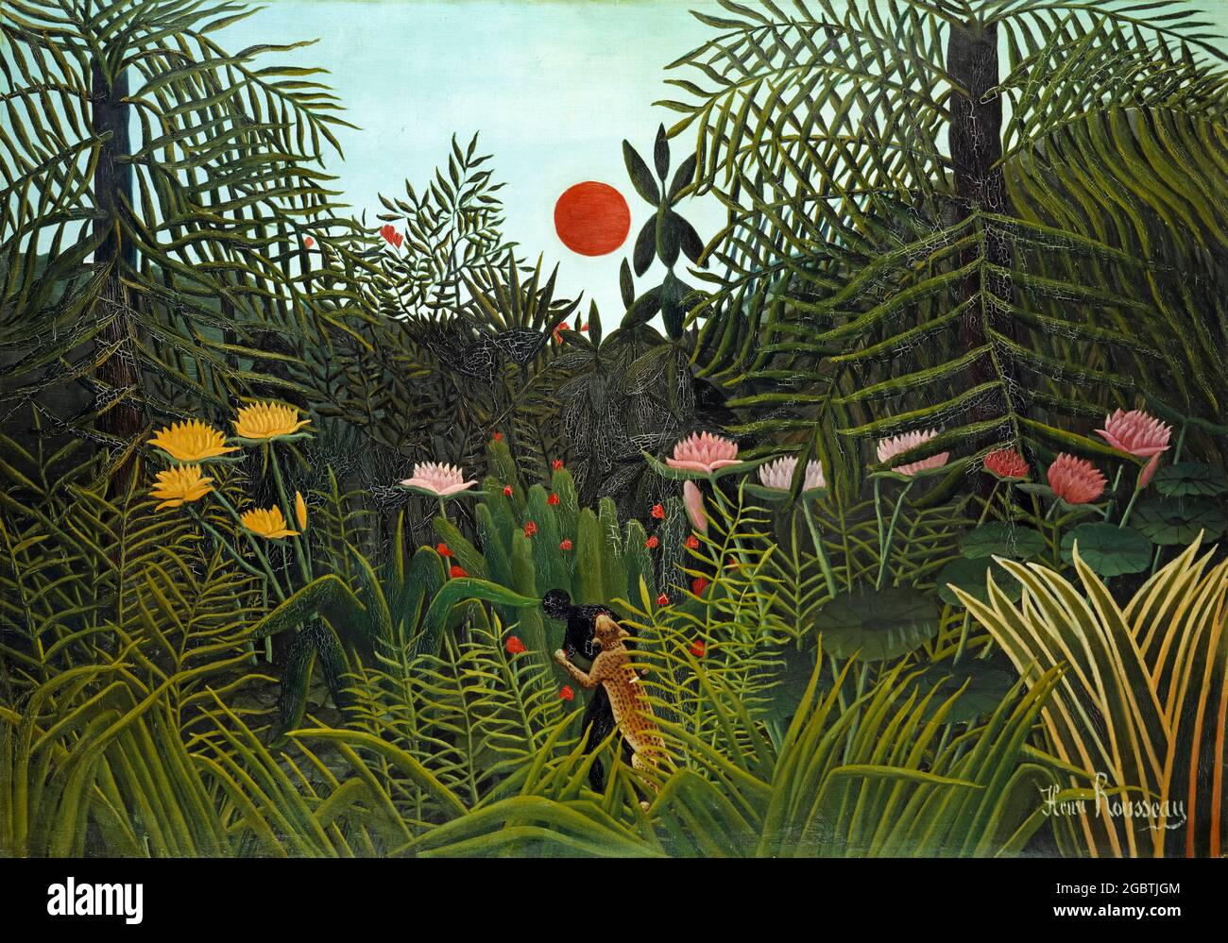
7 | Virgin Forest at Sunset (1910) | Henri Rousseau (1844-1910), French Oil on canvas 116 cm x162.5 cm Kunstmuseum, Basel, Switzerland
Visual Arts Slide Deck
Landscapes
Grade 2

Slide 11
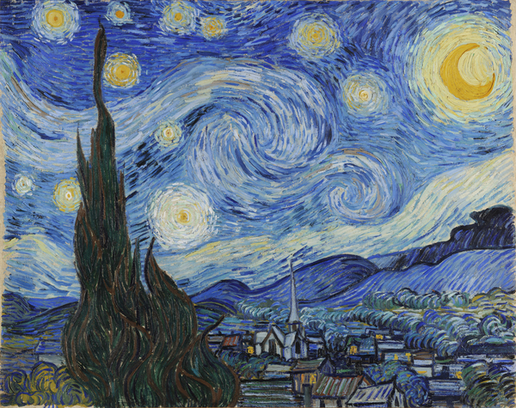
8 | The Starry Night (1889) | Vincent Van Gogh (1853 - 1890), Dutch Oil on canvas 73.7 cm x 92.1 cm Museum of Modern Art (MoMA), New York, USA
Visual Arts Slide Deck
Landscapes
Grade 2

Slide 12
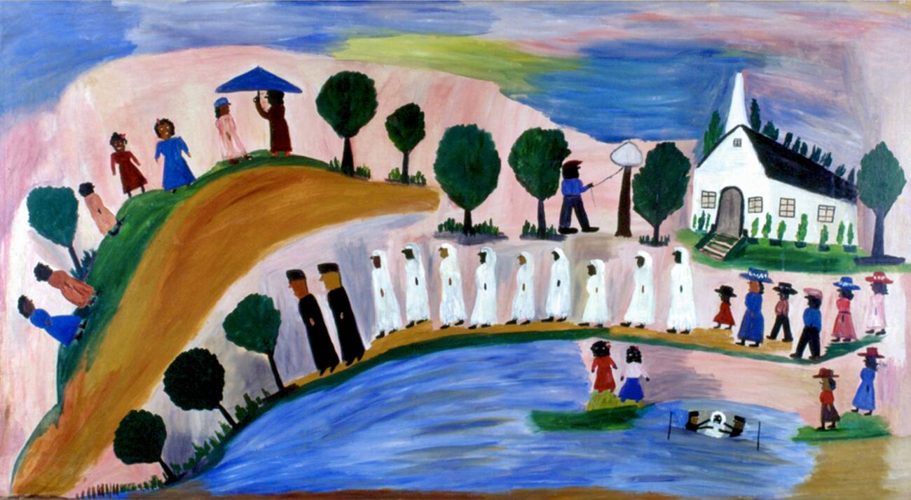
9 | Baptism (1955) | Clementine Hunter (1886 - 1988), American Mural African House at Melrose Plantation
Visual Arts Slide Deck
Landscapes
Grade 2

Slide 13
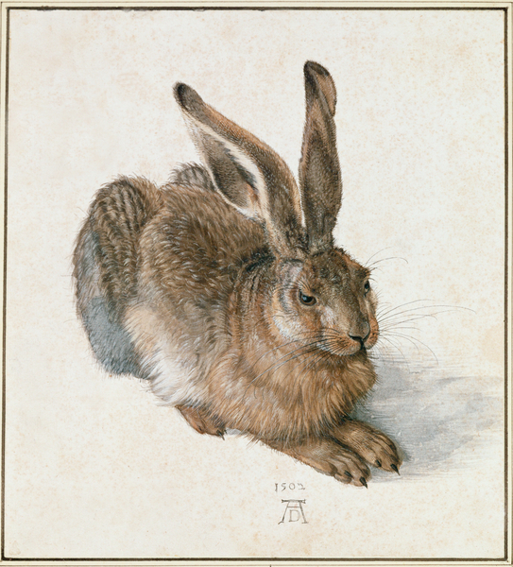
10 | Young Hare (1502) | Albrecht Durer (1471–1528), German Watercolor 25.1 cm x 22.6 cm Graphische Sammlung Albertina, Vienna, Austria
Visual Arts Slide Deck
Abstract Art
Grade 2

Slide 14
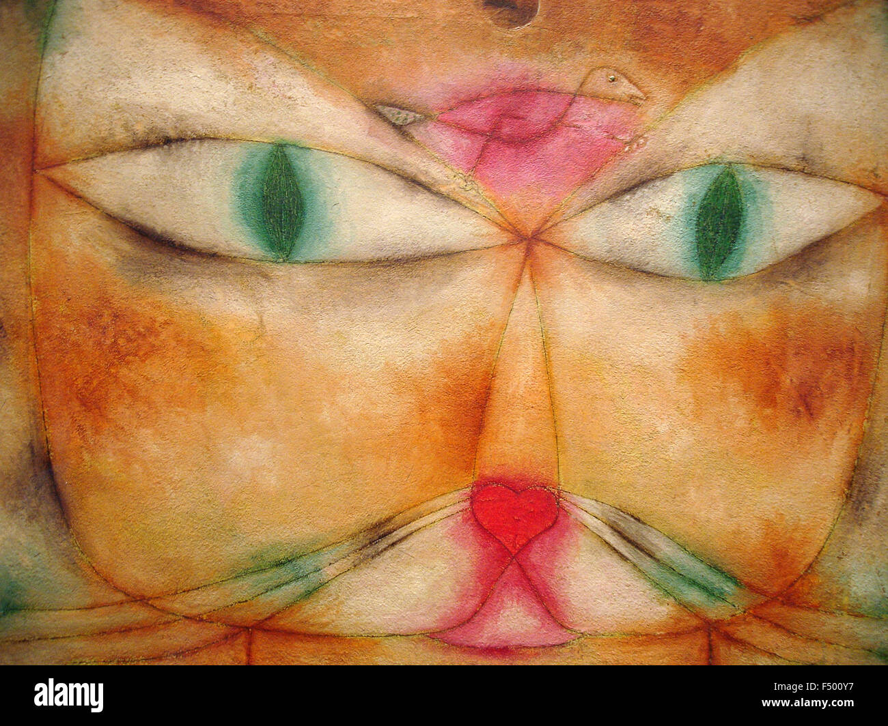
11 | Cat and Bird (1928) | Paul Klee (1879 – 1940), Swiss-German Oil and ink on plaster-primed gauze mounted on plywood 38.1 cm × 53.2 cm Museum of Modern Art, New York, USA
Visual Arts Slide Deck
Abstract Art
Grade 2

Slide 15
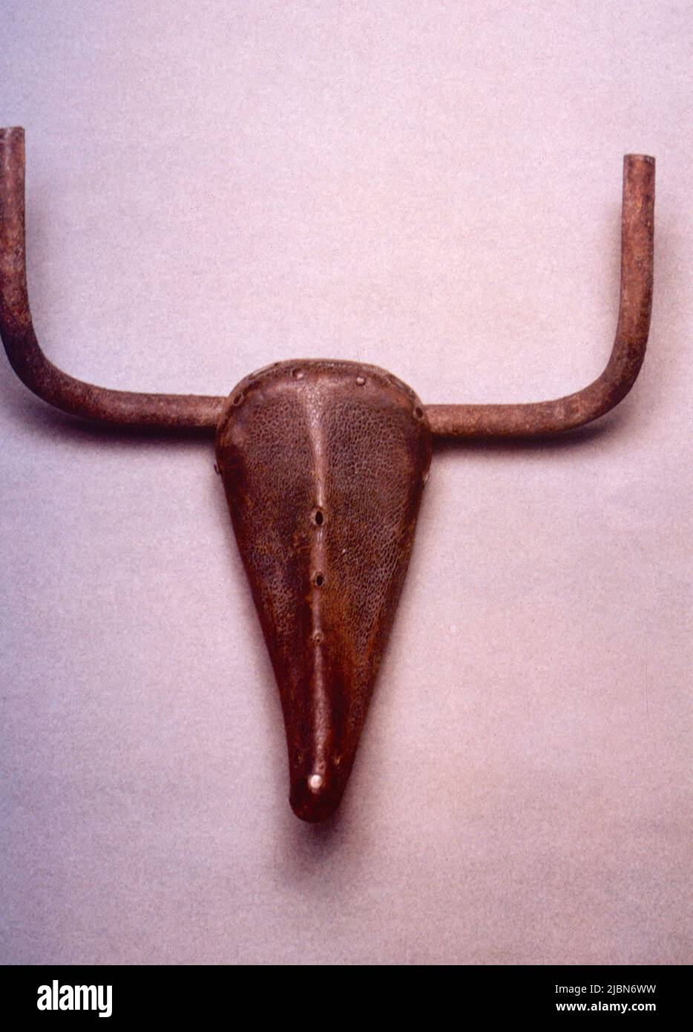
12 | Bull's Head (1942) | Pablo Picasso (1881 - 1973), Spanish bicycle seat and handlebars 33.5 cm x 43.5 cm x 19 cm Musée Picasso, Paris
Visual Arts Slide Deck
Abstract Art
Grade 2

Slide 16
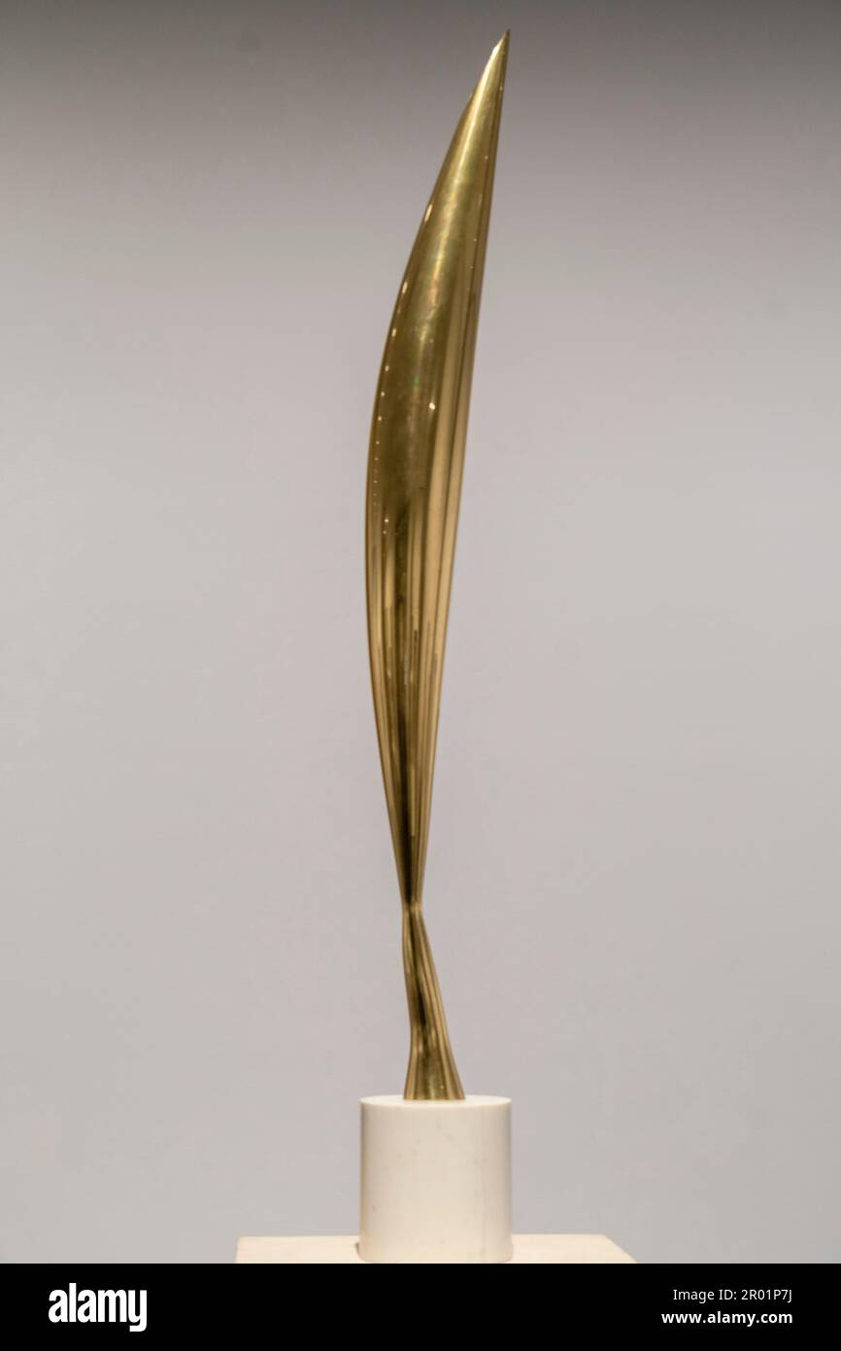
13 | Bird in Space (1923) | Constantin Brancusi (1876 - 1957), Romanian Marble, bronze 287.7 cm Philadelphia Museum of Art
Visual Arts Slide Deck
Abstract Art
Grade 2

Slide 17
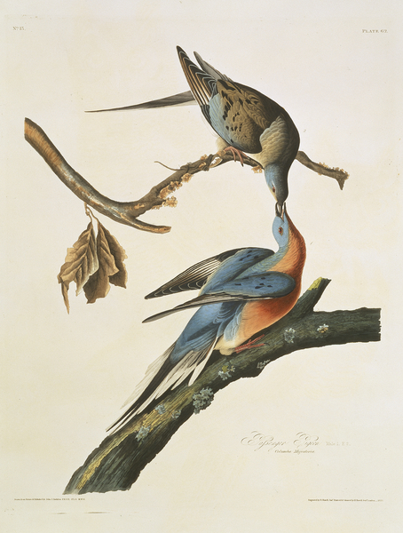
14 | Passenger Pigeon (1827-30) | John James Audubon (1785 - 1851), French-American Hand-coloured aquatint 66.8 cm x 47 cm Natural History Museum, London, UK
Visual Arts Slide Deck
Abstract Art
Grade 2

Slide 18
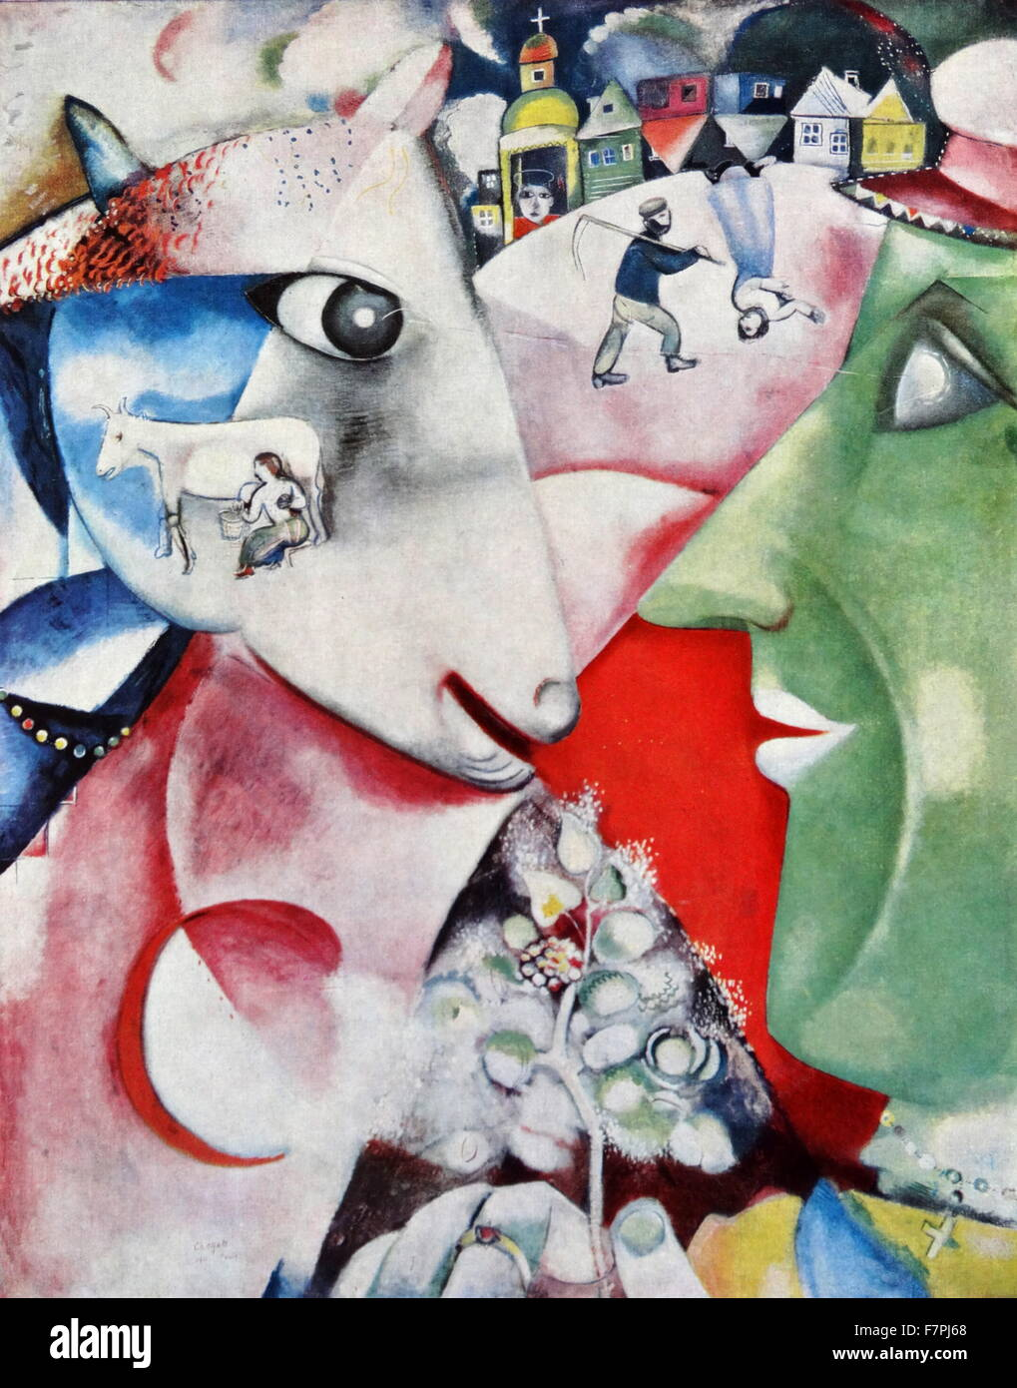
15 | I and the Village (1911) | Marc Chagall (1887 – 1985), Russian-French Oil on canvas 192.1 cm × 151.4 cm Museum of Modern Art, New York
Visual Arts Slide Deck
Abstract Art
Grade 2

Slide 19
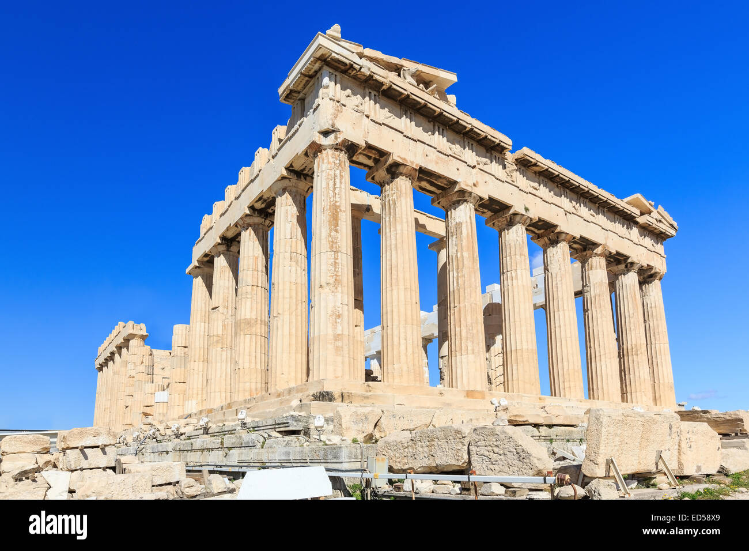
16 | The Parthenon | 69.5 m x 30.9 m Athens, Greece
Visual Arts Slide Deck
Architecture
Grade 2

Slide 20
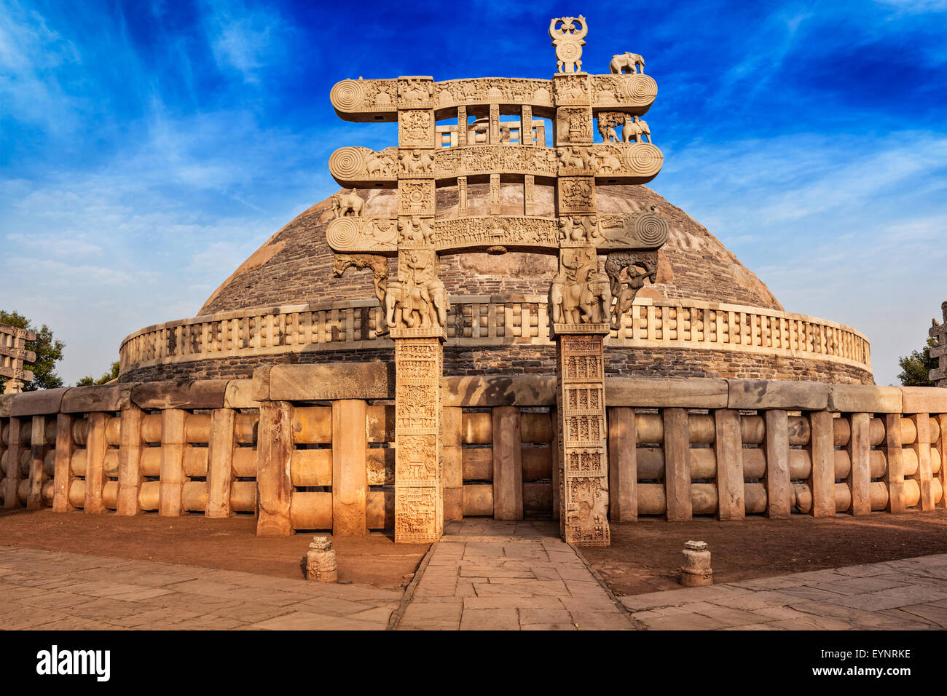
17 | Great Stupa (3rd century BCE) | Great Stupa. Sanchi, Madhya Pradesh, India 16.46 m height, 36.6 m diameter Sanchi Town, Raisen district, Madhya Pradesh, India
Visual Arts Slide Deck
Architecture
Grade 2

Slide 21
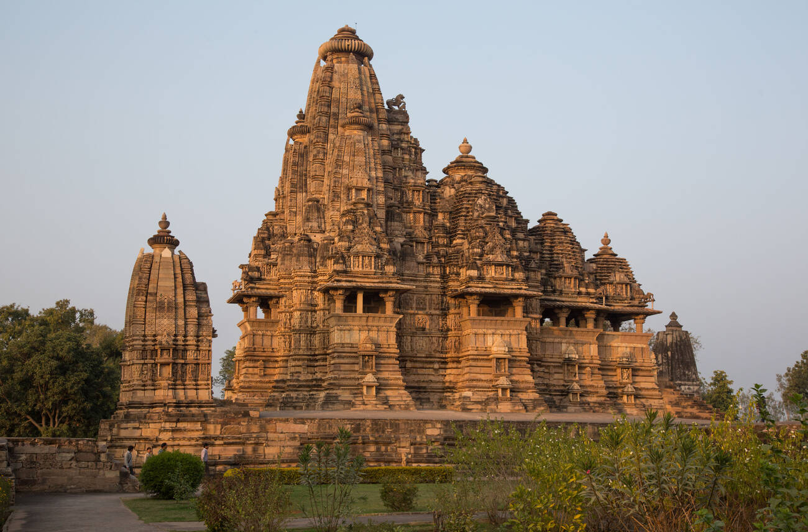
18 | Lakshmana Temple | Lakshmana Temple, Khajuraho, India
Visual Arts Slide Deck
Architecture
Grade 2

Slide 22
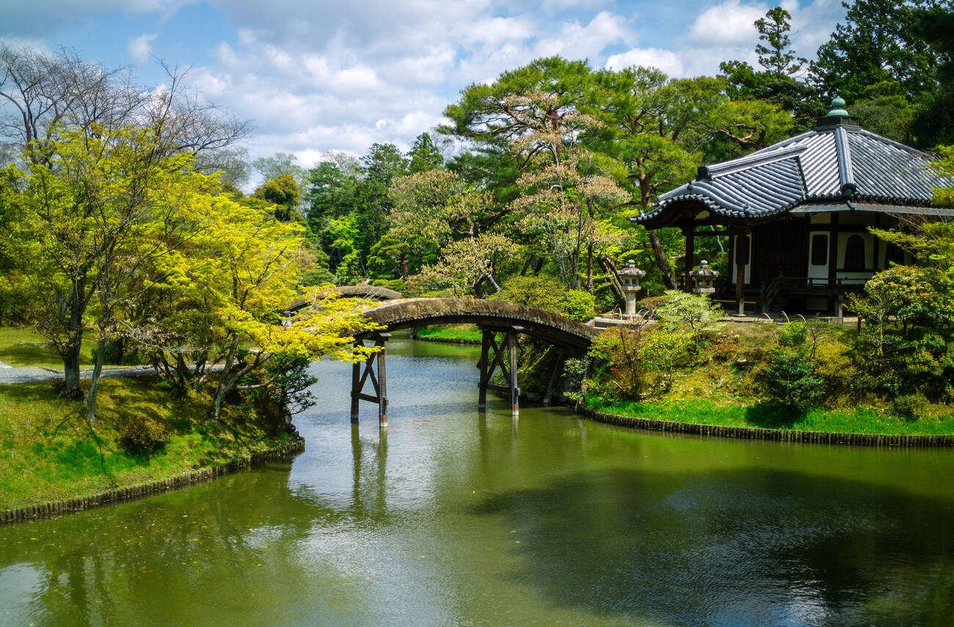
19 | Katsura Palace | Japan, Kansai, Kyoto, The Katsura Imperial Villa (Katsura Rikyū) is an Imperial residence with associated gardens and outbuildings Kyoto, Japan
Visual Arts Slide Deck
Architecture
Grade 2

Slide 23
Visual Art Cards
Grade 2
Credits
Image 1 | Mother and Child, 1922 (oil on canvas)/Picasso, Pablo (1881-1973) / Spanish/Baltimore Museum of Art, Maryland, USA/Baltimore Museum of Art / © Succession Picasso/DACS, London 2025 / Bridgeman Images
Image 2 | 'Under the wave of Kanagawa', or 'The great Wave' from the series '36 Views of Mt.Fuji',c.1830-31 (woodblock print) / Hokusai, Katsushika (1760-1849) / Japanese / Private Collection / Bridgeman Images
Image 3 | The History Collection / Alamy Stock Photo
Image 4 | The Thinker, modeled 1880-81, cast by Alexis Rudier (1874-1952), 1924 (bronze) / Rodin, Auguste (1840-1917) / French / Philadelphia Museum of Art, Pennsylvania, PA, USA / Philadelphia Museum of Art / Bridgeman Images
Image 5 | View from Mount Holyoke, Northampton, Massachusetts, after a Thunderstorm—The Oxbow, 1836 (oil on canvas) / Cole, Thomas (1801-1848) / American / Metropolitan Museum of Art, New York, USA / Bridgeman Image
Image 6 | View of Toledo, c.1597-99 (oil on canvas) / Greco, El (Domenico Theotocopuli) (1541-1614) / Greek / Metropolitan Museum of Art, New York, USA / Bridgeman Images
Image 7 | incamerastock / Alamy Stock Photo
Image 8 | The Starry Night, June 1889 (oil on canvas) / Gogh, Vincent van (1853-90) / Dutch / Museum of Modern Art (MoMA), New York, USA / Bridgeman Images
Image 9 | steeve-x-art / Alamy Stock Photo
Image 10 | Young Hare, 1502 (watercolour) / Dürer or Duerer, Albrecht (1471-1528) / German / Lessing, Erich (1923-2018) / Austrian / Graphische Sammlung Albertina, Vienna, Austria / © Erich Lessing / Bridgeman Images
Image 11 | The Artchives / Alamy Stock Photo
Image 12 | colaimages / Alamy Stock Photo
Image 13 | Album / Alamy Stock Photo
Image 14 | Ectopistes migratorius, passenger pigeon, Plate 62 from John James Audubon's Birds of America, original double elephant folio, 1827-30 (hand-coloured aquatint) / Audubon, John James (1785-1851) / American / Natural History Museum, London, UK / © Natural History Museum, London / Bridgeman Images
Image 15 | World History Archive / Alamy Stock Photo
Image 16 | Sorin Colac / Alamy Stock Photo
Image 17 | Dmitry Rukhlenko - Photos of India / Alamy Stock Photo
Image 18 | dbtravel / Alamy Stock Photo
Image 19 | Ben Pruchnie / Alamy Stock Photo

