Slide 1



Music Slide Deck
Grade 3

Slide 2

Music Slide Deck
Grade 3
This work is licensed under a Creative Commons Attribution-NonCommercial-ShareAlike 4.0 International License.
You are free:
to Share—to copy, distribute, and transmit the work to Remix—to adapt the work
Under the following conditions:
Attribution—You must attribute the work in the following manner:
This work is based on an original work of the Core Knowledge® Foundation (www.coreknowledge.org) and the additions from the Louisiana
Department of Education, made available through licensing under a Creative Commons Attribution-NonCommercial-ShareAlike4.0 International License. This does not in any way imply that the Core Knowledge Foundation or the Louisiana Department of Education endorses this work.
Noncommercial—You may not use this work for commercial purposes.
Share Alike—If you alter, transform, or build upon this work, you may distribute the resulting work only under the same or similar license to this one.
With the understanding that:
For any reuse or distribution, you must make clear to others the license terms of this work. The best way to do this is with a link to this web page:
https://creativecommons.org/licenses/by-nc-sa/4.0/
Copyright © 2025 Core Knowledge Foundation
www.coreknowledge.org
All Rights Reserved.
Core Knowledge©, Core Knowledge Curriculum Series™, Core Knowledge Arts™, Core Knowledge Music™ are trademarks are trademarks of the Core Knowledge Foundation. Foundations of Freedom is a trademark of the Louisiana Department of Education.
Trademarks and trade names are shown in this book strictly for illustrative and educational purposes and are the property of their respective owners. References herein should not be regarded as affecting the validity of said trademarks and trade names.
ISBN: 979-8-88970-658-8

Slide 3

Content
Music Slide Deck
Grade 3
I. Elements of Music
1 | Beat and Meter
2 | “Draw Me a Bucket of Water”
3 | “The Earth is Our Mother”
4 | Tempo
5 | Solfege Syllables and Signals
6 | Repeat Notation
7 | “He’s Got the Whole World”
8 | “The Rattlin’ Bog”
9 | “Alouette”
10 | Notes and Rests
11 | Staff and Treble Clef
12 | “Simple Gifts”
II. The Orchestra
13 | The Trumpet
III. Composers

Slide 4

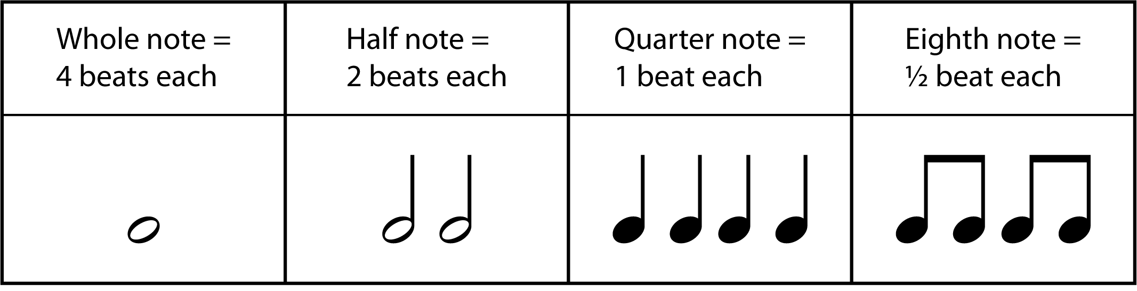
1 | Beat and Meter
Music Slide Deck
Elements of Music
Grade 3

Slide 5
2 | “Draw Me a Bucket of Water”
Draw me a bucket of water,
for my oldest daughter
There’s none in the bunch,
we’re all out the bunch.
You go under, sister Sally.
Draw me a bucket of water,
for my oldest daughter.
There’s one in the bunch,
and three out the bunch.
You go under, sister Sally.
Draw me a bucket of water,
for my oldest daughter.
There’s two in the bunch,
and two out the bunch.
You go under, sister Sally.
Draw me a bucket of water,
for my oldest daughter.
There’s three in the bunch,
and one out the bunch.
You go under, sister Sally.
Frog in the bucket, and I can’t get it out.
Frog in the bucket, and I can’t get it out.
Frog in the bucket, and I can’t get it out.
Frog in the bucket, and I can’t get it out.
Music Slide Deck
Elements of Music
Grade 3

Slide 6

3 | “The Earth is Our Mother”
The earth is our mother.
We must take care of her.
Hey yanna, ho yanna, hey yan yan.
Her sacred ground we walk upon,
with every step we take.
The earth is our mother.
She will take care of us.
Music Slide Deck
Elements of Music
Grade 3

Slide 7
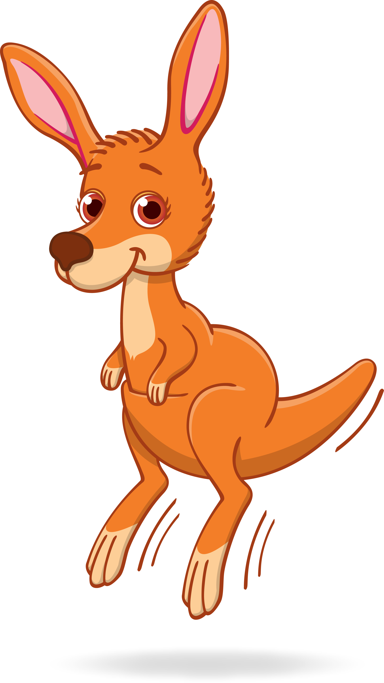

4 | Tempo
Adagio
Moderato
Allegro
Music Slide Deck
Elements of Music
Grade 3

Slide 8
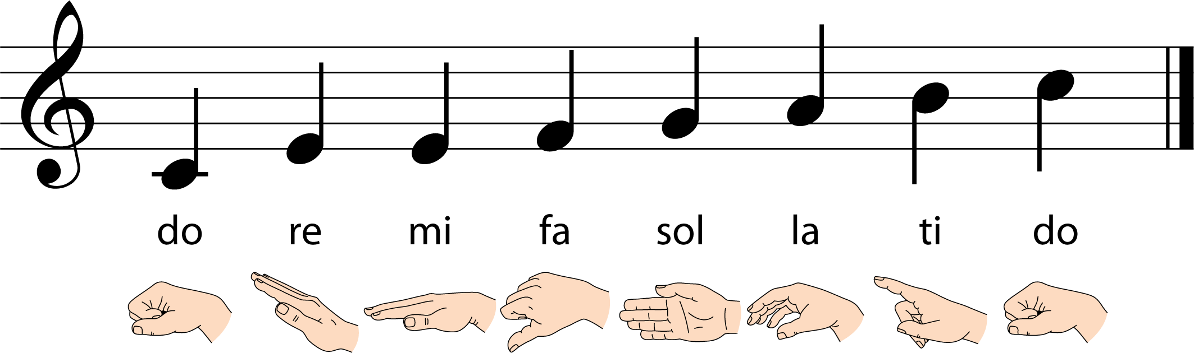
5 | Solfege Syllables and Signals
Music Slide Deck
Elements of Music
Grade 3

Slide 9
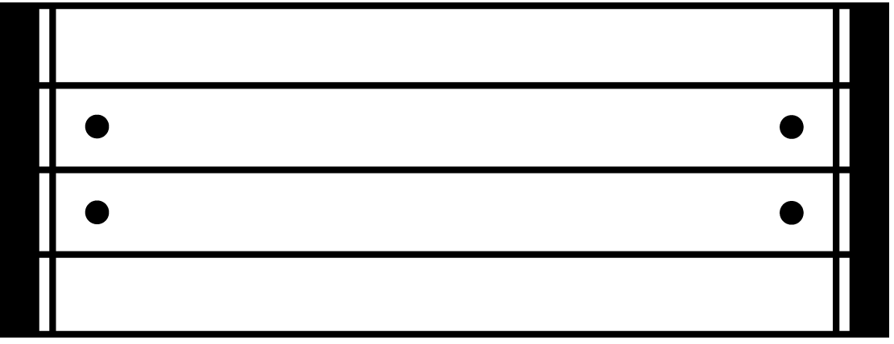
6 | Repeat Notation
Repeat
Music Slide Deck
Elements of Music
Grade 3

Slide 10
7 | “He’s Got the Whole World”
He’s got the whole world in His hands.
He’s got the whole wide world in His hands
He’s got the whole world in His hands
He’s got the whole world in His hands!
He’s got you an’ me, sister, in His hands.
He’s got you an’ me, brother, in His Hands.
He’s got you an’ me, sister, in His hands.
He’s got the whole world in His hands!
He’s got the little tiny baby in His hands.
He’s got the little tiny baby in His hands.
He’s got the little tiny baby in His hands.
He’s got the whole world in His hands!
He’s got all of us here in His hands.
He’s got all of us here His hands.
He’s got all of us here, in His hands.
He’s got the whole world in His hands!
(The last verse is repeated.)
He’s got the whole world in His hand
Music Slide Deck
Elements of Music
Grade 3

Slide 11
8 | “The Rattlin’ Bog”
Chorus:
Hi ho, the rattlin’ bog,
The bog down in the valley-o,
Hi ho, the rattlin’ bog,
The bog down in the valley-o.
Now in the bog, there was a tree,
A rare tree, a rattlin’ tree,
The tree in the bog,
And the bog down in the valley-o.
Chorus
And on that tree, there was a branch,
A rare branch, a rattlin’ branch,
The branch on the tree, and the tree in the bog
And the bog down in the valley-o.
Chorus
Music Slide Deck
Elements of Music
Grade 3

Slide 12
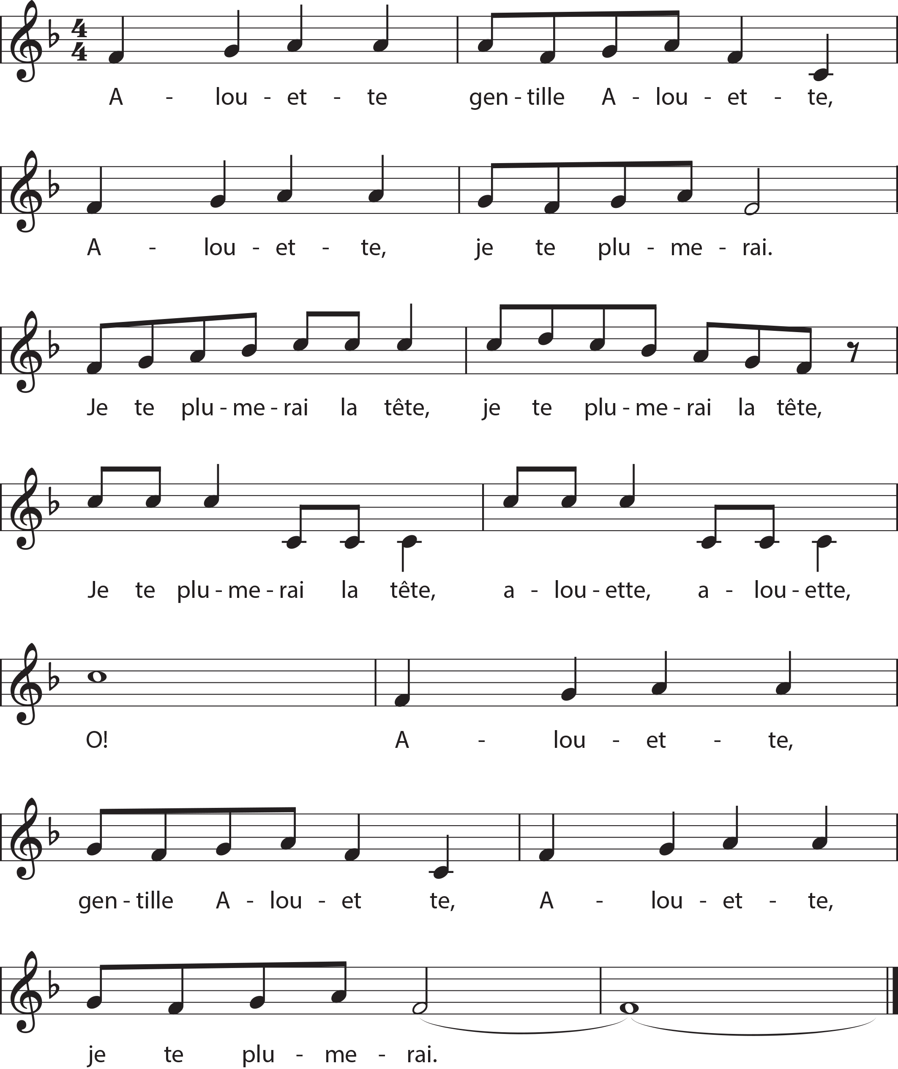
9 | “Alouette”
Music Slide Deck
Elements of Music
Grade 3

Slide 13
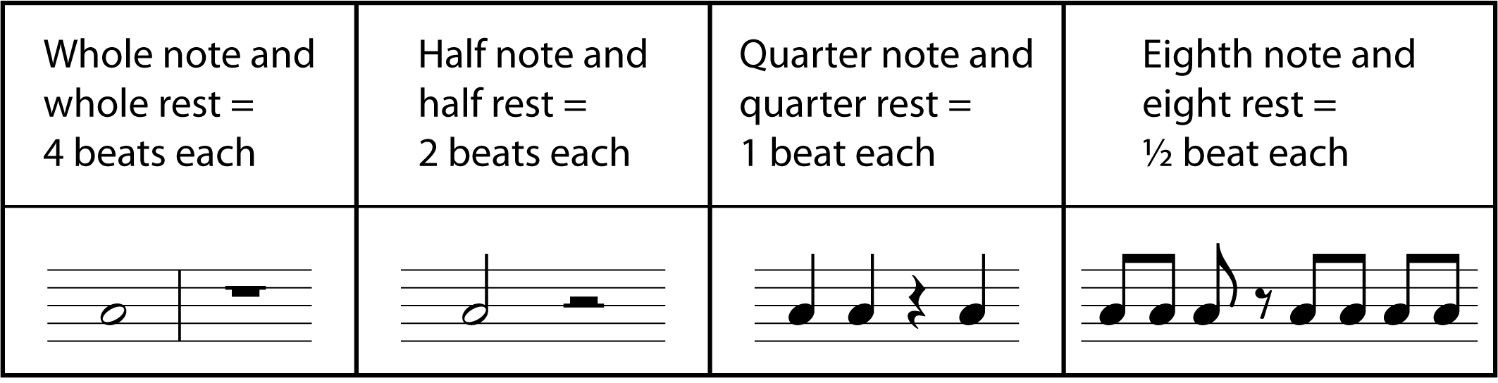
10 | Notes and Rests
Music Slide Deck
Elements of Music
Grade 3

Slide 14
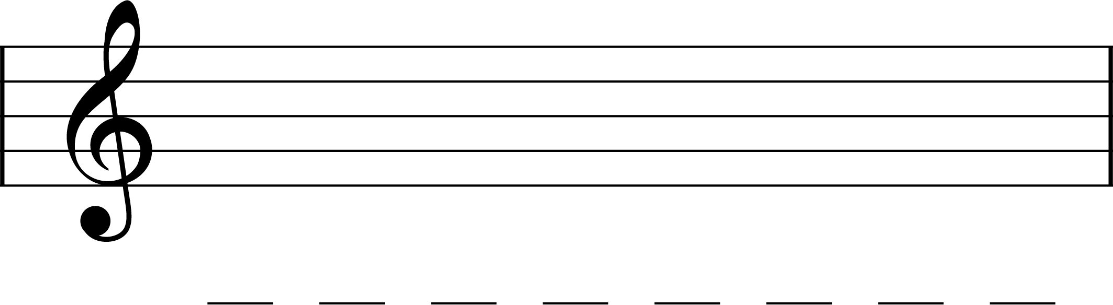
11 | Staff and Treble Clef
Music Slide Deck
Elements of Music
Grade 3

Slide 15
12 | “Simple Gifts”
‘Tis the gift to be simple, ’tis the gift to be free
’tis the gift to come down where you ought to be
And when we find ourselves in the place just right
‘Twill be in the valley of love and delight.
When true simplicity is gained
To bow and to bend we shan’t be ashamed
To turn, turn will be our delight
‘Till by turning, turning we come round right.
Tis the gift to be simple, ’tis the gift to be free
’tis the gift to come down where you ought to be
And when we find ourselves in the place just right
‘Twill be in the valley of love and delight.
Music Slide Deck
Elements of Music
Grade 3

Slide 16
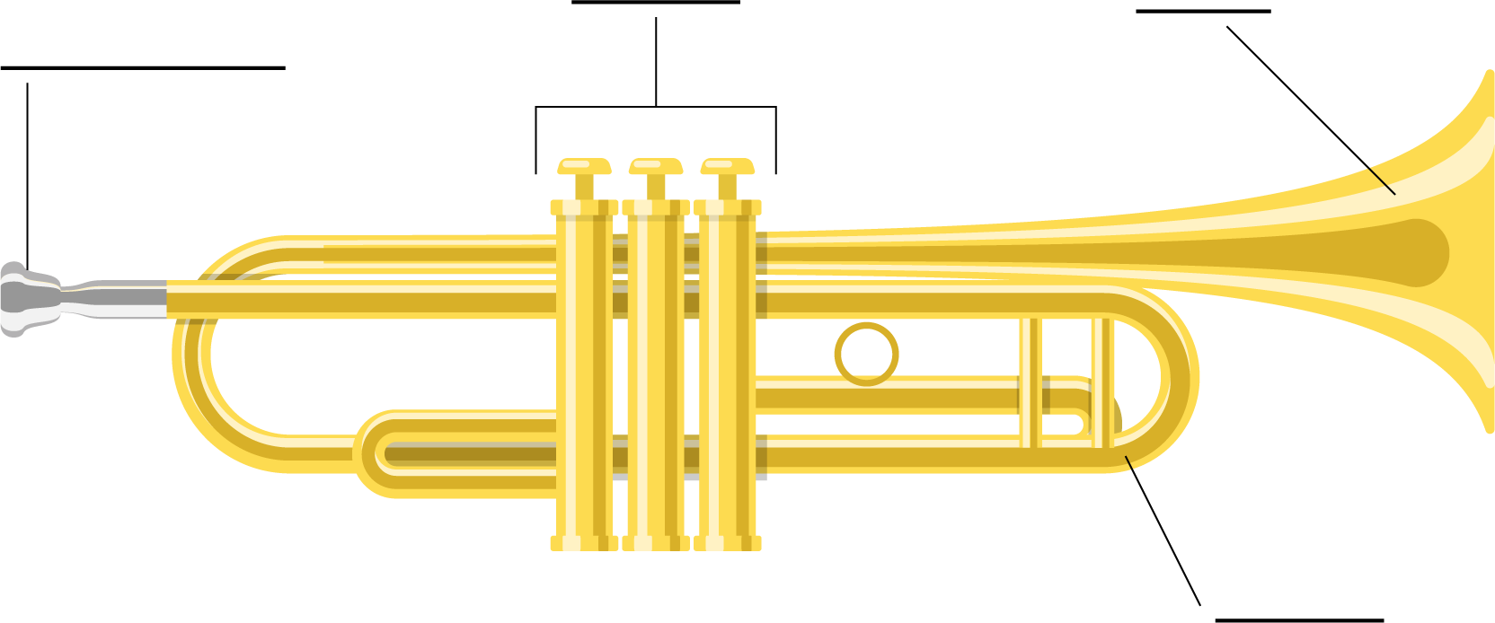
13 | The Trumpet
Music Slide Deck
The Orchestra
Grade 3

Slide 17

Music Cards
Credits
Grade 3
Bohdan Skrypnyk / Alamy Stock Photo: 7c
imageBROKER.com / Alamy Stock Photo: 11
Ingram Publishing / Alamy Stock Photo: 7a
Martys Art / Alamy Stock Photo: 7b
mauritius images GmbH / Alamy Stock Photo: 5
RooM the Agency / Alamy Stock Photo: 6
Wavebreak Media ltd / Alamy Stock Photo: 10

