Slide 1



Music Slide Deck
Grade 2

Slide 2

Music Slide Deck
Grade 2
This work is licensed under a Creative Commons Attribution-NonCommercial-ShareAlike 4.0 International License.
You are free:
to Share—to copy, distribute, and transmit the work to Remix—to adapt the work
Under the following conditions:
Attribution—You must attribute the work in the following manner:
This work is based on an original work of the Core Knowledge® Foundation (www.coreknowledge.org) and the additions from the Louisiana
Department of Education, made available through licensing under a Creative Commons Attribution-NonCommercial-ShareAlike4.0 International License. This does not in any way imply that the Core Knowledge Foundation or the Louisiana Department of Education endorses this work.
Noncommercial—You may not use this work for commercial purposes.
Share Alike—If you alter, transform, or build upon this work, you may distribute the resulting work only under the same or similar license to this one.
With the understanding that:
For any reuse or distribution, you must make clear to others the license terms of this work. The best way to do this is with a link to this web page:
https://creativecommons.org/licenses/by-nc-sa/4.0/
Copyright © 2025 Core Knowledge Foundation
www.coreknowledge.org
All Rights Reserved.
Core Knowledge©, Core Knowledge Curriculum Series™, Core Knowledge Arts™, Core Knowledge Music™ are trademarks are trademarks of the Core Knowledge Foundation. Foundations of Freedom is a trademark of the Louisiana Department of Education.
Trademarks and trade names are shown in this book strictly for illustrative and educational purposes and are the property of their respective owners. References herein should not be regarded as affecting the validity of said trademarks and trade names.
ISBN: 979-8-88970-657-1

Slide 3

Content
Music Slide Deck
Grade 2
I. Elements of Music
1 | Rounds
2 | Whole Notes and Half Notes
3 | Quarter Notes and Eighth Notes
4 | The Sound of Silence
5 | Name the Notes
6 | Do-Re-Mi
II. Instrument Families
III. Composers
7 | Meet Antonio Vivaldi
8 | Meet Johann Sebastian Bach
9 | Meet Ludwig van Beethoven

Slide 4

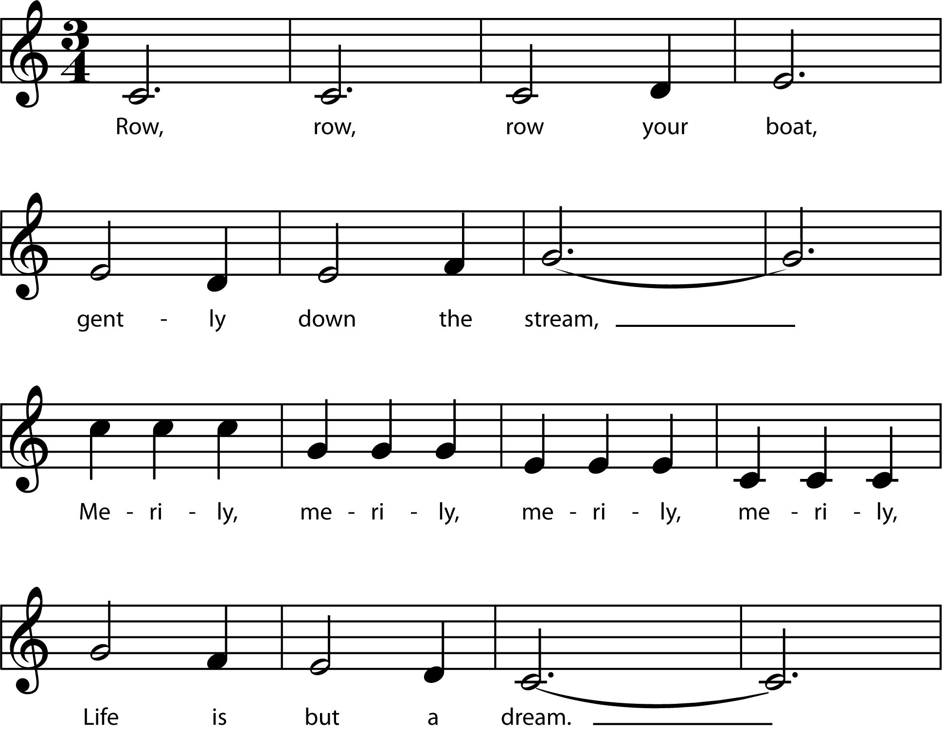
1 | Rounds
Music Slide Deck
Elements of Music
Grade 2

Slide 5
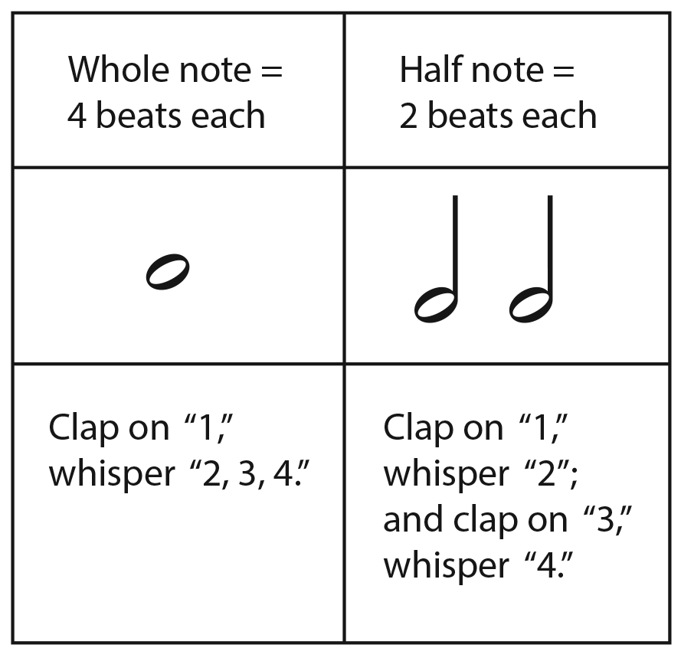
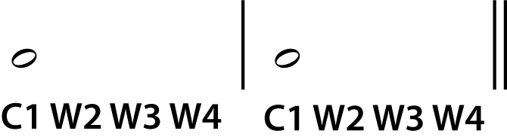
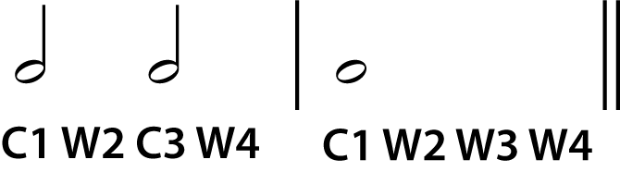
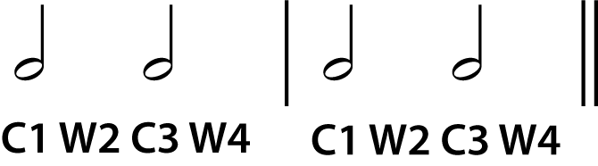
2 | Whole Notes and Half Notes
a.
b.
c.
Music Slide Deck
Elements of Music
Grade 2

Slide 6


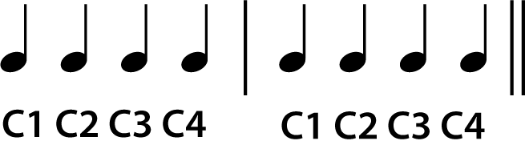
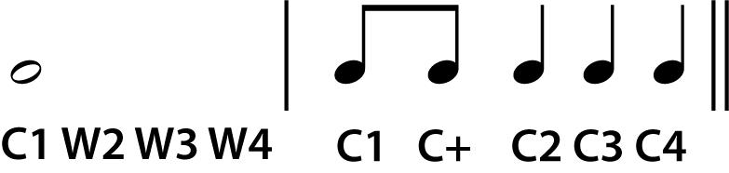
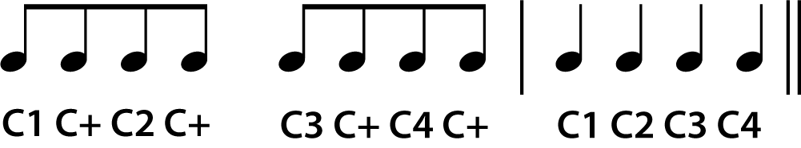
3 | Quarter Notes and Eighth Notes
Quarter note = 1 beat each | Eighth note = ½ beat each
Clap on each note “1, 2, 3, 4” | Clap on each note, counting “1 and 2 and 3 and 4 and.”
a.
c.
b.
Music Slide Deck
Elements of Music
Grade 2

Slide 7
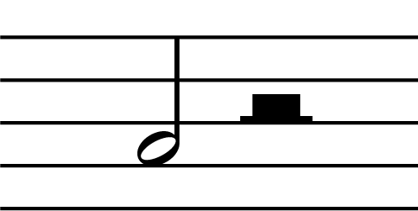
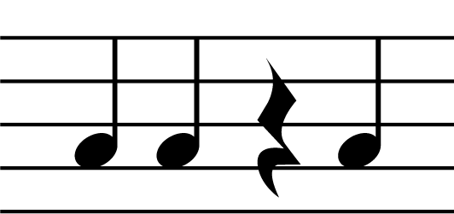
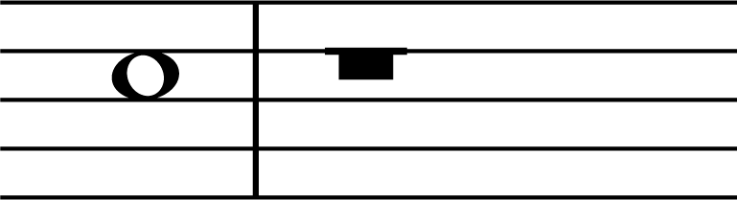
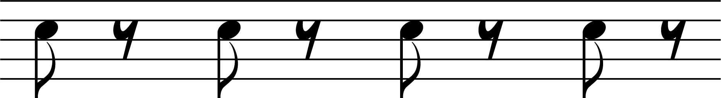
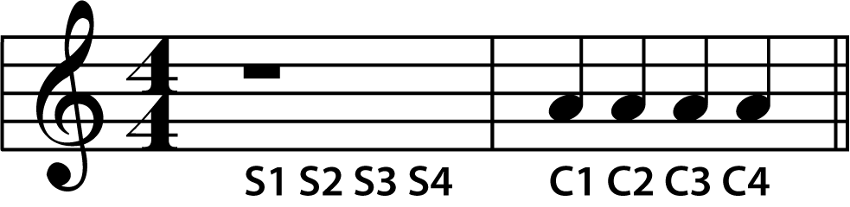
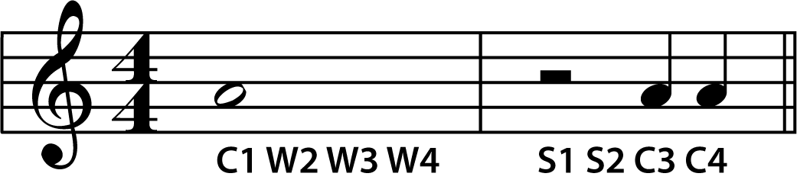
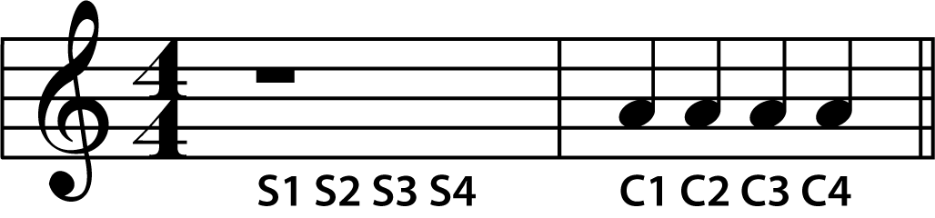
4 | The Sound of Silence
Whole note and whole rest = 4 beats each | Half note and half rest = 2 beats each | Quarter note and quarter rest = 1 beat each | Eighth note and eighth rest = ½ a beat each
Clap on “1”, whisper “2, 3, 4” silence on “1, 2, 3, 4” | Clap on “1,” whisper “2”; silence on “3, 4” | Clap on each note “1, 2”; silence on “3”; clap on “4” | Clap on “1,” silence on “and”; clap on “2,” silence on “and”; clap on “3,” silence on “and”; clap on “4,” silence on “and”
a.
c.
b.
Music Slide Deck
Elements of Music
Grade 2

Slide 8
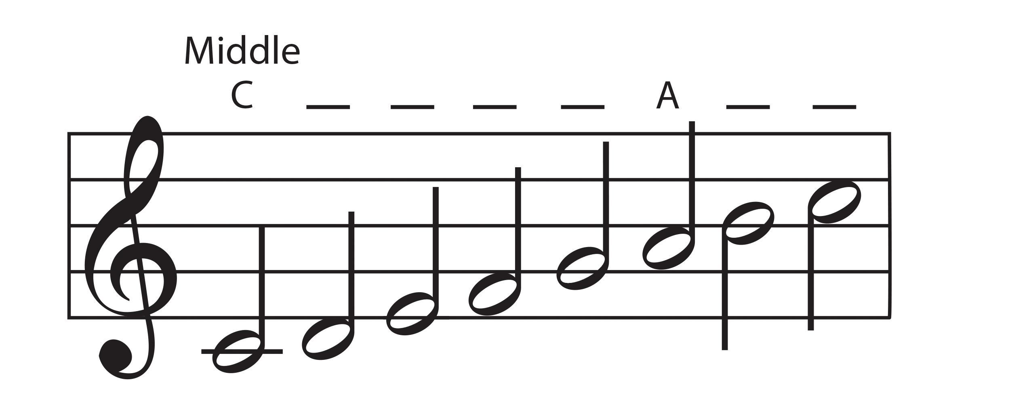
5 | Name the Notes
Music Slide Deck
Elements of Music
Grade 2

Slide 9
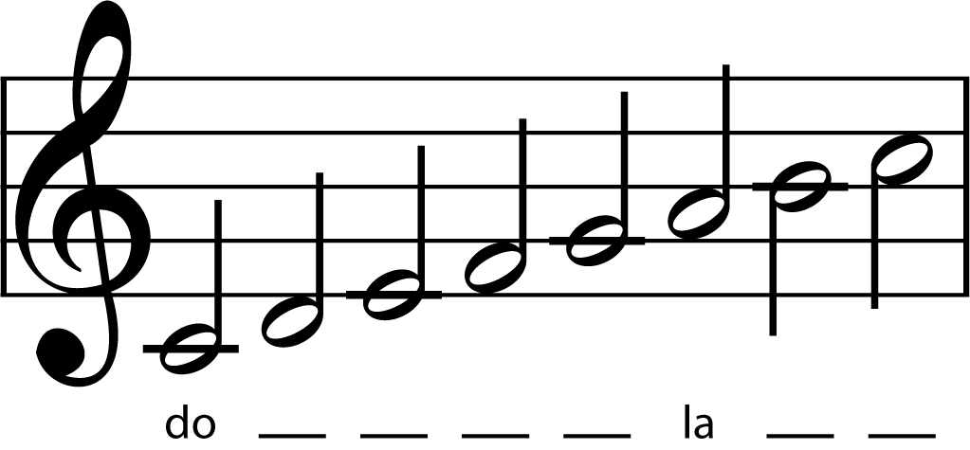
6 | Do-Re-Mi
Music Slide Deck
Elements of Music
Grade 2

Slide 10
7 | Meet Antonio Vivaldi
Antonio Vivaldi was a composer.
He lived during the Baroque period in music.
Vivaldi was born in 1678. He lived in Venice, Italy. He spent most of his life teaching music
at a school for girls. Part of his job there was
to compose music for the girls’ orchestra to
play. He composed several pieces each month!
Vivaldi was also a Catholic priest. At the school, people called him “The Red Priest” because he
had red hair.
Vivaldi was a great violinist. He wrote many pieces that showcased his violin skills. He also composed music for singers and religious music.
Music Slide Deck
Composers
Grade 2

Slide 11
8 | Meet Johann Sebastian Bach
Johann Sebastian Bach was a composer during the Baroque period in music. He is one of the greatest composers in Western music.
Bach was born in 1685 in Germany. There were many musicians in his family! When he was young, he learned to play the keyboard. He became a church musician. He composed many pieces for church choirs. He also wrote many pieces for instruments.
Bach’s music was often very carefully put together.
Every note was written before the piece was played.
But he also improvised, or made up music as he was playing. He even wrote pieces that let certain musicians within in the group of performers improvise as part of the piece!
Music Slide Deck
Composers
Grade 2

Slide 12
9 | Meet Ludwig van Beethoven
Ludwig van Beethoven was a composer during the Classical period of music. His later work led the way to the Romantic period.
Beethoven was born in 1770 in Germany. He learned to play keyboard instruments, including the organ. He also played the viola.
He began to lose his hearing in his twenties. After a while he could not hear at all. But he kept composing music. He could still imagine the sound.
Beethoven wrote nine symphonies. A symphony is a long piece that an orchestra plays. His Ninth Symphony is very famous. But he was never able to hear this famous piece!
Music Slide Deck
Composers
Grade 2

Slide 13
Music Cards
Credits
Grade 2
Album / Alamy Stock Photo: 10
Georgios Kollidas / Alamy Stock Photo: 11
GL Archive / Alamy Stock Photo: 12

