Slide 1



Visual Art Slide Deck
Kindergarten

Slide 2

Visual Arts Slide Deck
Kindergarten
This work is licensed under a Creative Commons Attribution-NonCommercial-ShareAlike 4.0 International License.
You are free:
to Share—to copy, distribute, and transmit the work to Remix—to adapt the work
Under the following conditions:
Attribution—You must attribute the work in the following manner:
This work is based on an original work of the Core Knowledge® Foundation (www.coreknowledge.org) and the additions from the Louisiana Department of Education, made available through licensing under a Creative Commons Attribution-NonCommercial-ShareAlike4.0 International License. This does not in any way imply that the Core Knowledge Foundation or the Louisiana Department of Education endorses this work.
Noncommercial—You may not use this work for commercial purposes.
Share Alike—If you alter, transform, or build upon this work, you may distribute the resulting work only under the same or similar license to this one.
With the understanding that:
For any reuse or distribution, you must make clear to others the license terms of this work. The best way to do this is with a link to this web page:
https://creativecommons.org/licenses/by-nc-sa/4.0/
Copyright © 2025 Core Knowledge Foundation
www.coreknowledge.org
All Rights Reserved.
Core Knowledge©, Core Knowledge Curriculum Series™, Core Knowledge Visual Arts™, Core Knowledge Music™ are trademarks are trademarks of the Core Knowledge Foundation. Foundations of Freedom is a trademark of the Louisiana Department of Education.
Trademarks and trade names are shown in this book strictly for illustrative and educational purposes and are the property of their respective owners. References herein should not be regarded as affecting the validity of said trademarks and trade names.
ISBN: 979-8-88970-642-7

Slide 3
Content
Visual Art Slide Deck
Kindergarten
I. Elements of Art
Color
1 | The Hunters in the Snow, Peter Bruegel the Elder
2 | Tahitian Landscape, Paul Gauguin
3 | Le Gourmet, Pablo Picasso
Line
4 | Turning the Samisen, Katsushika Holusai
5 | The Banjo Lesson, Henry Ossawa Tanner
6 | Purple Robe and Anemones, Henri Matisse
7 | People and Dog in the Sun, Joan Miro
8 | Sleeping Woman and Child (1929), Kathe Kollwitz
9 | Li’L Sis (1944), William H. Johnson
10 | Family Supper, Horace Pippin
11 | Children’s Games, Pieter Bruegel
12 | Snap the Whip, Winslow Homer
II. Types of Art
Sculpture and Architecture
13 | Northwest Coast Native American Totem Pole, Ellen Neel
14 | Hall of Supreme Harmony
15 | Eiffel Tower (1887)
16 | Sydney Opera House (1973)

Slide 4

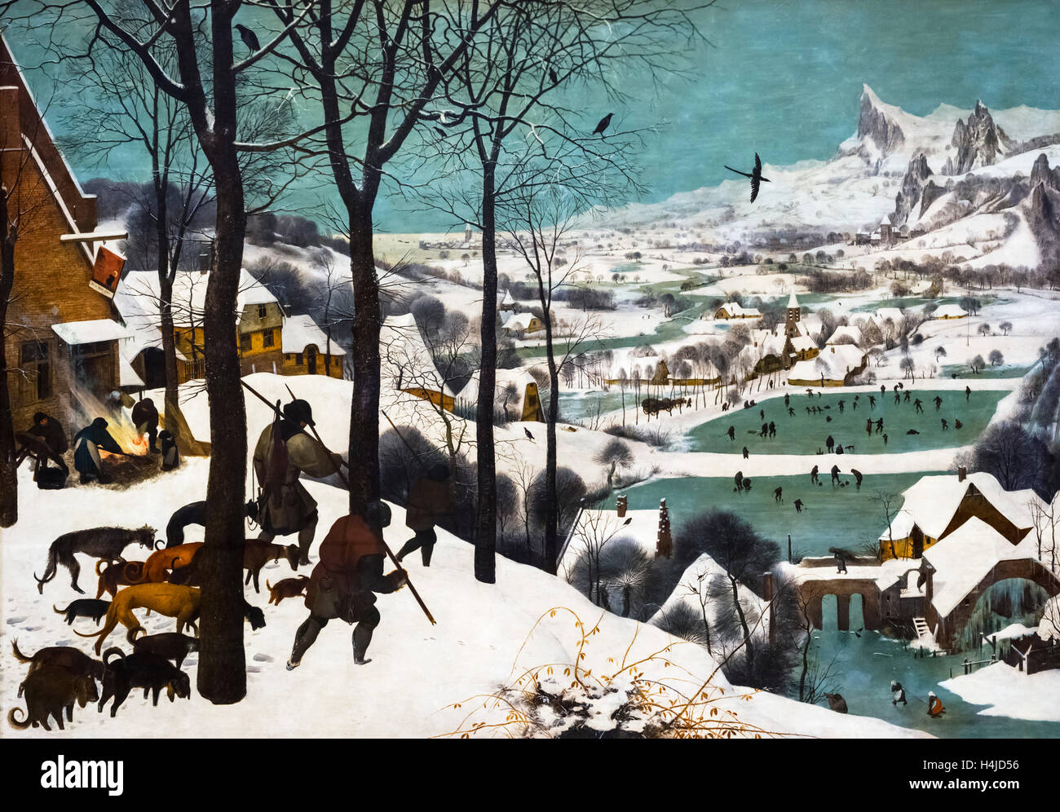
1 | Hunters in the Snow (1565) | Pieter Bruegel the Elder (1525–1569), Dutch Oil on oakwood 117 x 162 cm Kunsthistorisches Museum, Vienna, Austria
Visual Art Slide Deck
Elements of Art
Color
Kindergarten

Slide 5
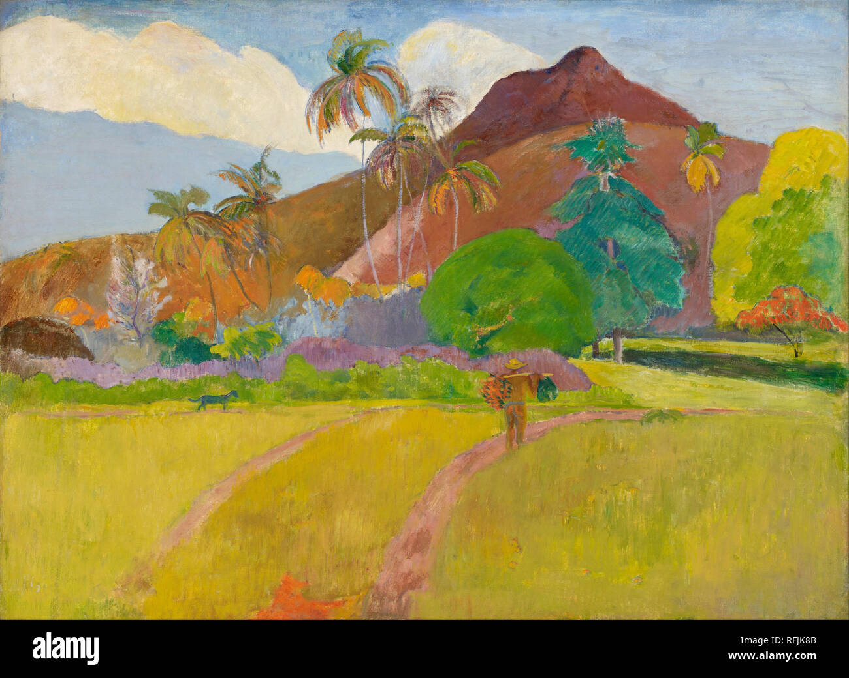
2 | Tahitian Landscape (1891) | Paul Gauguin (1848–1903), French Oil on canvas. 67.95 cm x 92.39 cm Minneapolis Institute of Arts, Minneapolis
Visual Art Slide Deck
Elements of Art
Color
Kindergarten

Slide 6
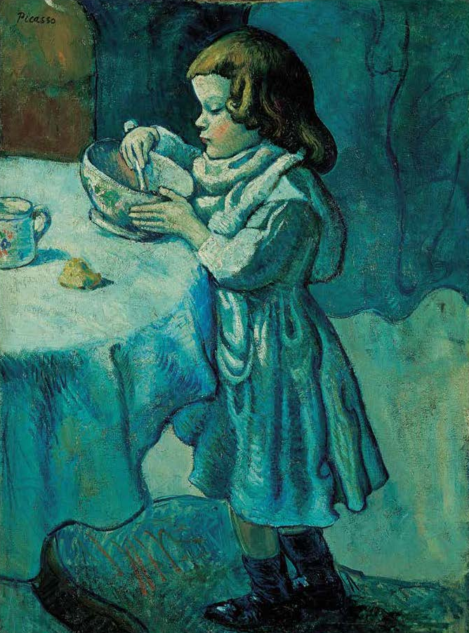
3 | Le Gourmet (1901) | Pablo Picasso (1881 - 1973), Spanish Oil on canvas 92.8 cm x 68.3 cm National Gallery of Art, Washington, D.C.
Visual Art Slide Deck
Elements of Art
Color
Kindergarten

Slide 7
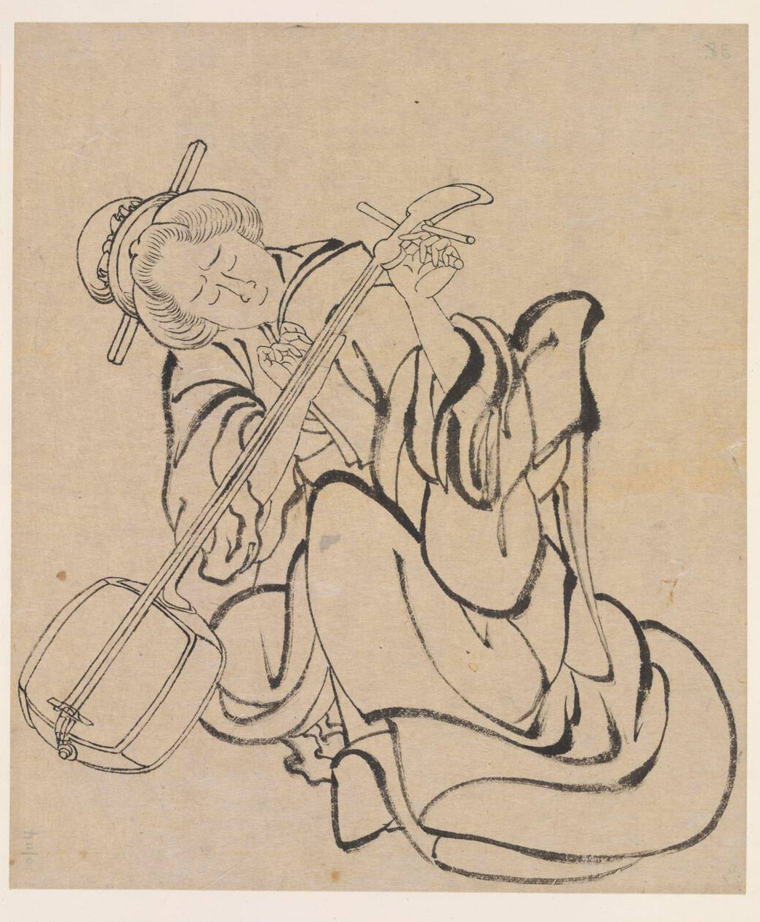
4 | Tuning the Samisen (c. 1822) | Katsushika Hokusai (1760–1849), Japanese Ink on Paper 36.6 cm x 59 cm Freer Gallery of Art, Washington, D.C.
Visual Art Slide Deck
Elements of Art
Line
Kindergarten

Slide 8
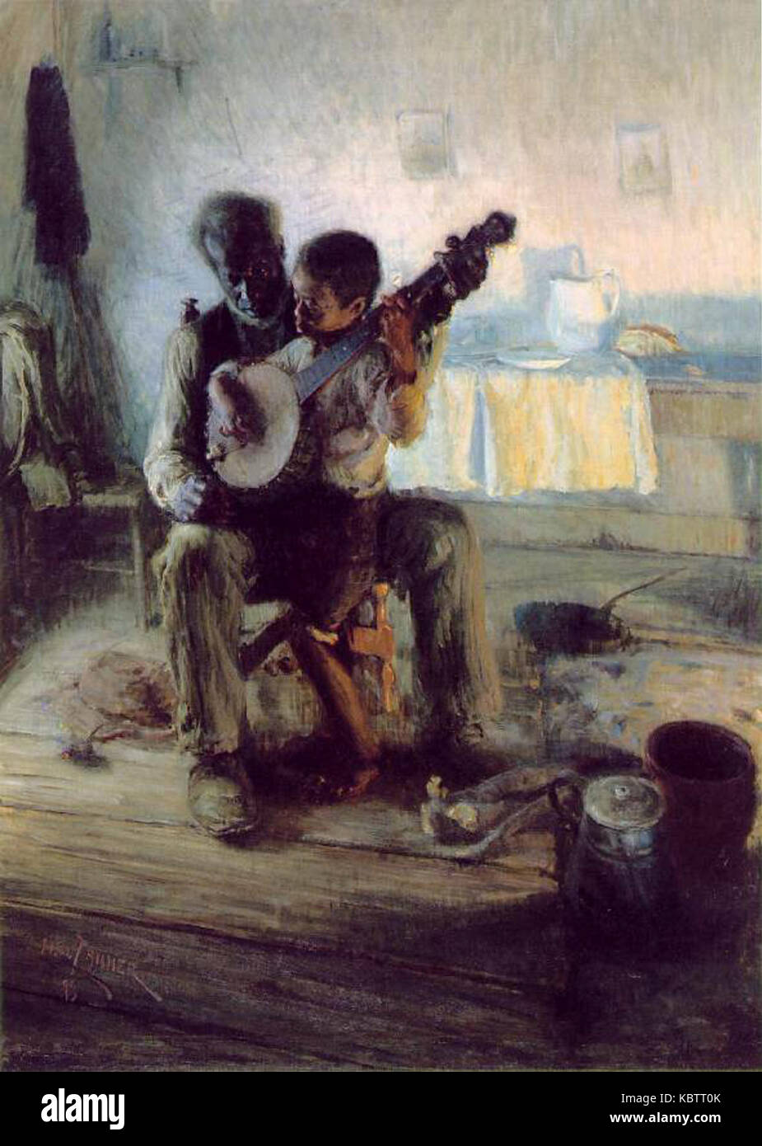
5 | The Banjo Lesson (1893) | Henry Ossawa Tanner (1859–1937), African-American Oil on canvas 124.4 cm x 90.1 cm Hampton University Museum, Hampton, VA
Visual Art Slide Deck
Elements of Art
Line
Kindergarten

Slide 9
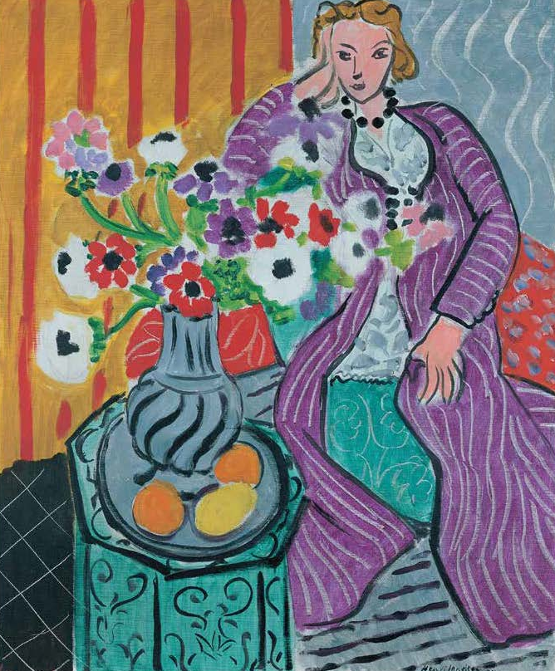
6 | Purple Robe and Anemones (1937) | Henri Matisse (1869–1954), French Oil on canvas. 73 cm x 60 cm The Baltimore Museum of Art
Visual Art Slide Deck
Elements of Art
Line
Kindergarten

Slide 10
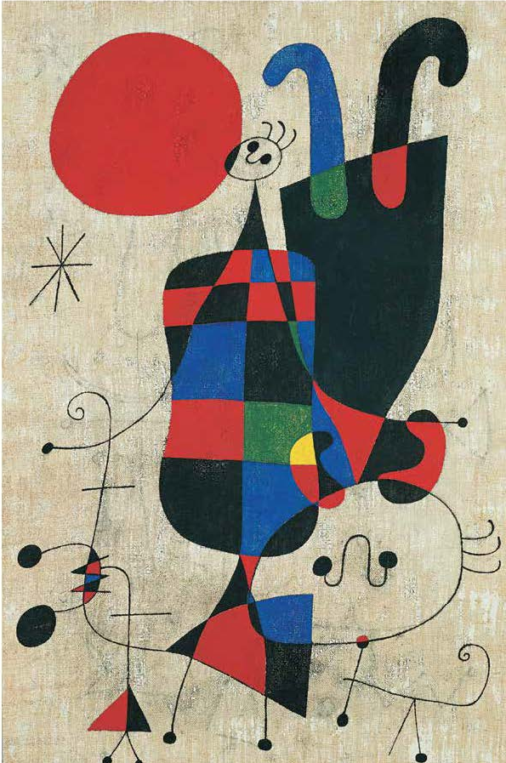
7 | People and Dog in the Sun (1949) | Joan MirÓ (1893–1983), Spanish Varnished distemper on canvas 81 cm x 54.5 cm Kunstmuseum, Basel, Switzerland
Visual Art Slide Deck
Elements of Art
Line
Kindergarten

Slide 11
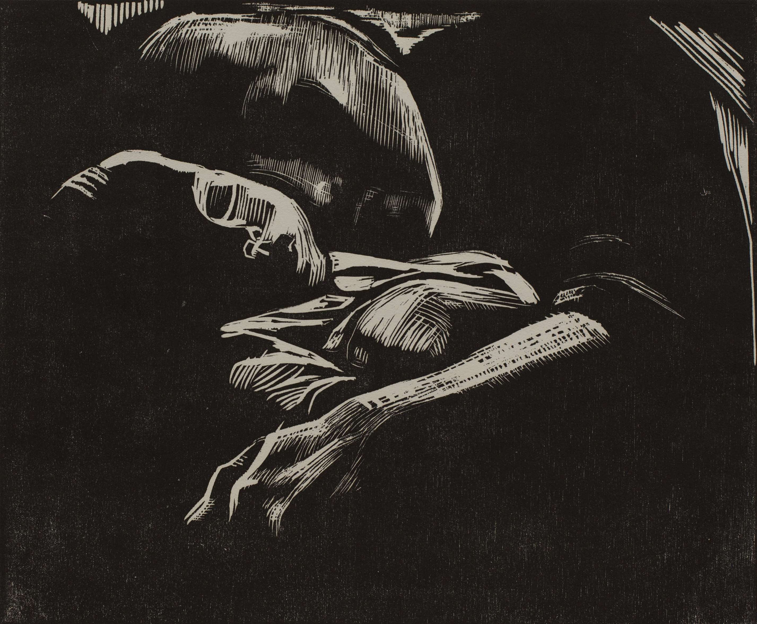
8 | Sleeping Woman and Child (1929) | Kathe Kollwitz (1867–1945), German Woodcut 29.9 cm x 35.8 cm Cleveland Museum of Art
Visual Art Slide Deck
Elements of Art
Line
Kindergarten

Slide 12
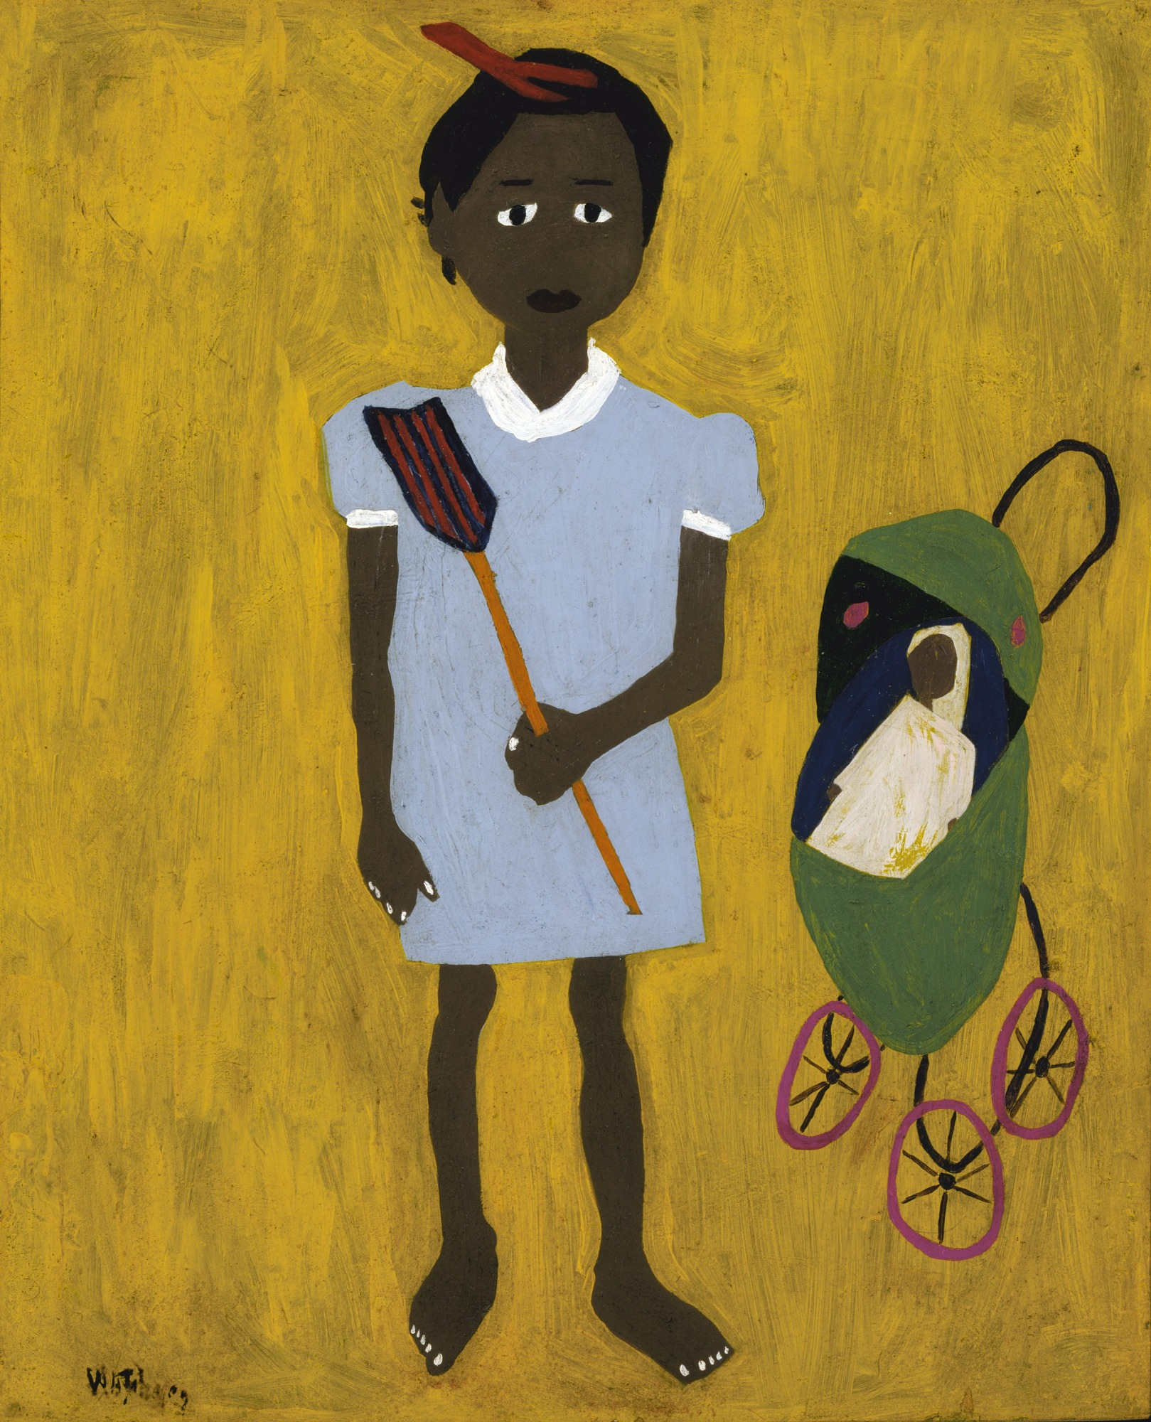
9 | Li’l Sis (1944) | William H. Johnson (1901–1970), American oil on paperboard 66.1 cm x 54.0 cm Smithsonian American Art Museum
Visual Art Slide Deck
Elements of Art
Line
Kindergarten

Slide 13
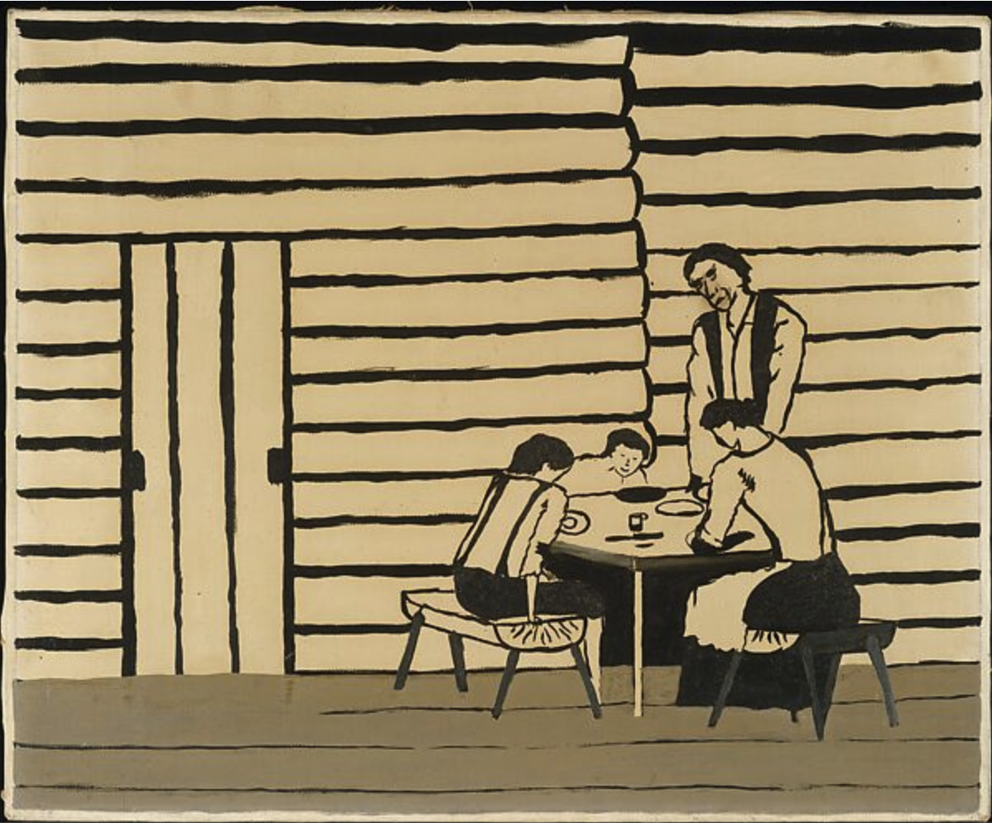
10 | Family Supper (1946) | Horace Pippin (1888 - 1946), American Oil on canvas 45.7 cm x 55.9 cm The Metropolitan Museum of Art, New York
Visual Art Slide Deck
Elements of Art
Line
Kindergarten

Slide 14
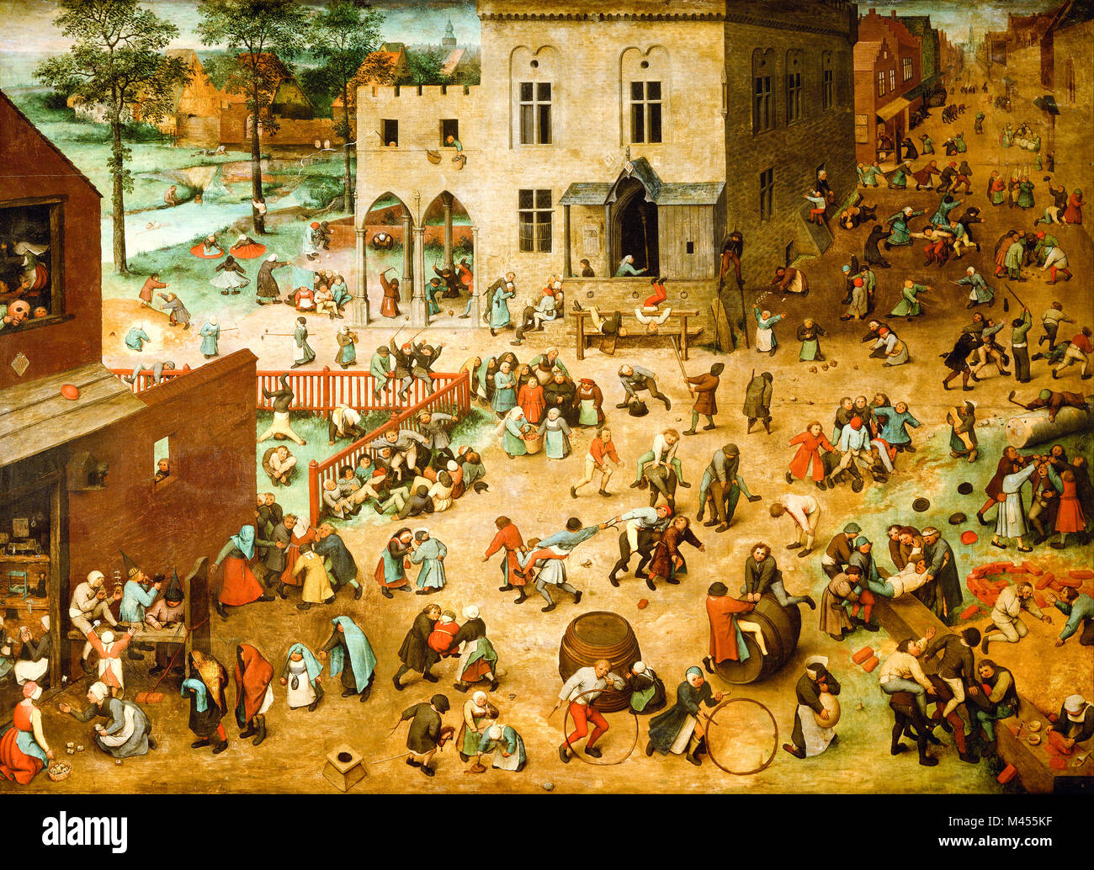
11 | Children’s Game (1560) | Pieter Bruegel the Elder (1525–1569), Dutch Oil on oakwood. 118 x 161 cm Kunsthistorisches Museum, Vienna
Visual Art Slide Deck
Elements of Art
Line
Kindergarten

Slide 15
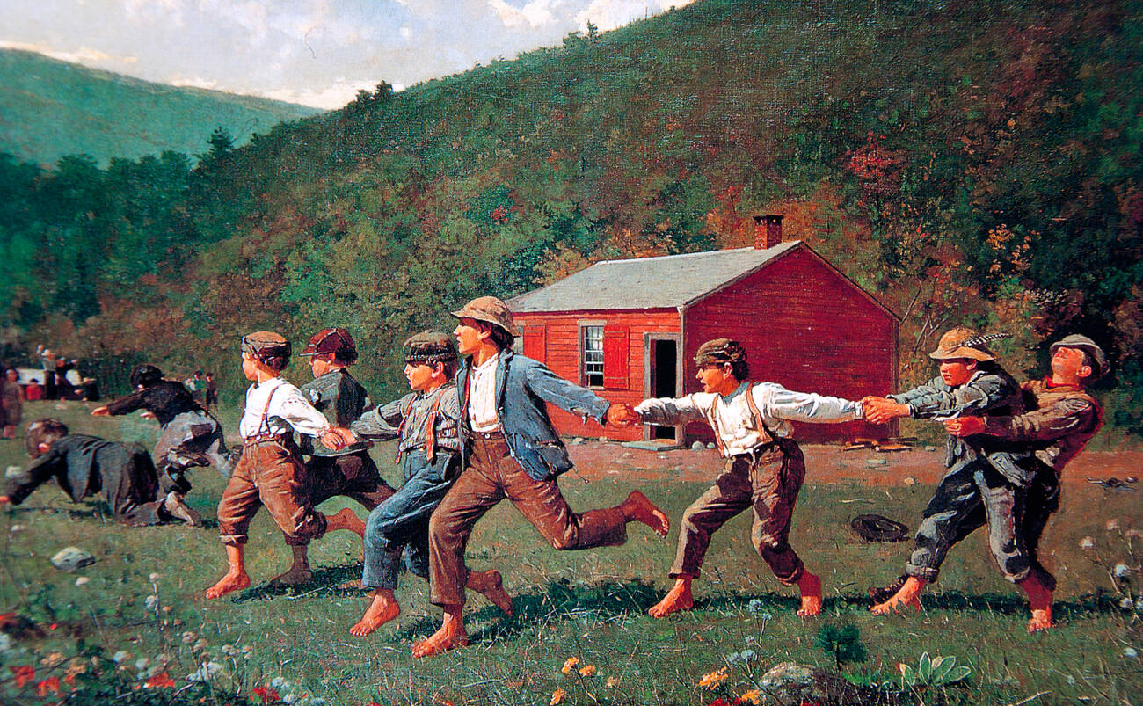
12 | Snap the Whip (1872) | Winslow Homer (1836–1910), American Oil on canvas. 30.5 cm x 50.8 cm The Metropolitan Museum of Art, New York
Visual Art Slide Deck
Elements of Art
Line
Kindergarten

Slide 16
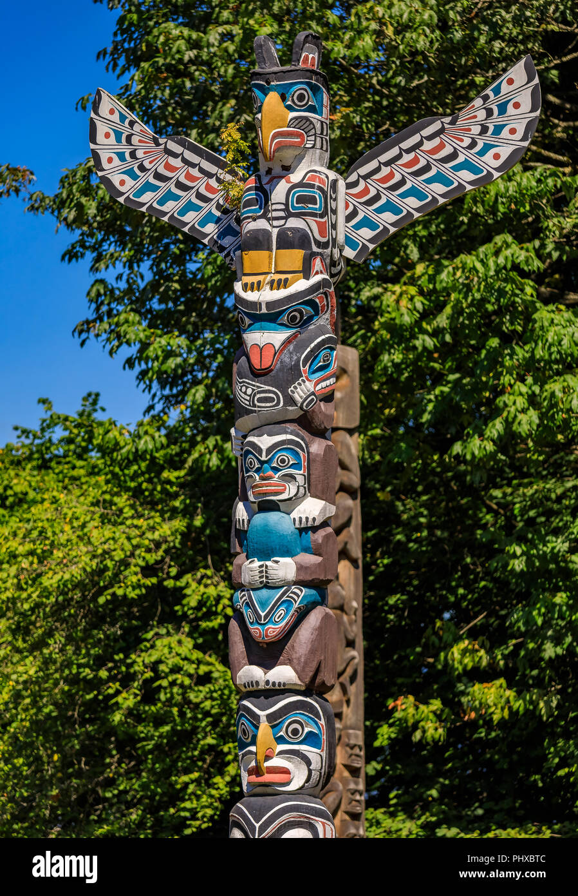
13 | Northwest Coast Native American Totem Pole | Ellen Noel (1916–1966), American First Nations American Indian thunderbird totem pole at Brockton Point in Stanley Park in Vancouver, Canada
Visual Art Slide Deck
Types of Art: Sculpture and Architecture
Kindergarten

Slide 17
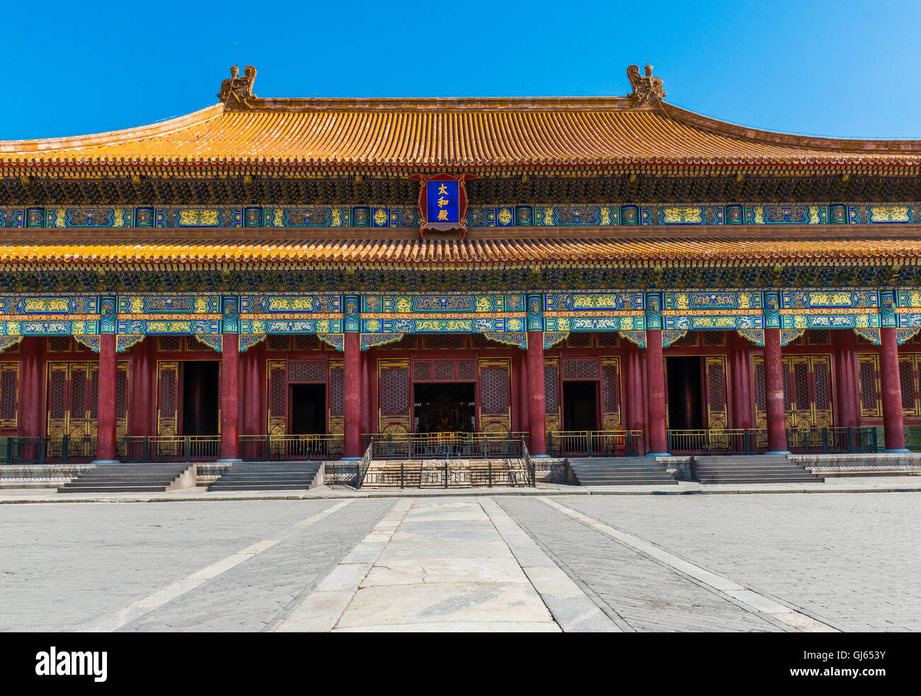
14 | Hall of Supreme Harmony (1406) | Hall of Supreme Harmony in Forbidden City, Beijing, China
Visual Art Slide Deck
Types of Art: Sculpture and Architecture
Kindergarten

Slide 18
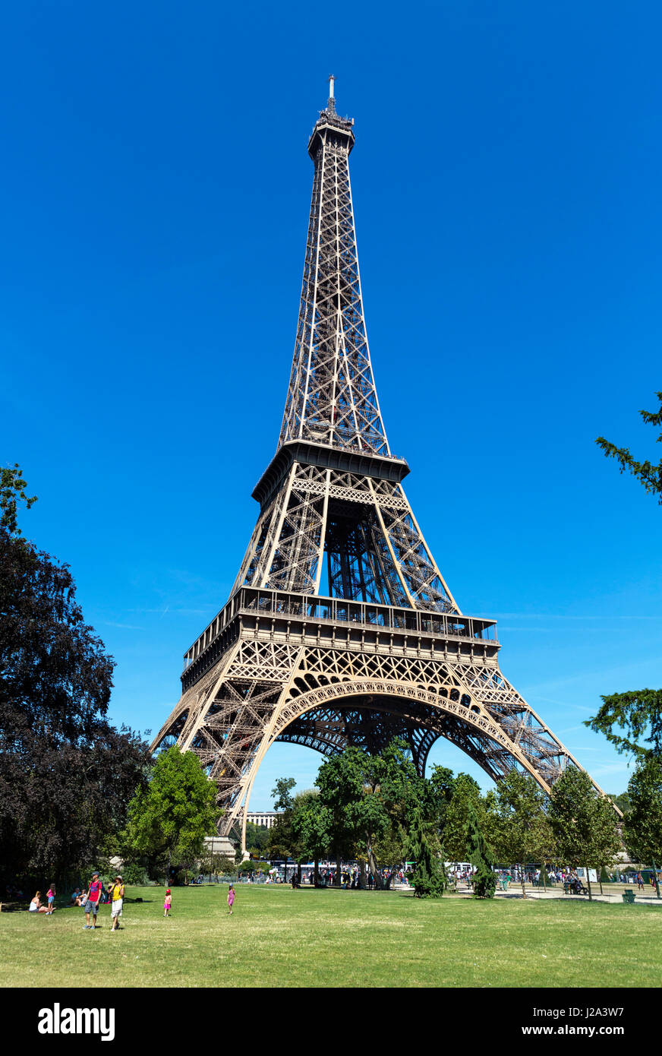
15 | Eiffel Tower (1887) | Paris, France
Visual Art Slide Deck
Types of Art: Sculpture and Architecture
Kindergarten

Slide 19
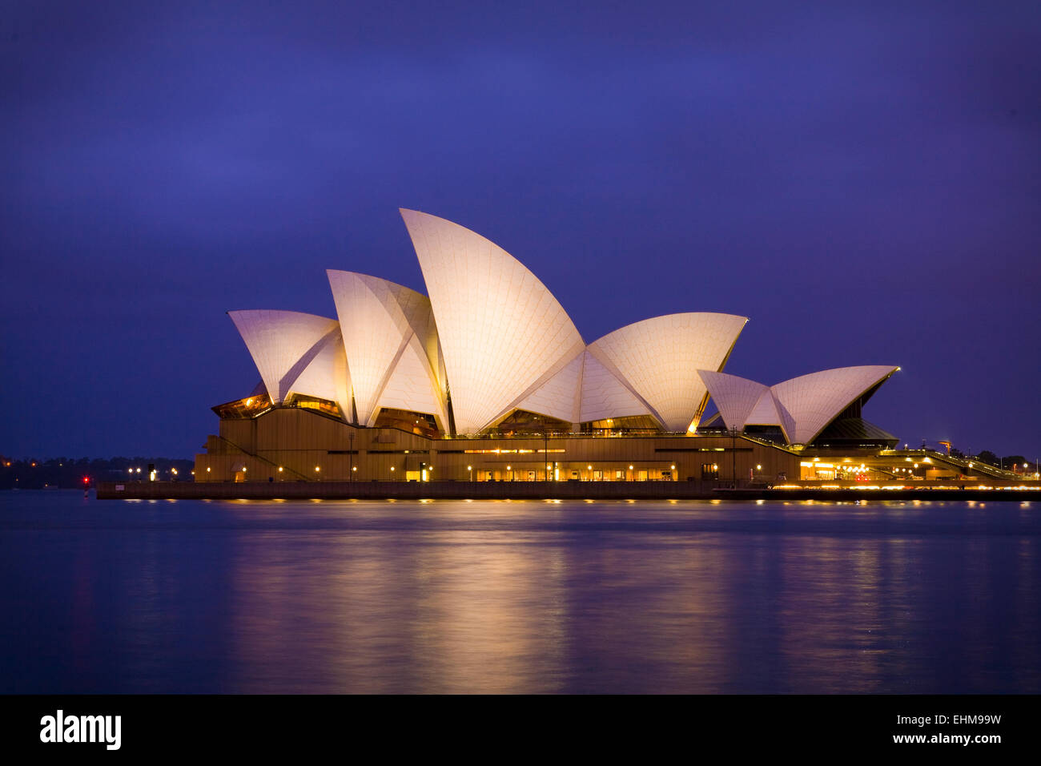
16 | Sydney Opera House (1973) | Sydney, Australia
Visual Art Slide Deck
Types of Art: Sculpture and Architecture
Kindergarten

Slide 20
Visual Art Cards
Kindergarten
Credits
Image 1 | IanDagnall Computing / Alamy Stock Photo
Image 2 | Album / Alamy Stock Photo
Image 3 | Peter Barritt / Alamy Stock Photo
Image 4 | Album / Alamy Stock Photo
Image 5 | Historic Collection / Alamy Stock Photo
Image 6 | Gina Rodgers / Alamy Stock Photo
Image 7 | © Successió Miró / Artists Rights Society (ARS), New York / ADAGP, Paris 2025
Image 8 | The Julian and Hope Edison Print Fund and Museum Shop Fund
Image 9 | Artepics / Alamy Stock Photo
Image 10 | Penta Springs Limited / Alamy Stock Photo
Image 11 | Art Library / Alamy Stock Photo
Image 12 | PAINTING / Alamy Stock Photo
Image 13 | Svetlana Day / Alamy Stock Photo
Image 14 | zhencong chen / Alamy Stock Photo
Image 15 | Ian Dagnall / Alamy Stock Photo
Image 16 | Bella Falk / Alamy Stock Photo

