Slide 1



Music Slide Deck
Kindergarten

Slide 2


Music Slide Deck
Kindergarten
This work is licensed under a Creative Commons Attribution-NonCommercial-ShareAlike 4.0 International License.
You are free:
to Share—to copy, distribute, and transmit the work to Remix—to adapt the work
Under the following conditions:
Attribution—You must attribute the work in the following manner:
This work is based on an original work of the Core Knowledge® Foundation (www.coreknowledge.org) and the additions from the Louisiana
Department of Education, made available through licensing under a Creative Commons Attribution-NonCommercial-ShareAlike4.0 International License. This does not in any way imply that the Core Knowledge Foundation or the Louisiana Department of Education endorses this work.
Noncommercial—You may not use this work for commercial purposes.
Share Alike—If you alter, transform, or build upon this work, you may distribute the resulting work only under the same or similar license to this one.
With the understanding that:
For any reuse or distribution, you must make clear to others the license terms of this work. The best way to do this is with a link to this web page:
https://creativecommons.org/licenses/by-nc-sa/4.0/
Copyright © 2025 Core Knowledge Foundation
www.coreknowledge.org
All Rights Reserved.
Core Knowledge©, Core Knowledge Curriculum Series™, Core Knowledge Arts™, Core Knowledge Music™ are trademarks are trademarks of the Core Knowledge Foundation. Foundations of Freedom is a trademark of the Louisiana Department of Education.
Trademarks and trade names are shown in this book strictly for illustrative and educational purposes and are the property of their respective owners. References herein should not be regarded as affecting the validity of said trademarks and trade names.
ISBN: 979-8-88970-655-7

Slide 3

Content
Music Slide Deck
Kindergarten
I. Elements of Music
1 | “Bingo”
2 | “This Old Man”
3 | Loud and Soft
4 | Fast and Slow
5 | “London Bridge”
6 | Feelings
7 | “Jingle Bells”
8 | Same or Different?
9 | Call and Response
II. Instruments and Music
10 | Animals and Instruments
11 | A New Animal Song
12 | Tell a Musical Story

Slide 4

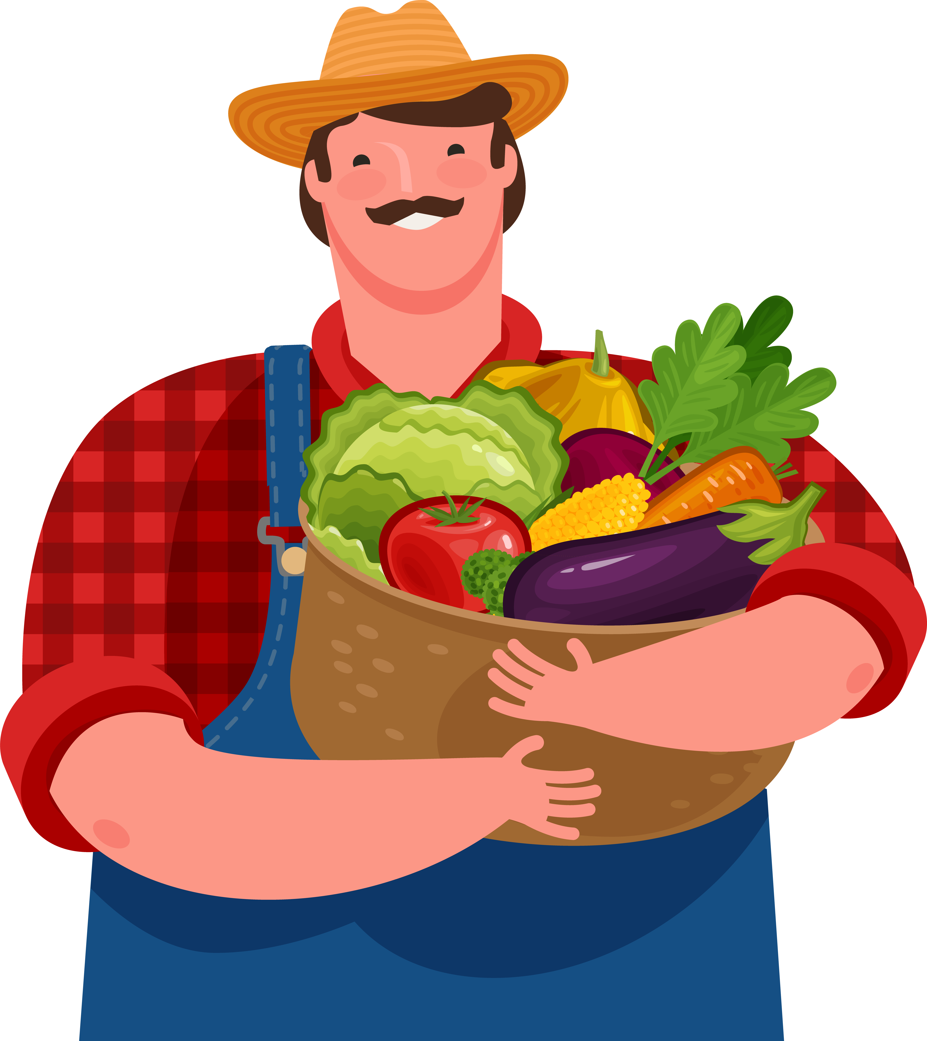
1 | “Bingo”
B-I-N-G-O
Music Slide Deck
Elements of Music
Kindergarten

Slide 5


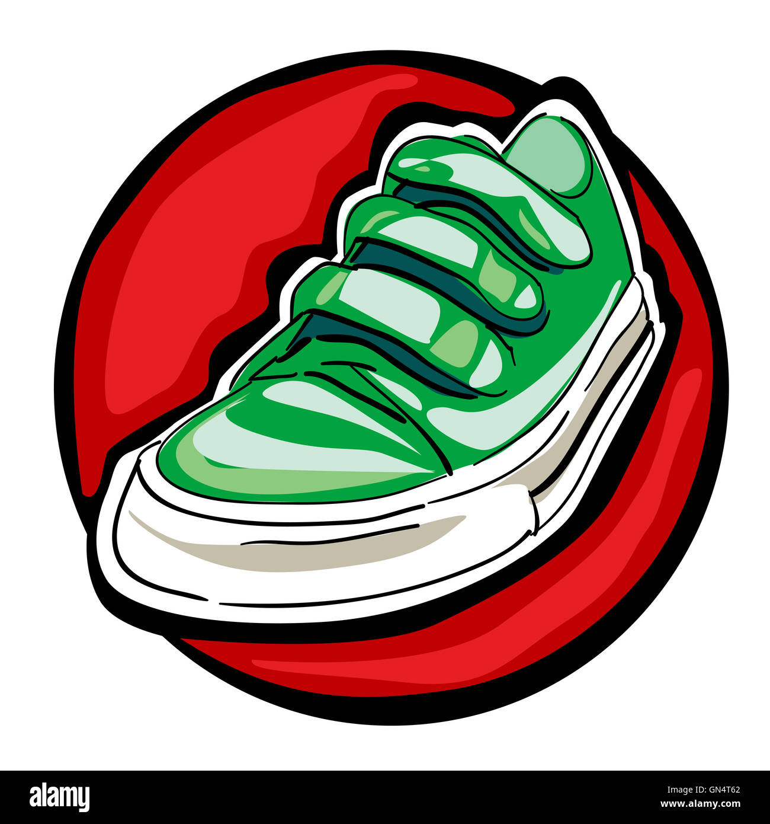
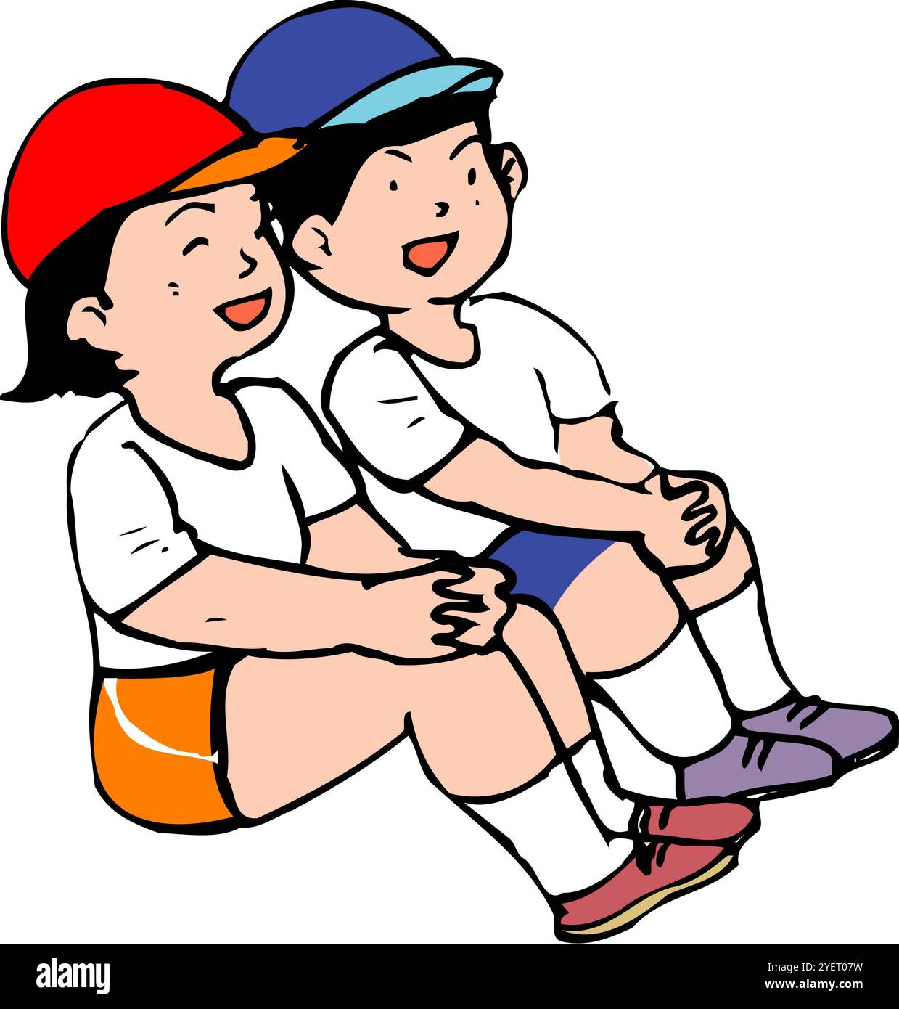
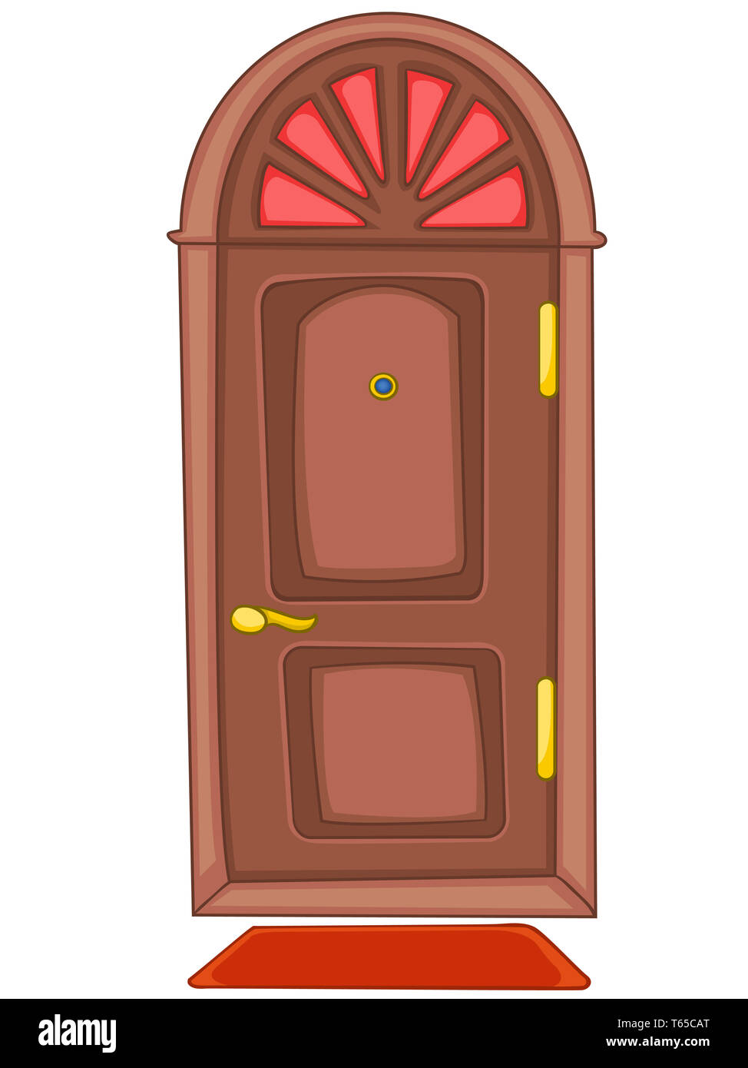

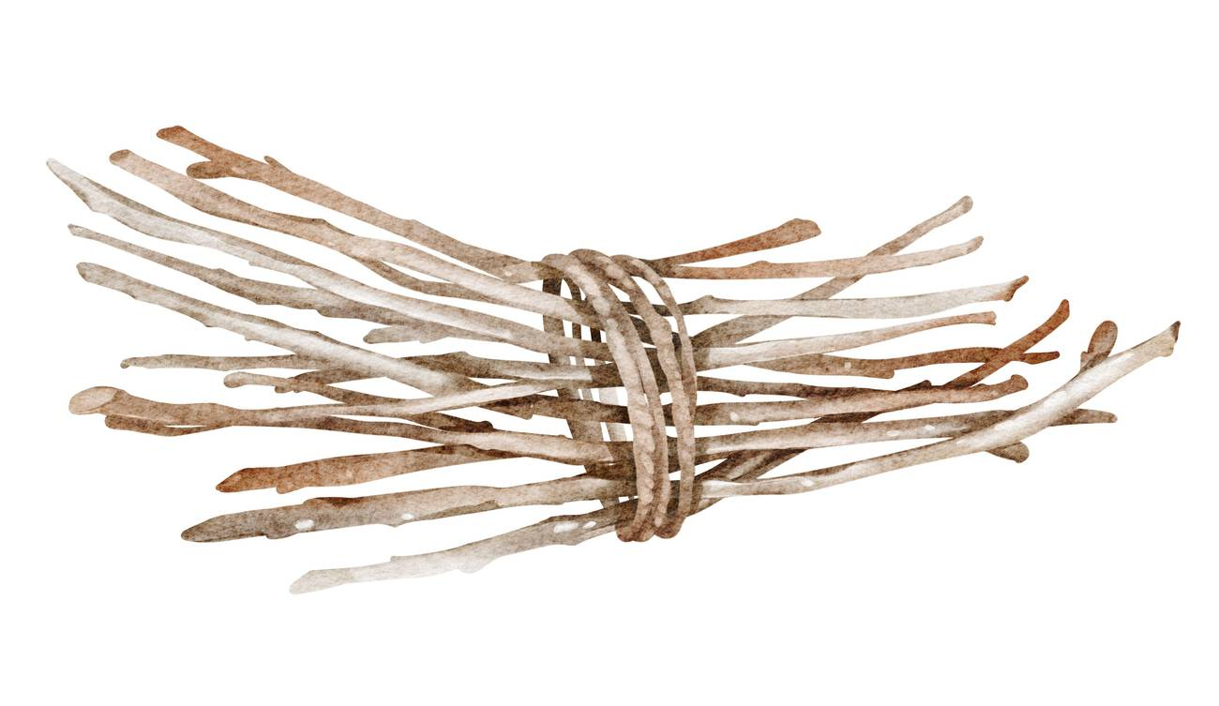

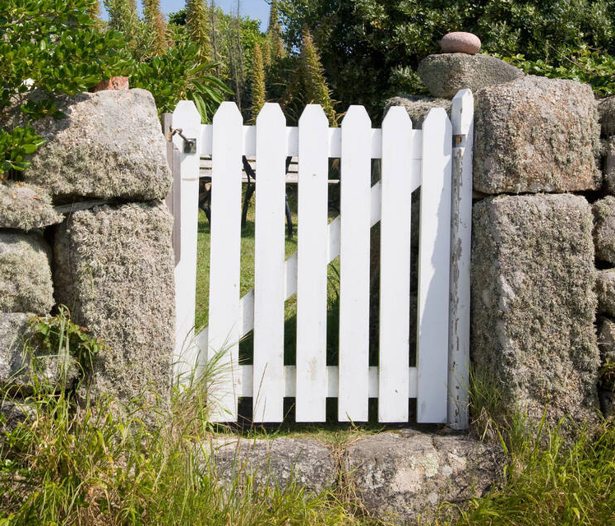
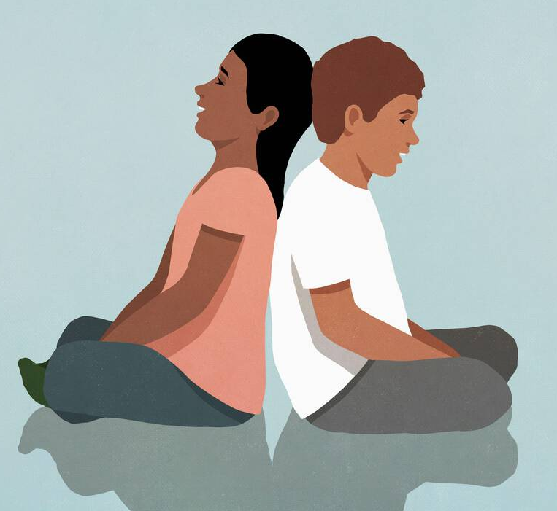

2 | “This Old Man”
1
2
3
4
5
6
7
8
9
10
Music Slide Deck
Elements of Music
Kindergarten

Slide 6
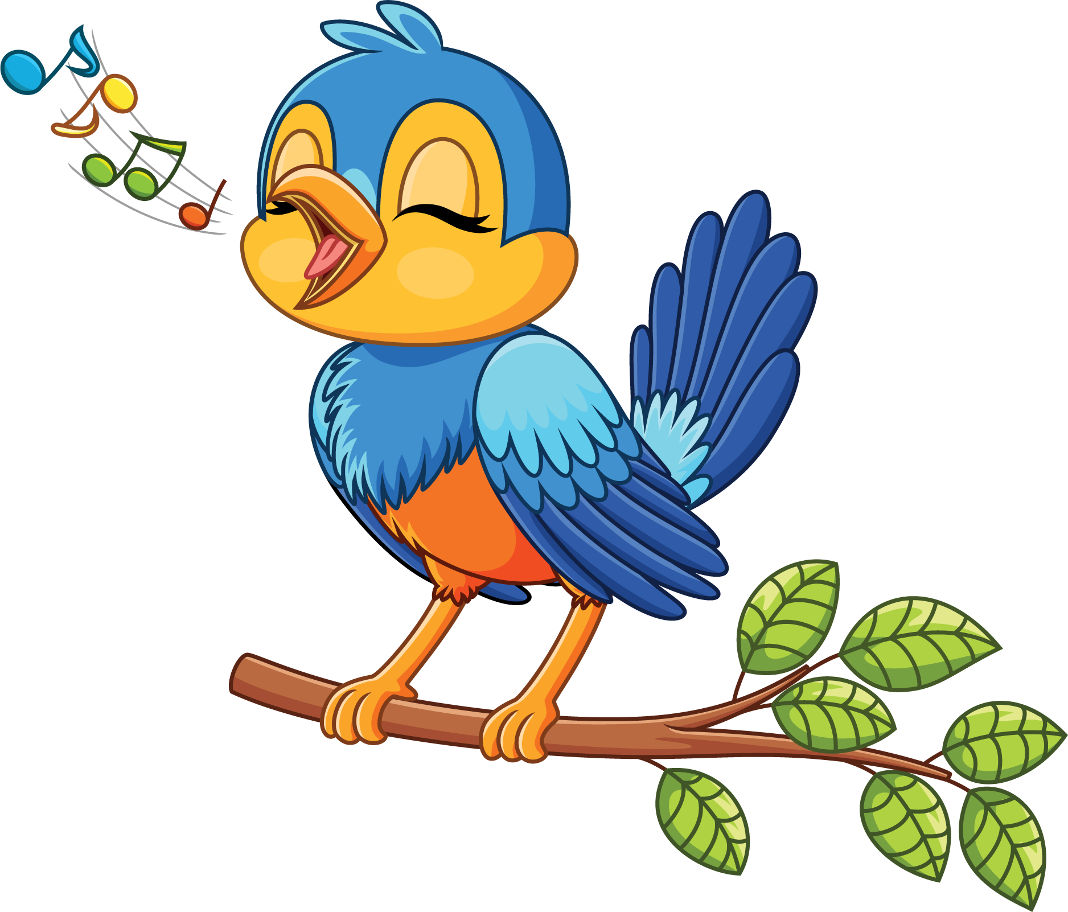
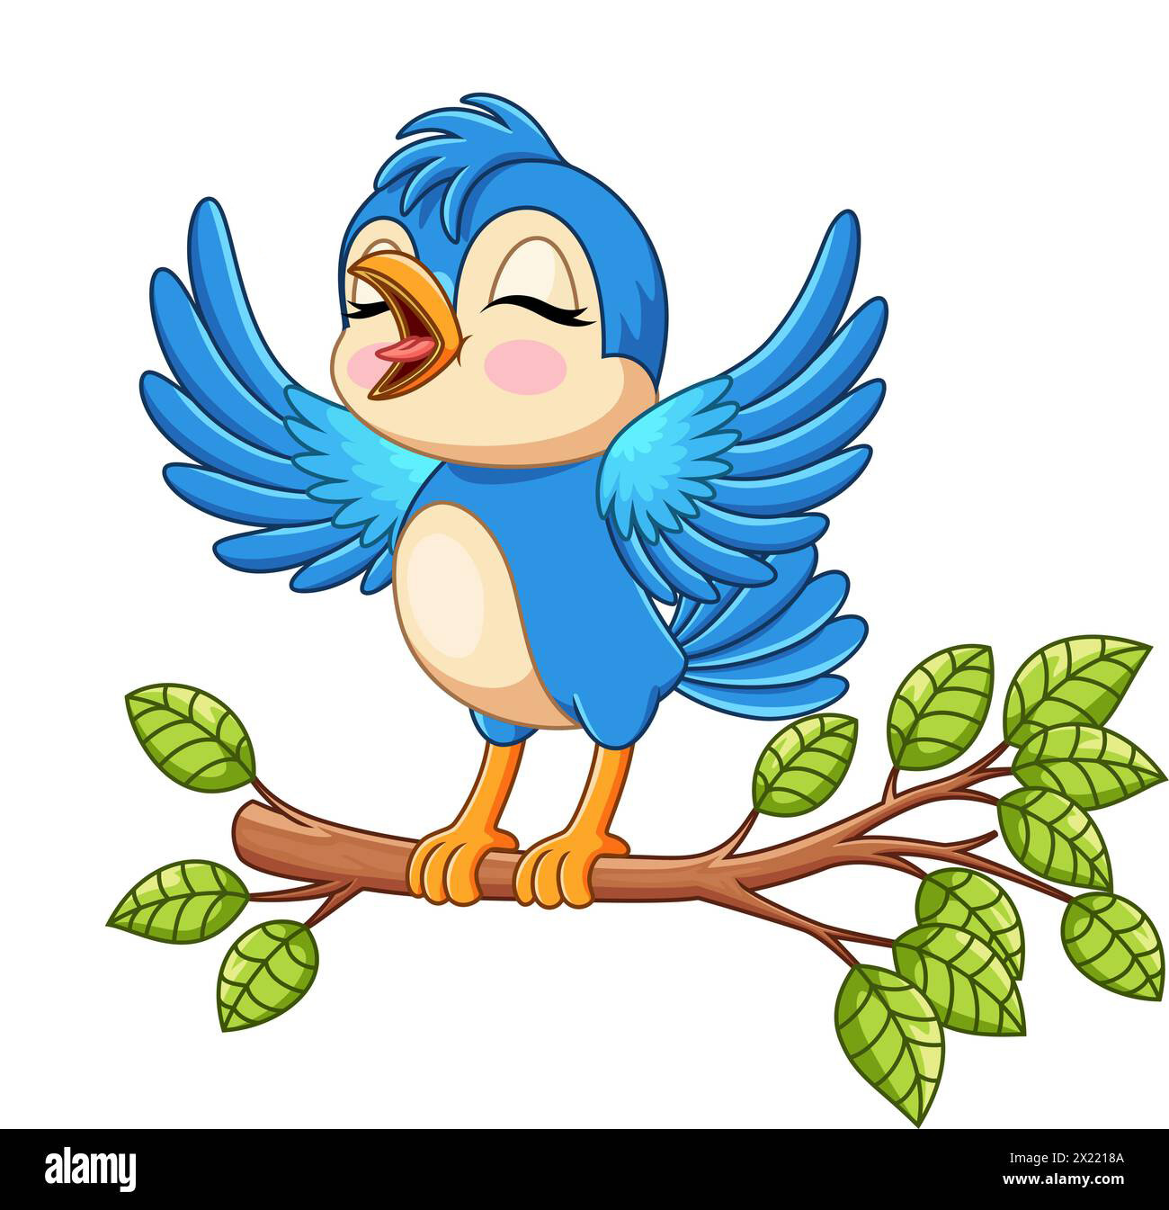
3 | Loud and Soft
Music Slide Deck
Elements of Music
Kindergarten

Slide 7
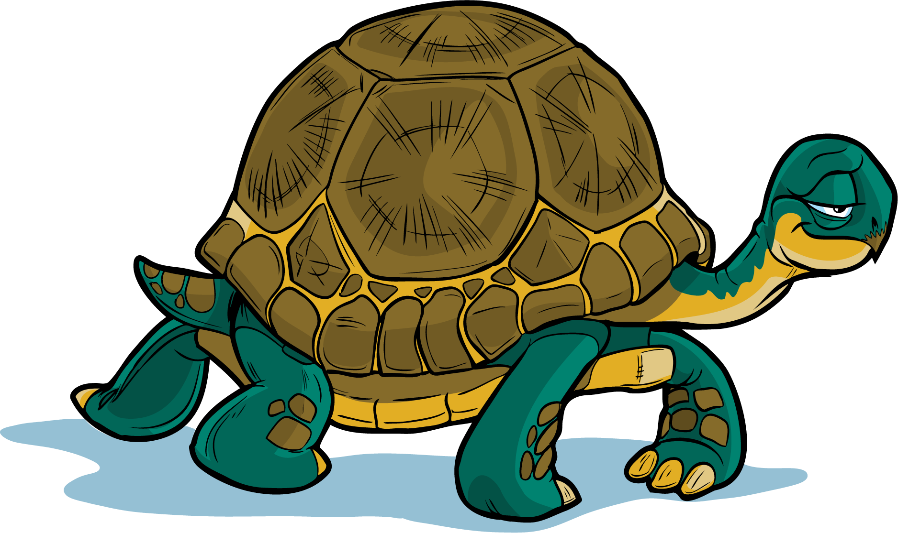
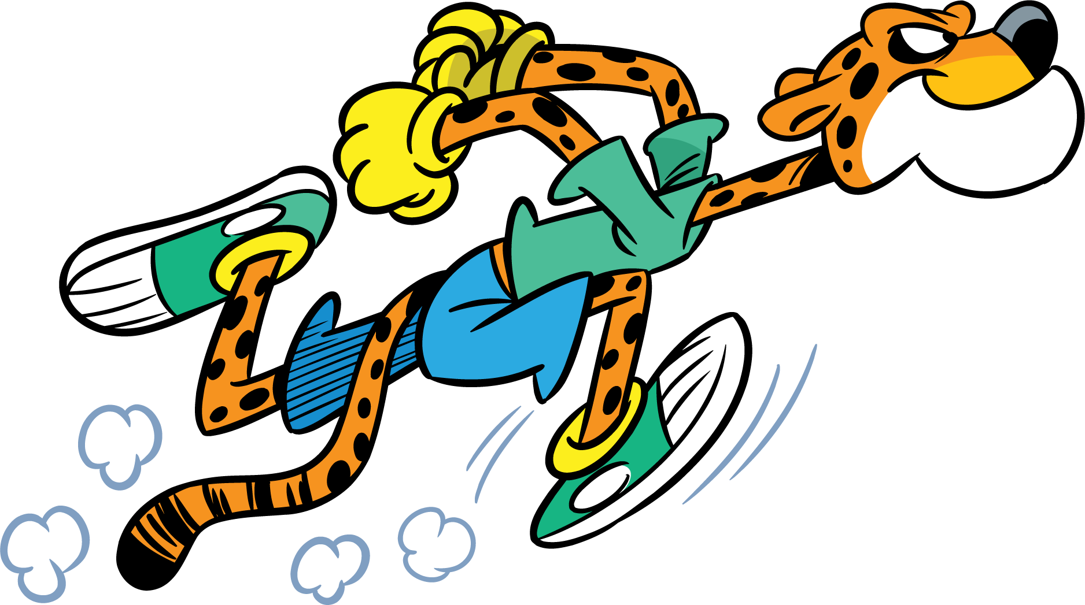
4 | Fast and Slow
Music Slide Deck
Elements of Music
Kindergarten

Slide 8

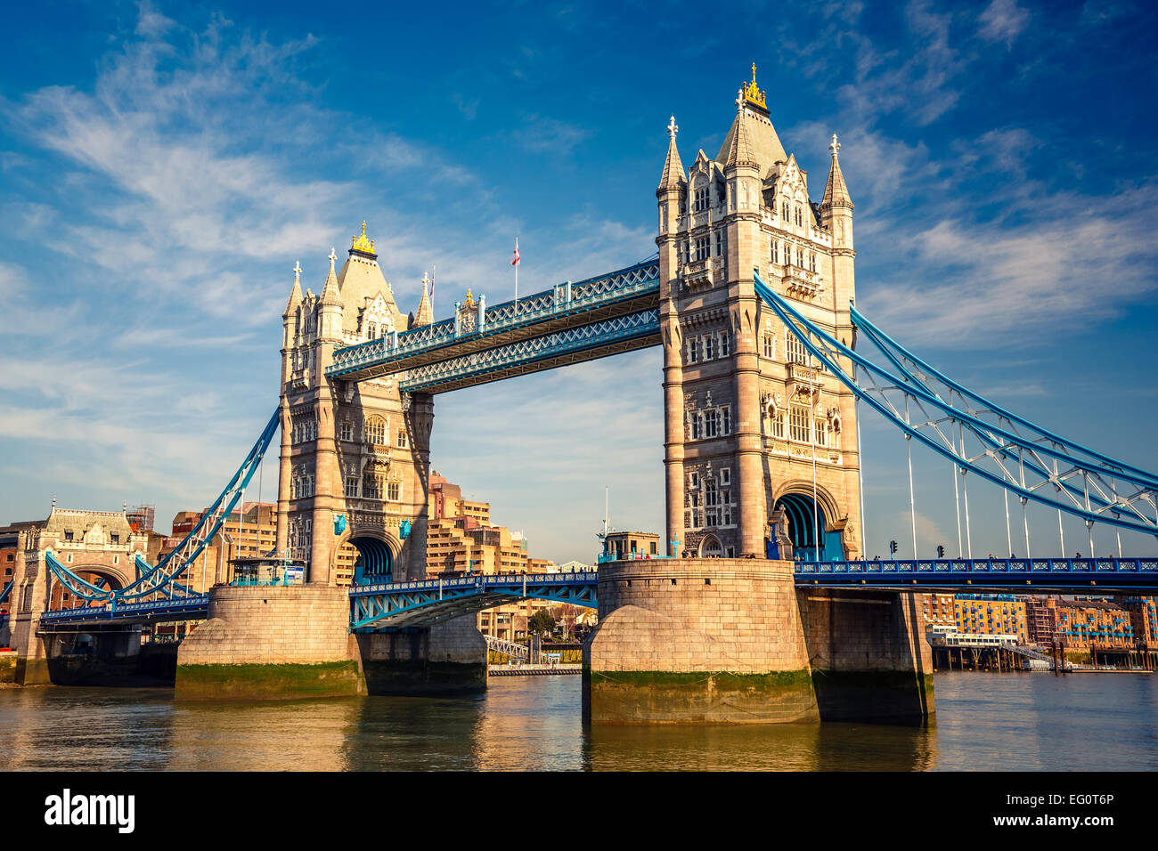
5 | “London Bridge”
Music Slide Deck
Elements of Music
Kindergarten

Slide 9

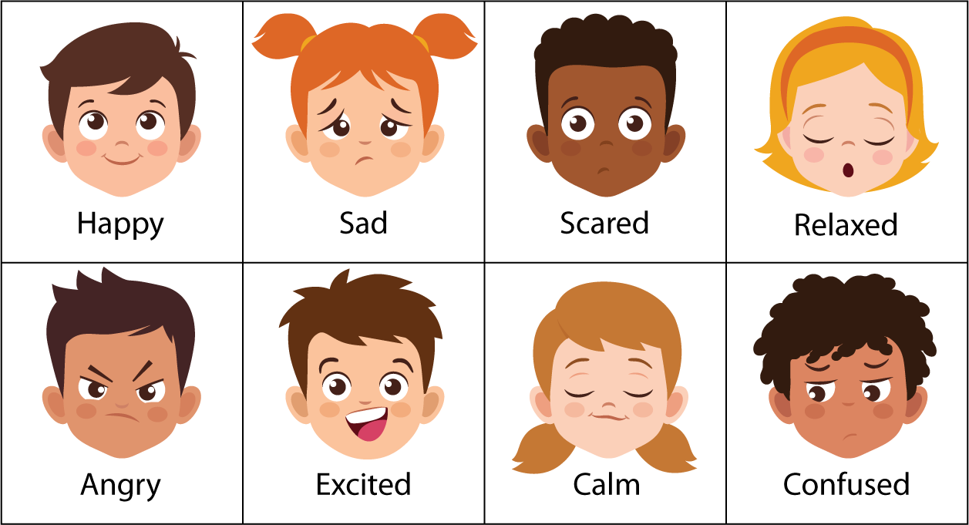
6 | Feelings
Music Slide Deck
Elements of Music
Kindergarten

Slide 10
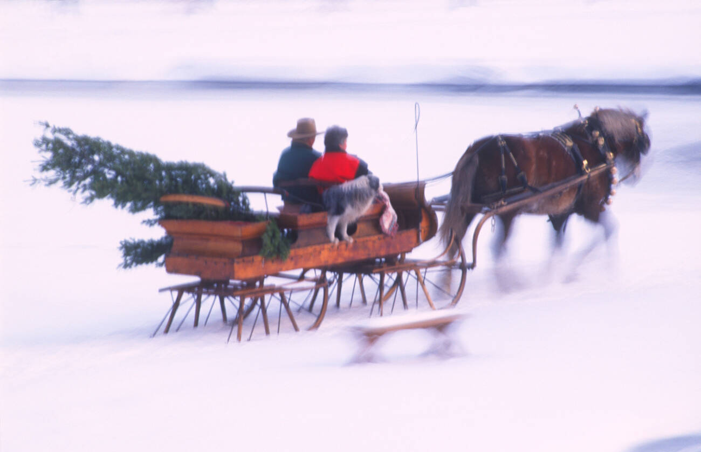
7 | “Jingle Bells”
Dashing through the snow
In a one-horse open sleigh
O'er the fields we go
Laughing all the way
Bells on bob tail ring
Making spirits bright
What fun it is to ride and sing
A sleighing song tonight!
(CHORUS)
Oh! Jingle bells, jingle bells,
Jingle all the way.
Oh! what fun it is to ride
In a one-horse open sleigh. Hey!
Jingle bells, jingle bells,
Jingle all the way;
Oh! what fun it is to ride
In a one-horse open sleigh.
Music Slide Deck
Elements of Music
Kindergarten

Slide 11

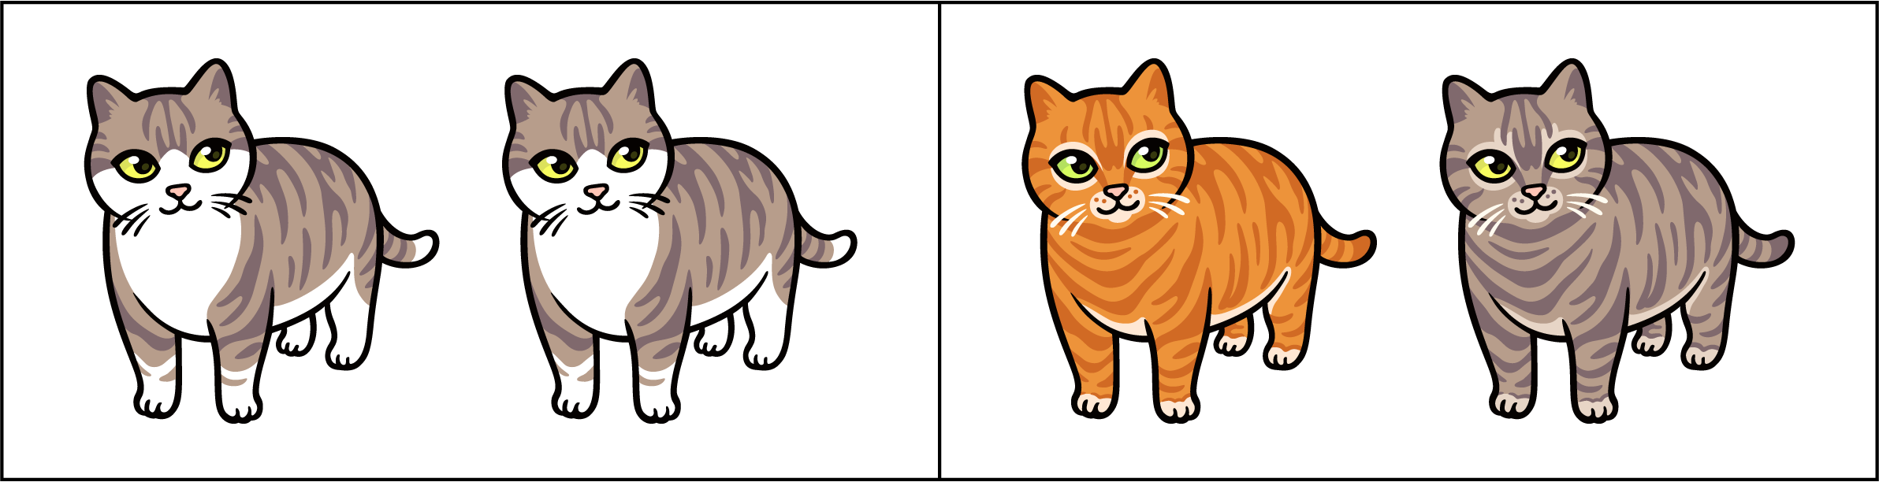
8 | Same or Different?
Music Slide Deck
Elements of Music
Kindergarten

Slide 12
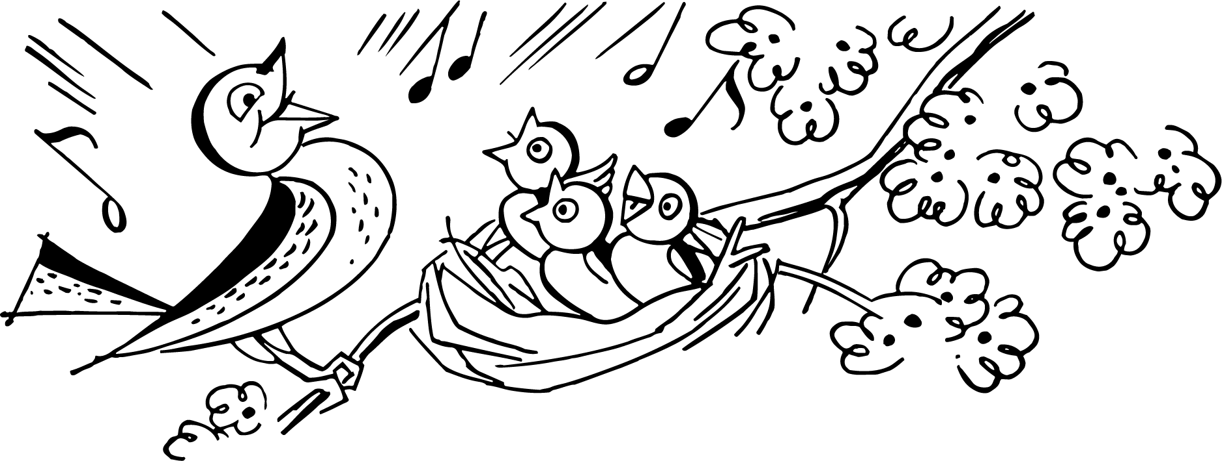
9 | Call and Response
Music Slide Deck
Elements of Music
Kindergarten

Slide 13

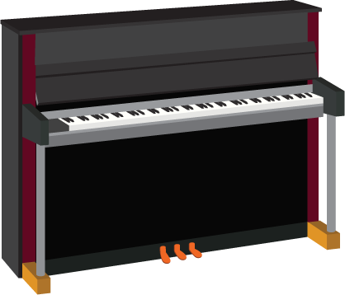
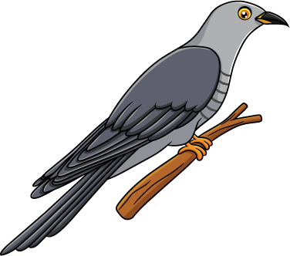
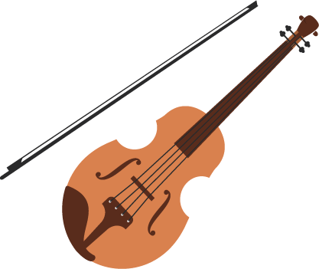
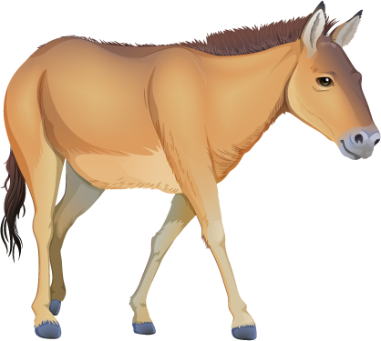
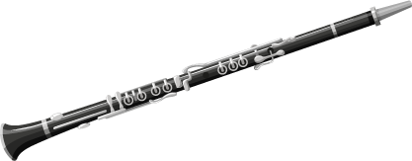
10 | Animals and Instruments
Music Slide Deck
Instruments and Music
Kindergarten

Slide 14
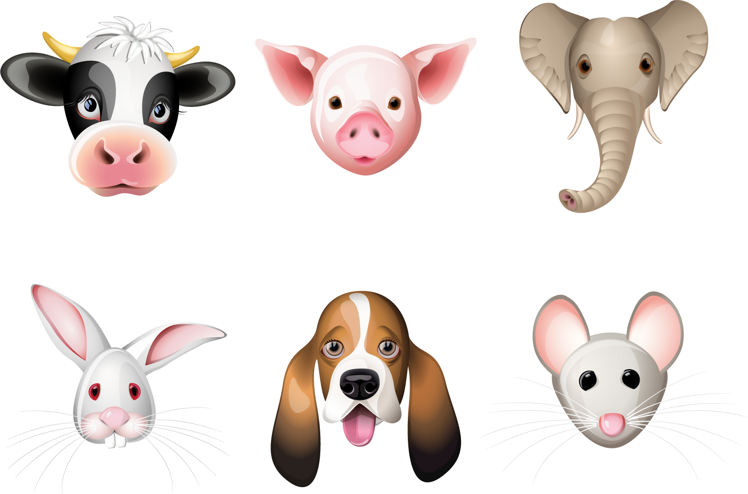
11 | A New Animal Song
Music Slide Deck
Instruments and Music
Kindergarten

Slide 15
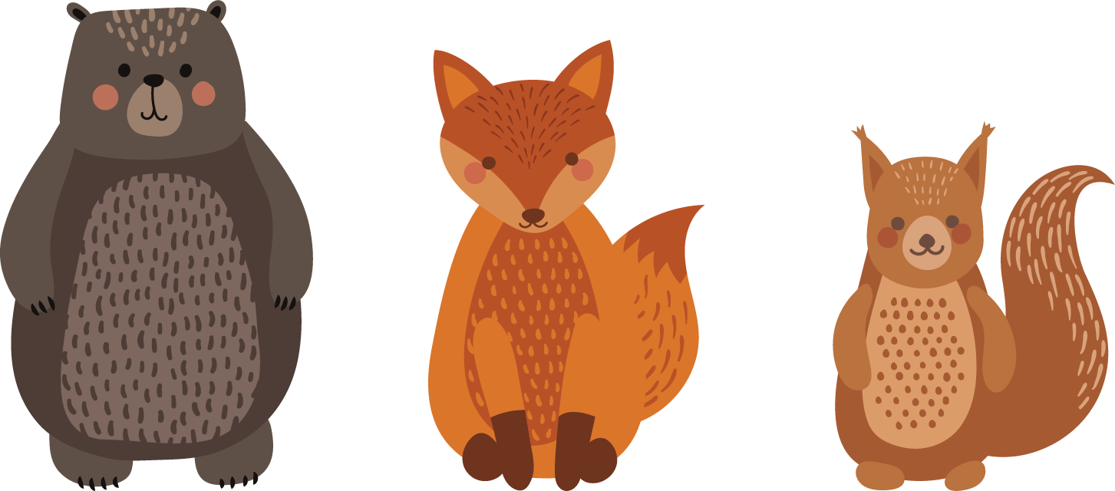

12 | Tell a Musical Story
Music Slide Deck
Instruments and Music
Kindergarten

Slide 16
Music Cards
Credits
Kindergarten
Christopher Doehling / Alamy Stock Photo: 7a
Cienpies Design / Alamy Stock Photo: 5j
Derriva / Alamy Stock Photo: 13d
Don B. Stevenson / Alamy Stock Photo: 10
Elena Batura / Alamy Stock Photo: 5f
Foss / Alamy Stock Photo: 7b
fStop Images GmbH / Alamy Stock Photo: 5i
Igor Zakowski / Alamy Stock Photo: 15b
Ingram Publishing / Alamy Stock Photo: 13e
Irwan Johnny / Alamy Stock Photo: 6a-b
John Baran / Alamy Stock Photo: 5h
M-Studio / Alamy Stock Photo: 5g
Panther Media Global / Alamy Stock Photo: 13c, 13f
RetroClipArt / Alamy Stock Photo: 12
Rohit Kumar / Alamy Stock Photo: 13b
Samir Ranjan Tudu / Alamy Stock Photo: 13a
Sergey Borisov / Alamy Stock Photo: 8b
Sudowoodo / Alamy Stock Photo: 11
V3rc4 / Alamy Stock Photo: 15a
vipervxw / Alamy Stock Photo: 8a
Willy Mobilo / Alamy Stock Photo: 14

