Slide 1



Music Slide Deck
Grade 5

Slide 2

Music Slide Deck
Grade 5
This work is licensed under a Creative Commons Attribution-NonCommercial-ShareAlike 4.0 International License.
You are free:
to Share—to copy, distribute, and transmit the work to Remix—to adapt the work
Under the following conditions:
Attribution—You must attribute the work in the following manner:
This work is based on an original work of the Core Knowledge® Foundation (www.coreknowledge.org) and the additions from the Louisiana Department of Education, made available through licensing under a Creative Commons Attribution-NonCommercial-ShareAlike4.0 International License. This does not in any way imply that the Core Knowledge Foundation or the Louisiana Department of Education endorses this work.
Noncommercial—You may not use this work for commercial purposes.
Share Alike—If you alter, transform, or build upon this work, you may distribute the resulting work only under the same or similar license to this one.
With the understanding that:
For any reuse or distribution, you must make clear to others the license terms of this work. The best way to do this is with a link to this web page:
https://creativecommons.org/licenses/by-nc-sa/4.0/
Copyright © 2025 Core Knowledge Foundation
www.coreknowledge.org
All Rights Reserved.
Core Knowledge©, Core Knowledge Curriculum Series™, Core Knowledge Arts™, Core Knowledge Music™ are trademarks are trademarks of the Core Knowledge Foundation. Foundations of Freedom is a trademark of the Louisiana Department of Education.
Trademarks and trade names are shown in this book strictly for illustrative and educational purposes and are the property of their respective owners. References herein should not be regarded as affecting the validity of said trademarks and trade names.
ISBN: 979-8-88970-660-1

Slide 3

Content
Music Slide Deck
Grade 5
I. Elements of Music
1 | Reading Rhythms
2 | Rests
3 | Reading Tied and Dotted Notes
4 | “Dona nobis pacem” Part 1
5 | On the Scale
6 | “Dona nobis pacem” Part 2
7 | Dynamic Markings
II. Composers
III. Renaissance Music
IV. American Spirituals

Slide 4
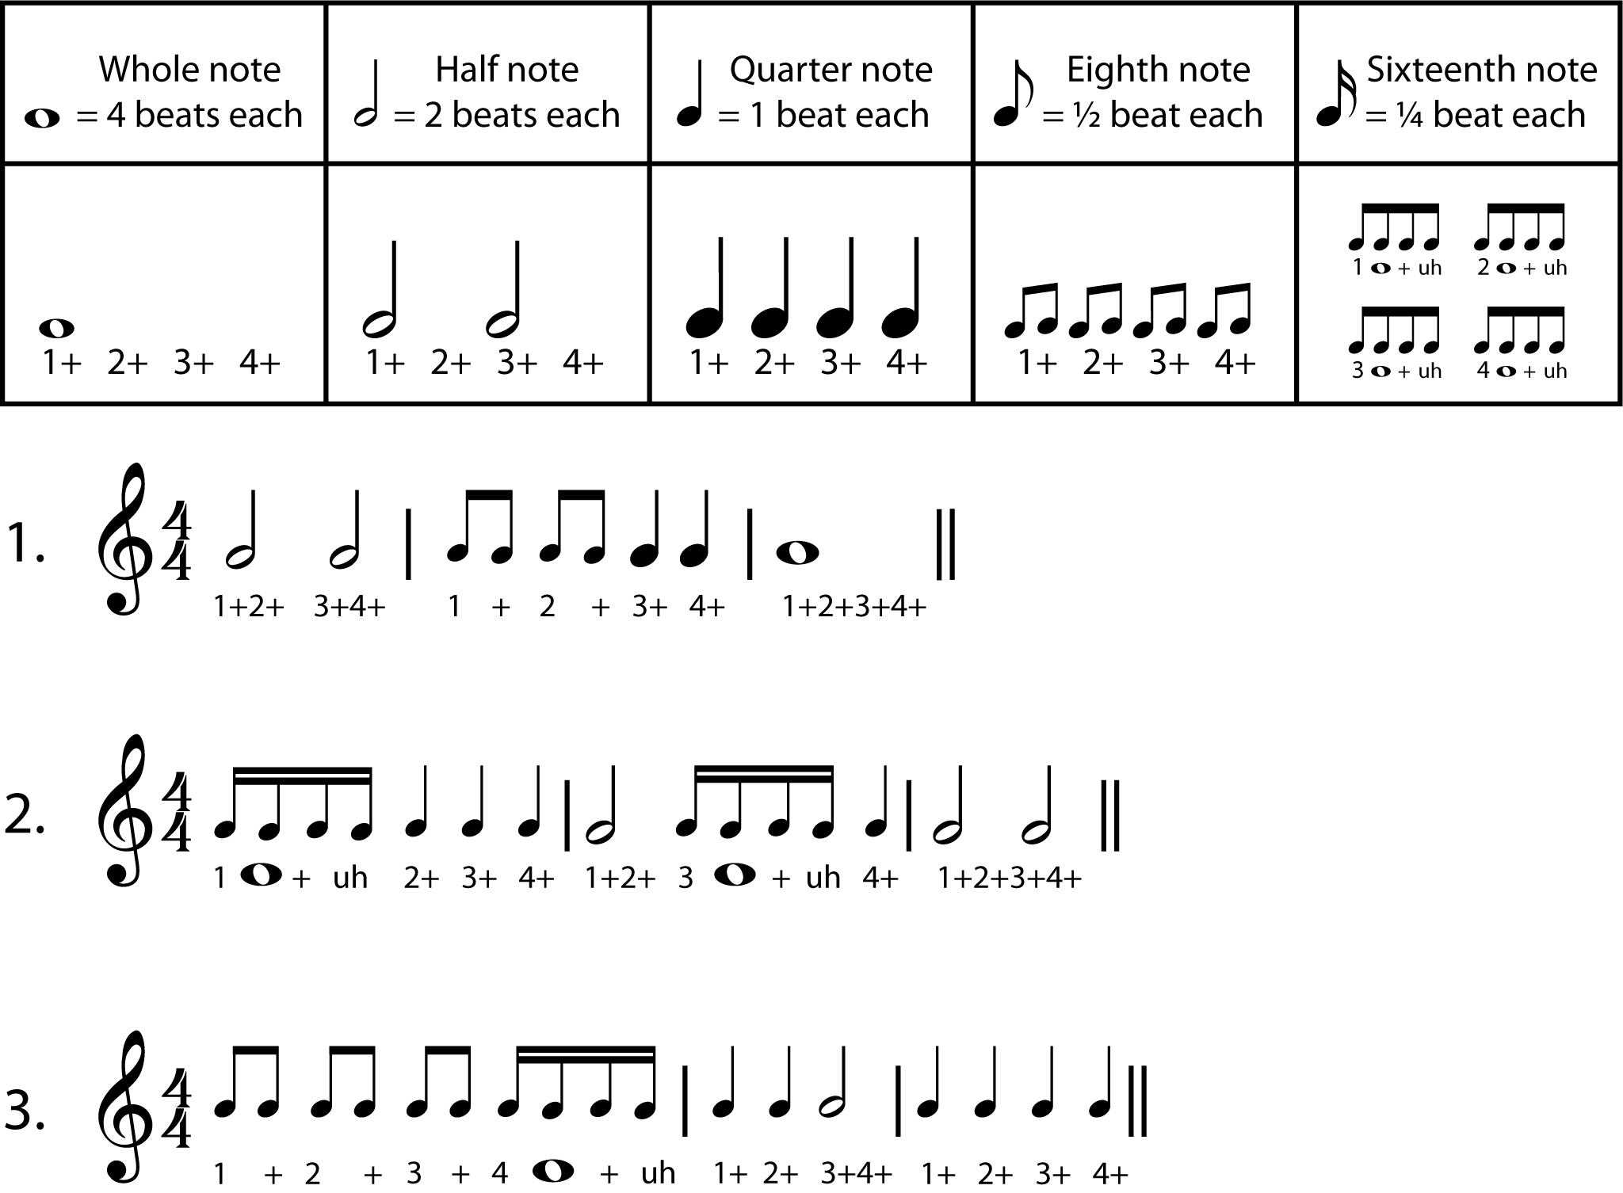
1 | Reading Rhythms
Music Slide Deck
Elements of Music
Grade 5

Slide 5
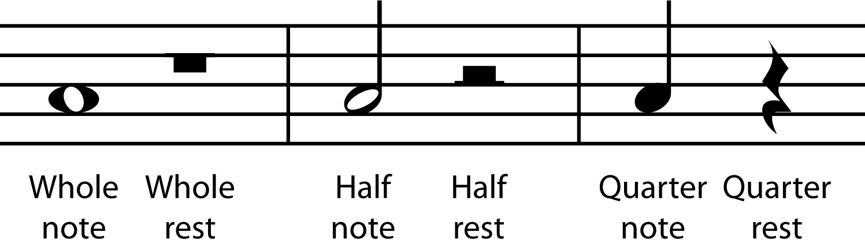
2 | Rests
Music Slide Deck
Elements of Music
Grade 5

Slide 6
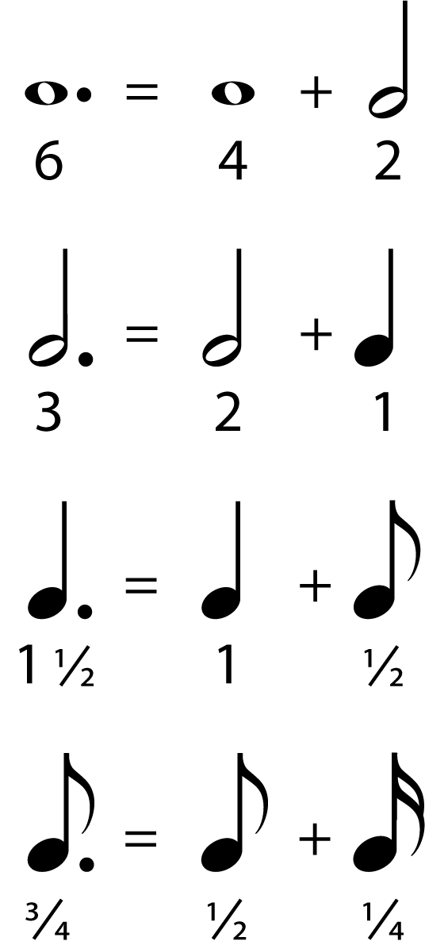
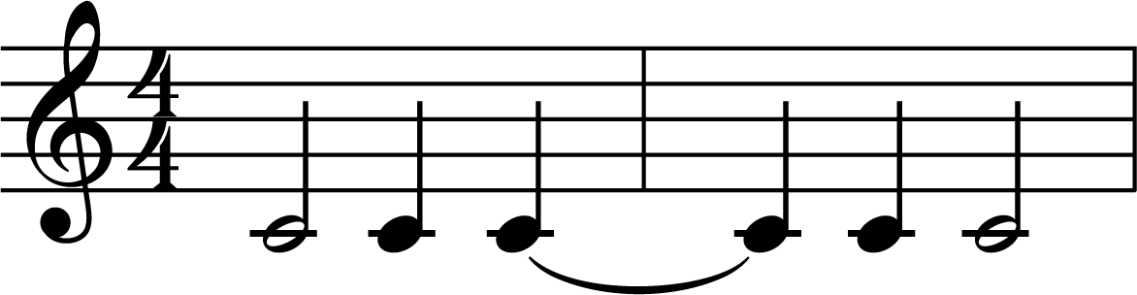
3 | Reading Tied and Dotted Notes
Tied notes connect the values of notes using a curved line, or tie.
Dotted notes add half the value of a note to the note that is dotted.
Music Slide Deck
Elements of Music
Grade 5

Slide 7
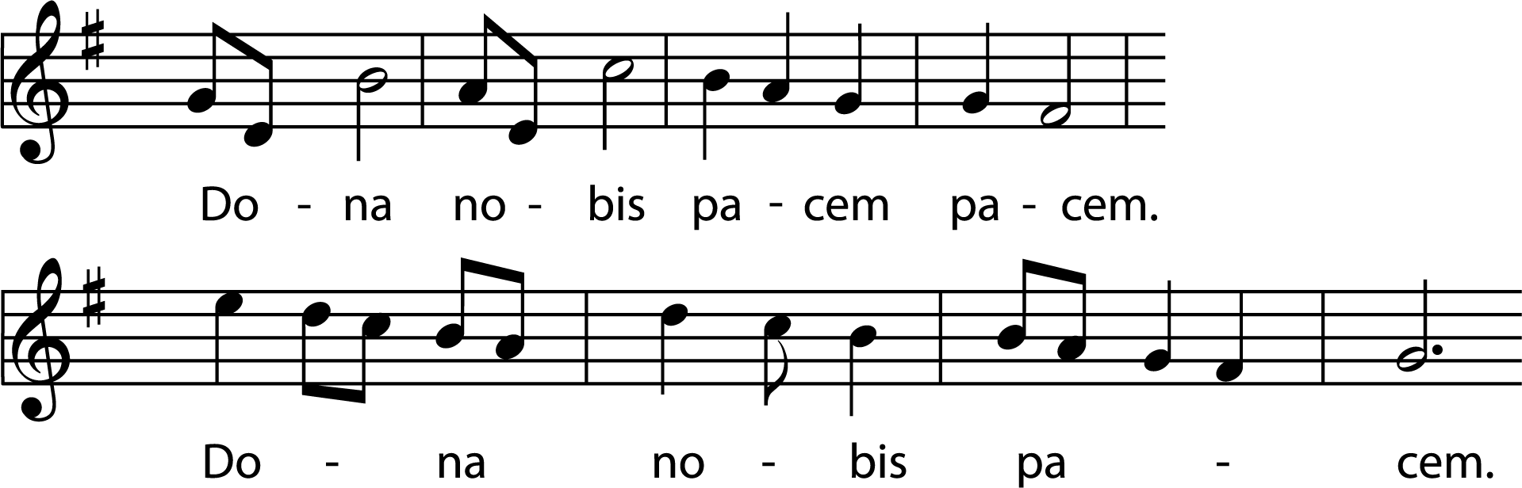
4 | “Dona nobis pacem” Part 1
Music Slide Deck
Elements of Music
Grade 5

Slide 8
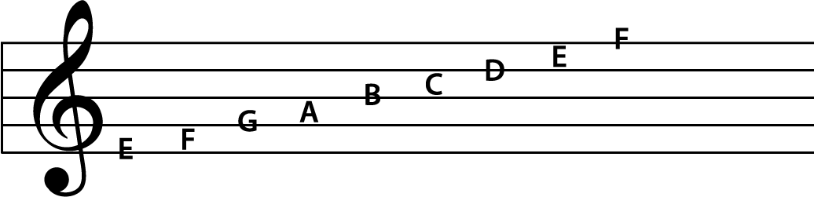
5 | On the Scale
Pitch Letters on a Scale
Music Slide Deck
Elements of Music
Grade 5

Slide 9
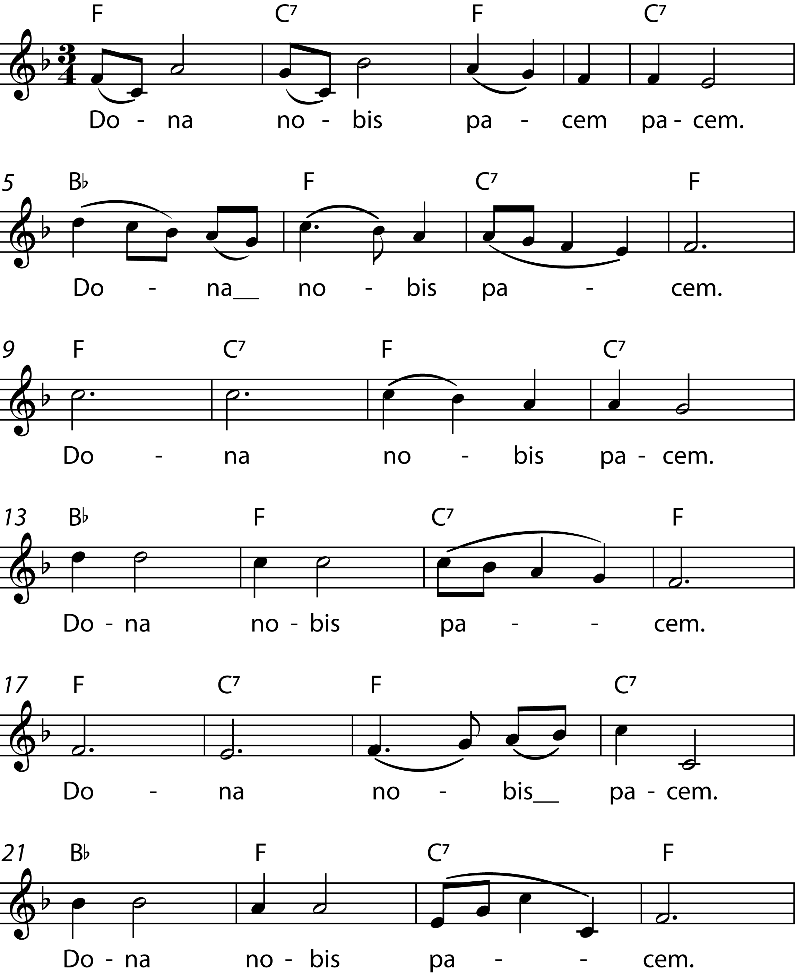
6 | “Dona nobis pacem” Part 2
Music Slide Deck
Elements of Music
Grade 5

Slide 10
7 | Dynamic Markings
Composers use various dynamics markings to indicate how sheet music should be played. ​
• forte = loud​
• piano = soft​
• mezzo = medium​
pp​ | p​ | mp​ | mf​ | f​ | ff​
Very soft​ | Soft​ | Medium soft​ | Medium loud​ | Loud​ | Very loud​
Pianissimo​ | Piano​ | Mezzo piano​ | Mezzo forte​ | Forte​ | Fortissimo​
crescendo gradual increase in volume
decrescendo gradual decrease in volume
Music Slide Deck
Elements of Music
Grade 5

