Slide 1



Music Slide Deck
Grade 1

Slide 2


Music Slide Deck
Grade 1
This work is licensed under a Creative Commons Attribution-NonCommercial-ShareAlike 4.0 International License.
You are free:
to Share—to copy, distribute, and transmit the work to Remix—to adapt the work
Under the following conditions:
Attribution—You must attribute the work in the following manner:
This work is based on an original work of the Core Knowledge® Foundation (www.coreknowledge.org) and the additions from the Louisiana Department of Education, made available through licensing under a Creative Commons Attribution-NonCommercial-ShareAlike4.0 International License. This does not in any way imply that the Core Knowledge Foundation or the Louisiana Department of Education endorses this work.
Noncommercial—You may not use this work for commercial purposes.
Share Alike—If you alter, transform, or build upon this work, you may distribute the resulting work only under the same or similar license to this one.
With the understanding that:
For any reuse or distribution, you must make clear to others the license terms of this work. The best way to do this is with a link to this web page:
https://creativecommons.org/licenses/by-nc-sa/4.0/
Copyright © 2025 Core Knowledge Foundation
www.coreknowledge.org
All Rights Reserved.
Core Knowledge©, Core Knowledge Curriculum Series™, Core Knowledge Arts™, Core Knowledge Music™ are trademarks are trademarks of the Core Knowledge Foundation. Foundations of Freedom is a trademark of the Louisiana Department of Education.
Trademarks and trade names are shown in this book strictly for illustrative and educational purposes and are the property of their respective owners. References herein should not be regarded as affecting the validity of said trademarks and trade names.
ISBN: 979-8-88970-656-4

Slide 3

Content
Music Slide Deck
Grade 1
I. Elements of Music
1 | “Dry Bones”
2 | High and Low Sounds 3 | Melody
4 | “Make New Friends”
5 | Loud and Soft
6 | Fast and Slow
7 | “When the Saints Go Marching In”
8 | Quarter Notes and Eighth Notes
9 | Unit 1 Assessment
III. Music Can Tell a Story
15 | Hansel and Gretel
16 | Musical Themes
17 | Dance
II. Composers and the Orchestra
10 | Emotions
11 | The String Family
12 | The Woodwind Family
13 | The Brass Family
14 | The Percussion Family

Slide 4

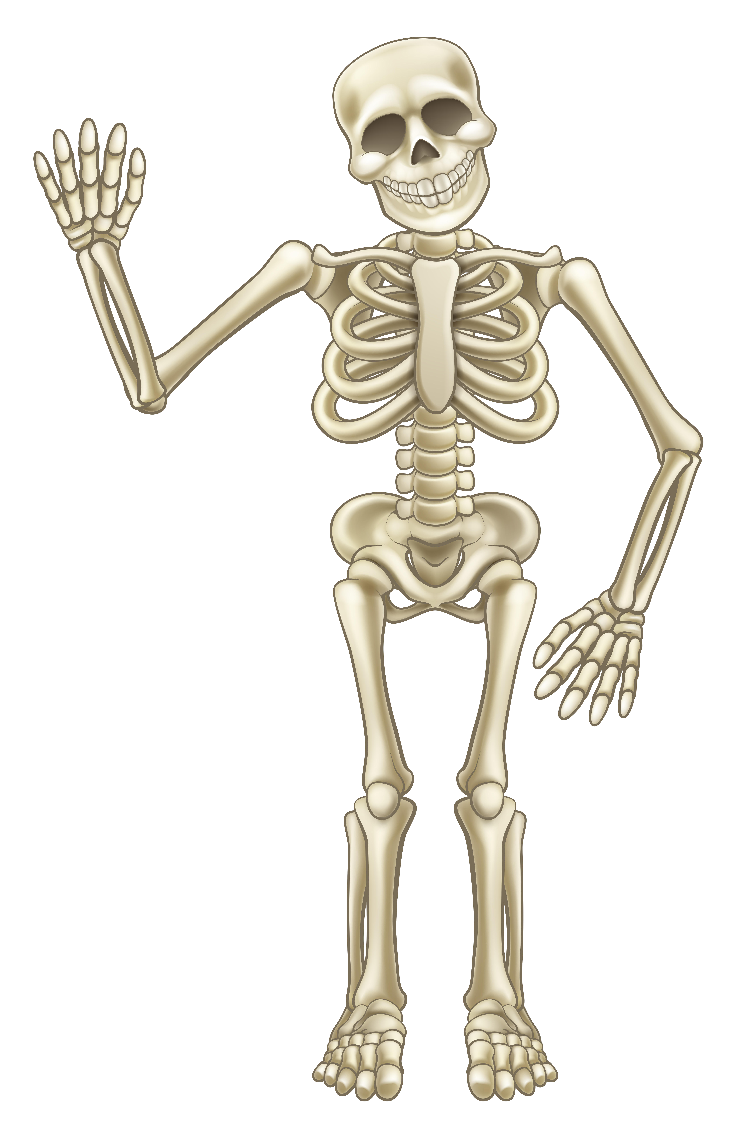
1 | “Dry Bones”
toe
foot
heel
ankle
leg
knee
thigh
hip
back
shoulder
neck
head
Music Slide Deck
Elements of Music
Grade 1

Slide 5


2 | High and Low Sounds
Music Slide Deck
Elements of Music
Grade 1

Slide 6

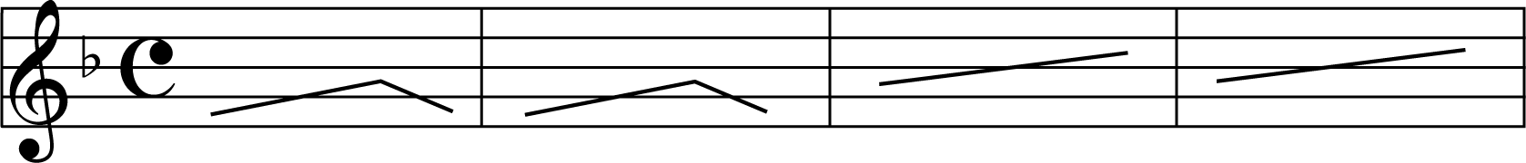
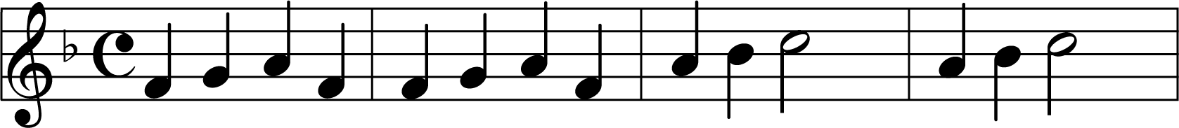
3 | Melody
Music Slide Deck
Elements of Music
Grade 1

Slide 7


4 | “Make New Friends”
Make new friends, but keep the old.
One is silver and the other gold.
Music Slide Deck
Elements of Music
Grade 1

Slide 8


5 | Loud and Soft
Music Slide Deck
Elements of Music
Grade 1

Slide 9

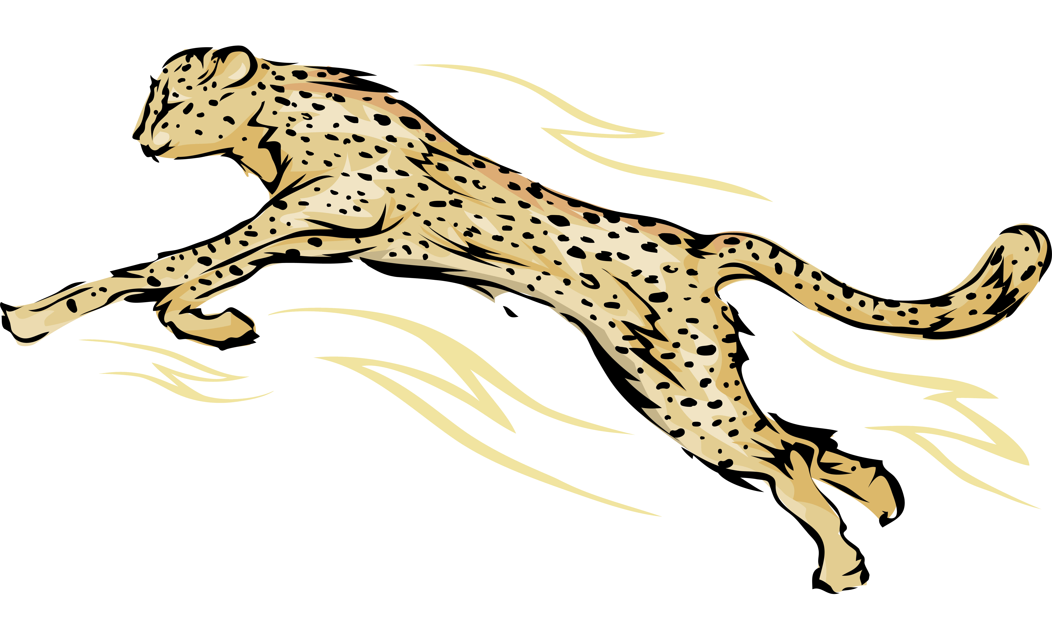
6 | Fast and Slow
adagio
moderato
allegro
Music Slide Deck
Elements of Music
Grade 1

Slide 10
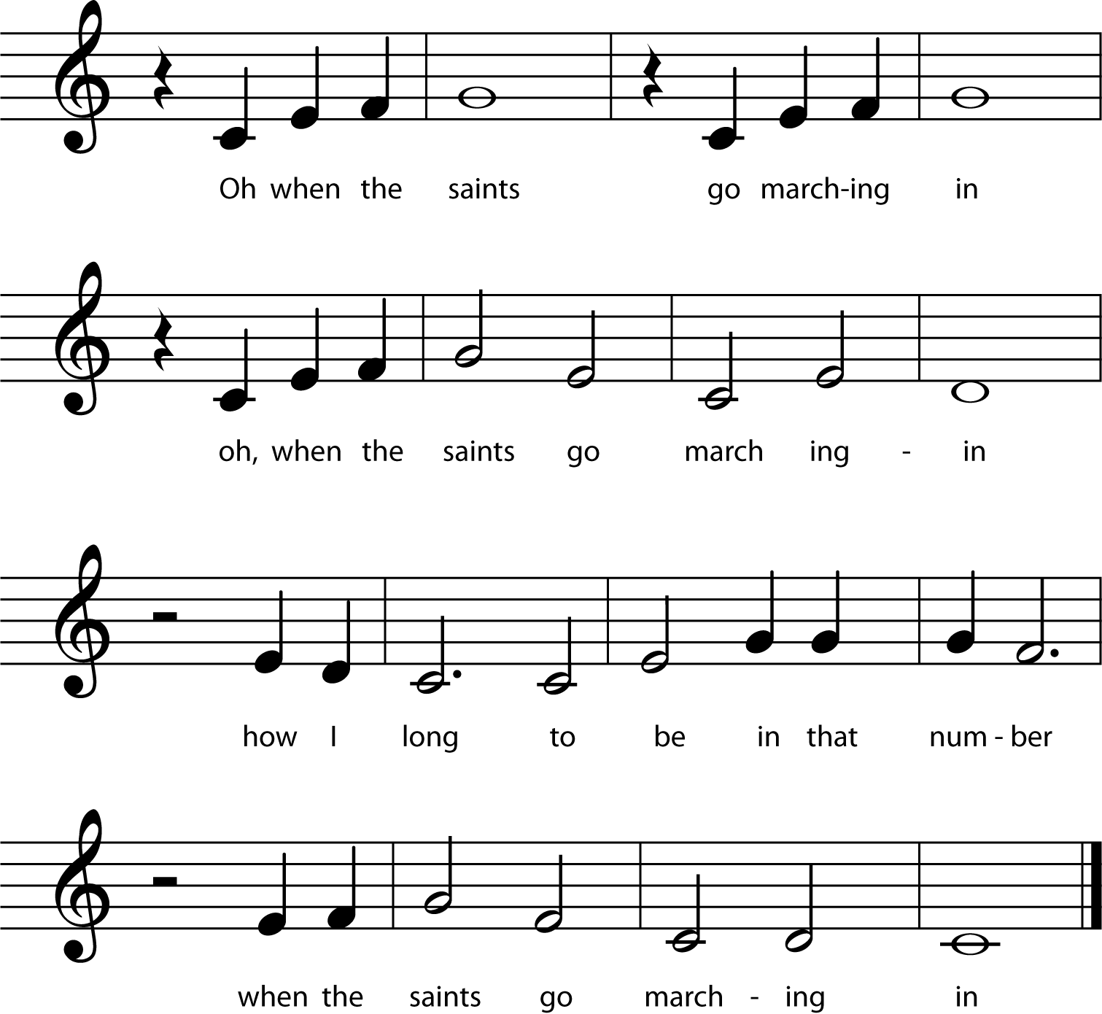
7 | “When the Saints Go Marching In”
Music Slide Deck
Elements of Music
Grade 1

Slide 11


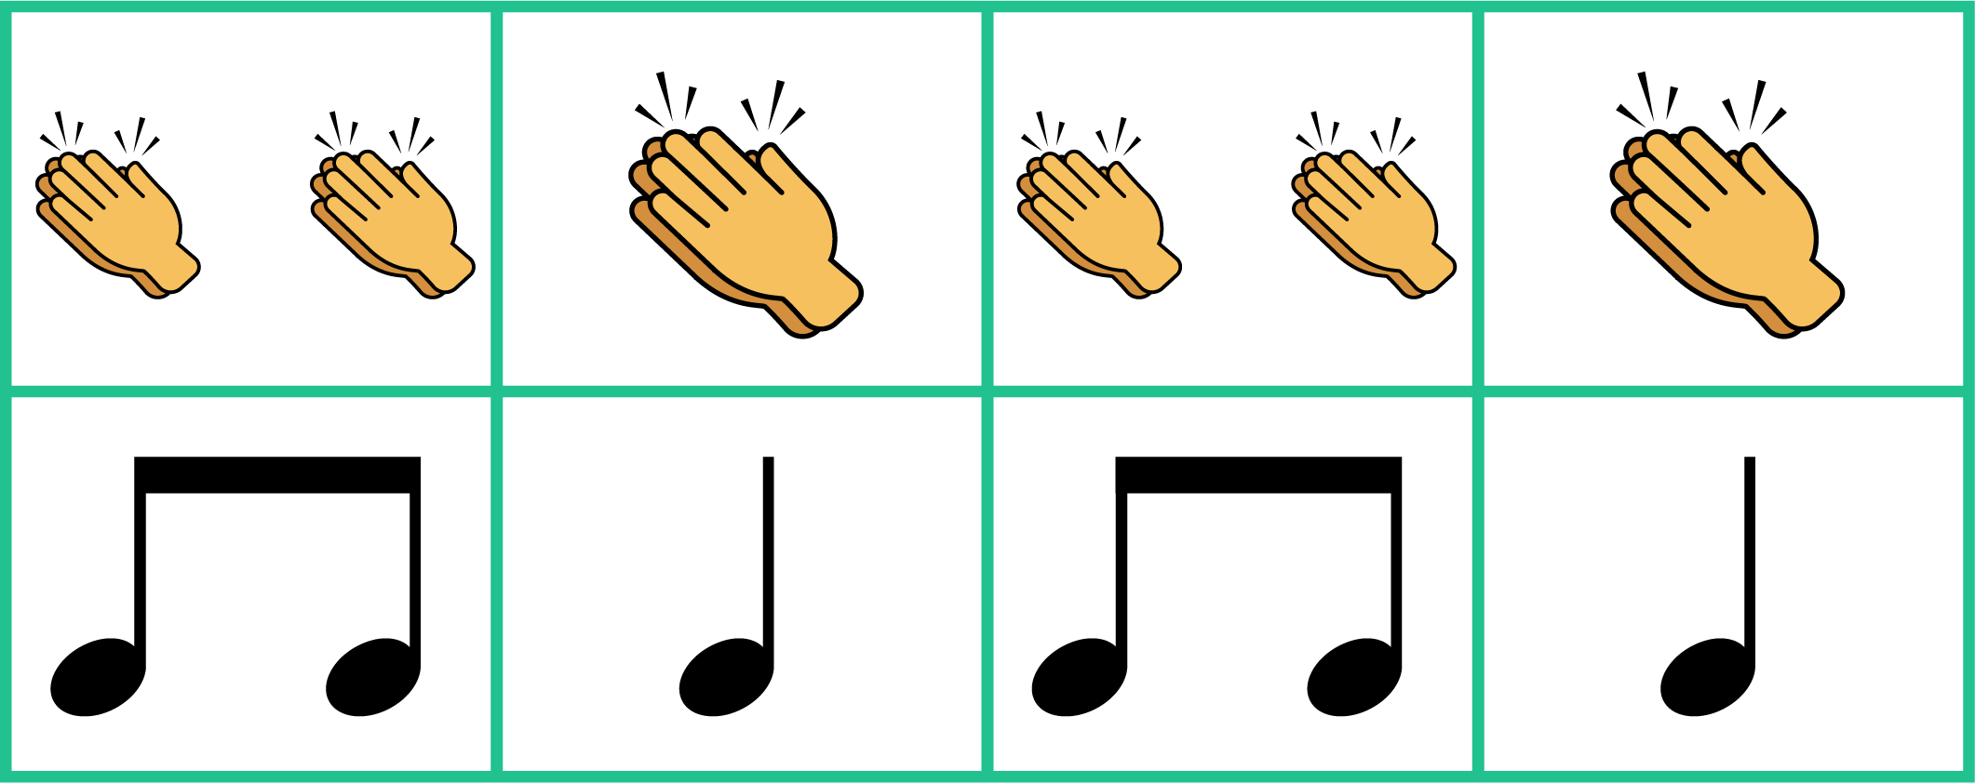

8 | Quarter Notes and Eighth Notes
Quarter note | Eighth notes
1
1 and
Music Slide Deck
Elements of Music
Grade 1

Slide 12



9 | Unit 1 Assessment
Music Slide Deck
Elements of Music
Grade 1

Slide 13
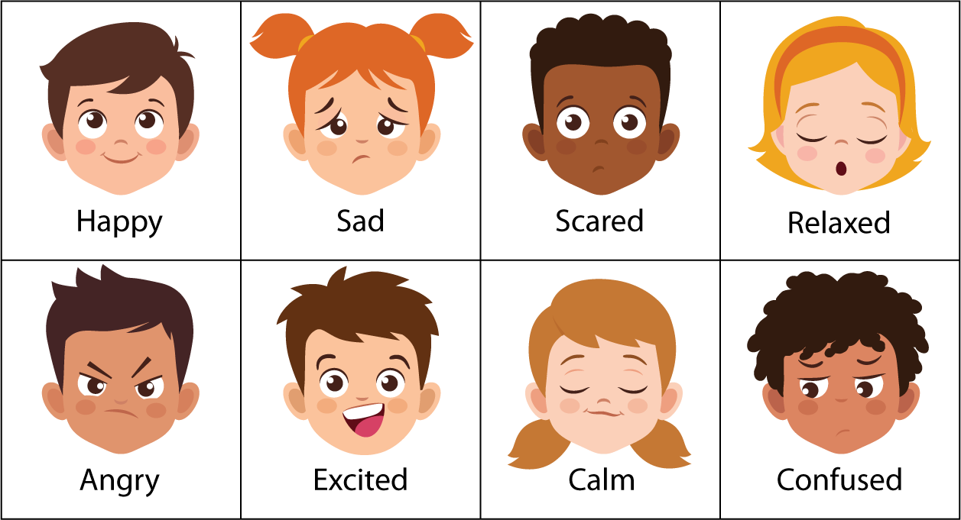
10 | Emotions
Music Slide Deck
Composers and the Orchestra
Grade 1

Slide 14
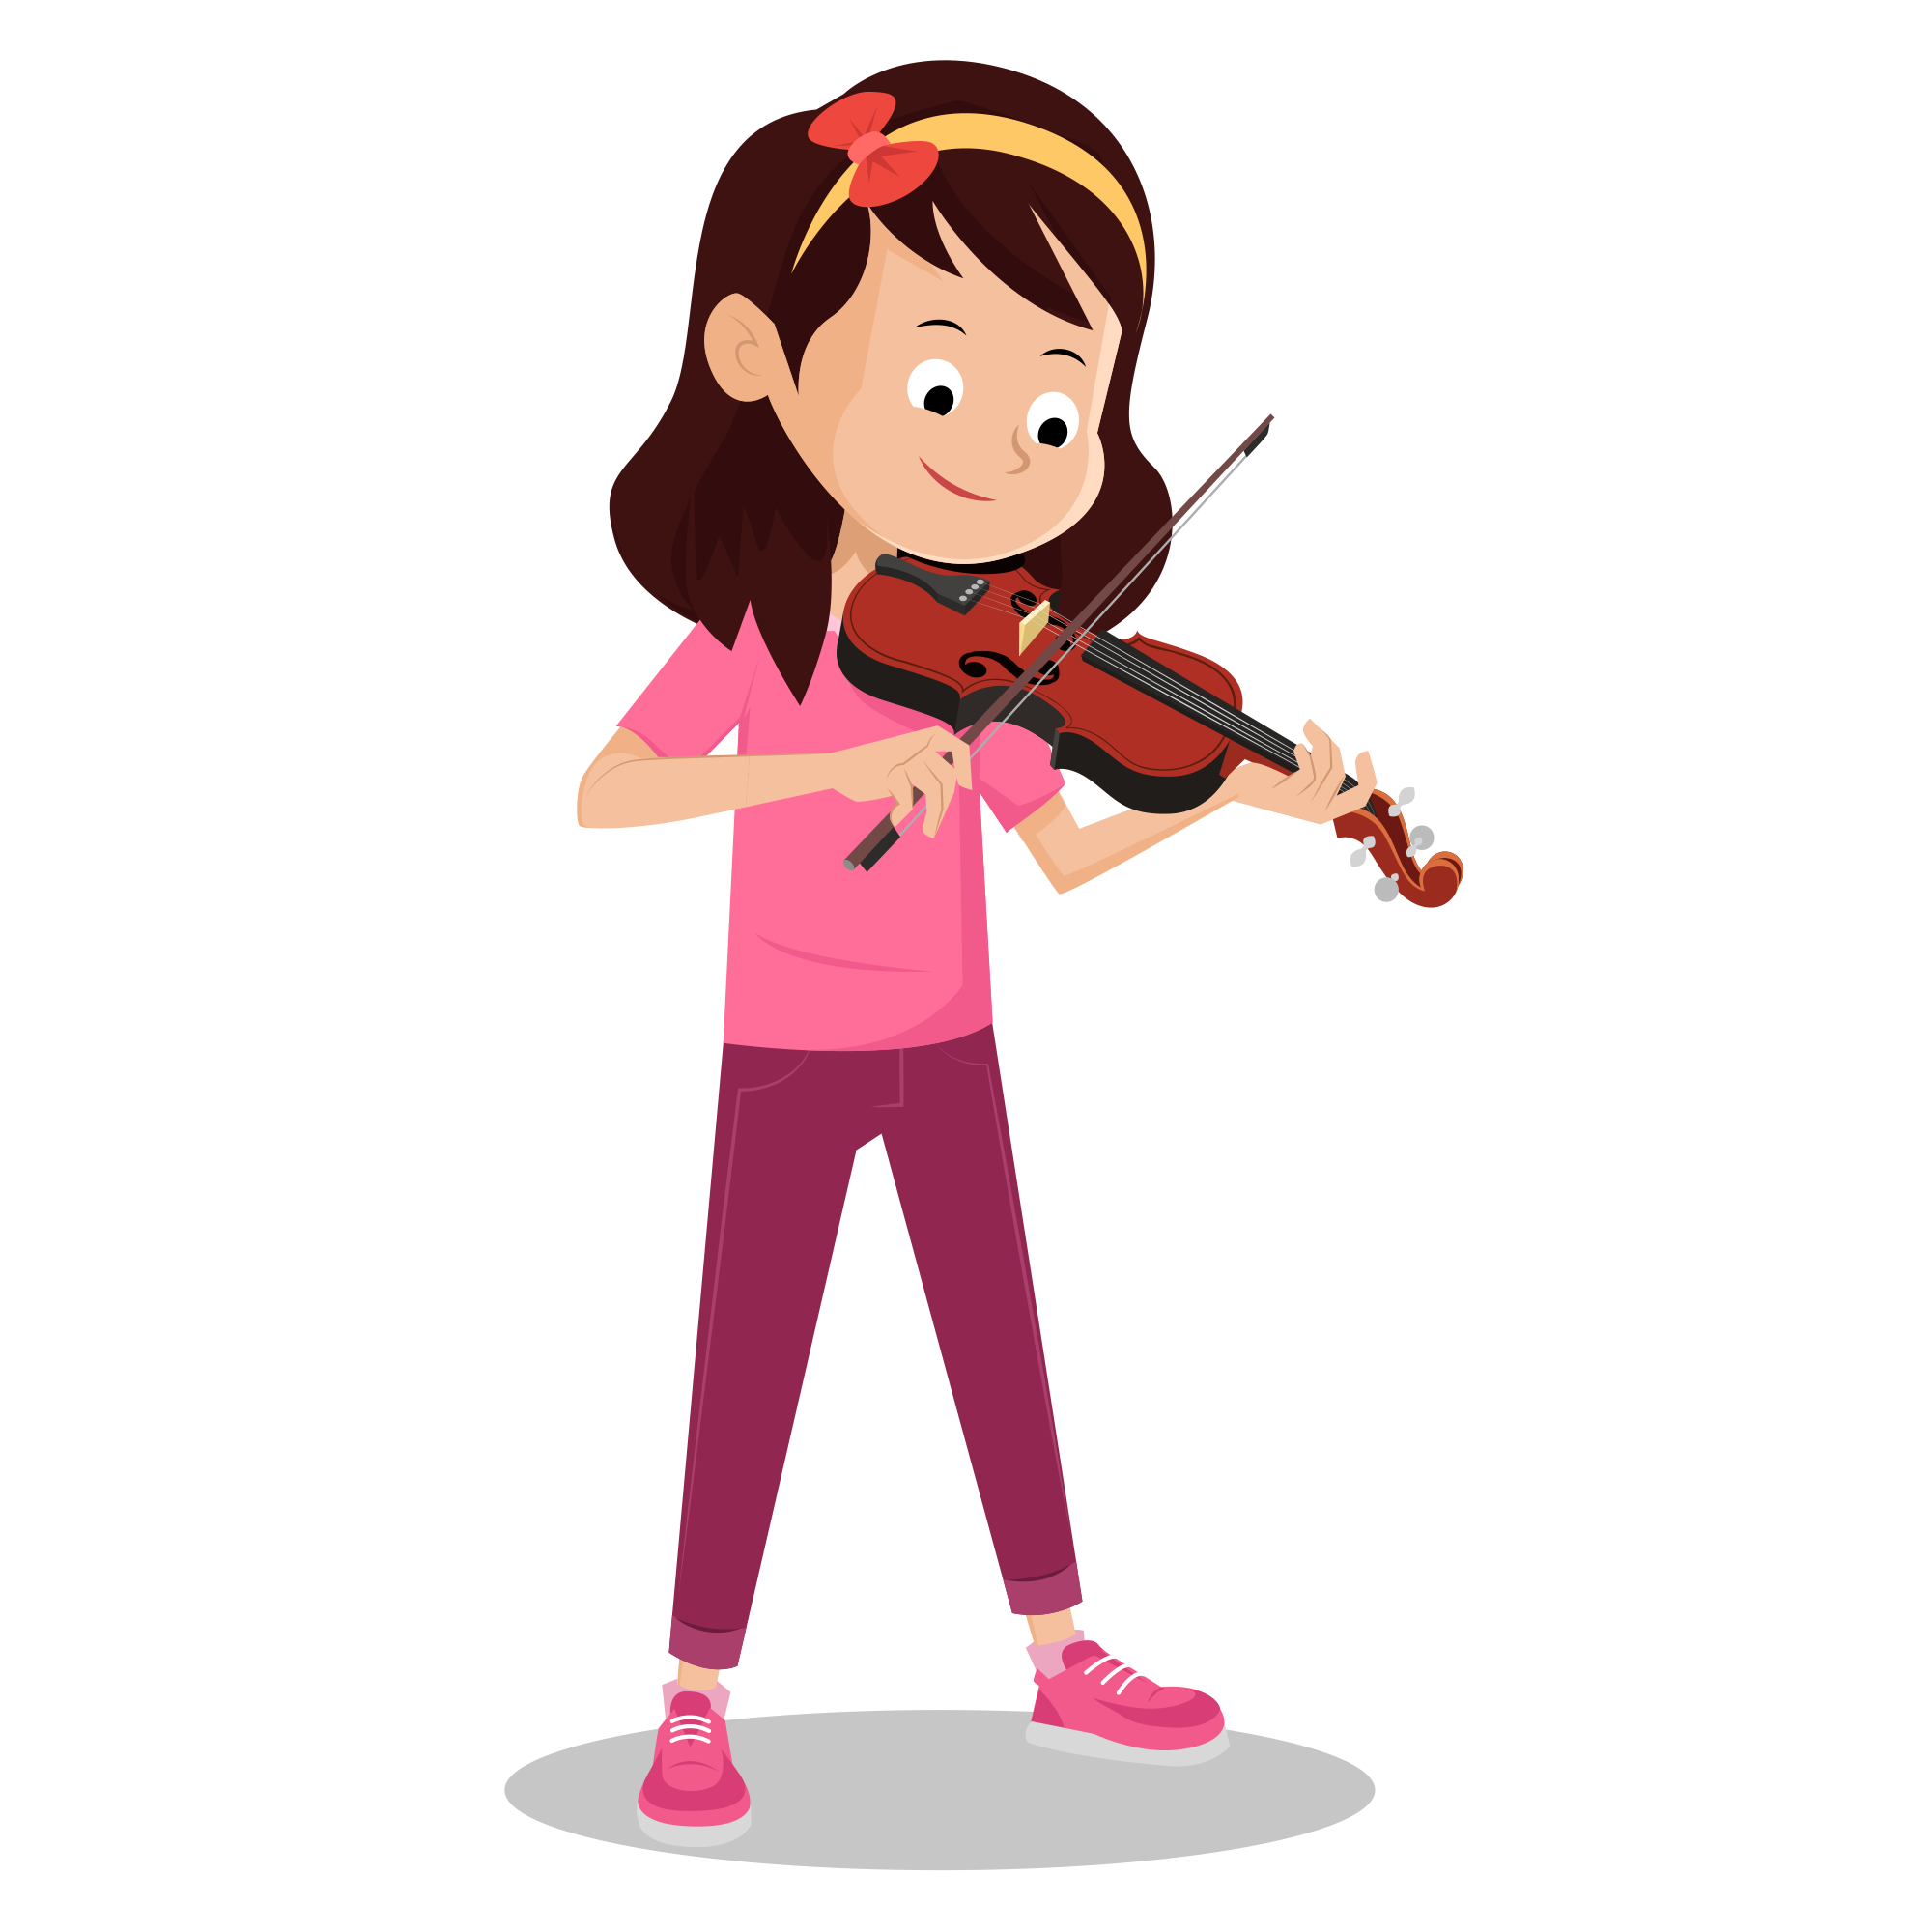
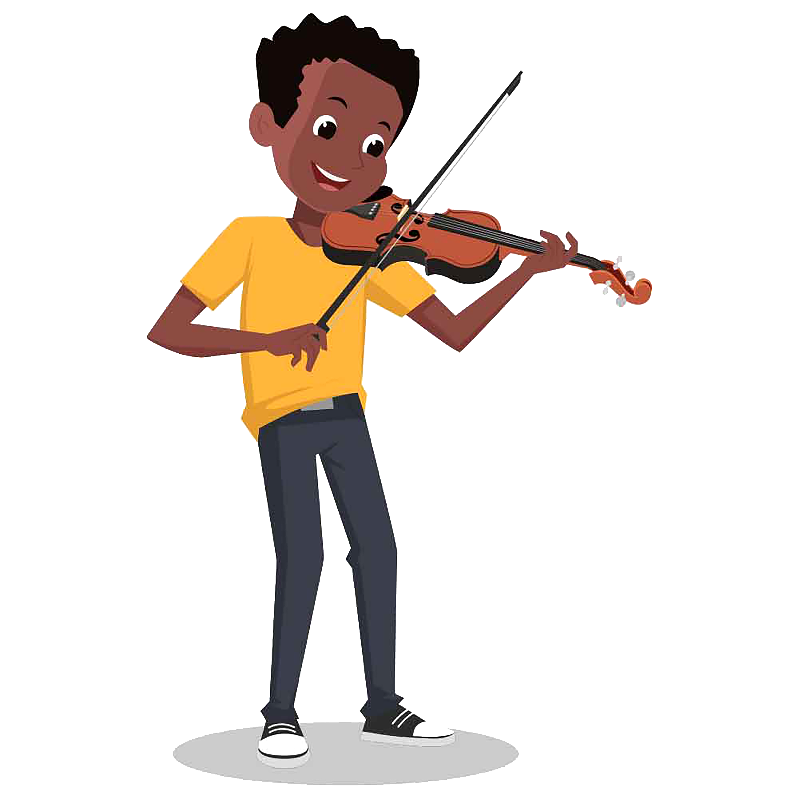
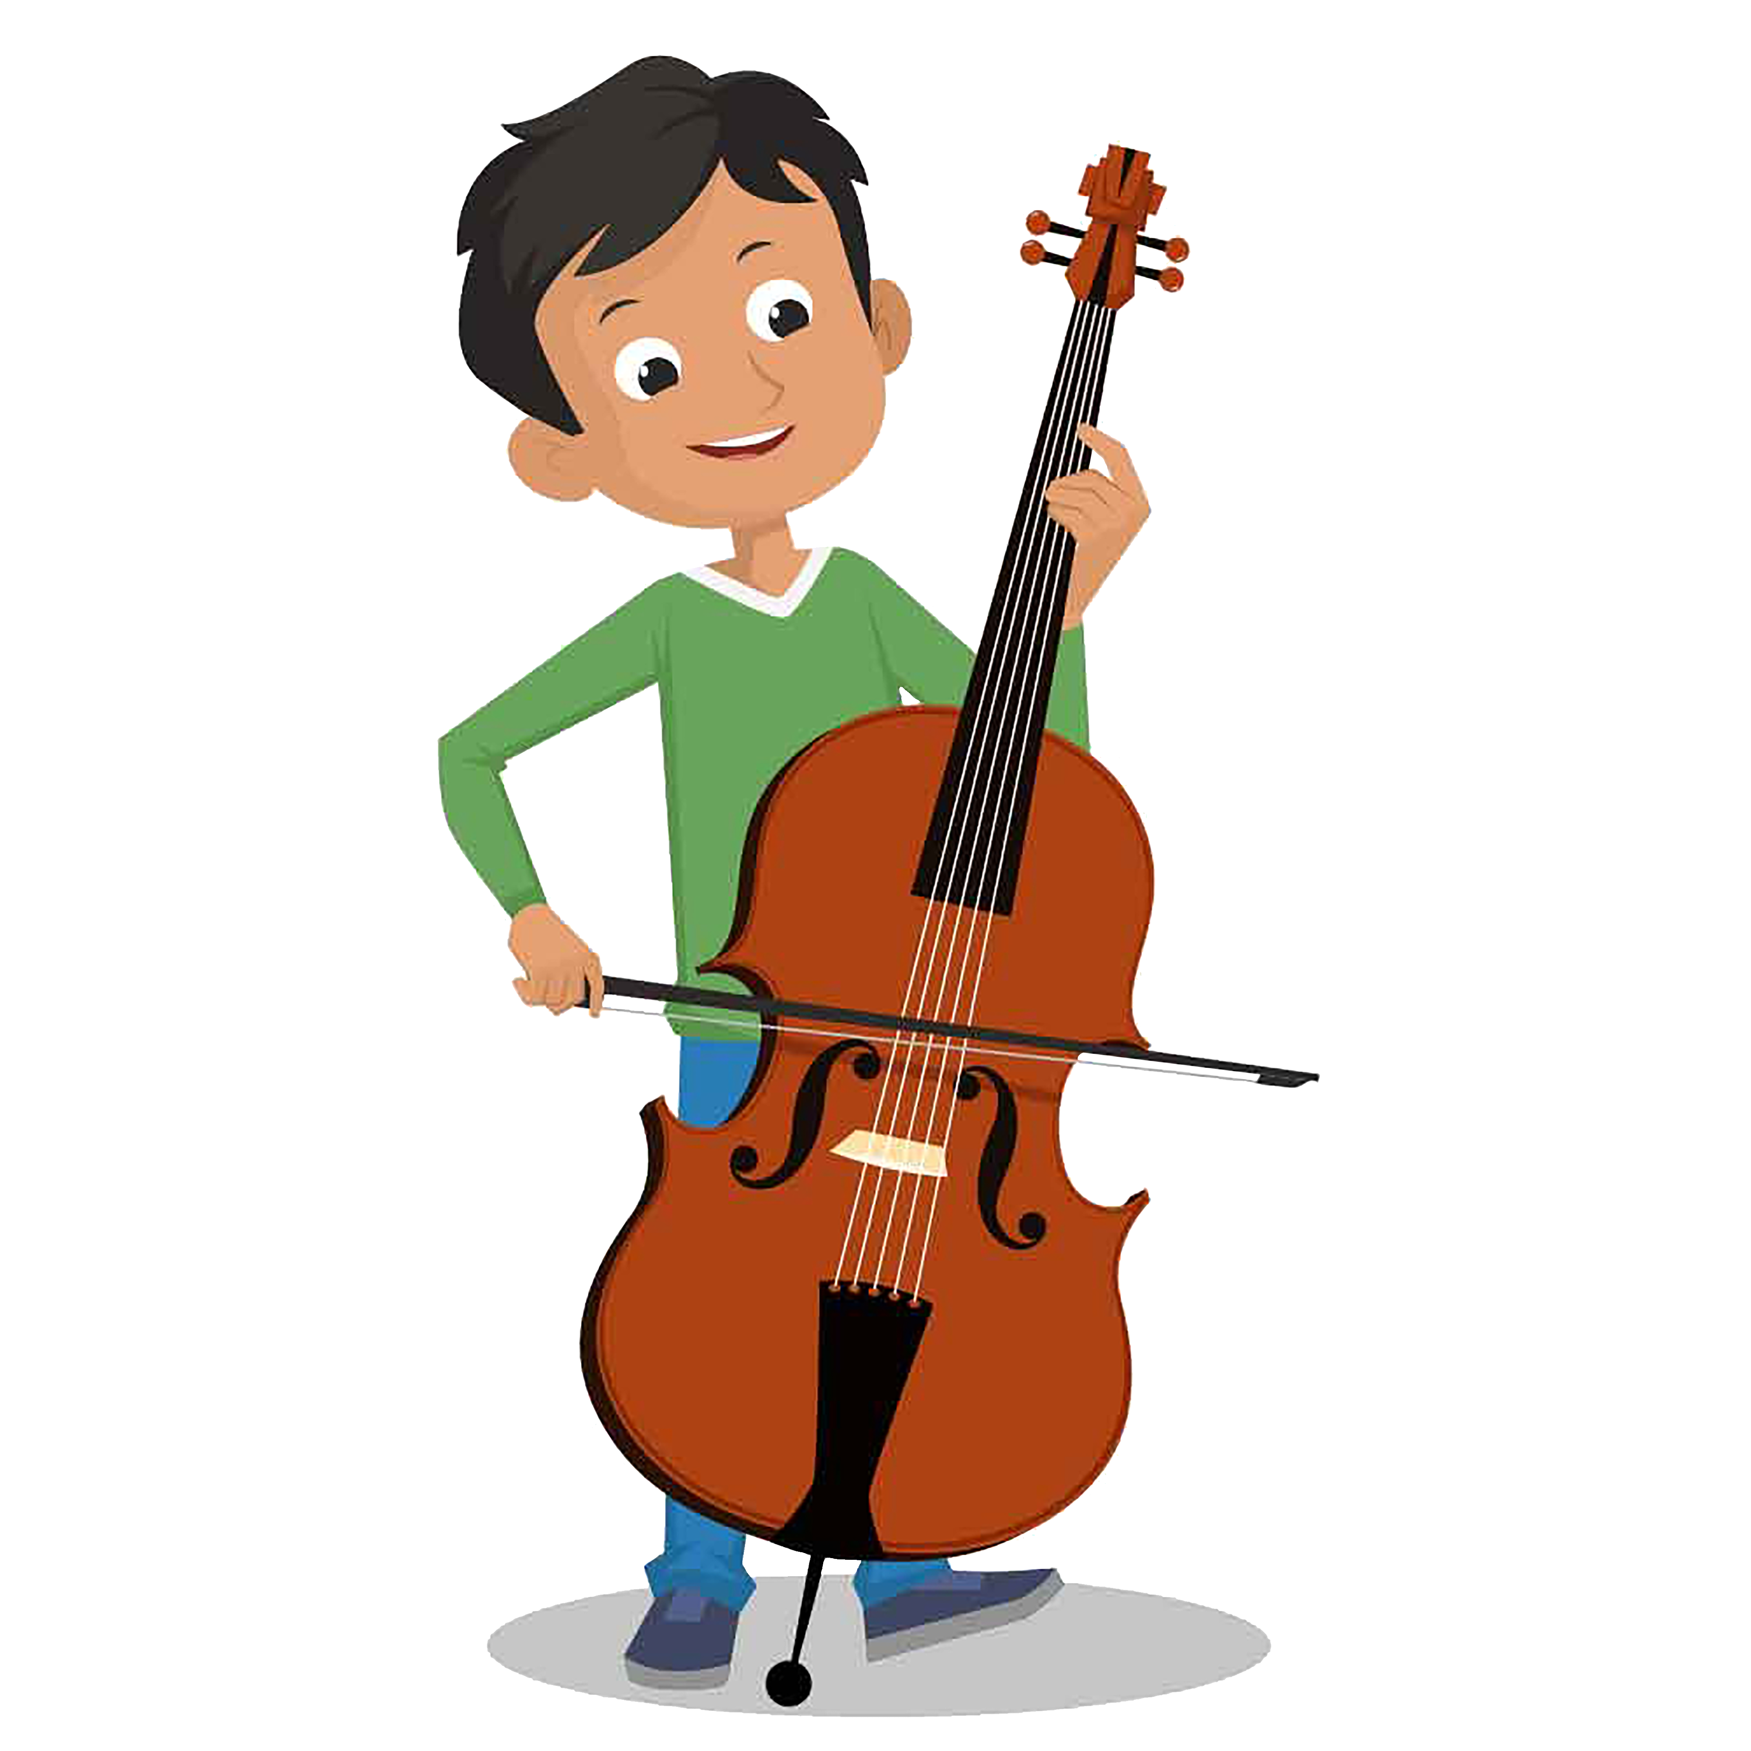
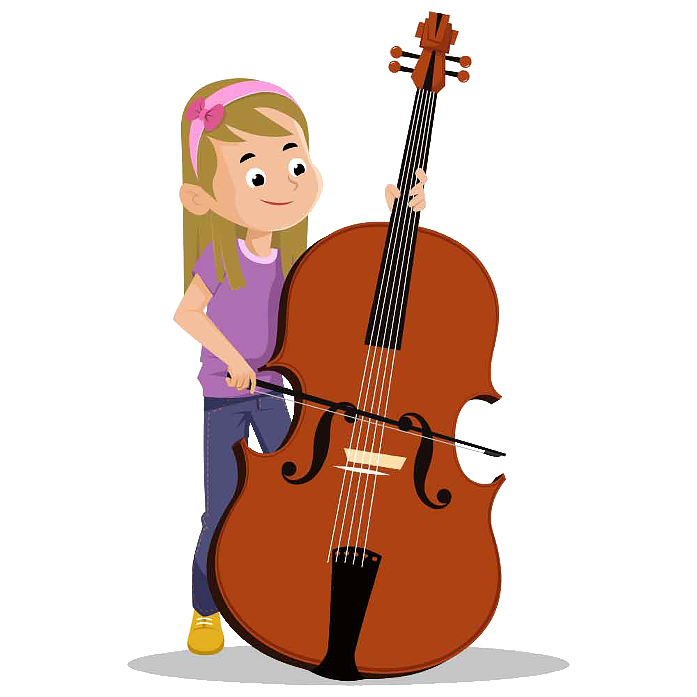
11 | The String Family
violin
viola
cello
double bass
Music Slide Deck
Composers and the Orchestra
Grade 1

Slide 15
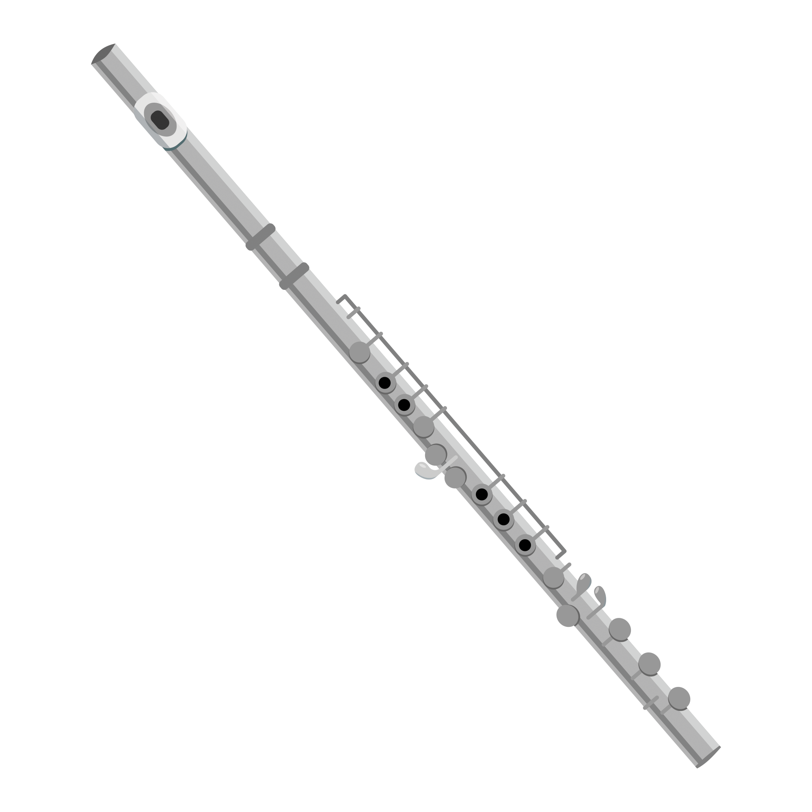
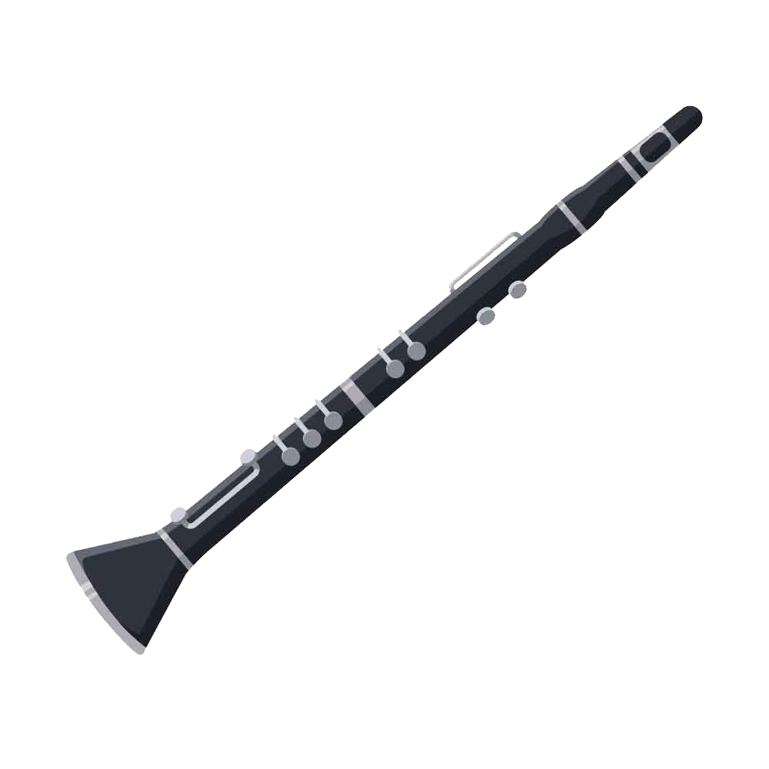
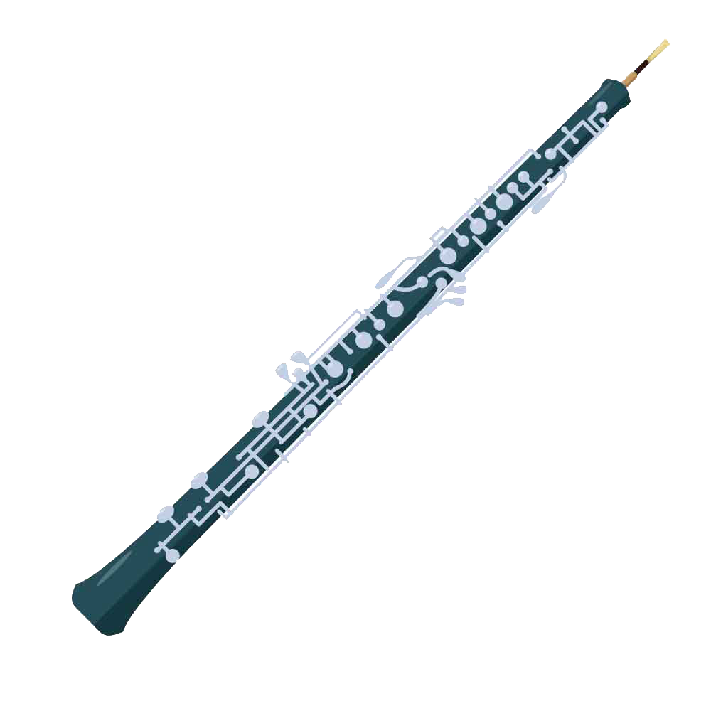
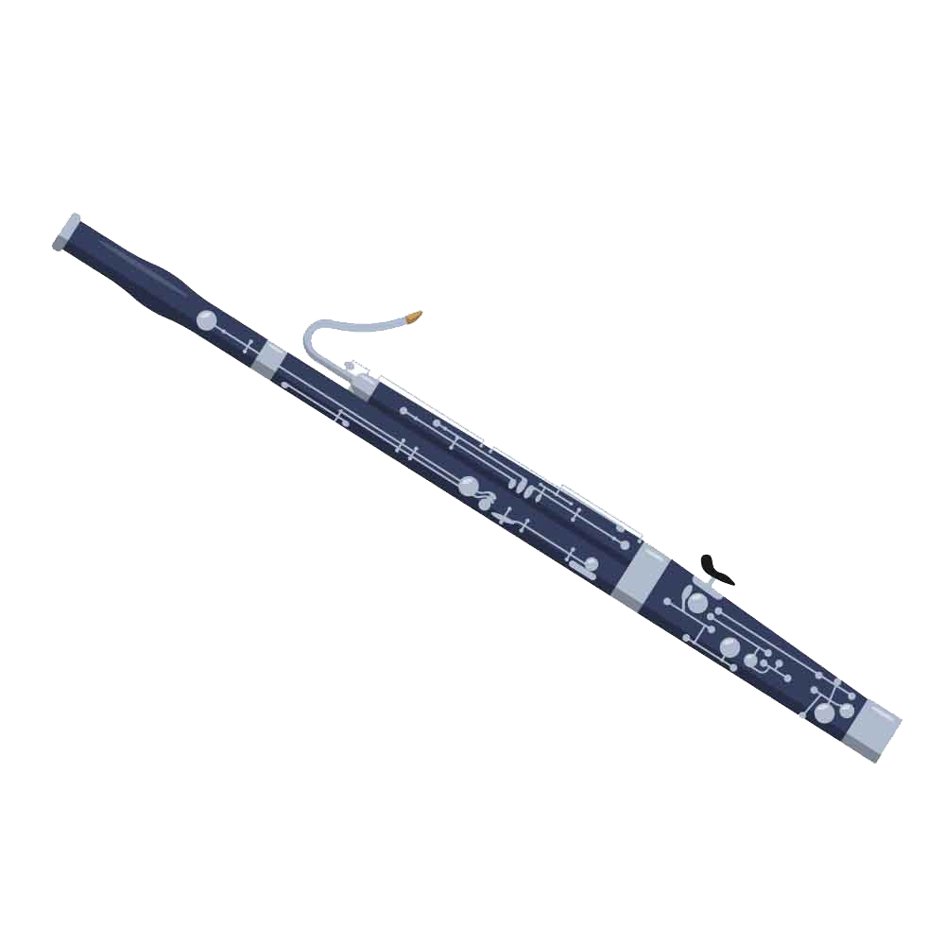
12 | The Woodwind Family
flute
clarinet
oboe
bassoon
Music Slide Deck
Composers and the Orchestra
Grade 1

Slide 16
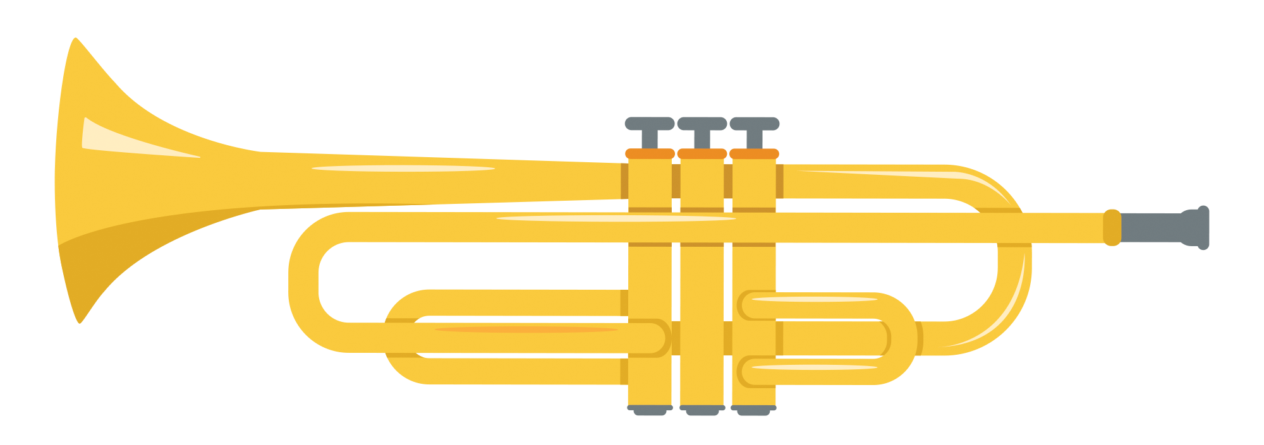
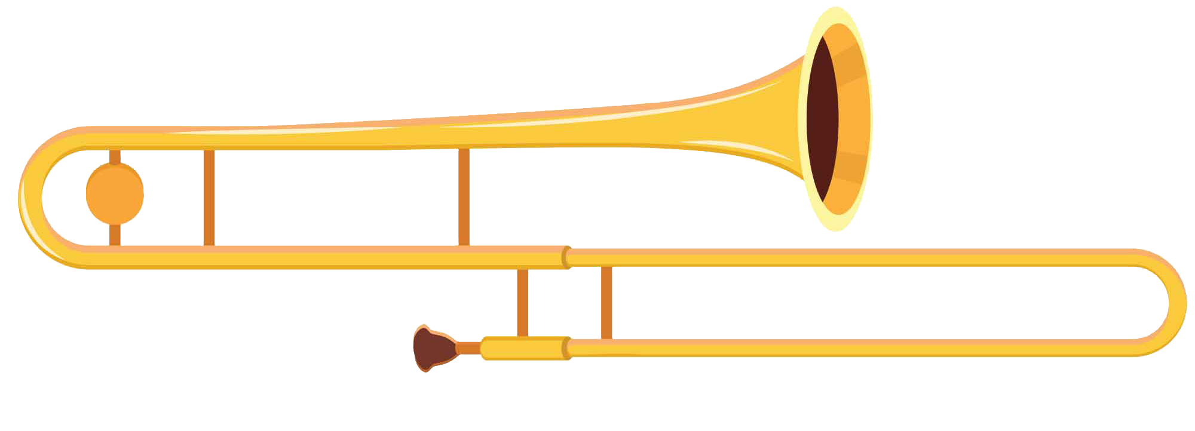


13 | The Brass Family
trumpet
trombone
French horn
tuba
Music Slide Deck
Composers and the Orchestra
Grade 1

Slide 17
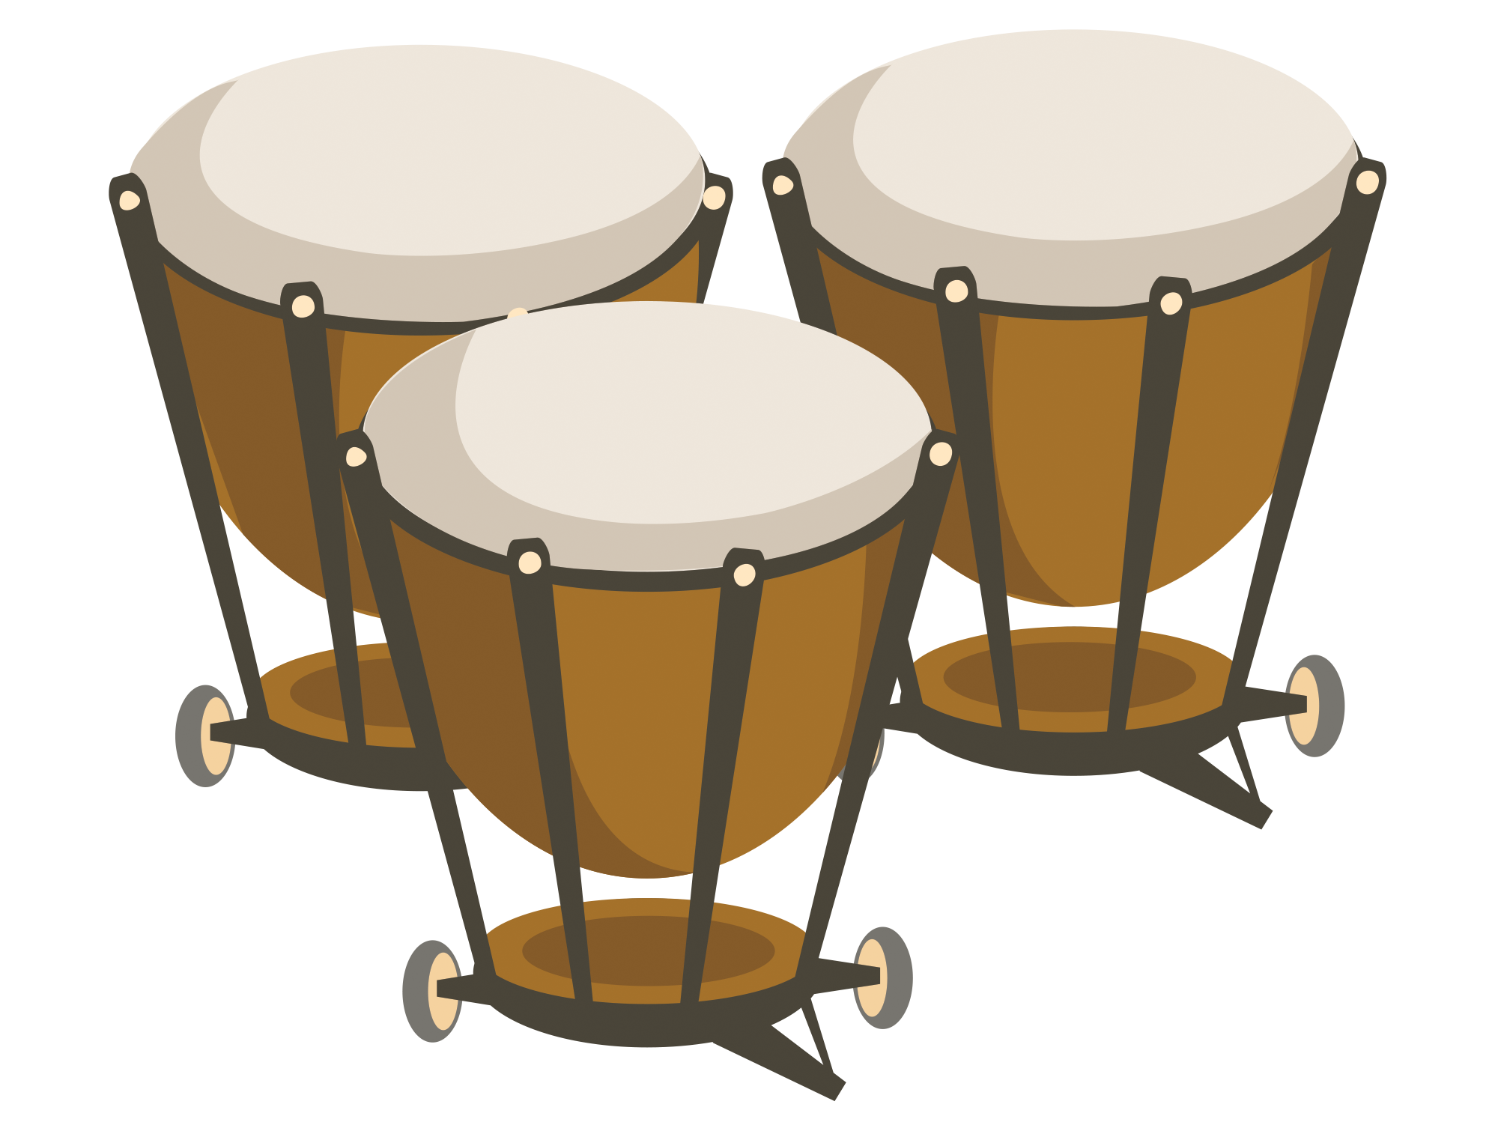


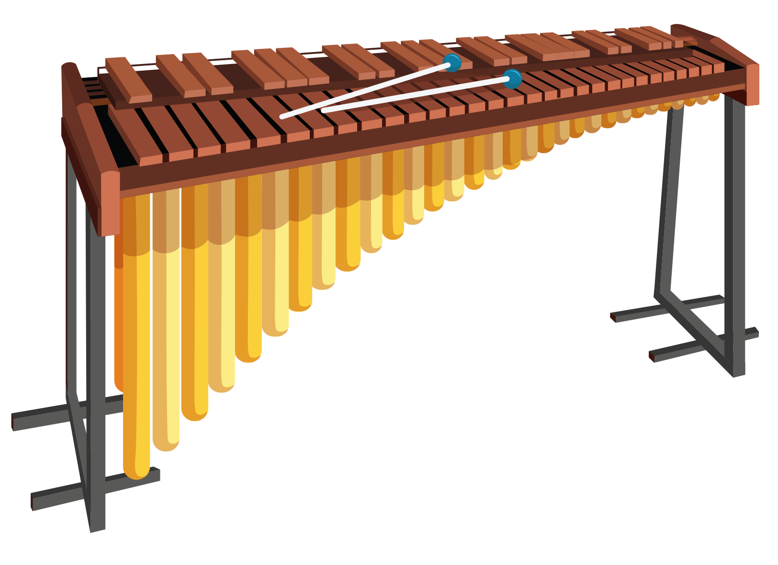
14 | The Percussion Family
drums
cymbals
triangle
xylophone
Music Slide Deck
Composers and the Orchestra
Grade 1

Slide 18

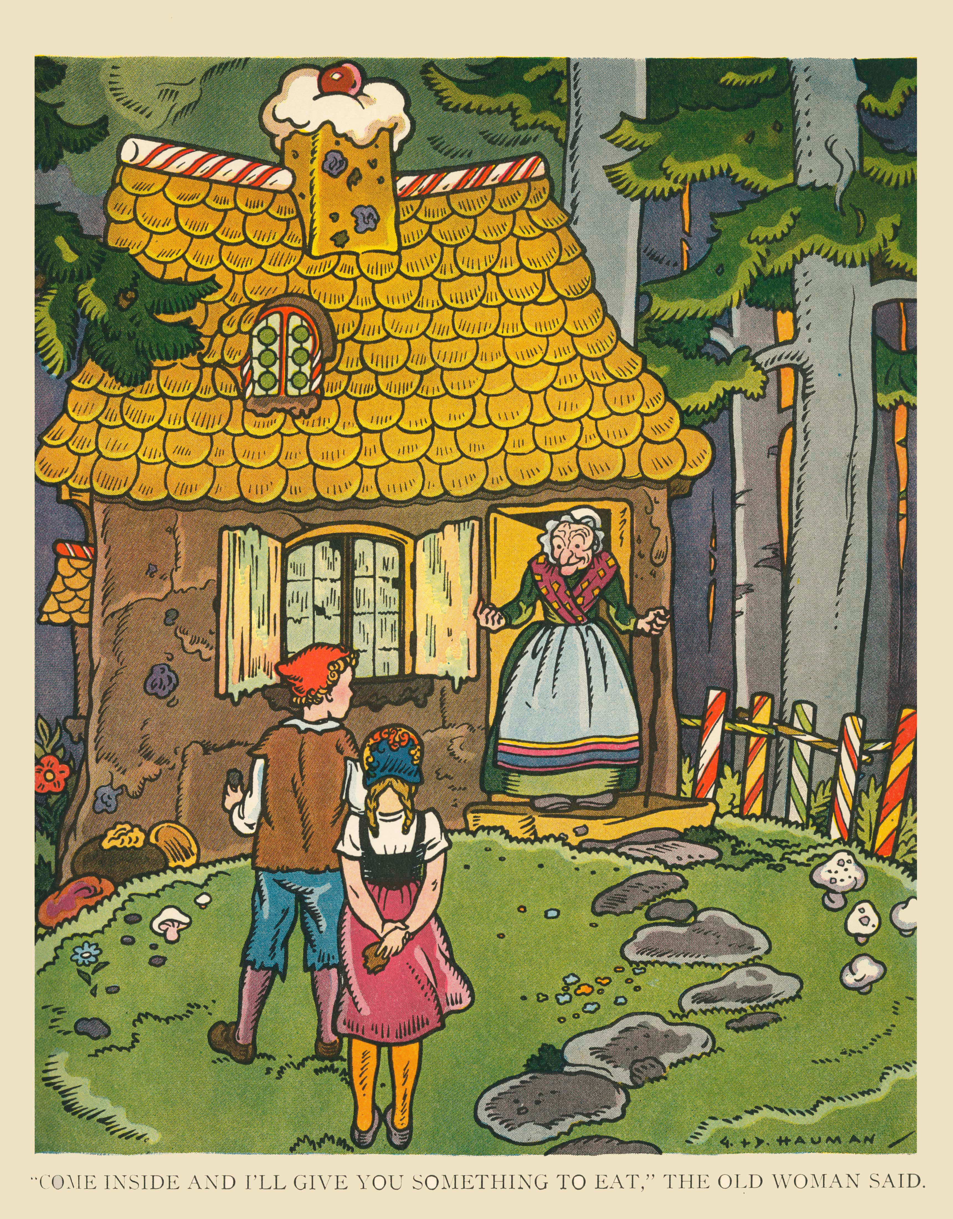
15 | Hansel and Gretel
Music Slide Deck
Music Can Tell a Story
Grade 1

Slide 19


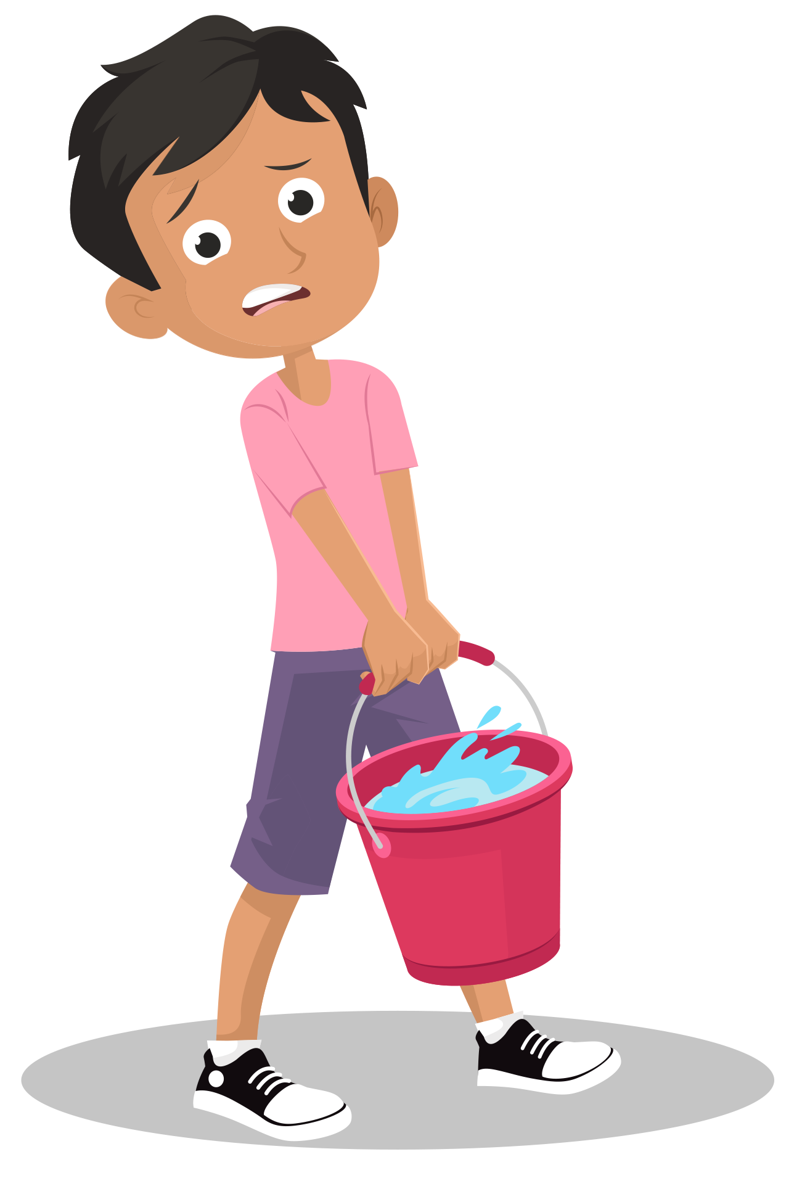
16 | Musical Themes
Water theme
Apprentice theme
Sorcerer theme
Broom theme
Music Slide Deck
Music Can Tell a Story
Grade 1

Slide 20


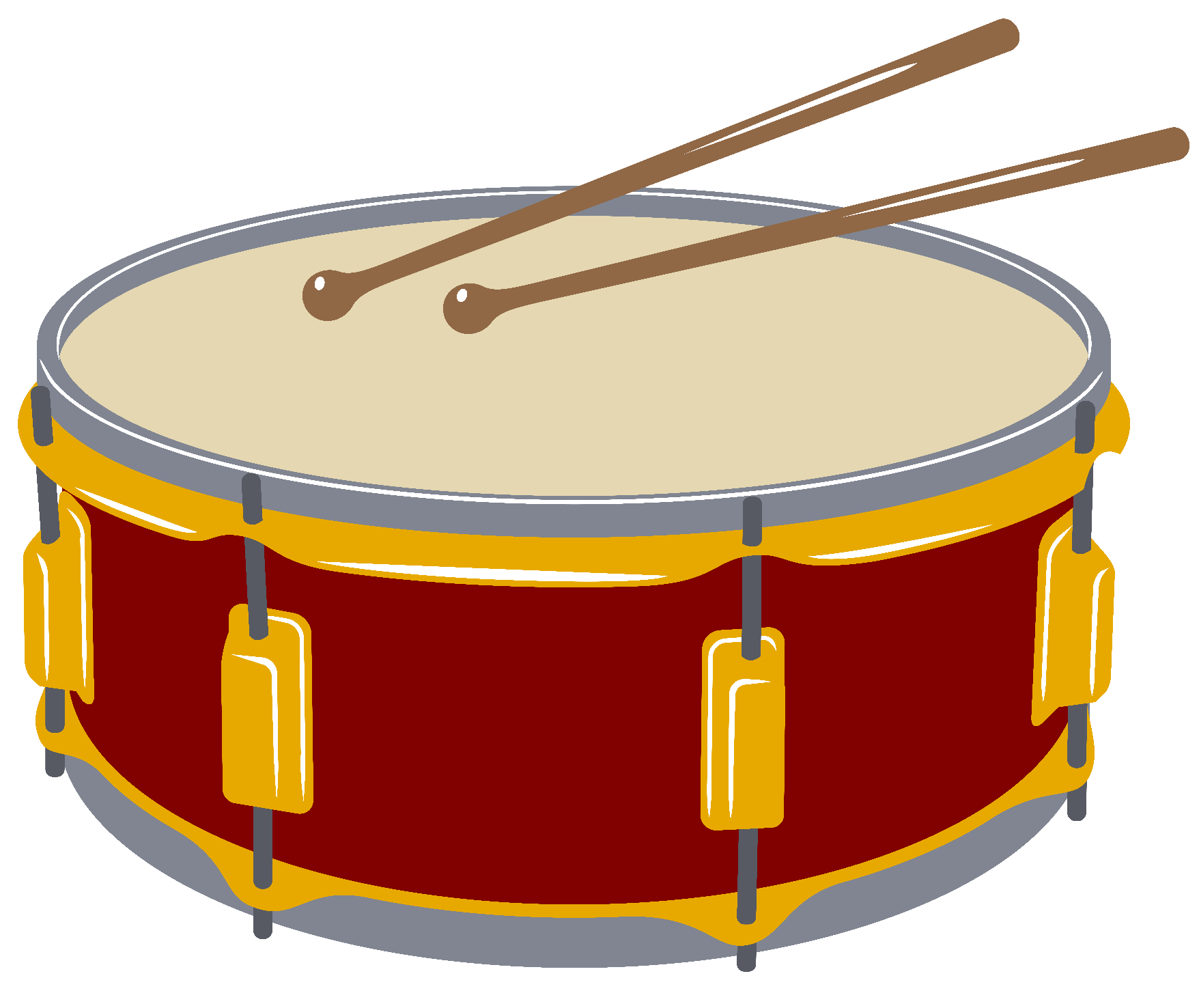
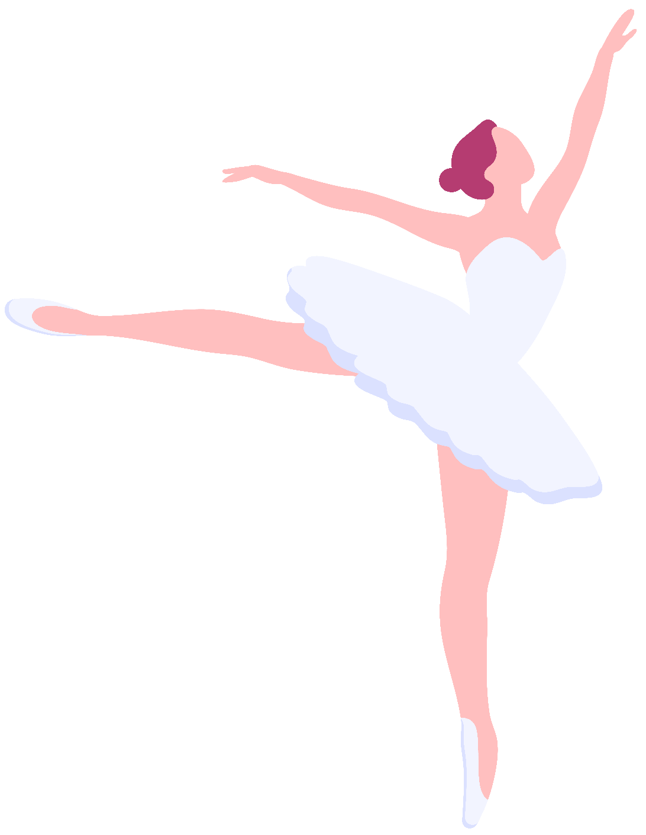
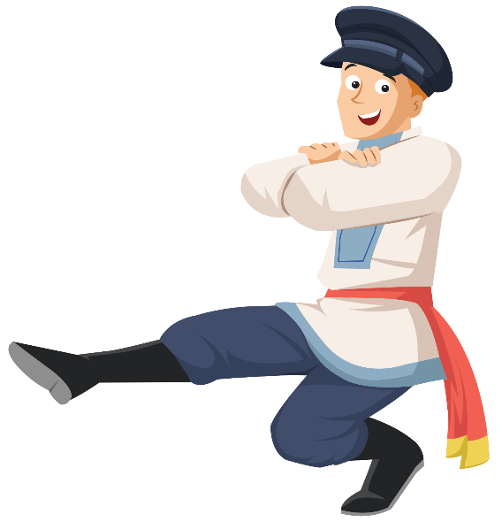
17 | Dance
“Miniature Overture”
“March”
“Dance of the Sugar-Plum Fairy”
“Russian Dance (Trepak)”
Music Slide Deck
Music Can Tell a Story
Grade 1

Slide 21
Music Cards
Credits
Grade 1
abbydesign / Alamy Stock Photo: 9a, 20a
Anastasiia Konko / Alamy Stock Photo: 9b
BNP Design Studio / Alamy Stock Photo: 9c
Esfir Dzhyshkariani / Alamy Stock Photo: 12a
Geo Images / Alamy Stock Photo: 4, 19a
iki hanoh illustration / Alamy Stock Photo: 7a
Nataliia Darmoroz / Alamy Stock Photo: 12c
Panther Media Global / Alamy Stock Photo: 5a, 8a
Prostorina / Alamy Stock Photo: 20c
Sergey Gromyko / Alamy Stock Photo: 8b Sudowoodo / Alamy Stock Photo: 5b
Svetlana Borokh / Alamy Stock Photo: 12b
Tatiana Klimiankova / Alamy Stock Photo: 19c-d
The Protected Art Archive / Alamy Stock Photo: 18
Yurii Lysiak / Alamy Stock Photo: 20b

